Slide 2
What to do with all these Clues? Call the Garbage Detective!
Observations and Inferences

Slide 3
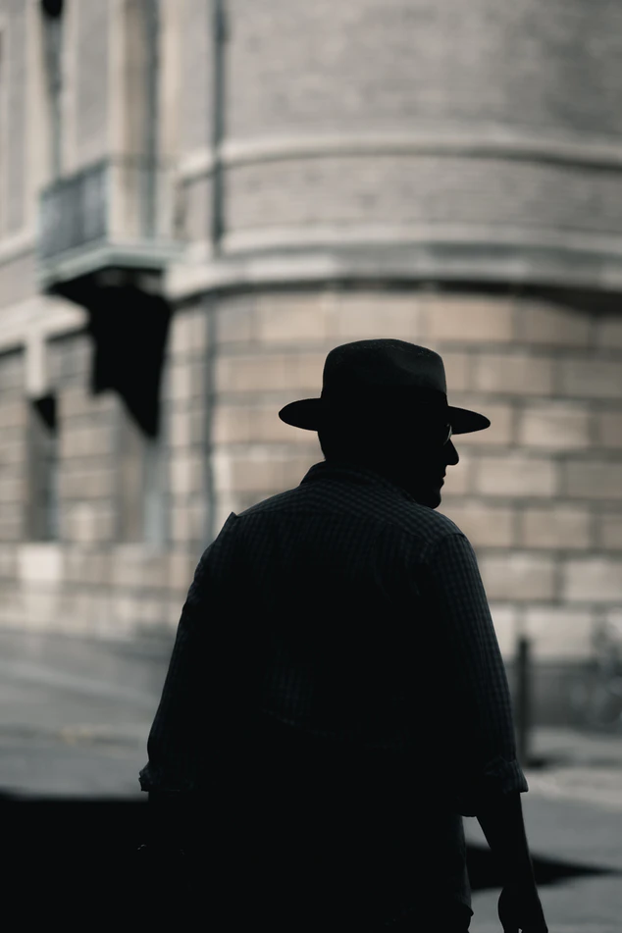
Notes:
Whitehead, C. (July 2017). Silhouette photo of a man. Unsplash. https://unsplash.com/photos/lbekri_riMg

Slide 4
Essential Question
How does “reading between the lines” help with drawing conclusions?

Slide 5
Learning Objectives
We will be able to evaluate how our perspective affects our understanding of information.
We will analyze information and make observations and inferences about a person.
We will use evidence to support our understanding.

Slide 6
Think-Pair-Share
Do you know of a job where a person needs to gather clues?

Slide 7
Detective
Someone who makes observations and inferences.

Slide 8
You are in charge of your neighborhood watch, which means that you are responsible for making sure that your neighbors are safe and nothing suspicious is going on.
A very mysterious new neighbor has moved in down the street. The neighborhood group has decided that you should dig through the garbage to see what you can learn. You will need to look for clues, and you will need to make observations and inferences!

Slide 9
Garbage Clues
This person has never been seen during the day.
The shutters on the windows are always closed during the day.
An eyewitness next door has seen a tall figure with dark brown or red hair leave around 8:00 p.m. most nights.
The neighbor drives a dark SUV with an out-of-state license plate.

Slide 10
Observation
The action or process of observing something or someone carefully in order to gain information.

Slide 11
Inference
A conclusion reached on the basis of evidence and reasoning.

Slide 12
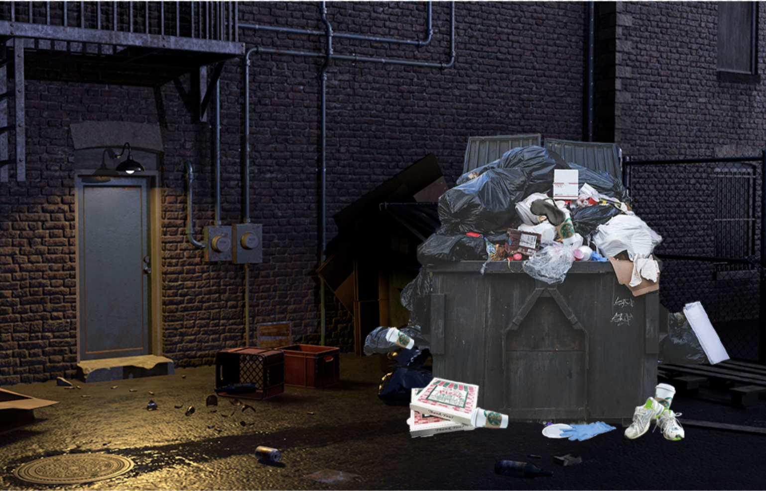

Slide 13
What can I observe?
In this picture, I can observe _______.

Slide 14
What can I infer?
Based on my observations of this picture, I can infer _______.

Slide 15
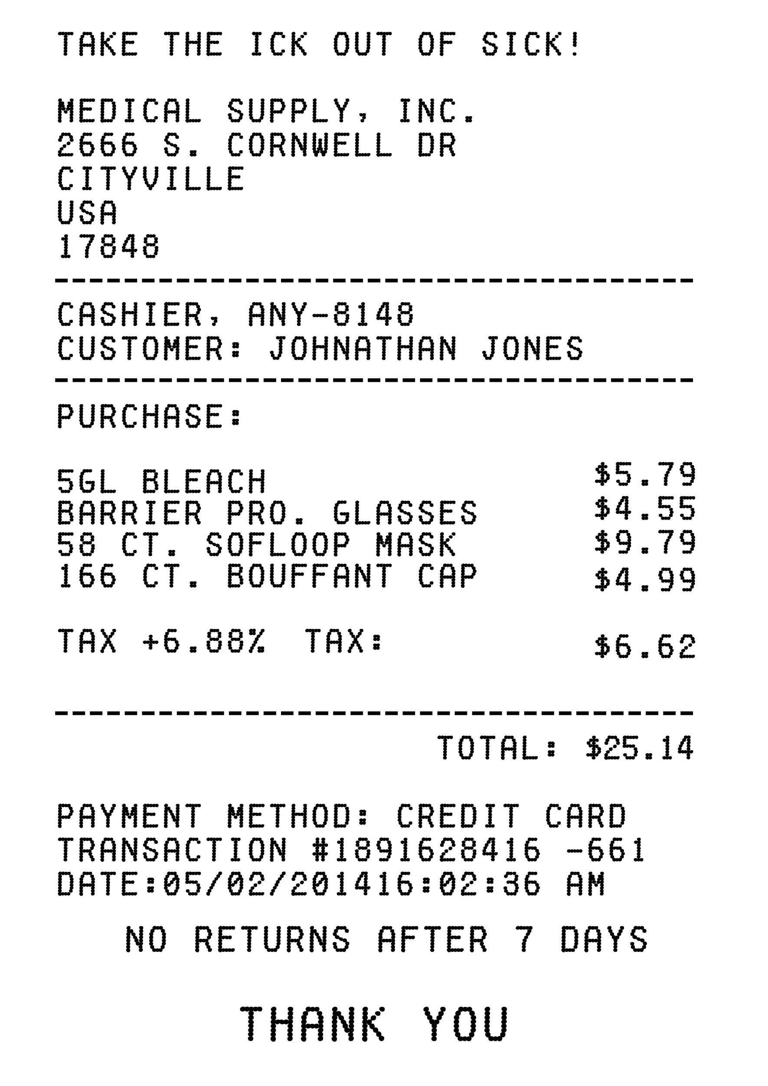
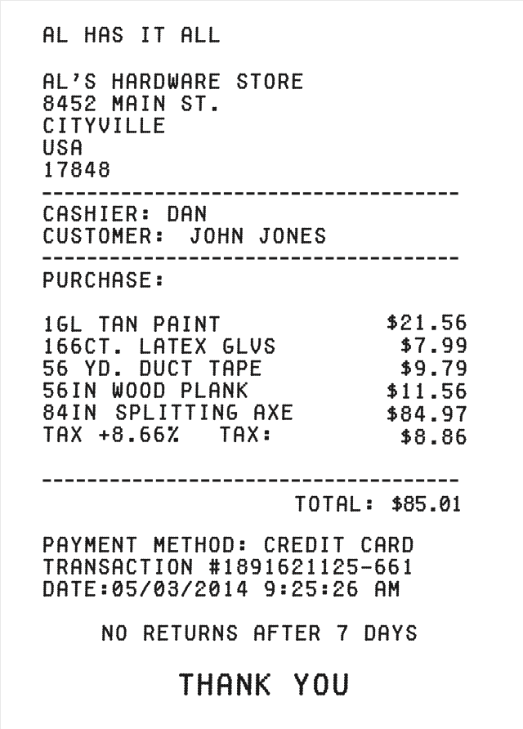
Receipt

Slide 16
Create a Character Profile
Create a possible suspect picture.
What do you know about the neighbor based on your observations and inferences?
What is their occupation?
What kind of life do they lead?
What can you tell about their schedule?

Slide 17
Gallery Walk
As you walk around the room looking at your classmate’s character profiles, leave a sticky note with constructive feedback. This may include:
What did you like most?
What can they add to the profile to make it more complete?

