Slide 1
It’s Raining Whats and Whats?
Colloquial Language

Slide 2
Colloquial Language
Colloquial language is informal and consists of words or phrases known primarily to native speakers of a language.
Examples: Idioms, Regional Phrases

Slide 3
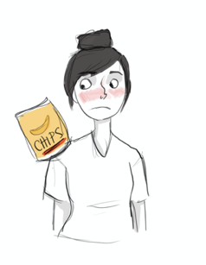
Chip on Your Shoulder

Slide 4
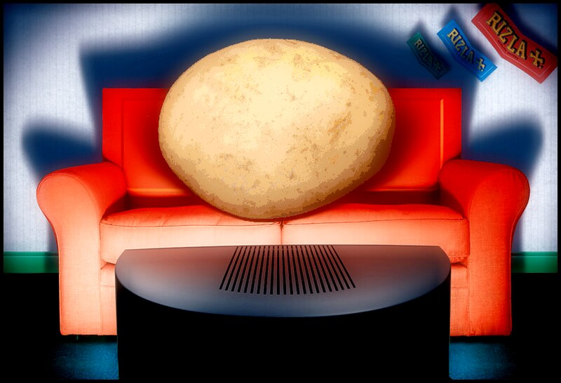
Couch Potato
Notes:
Image source: Burt, I. (2006, Oct. 15). Potato head - couch potato. Flickr. https://www.flickr.com/photos/oddsock/267206444

Slide 5
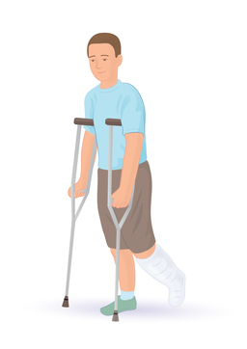
Break a Leg
Notes:
Image source: Injurymap. (2019, April 24). An illustration of a person with a broken leg. Wikimedia Commons. https://commons.wikimedia.org/wiki/File:Broken_Leg.png

Slide 6
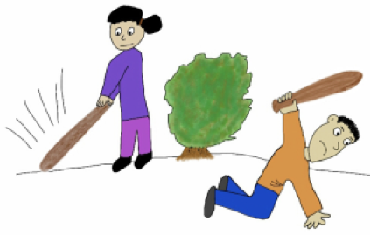
Beat Around the Bush

Slide 7
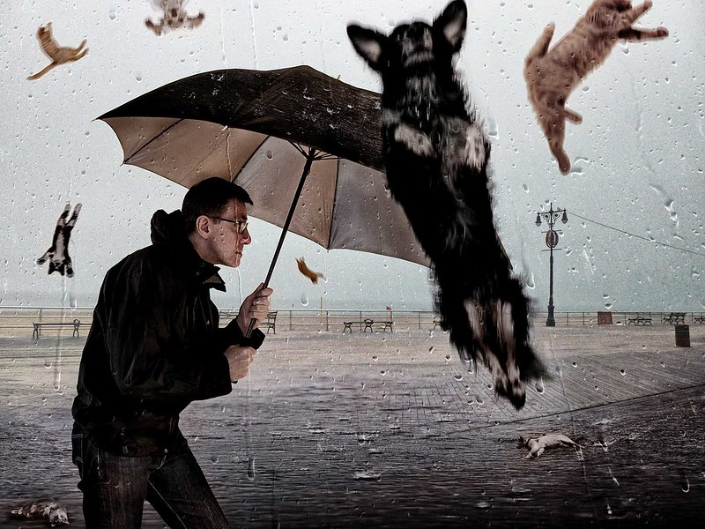
It’s Raining Cats and Dogs
Notes:
Image Source: Blackwell, D. (2014, Feb. 13). Raining cats and dogs. Flickr. https://www.flickr.com/photos/mobilestreetlife/12505752913

Slide 8
Essential Question
How do colloquialisms make our language confusing or give it clarity?

Slide 9
Learning Objectives
Explore colloquial phrases in a variety of languages.
Identify and evaluate positive and negative effects of colloquial language.
Revise a text of your choosing to incorporate or remove colloquial language, based on the genre and audience.

Slide 10
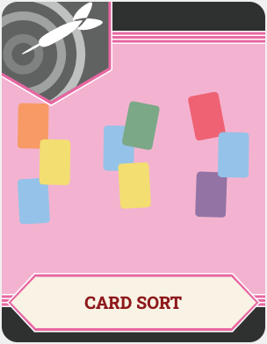
Card Sort
Match the colloquial term or phase with its origin and meaning.

Slide 11
Essential Question
How do colloquialisms make our language confusing or give it clarity?

Slide 12
Categorical Highlighting
While you read the articles, focus on identifying:
Positive effects and uses of colloquial language.
Negative effects and uses of colloquial language.

Slide 13
Revising Your Writing
Including Colloquial Language
Assume that you have decided to make a piece of your writing less formal to better match your genre and audience.
As you read through the piece as it’s currently written, think about the following:
How can you incorporate more colloquial language?
Where might you insert idioms?
Where can text such as greetings or references be replaced with regional colloquialisms?

Slide 14
Revising Your Writing
Removing Colloquial Language
Assume that you have decided to make a piece of your writing more formal to better match your genre and audience.
As you read through the piece as it’s currently written, think about the following:
How can you revise to rely less on colloquial language?
Where can you take idioms out and replace them with more straightforward language?
Where can regional colloquialisms be replaced with straightforward greetings or references?

Slide 15
Revising an Excerpt from The Outsiders
Including Colloquial Language
Assume that you have decided to revise a piece of published writing and make it less formal to better match your genre and audience.
As you read through the piece as it’s currently written, think about the following:
How can you incorporate more colloquial language?
Where might you insert idioms?
Where can text such as greetings or references be replaced with regional colloquialisms?

Slide 16
Revising an Excerpt from The Outsiders
Removing Colloquial Language
Assume that you have decided to revise a piece of published writing and make it more formal to better match your genre and audience.
As you read through the piece as it’s currently written, think about the following:
How can you revise to rely less on colloquial language?
Where can you take idioms out and replace them with more straightforward language?
Where can regional colloquialisms be replaced with straightforward greetings or references?

Slide 17
Cognitive Comics
Choose one sentence from your passage that included a revision.
Decide how the meaning of the communication in your passage would “look.”

Slide 18
Cognitive Comics
Show the effect that colloquial language had in the text before and after the revision.
Keep the essential question in mind: How do colloquialisms make our language confusing or give it clarity?

Slide 19
Essential Question
How do colloquialisms make our language confusing or give it clarity?

