Slide 2
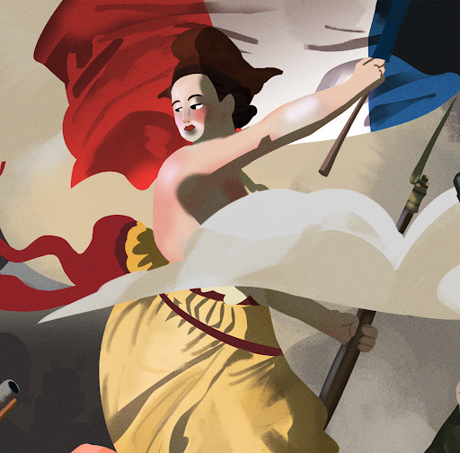
Why Do People Revolt?
Exploring Causes of the French Revolution

Slide 3

Tell Me Everything
On a piece of notebook paper, write everything you already know about revolutions. Think about:
What does revolution mean?
What does revolt mean?
What are some revolutions you have heard of or are familiar with?
Notes:
K20 Center. (n.d.). Tell me everything. Strategies. https://learn.k20center.ou.edu/strategy/107

Slide 4
Essential Question
What caused the French Revolution?

Slide 5
Learning Objectives
Explain the conditions of pre-revolutionary France.
Evaluate the social, economic, and political factors that contributed to the French Revolution.

Slide 6

Categorizing Causes
With a partner, sort each card into one of the three categories provided:
Political
Social
Economic
Notes:
K20 Center. (n.d.). Card sort. Strategies. https://learn.k20center.ou.edu/strategy/147

Slide 7
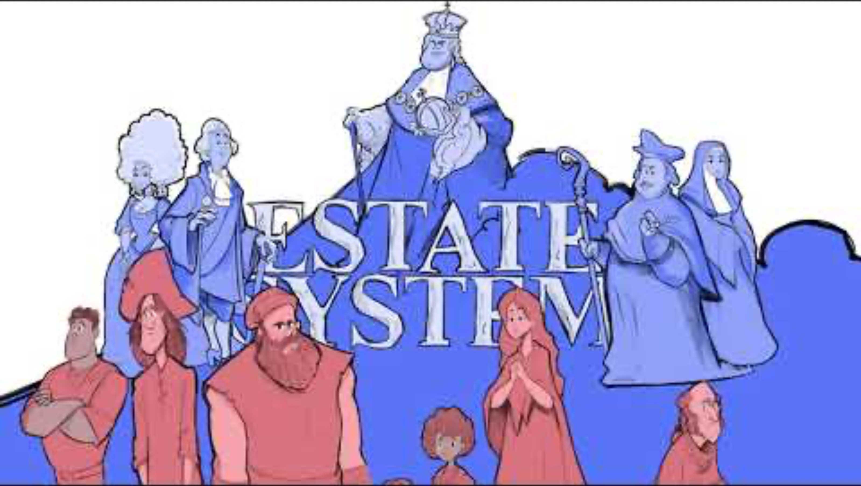
Causes of the French Revolution
Notes:
K20 Center. (2021, May 6). Causes of the French Revolution [Video]. YouTube. https://www.youtube.com/watch?v=VWSYXHTMVVo

Slide 8
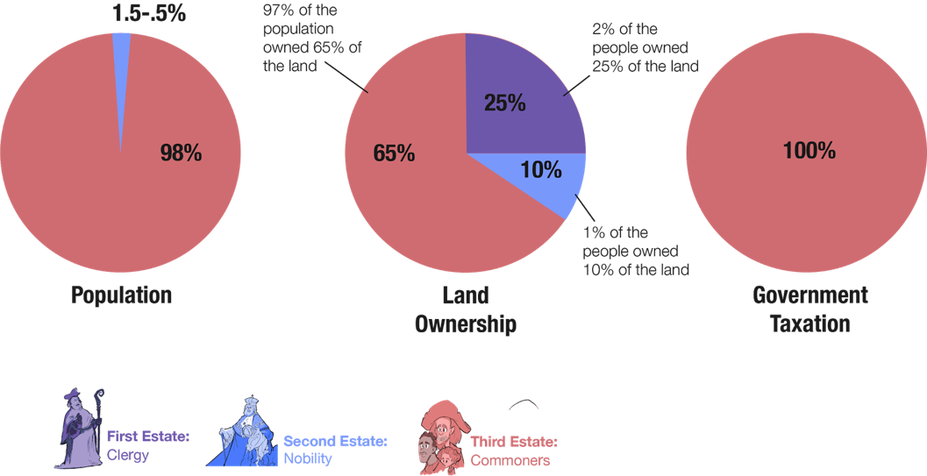
The Three Estates

Slide 9
Analyzing the Conditions of France
With a partner, review each document that provides information about France before the revolution.
Summarize each document on the handout provided.

Slide 10
Analyzing the Conditions of France
Discuss with a partner:
  Based on the documents, what was the main cause of the French Revolution?

Slide 11
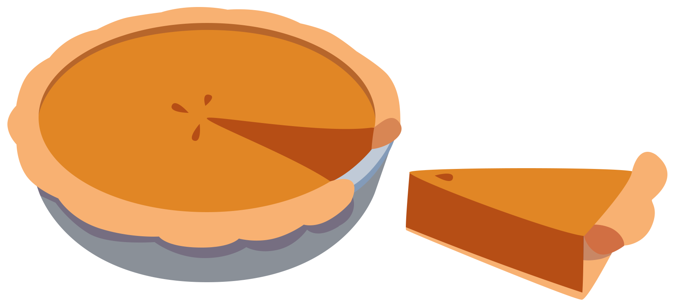
Causes Pie Chart
With a partner, create a pie chart that illustrates the causes of the French Revolution.
Use the documents to create each piece of the pie chart.
  The percentages of the causes should add up to 100%.

Slide 12

Six-Word Memoir
Summarize what caused the French Revolution in only six words.

