Slide 2
Why Do People Revolt?
Exploring Causes of the French Revolution

Slide 3
Essential Question
What causes people to revolt against authority?

Slide 4
Lesson Objectives
Explain the conditions of pre-revolutionary France.
Evaluate the social, economic, and political factors that contributed to the French Revolution.

Slide 5

Tell Me Everything
On a piece of notebook paper, write everything you already know about revolutions.
What does revolution mean?
What are some revolutions you have heard of or are familiar with?

Slide 6
Categorizing Causes
Sort each card provided into one of three categories: social issue, political issue, or economic issue.
Social issue: an issue characterized by the way different groups of people living in a country interact with each other and how each group feels they are being treated.
Political issue: an issue characterized by problems the citizens have with the way their government runs the country.
Economic issue: an issue characterized by the ability of a country’s people to earn a stable income and feed their families.

Slide 7
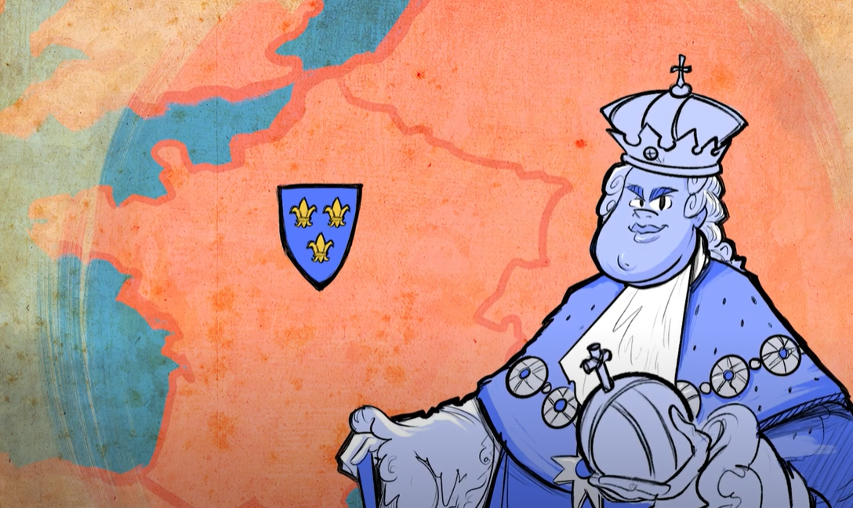
France in 1789
“Causes of the French Revolution”
Notes:
K20 Center. (2021, January 27). Causes of the French Revolution. YouTube. https://youtu.be/VWSYXHTMVVo

Slide 8
Analyzing the Conditions of France
Next, let’s analyze a few short documents that explore different aspects about life in France during the period leading up to the French Revolution.
Summarize each document in the graphic organizer.
  Categorizing each document based on whether it focuses on a political, economic, or social issue.
  Look for evidence in each document that the issue at hand could have led to the French Revolution. Use the Why-Lighting strategy to highlight this evidence.
Consider this information as you think about what the main cause of the French Revolution could have been.

Slide 9
Categorizing Causes in France
Sort each card provided into one of three categories: social issue, political issue, or economic issue. This time, the cards describe conditions in France.
Social issue: an issue characterized by the way different groups of people living in a country interact with each other and how each group feels they are being treated.
Political issue: an issue characterized by problems the citizens have with the way their government runs the country.
Economic issue: an issue characterized by the ability of a country’s people to earn a stable income and feed their families.

Slide 10
Two-Minute Paper
Take out a piece of notebook paper. Write for two minutes over the following questions:
  Are revolutions always necessary?
  Based on your information from the lesson, did the Third Estate have any other options besides revolting?
  Has there ever been an injustice that you (as a student) felt you should speak up against?
After writing, turn to another student and discuss your responses.

Slide 11
Claim, Evidence, Reasoning (CER)
Using the evidence you have gathered from the documents you analyzed and the cards you sorted, use the CER template to answer the following question:
  What was the main cause of the French Revolution?
Make a claim in the first box. Reference one or more documents as evidence in the second box. In the third box, explain your reasoning (that is, how the document you referenced supports your claim).

