Slide 2
“The Lady, or the Tiger?” Which Do You Choose?
Internal & External Conflict

Slide 3
Essential Questions
How did analyzing the characters and their conflicts help you understand the story?
What was the author’s purpose for writing this story, and how did you determine that?

Slide 4
Learning Objectives
Summarize a story in your own words.
Identify a story’s external conflict through plot and setting.
Identify characters’ motivations and internal conflicts.
Use textual evidence to determine your own ending to a story.

Slide 5
Magnetic Statements
Choose one statement that either “attracts” or “repels” you.
Move to that statement.
Discuss the statement with others in the group.
Notes:
K20 Center. (n.d.). Magnetic statements. Strategies. https://learn.k20center.ou.edu/strategy/166

Slide 6
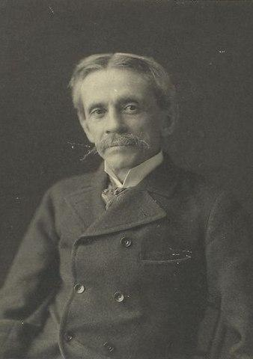
“The Lady, or the Tiger” Story Preview
The short story was written in 1882 by American writer Frank R. Stockton.
Like most short stories of the time, it was written for a magazine.
Stockton wrote many fairy tales, often with humorous characters and situations.
Notes:
Image Source:
New York Public Library. (2013, February 8). Frank R. Stockton [Image]. Wikimedia Commons. https://commons.wikimedia.org/w/index.php?curid=24515955

Slide 7
Partner Work
With your partner:
Read through the story again.
Circle the main ideas.
Create a summary of the story using 20 words or fewer.
Notes:
K20 Center. (n.d.). CUS and discuss. Strategies. https://learn.k20center.ou.edu/strategy/162

Slide 8
Setting
What do the words “amphitheater,” “arena,” “gladiators,” “tribunal,” and “galleries” tell you about the setting?
Who are the king’s “Latin neighbors”?
In what time period would you guess the story is placed?

Slide 9
Character Analysis
Work with your partner to:
Determine the personality of each character
Support your conclusions with textual evidence from the story

Slide 10
Character Analysis of the King
Personality Traits
Textual Evidence
Notes:
Select information from student volunteers

Slide 11
Character Analysis of the Princess
Personality Traits
Textual Evidence
Notes:
Select information from student volunteers

Slide 12
Character Analysis of the Courtier
Personality Traits
Textual Evidence
Notes:
Select information from student volunteers

Slide 13
External Conflict
Definition: In an external conflict, a character is struggling against another character, the natural world, or society.
What is the external conflict in this story?
Notes:
LitCharts. (n.d.). External conflict [Definition]. https://www.litcharts.com/literary-devices-and-terms/external-conflict

Slide 14
Internal Conflict
Definition: Internal conflict is when a character experiences two opposite emotions–usually vice and virtue, good and evil–inside him.
Who has the most internal conflict in the story?
What is the internal conflict?
Notes:
Literary Devices. (n.d.). Conflict [Definition]. https://literarydevices.net/conflict/

Slide 15
Claim, Evidence, Reasoning
As the reader, which door do you believe the courtier opened?
Claim: The door the courtier opened.
Evidence: Any textual evidence that supports this claim.
Reasoning: Why you believe the princess chose that door and how the evidence supports this belief.
Notes:
K20 Center. (n.d.). Claim, evidence, reasoning (CER). Strategies. https://learn.k20center.ou.edu/strategy/156

Slide 16
Philosophical Chairs Debate: Which Door?
Choose your side of the room.
Read through your CER statements and be prepared to discuss.
When called upon, share your viewpoint.
Notes:
K20 Center. (n.d.). Philosophical chairs. Strategies. https://learn.k20center.ou.edu/strategy/71

Slide 17
Essential Questions
How did analyzing the characters and their conflicts help you understand the story?
What was the author’s purpose for writing this story, and how did you determine that?

Slide 18
Which Theme Best Fits the Story?
Vote for one:
Humans are basically good.
Humans have a capacity for great evil and violence.
Jealousy can cause people to act cruelly.
True love is unselfish.
In extreme situations, it is impossible to make good decisions.
Family bonds are stronger than other relationships.

