Slide 2
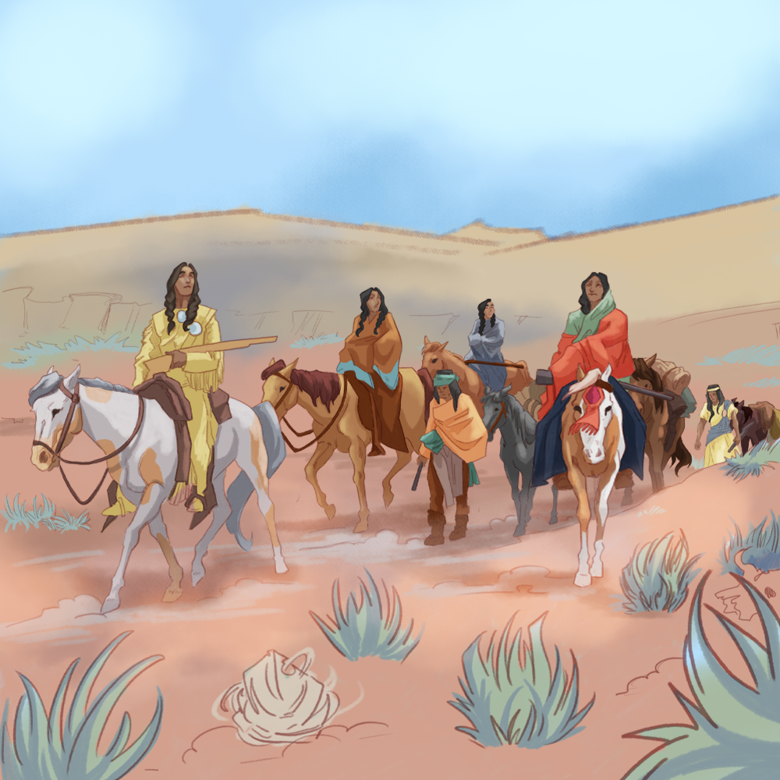
Many Trail of Tears
The Era of Indian Removal

Slide 3
Scenario
Your parents tell you that they have been given 24 hours by the government to leave their home. They are a little unsure of where the family will actually go.
They have been told by authorities that each person can only take what they can carry themselves and nothing else.
What would you take?

Slide 4

Commit and Toss
Choose one or two items that you can carry and might be important to take on a trip.
Write your answers on scrap piece of paper.
Crumple it.
Toss it in the box or basket provided.
Notes:
K20 Center. (n.d.). Commit and toss. Strategies. https://learn.k20center.ou.edu/strategy/119

Slide 5
Learning Objectives
Determine how the United States government changed its stance toward Native American settlements, leading to removal.
Identify the impact of the Indian Removal Act.
Construct a presentation about the motivation of the government and the effects of removal on the tribe.

Slide 6
Essential Questions
What prompted the United States government to remove tribes from their ancestral lands?
How did Native Americans react to this forced removal?

Slide 7
Cherokee Removal, 1838
As you watch the short PBS video, “Trail of Tears,” jot down information and ideas that will help you answer the following question:
How did the United States government’s attitude about Native Americans change from Jefferson’s administration to the election of Andrew Jackson?
Notes:
American Experience. (2026, April 29). Trail of Tears: American experience: Grades 9-12 social studies teaching and Lesson Resources. PBS LearningMedia. https://www.pbslearningmedia.org/resource/akh10.socst.ush.exp.trail/trail-of-tears/

Slide 8
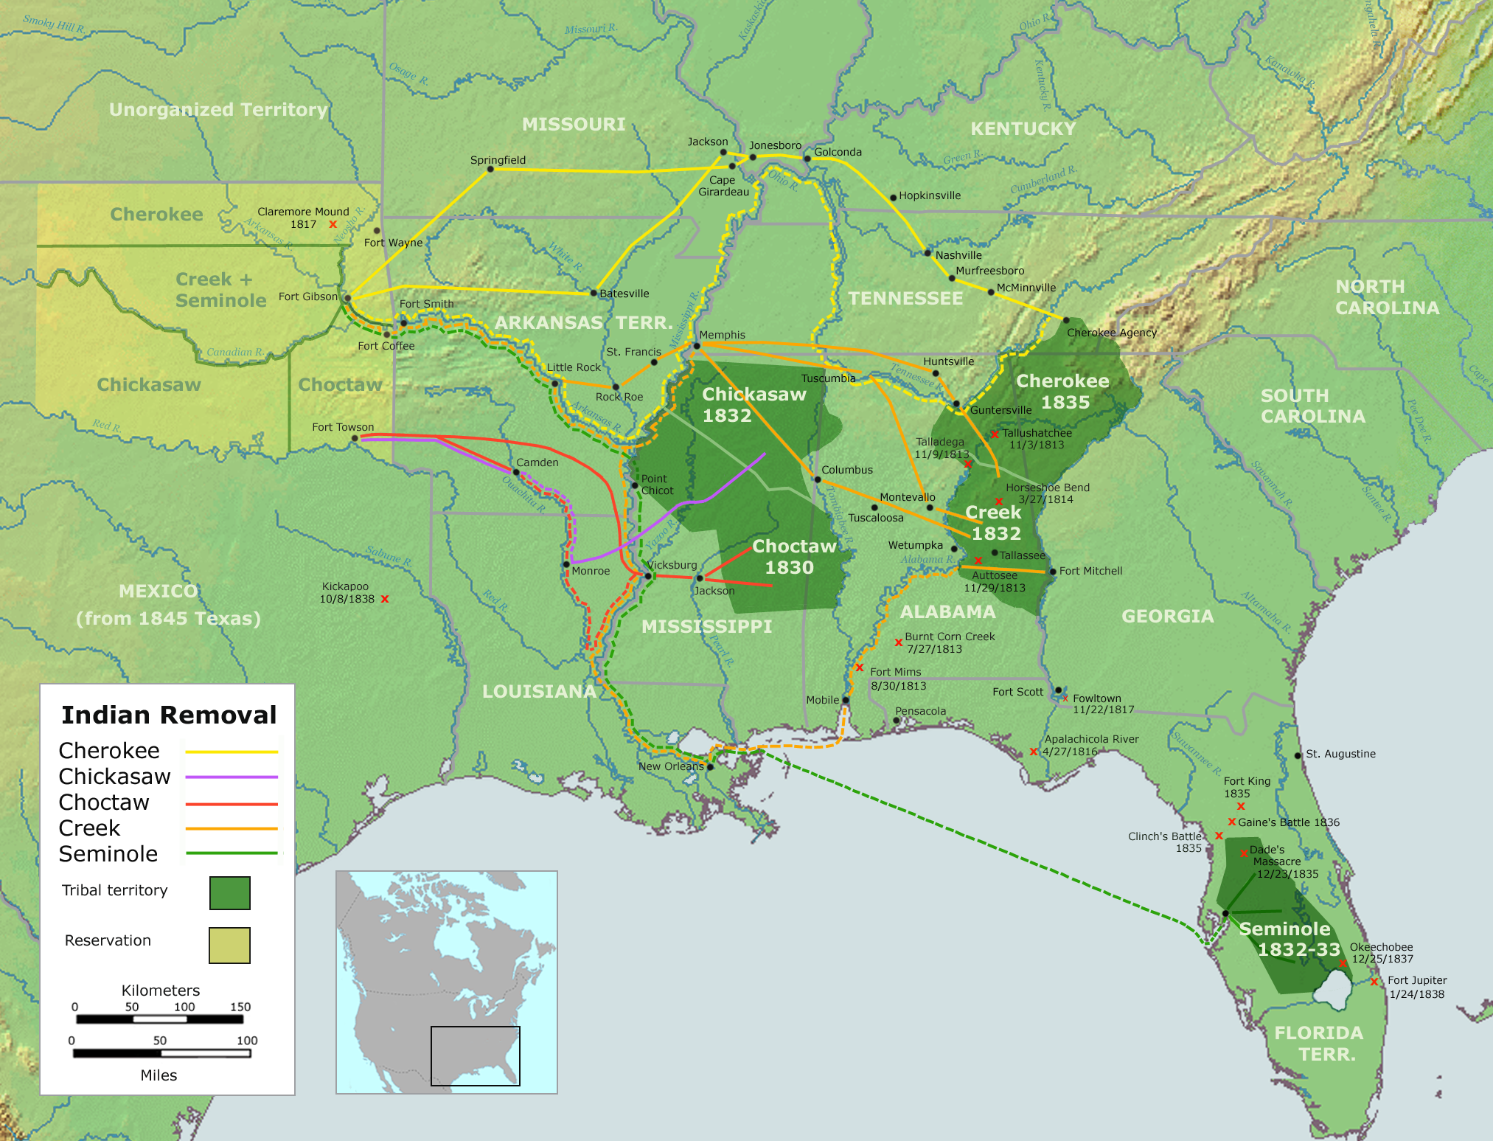
Notes:
File:trails of tears en.png - Wikimedia Commons. (n.d.-a). https://commons.wikimedia.org/wiki/File:Trails_of_Tears_en.png

Slide 9
Group Research
Review the guiding questions on the note organizer for the topic you have been assigned.
Use https://k20.ou.edu/lz to research the topic.
Use the research links to address the questions.
Divide up the work and share information.

Slide 10
Group Poster
Using gathered information, create a presentation about your topic.
Look for ways to use photos and images to illustrate your research.

Slide 11
Presentation Rubric
Read through the rubric handout.
Ask any questions you have about the rubric.
All group members will participate in the presentation.
Be knowledgeable about your part.

Slide 12

Two-Minute Paper
Explain why the United States passed the Indian Removal Act and describe how tribes were affected.
Consider the impact of this legislation on the lifestyle and development of the Native American tribes.
Notes:
K20 Center. (n.d.). Two-minute paper. Strategies. https://learn.k20center.ou.edu/strategy/152

