Slide 2
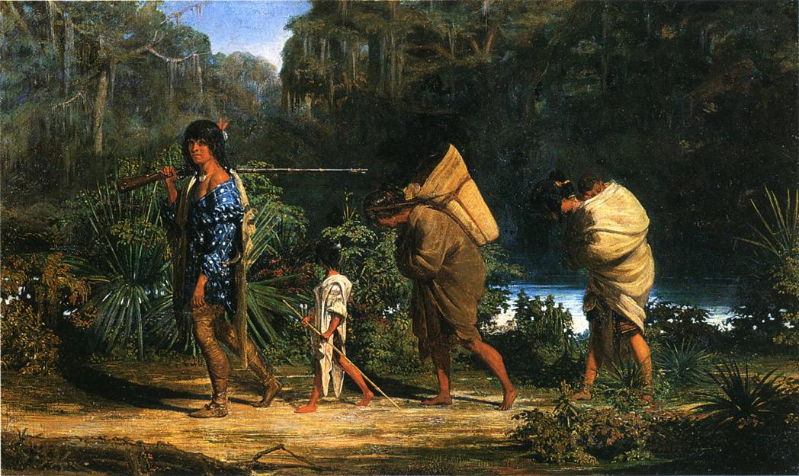
Many Trails of Tears
The Era of Indian Removal

Slide 3
Essential Questions
What prompted the United States government to remove tribes from their ancestral lands?
How did Native Americans react to this forced removal?

Slide 4
Lesson Objectives
By the end of the lesson, students will:
Determine how the United States government changed its stance toward Native American settlements, leading to removal.
Identify the impact of the Indian Removal Act.
Construct a presentation about the motivation of the government and the effects of removal on the tribes.

Slide 5

Scenario
Your parents tell you that they have been given 24 hours by the government to leave their home. They are a little unsure of where the family will actually go.
They have been told by authorities that each person can only take what they can carry themselves and nothing else.
What would you take?
Notes:
Image source: Freepik. (n.d.). Luggage [Image file]. Flaticon. https://www.flaticon.com/free-icon/luggage_2118883?related_id=2118864&origin=search

Slide 6

Commit and Toss
Choose one or two items that you can carry and might be important to take on a trip.
Write your answers on scrap piece of paper.
Crumple it.
Toss it in the box or basket provided.
Notes:
Source: https://learn.k20center.ou.edu/strategy/119

Slide 7
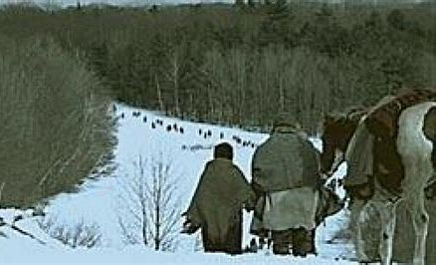
Cherokee Removal, 1838
Notes:
Source: N.a. (n.d.). For Students: The Lasting Impact of the Trail of Tears. New American History. https://resources.newamericanhistory.org/for-students-the-lasting-impact-of-the-trail-of-tears

Slide 8
Cherokee Removal,1838
As you watch the short PBS video, “Trail of Tears,” jot down information and ideas that will help you answer the following question:
How did the United States government’s attitude about Native Americans change from Jefferson’s administration to the election of Andrew Jackson?
Notes:
Source: https://www.pbslearningmedia.org/resource/akh10.socst.ush.exp.trail/trail-of-tears/

Slide 9
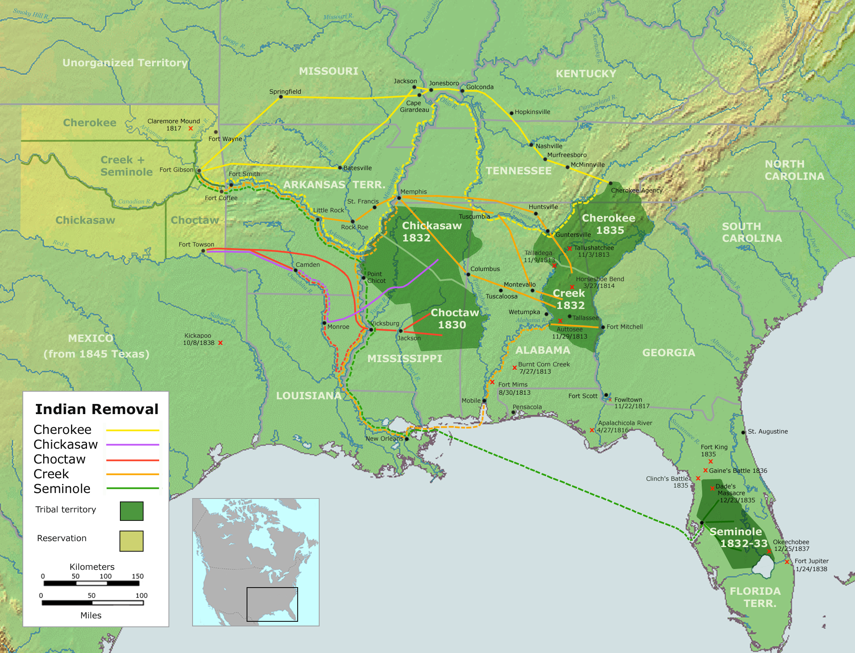
Notes:
Source: Nikater.(2007). Map of the route of trails of tears [Map]. Wikipedia. https://commons.wikimedia.org/wiki/File:Trails_of_Tears_en.png

Slide 10
Group Research
Your group has been assigned a specific topic about Indian removal during the 1800s-1850s. Each group is responsible for the following tasks:
Review the guiding questions on the note organizer for the tribe you have been assigned.
Use the research links to address the questions.
Divide up the work and share information.

Slide 11
Research Work
Review the questions on the Task Sheet and Organizer.
  Where was the tribal ancestral home?
  What was the lifestyle there?
  How and when was the tribe removed from their homeland?
  What was it like for them on the Trail of Tears?
  Where in the new territory was the tribe re-located?
  How did the tribe and tribal leaders respond to removal and relocation?
  What additional information did you find during your research?

Slide 12
Creating Group Slide Deck/Poster
After completing your research, use the questions on your Organizer to create either three slides OR a poster.
Look for ways to use photos and images to illustrate your research.
Name your document as instructed and upload to a designated shared file.
If your group prepared a poster instead of slides, hang the poster in the designated place in your classroom.
Notes:
Decide in advance what you want students to prepare as the culminating activity for their research.

Slide 13

Historical Mingle
Your teacher will either ask you to assume the identity of an historical figure, or you may draw a slip of paper with the name of an historical figure from a box or hat.
Once you have your role, think about what your person would have said about Indian removal.
Jot down some ideas for conversation.
When instructed, assume the persona of your figure and talk to three other classmates outside of your research group about Indian removal.
When you return to your seat, jot down notes about things you learned or which affected you in some way.
Be prepared to share out memorable parts of your conversation with the whole class.
Notes:
Source: K20 LEARN (ouhttps://learn.k20center.ou.edu/strategy/184.edu)

Slide 14

Presentation Rubric
Read through the rubric handout.
Ask any questions you have about the rubric.
All group members will participate in the presentation.
Be knowledgeable about your part.
Assign or volunteer for the portion of the preparation you individually wish to present to the whole class.

Slide 15
Presentation Rubric
Content
  Presentation addresses guiding questions.
  Information presented logically.
  Presentation reflects understanding of topic.
Design
  Slides include relevant pictures.
  Presentation free of spelling and grammar errors.
  Slides have brief talking points.
Presentation
  Presenter familiar with content.
  Presenter speaks clearly and slowly.
  Presenter shows enthusiasm for subject matter.
  Presenter makes eye contact with audience.

