Slide 2
Save the 'Ulu
Investigating Forces within Engineering Design

Slide 3
Essential Questions
Can modern science explain cultural fables or legends?
How do you know when you have considered all possibilities before building a solution to a problem?

Slide 4
Lesson Objectives
We will demonstrate an understanding of the steps of the engineering design process.
We will evaluate what variables and forces affect parachute performance.
We will design a prototype of a parachute and reflect on its performance.

Slide 5
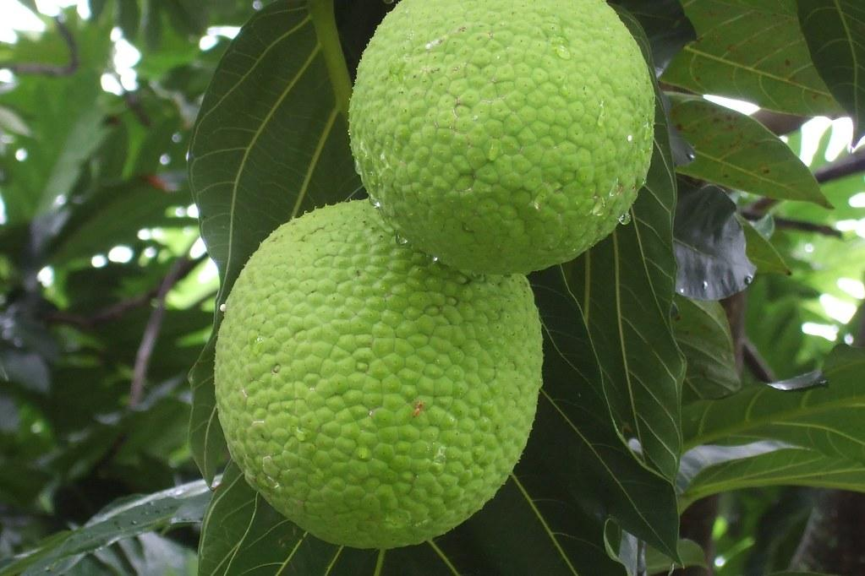
'Ulu Fruit, Also Called Breadfruit
Notes:
Source: McMillan, V. (2010, March 27). Breadfruit [Image]. Flickr. https://www.flickr.com/photos/27614859@N04/4481426425

Slide 6
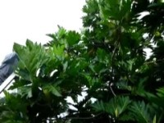
'Ulu Fruit Harvesting
Notes:
Source: HIHomegrown. (2011, September 5). Breadfruit Harvest Tool [Video]. YouTube. https://www.youtube.com/watch?v=6ZQaRVdQ66Q&feature=youtu.be

Slide 7
Notes:
Source: The STEMAZing Project. (n.d.). Engineering Design Process, Adapted from the UA College of Engineering [Graphic]. The STEMAZing Project for the Office of the Pima County School Superintendent. https://stemazing.org/engineering-design-process-university-of-arizona/

Slide 8
Reminders: Variables
Independent | Dependent | Control
Which variable are you changing directly before the trial? | Which variable are you looking for a change in during the trial? | What never changes, no matter what?

Slide 9
Testing Stations
Canopy Size | Canopy Material | Suspension Length
Small | Paper | Short
Medium | Plastic | Medium
Large | Fabric | Long

Slide 10
Design, Build, and Test
Create your blueprint. Make sure to include a feature that will securely hold the 'ulu you have received because you will test the parachute several times.
Build your parachute.
Run three trials of your parachute. Document fall time and other observations related to “protecting” the 'ulu as it falls.

Slide 11
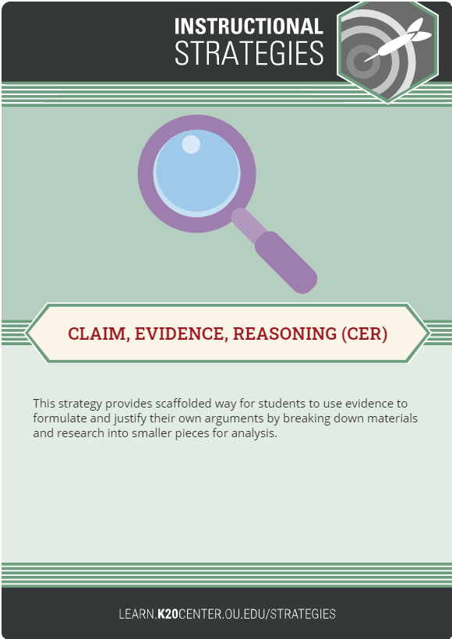
Assess and Reflect
Use the Claim, Evidence, Reasoning (CER) strategy to write a statement on what the best parachute would be for Kai'ulani and Kekahu.
If you had more time, are there any changes you would make to improve your parachute design?
Notes:
Source: K20 Center. (n.d.). Claim, Evidence, Reasoning (CER). Strategies. https://learn.k20center.ou.edu/strategy/156

