Slide 1
Forgotten Figures
The Civil Rights Movement
Grade 11 U.S. & Oklahoma History Lesson

Slide 2
Oklahoma Academic Standards for Social Studies
OKH.6.1 Evaluate the progress of race relations and actions of civil disobedience in the state including:
B. landmark Supreme Court cases of Sipuel v. Board of Regents of the University of Oklahoma (1948) and McLaurin v. Oklahoma Board of Regents for Higher Education (1950)
C. lunch counter sit-ins organized by Clara Luper and the NAACP
USH.7.1 Analyze the major events, personalities, tactics and effects of the Civil Rights Movement.
A. Assess the effects of the United States Supreme Court decisions in the cases of Oklahomans Ada Lois Sipuel Fisher and George McLaurin.
B. Evaluate the events arising from conflicts over segregation including: 4. Oklahoma City lunch counter sit-ins led by Clara Luper
C. Describe the tactics used at different times including civil disobedience, non-violent resistance, sit-ins, boycotts, marches, and voter registration drives.

Slide 3

Tip of the Iceberg
What do you know about the Civil Rights Movement?
Take a moment to fill out only the “tip” of the iceberg (above the water line) on your handout.

Slide 4
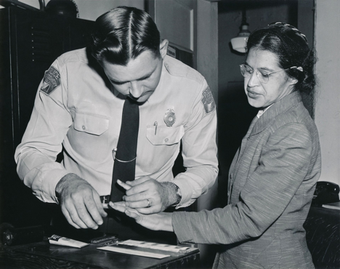
True or False?
Rosa Parks was the first African American to protest the segregation of public transportation in a display of defiance onboard a vehicle.
Notes:
Image Source: Photo of Rosa Parks being fingerprinted by Sheriff D.H. Lackey. (1956, Feb. 22). Wikimedia Commons. https://commons.wikimedia.org/wiki/File:Rosa_Parks_being_fingerprinted_by_Deputy_Sheriff_D.H._Lackey_after_being_arrested_for_refusing_to_give_up_her_seat_for_a_white_passenger_on_a_segregated_municipal_bus_in_Montgomery,_Alabama.jpg

Slide 5
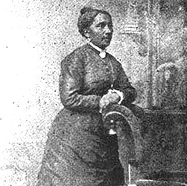
False!
On July 16, 1854, over a century before Rosa Parks refused to relinquish her seat on the bus, Elizabeth Jennings refused to disembark from a New York City streetcar after the conductor had ordered her to because of her race.
Notes:
Image Source: Photo of Elizabeth Jennings. (n.d.). Wikimedia Commons. https://commons.wikimedia.org/wiki/File:Elizabeth_jennings_01.jpg

Slide 6
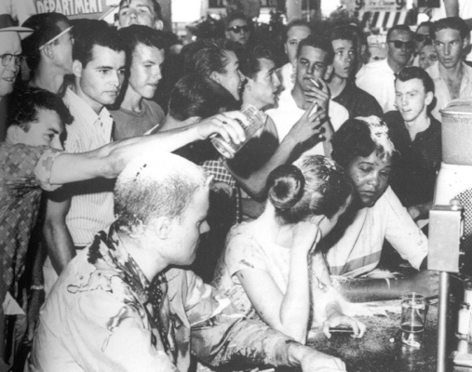
True or False?
America’s first sit-in took place at the segregated lunch counter at a Woolworth’s in Greensboro, North Carolina.
Notes:
Image Source: Photo of Greensboro sit-in. (1960). Wikimedia Commons. https://commons.wikimedia.org/wiki/File:The_Greensboro_Sit-ins.jpg

Slide 7
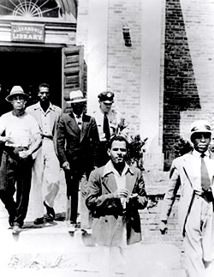
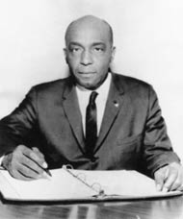
False!
One of America’s first sit-ins was organized in 1939 by lawyer Samuel W. Tucker, and it took place at a library in Alexandria, Virginia, in protest of the library’s refusal to provide African American patrons with library cards.
Notes:
Image Sources:
Photo of Alexandria Library sit-in. (1939, Aug. 21). Courtesy of the Alexandria Black History Museum collection.
Photo of Samuel W. Tucker. (n.d.). Courtesy of the Alexandria Black History Museum collection.

Slide 8
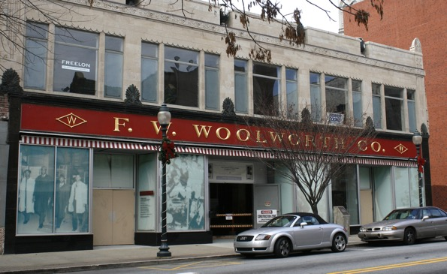
True or False?
America’s first lunch counter sit-in took place at the Woolworth’s in Greensboro, North Carolina.
Notes:
Image Source: King, D. B. (2008, Nov. 28). Photo of the Woolworth store where the Greensboro sit-ins took place. Wikimedia Commons. https://commons.wikimedia.org/wiki/File:Former_Woolworth_store_in_Greensboro,_NC_(2008).jpg

Slide 9
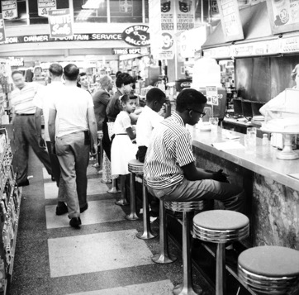
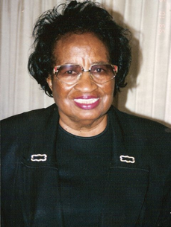
False!
In 1958, Clara Luper, her children, and members of the NAACP Youth Council held a series of sit-ins at Katz Drug Store and other lunch counters in Oklahoma City, which ultimately brought about the end of segregation in the city. The initial sit-in at Katz was also not the first lunch counter sit-in.
Notes:
Image Sources:
Melton, J. (1958, Aug. 26). Photo of a group at Katz Drug, 200 W Main, Oklahoma City, OK, during an African American Civil Rights protest. From the John Melton Collection. Courtesy of the Oklahoma Historical Society, 20246.38.395.T.
Photo of Clara Luper. (c. 1995). Courtesy of Oklahoma Hall of Fame Archives, Oklahoma Hall of Fame at the Gaylord-Pickens Museum, Oklahoma City, OK.

Slide 10
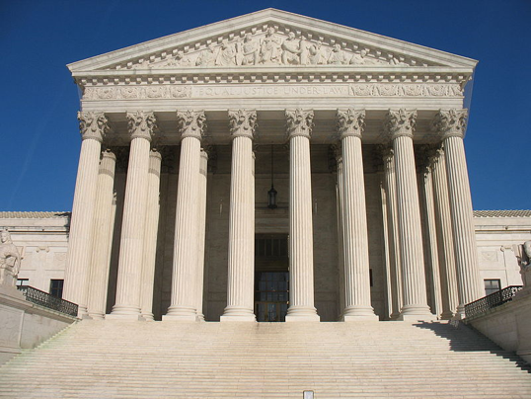
True or False?
Brown v. Board of Education of Topeka was the first Supreme Court case to have a ruling that asserted that African American students were entitled to the same educational opportunities as white students.
Notes:
Image Source: Ree, K. (2007, Mar. 8). Photo of the Supreme Court of the United States. Wikimedia Commons. https://commons.wikimedia.org/w/index.php?search=Supreme%20Court%20of%20the%20United%20States&title=Special%3ASearch&ns0=1&ns6=1&ns12=1&ns14=1&ns100=1&ns106=1#/media/File:US_Supreme_Court.JPG

Slide 11
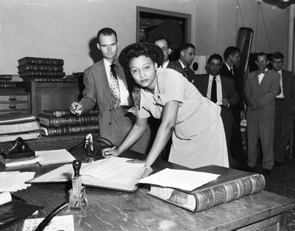
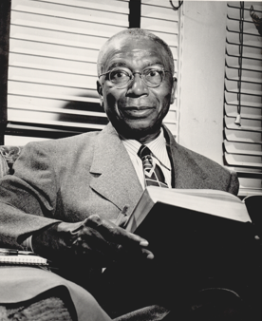
False!
In 1948, the ruling in Sipuel v. Board of Regents of the University of Oklahoma guaranteed Ada Lois Sipuel Fisher the right to study law at OU. Two years later, the ruling in McLaurin v. Oklahoma State Regents ensured that George McLaurin and other Africa American students would not be subjected to segregation in college.
Notes:
Image Sources:
Photo of Ada Lois Sipuel Fisher signing the register of attorneys. (1952). Courtesy of Z. P. Meyers/Barney Hillerman Photographic Collection, OHS. 21412.M657.12
Photo of George McLaurin. (n.d.). Courtesy of Oklahoma Publishing Company Photography Collection, OHS. 2012.201.B0391.0687

Slide 12
Essential Questions
Who are some of the lesser-known contributors to the civil rights movement?
Why have we forgotten about these people?

Slide 13
Objectives for Today
Describe the significance of the contributions of several forgotten pioneers of the civil rights movement and the circumstances that brought about their actions.
Determine why these figures have been omitted from our collective memory.
Acquire a more thorough understanding of the scope of the civil rights movement, both in Oklahoma and in other parts of the United States.

Slide 14

Think-Pair-Share
What is collective memory?
Think about what “collective memory” means.
Share your thoughts with a partner. Come up with a definition for collective memory.
Share your definition with the class.

Slide 15
What is Collective Memory?
“Collective memory” refers to the way in which social groups (nations, families, etc.) remember their past.
Each of us has some sort of collective memory for any important social group to which we belong.
Collective memories reflect the national identity and the outlook of a country’s citizens.
Collective memories of a group of people can evolve over generations.
Notes:
Source: Roediger, III, H. & DeSoto, K. A. (2016, June 28). The power of collective memory. Scientific American. https://www.scientificamerican.com/article/the-power-of-collective-memory/

Slide 16
Five Forgotten Figures
On your T-Chart handout, record evidence from your sources about your group’s forgotten figure.
Ada Lois Sipuel Fisher
Elizabeth Jennings
Clara Luper
George McLaurin
Samuel W. Tucker
Prepare a presentation to share your findings with the class.

Slide 17
Questions To Guide Your Research
What was this person’s background?
What actions did this person take in response to injustices they faced?
With whom did this person collaborate when acting against injustice?
What, if any, were the immediate changes in the treatment of African Americans that resulted from this person’s actions?
Did this individual’s actions have an influence on the civil rights movement? How?
Why do you think the actions of this individual have been omitted from our collective memory?

Slide 18
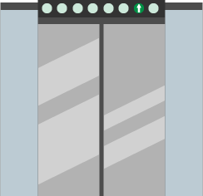
Elevator Speech
Should your forgotten figure be included in the history textbook?
As a group, come up with an elevator speech (no longer than 30 seconds) addressing the question above. Select a spokesperson from your group to share your speech with the class.

Slide 19
Who Else Are We Leaving Out?
Are there other forgotten figures we don’t know about?
Write what you used to think about the civil rights movement under “I Used to Think.”
Research to find information about another individual who history textbooks have left out.
Write what you learn about this person’s contributions under “But Now I Know.”

Slide 20
Beneath the Surface
Think about the ways that forgotten figures have contributed to the civil rights movement.
Finish your “Tip of the Iceberg” handout by summarizing beneath the surface (below the water line) the new information you’ve learned.

