Slide 2
Just Say No!
Exploring Temptation through the Lotus Eaters

Slide 3
Essential Questions
How can a person’s decisions and actions change their life and others’ lives?
How do the decisions and actions of characters reveal their personalities?

Slide 4
Lesson Objectives
Make connections across multiple texts and provide evidence to support inferences.
Analyze and evaluate the effectiveness of various persuasive techniques across multiple texts.
Give formal and informal presentations.

Slide 5
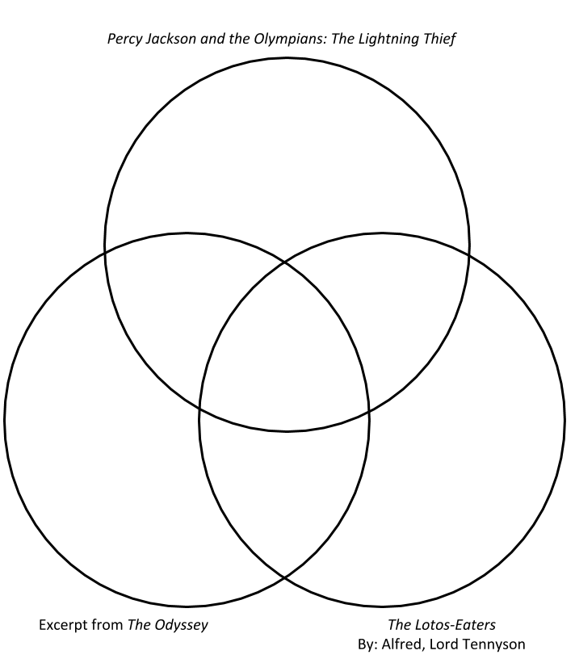
Venn Diagram
While you watch the clip from Percy Jackson and the Olympians: The Lightning Thief, complete the top circle of the Venn diagram with your observations:
Setting
Characters
Plot, etc.

Slide 6
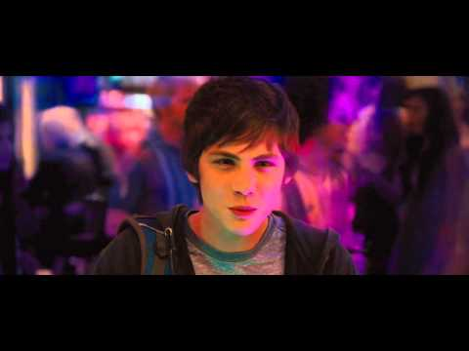
Notes:
Source: Muller, P. (Adapter) & Columbus, C. (Director). (2015, June 21). Percy Jackson (Lotus Casino Scene) [Video]. YouTube. https://www.youtube.com/watch?v=p9-Fbl2QVJc&feature=youtu.be

Slide 7
ABC Graffiti
Work in small groups to brainstorm words or phrases related to this question:
What are different temptations that people face?
Be prepared to move after time is called. You’ll need only the marker provided to your group.
Notes:
Source: K20 Center. (n.d.). ABC Graffiti. Strategies. https://learn.k20center.ou.edu/strategy/96

Slide 8
The Different Temptations that People Face
Round 1
In your small group, generate words or phrases related to the topic for each letter of the alphabet.
Notes:
Source: K20 Center. (n.d.). K20 3 minute timer. YouTube. https://www.youtube.com/watch?v=iISP02KPau0&feature=youtu.be

Slide 9
The Different Temptations that People Face
Round 2
Rotate to the next poster and read through the list. Add words and phrases for the letters that haven’t already been addressed.
Notes:
Source: K20 Center. (n.d.). K20 3 minute timer. YouTube. https://www.youtube.com/watch?v=iISP02KPau0&feature=youtu.be

Slide 10
The Different Temptations that People Face
Round 3
Again, rotate to the next poster and read through the list. Add words and phrases for the letters that haven’t already been addressed.
Notes:
Source: K20 Center. (n.d.). K20 3 minute timer. YouTube. https://www.youtube.com/watch?v=iISP02KPau0&feature=youtu.be

Slide 11
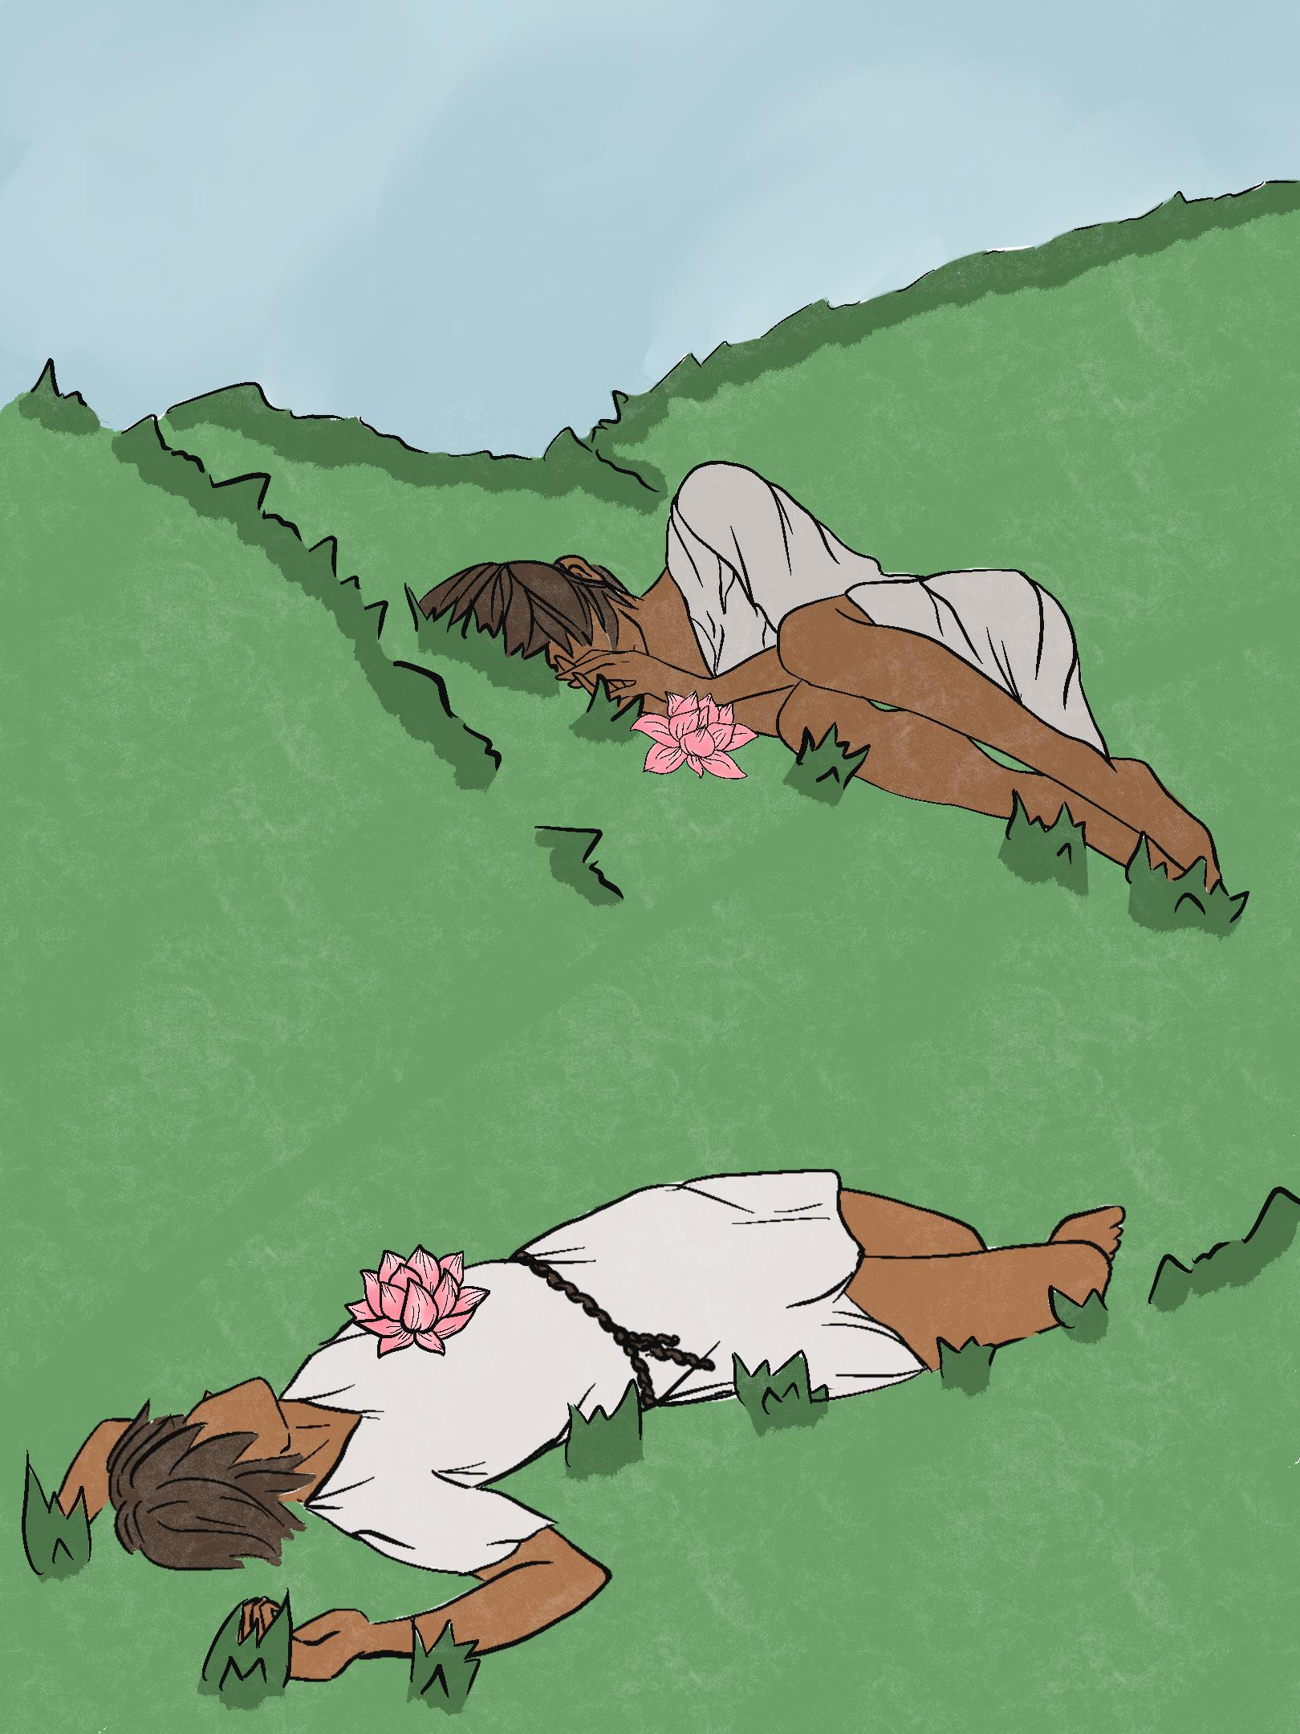
Lotus Eaters: Readings
Independently read the text provided to you:
Excerpt from Homer’s The Odyssey
“The Lotos-Eaters,” a poem by Alfred, Lord Tennyson
As you read, fill out the corresponding section of the Venn diagram.
Notes:
Source: K20 Center. (n.d.). Lotus Eaters [Image].

Slide 12
Partner Up
With a partner who read a text different from yours, complete the following:
Share information about your text.
Write down information about what your partner read.
Fill out the final “outside” section of the Venn diagram.

Slide 13
Complete the Venn Diagram: Step 1
Specific information about the Percy Jackson movie clip
Specific information about the poem by Alfred, Lord Tennyson
Specific information about the excerpt from The Odyssey

Slide 14
Complete the Venn Diagram: Step 2
Similarities between the Percy Jackson movie clip and the excerpt from The Odyssey
Similarities between the Percy Jackson movie clip and the poem by Alfred, Lord Tennyson
Similarities between the excerpt from The Odyssey and the poem by Alfred, Lord Tennyson

Slide 15
Complete the Venn Diagram: Step 3
Details from all three selections (the Percy Jackson movie clip, the excerpt from The Odyssey, and the poem) that are similar

Slide 16
How would you react?
Imagine you are a sailor who has encountered lotus eaters. Use Flipgrid to record a video that answers these questions:
Would you have given in to the temptation of the lotus?
How would you overcome the temptation of the lotus today?
What is your exit strategy?
Notes:
Source: Flipgrid. (n.d.). Logo [Image]. Microsoft. https://info.flipgrid.com/

Slide 17
Flipgrid Presentation
Directions: Give an example of when and how you avoided temptation in the past. Next, explain your plan to avoid the lotus flower’s temptation. Include an exit strategy.
Review the provided rubric before creating your response. Your presentation will be evaluated using the rubric as a reference.
Rehearse what you will say before recording your response. Your voice should be clear and distinct. Do not mumble!

Slide 18
View and Respond
Watch your classmates’ presentations and take notes.
Using the rubric as a reference, provide positive feedback and offer questions about your classmates’ exit strategies.

