Slide 2
What Does it Mean to Be a Good Citizen?
Responsibilities and Rights of U.S. Citizens

Slide 3

Word Cloud
Navigate to menti.com.
Enter the code to join: INSERT CODE
Submit at least one response to the question:
“What does it mean to be a good citizen of our democracy?”
Notes:
Teacher’s Note: Insert Mentimeter join code in place of the highlighted text above.
K20 Center. (n.d.). Collaborative word clouds. Strategies. https://learn.k20center.ou.edu/strategy/103
K20 Center. (n.d.). Mentimeter. Tech Tools. https://learn.k20center.ou.edu/tech-tool/645

Slide 4
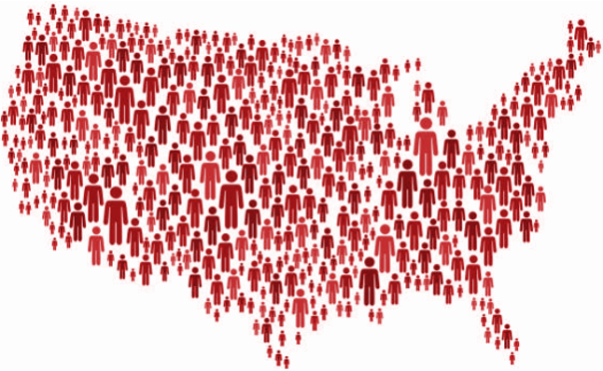
Essential Questions
What does it mean to be a good citizen of our democracy?
What are the responsibilities and rights of citizens in our democracy?
Notes:
bamlou. (n.d.). USA map made of red stickman figures [Image]. Getty Images. https://www.gettyimages.com/detail/illustration/map-made-of-red-stickman-figures-royalty-free-illustration/1212542267

Slide 5
Learning Objectives
Identify and describe the responsibilities of citizens of the U.S.
Evaluate and explain what it means to be a good citizen of our democracy.

Slide 6

Text-to-Text Article Analysis
Read the article “Responsibilities of U.S. Citizens.”
As you read, highlight information that helps you answer the question, “What does it mean to be a good citizen of our democracy?”
Next to each piece of information you highlight, explain why you highlighted it in the margins.
Notes:
K20 Center. (n.d.). Why-Lighting. Strategies. https://learn.k20center.ou.edu/strategy/128

Slide 7
Share Ideas
When your group is called on, share one piece of information you highlighted along with your reasoning.
Notes:
K20 Center. (n.d.). Why-Lighting. Strategies. https://learn.k20center.ou.edu/strategy/128

Slide 8
Text-to-Text Article Analysis
Read the article “President Obama’s Farewell Address.”
As you read, highlight information that helps you answer the question, “What does it mean to be a good citizen of our democracy?”
Next to each piece of information you highlight, explain why you highlighted it in the margins.
Notes:
K20 Center. (n.d.). Why-Lighting. Strategies. https://learn.k20center.ou.edu/strategy/128

Slide 9
Share Ideas
When your group is called on, share one piece of information you highlighted along with your reasoning.
Notes:
K20 Center. (n.d.). Why-Lighting. Strategies. https://learn.k20center.ou.edu/strategy/128

Slide 10

Text-to-Text Four Corners
How are the texts similar or related? Explain.
What specific lines and details of these texts echo each other or connect? Explain.
If the creators of these texts were to have a conversation, what is one important thing they might say to each other? Explain.
What questions do these texts raise for you? What reactions do you have to one or both texts? Explain.
Notes:
K20 Center. (n.d.). Four corners. Strategies. https://learn.k20center.ou.edu/strategy/138

Slide 11
Share Ideas
Discuss one question with your group.
Choose a representative to share the group’s response to the question with the whole class.
Notes:
K20 Center. (n.d.). Four corners. Strategies. https://learn.k20center.ou.edu/strategy/138

Slide 12
Responsibilities of Citizenship Graphic Organizer
Use the information from both texts to complete the graphic organizer with your group members.

Slide 13
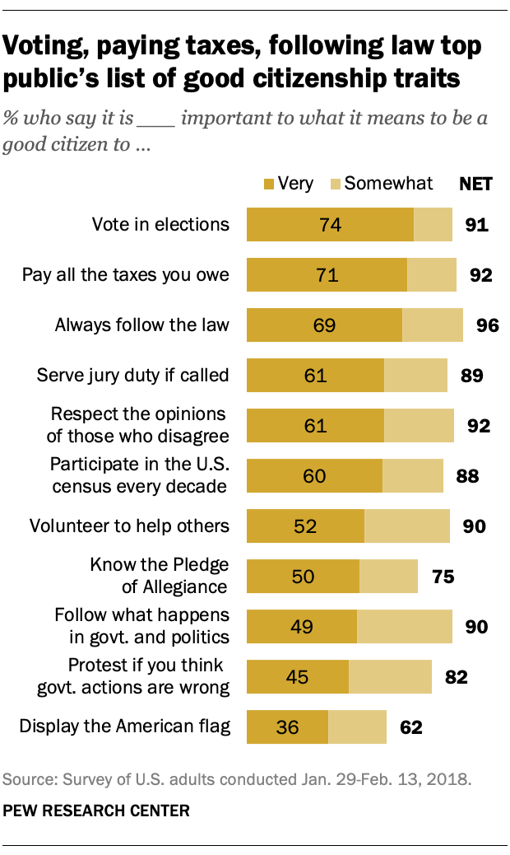
Notes:
Pew Research Center. (2018, April 26). The responsibilities of citizenship. The Public, the Political System, and American Democracy. https://www.pewresearch.org/politics/2018/04/26/9-the-responsibilities-of-citizenship/

Slide 14
Text-to-Texts, Text-to-World, and Text-to-Self
Study the results from the Pew Research Center study about the responsibilities of citizenship.
Create one text-to-texts response and either a text-to-world or text-to-self response.
Use the prompts on your handout to help you create a response.

Slide 15

Sticky Bars
Reflect on the information you have analyzed.
Choose the two responsibilities of citizenship that you believe are most important to a thriving democracy.
Write each responsibility on a sticky note and explain why you chose each responsibility.
Post your sticky note on the graph.
Notes:
K20 Center. (n.d.). Sticky bars. Strategies. https://learn.k20center.ou.edu/strategy/129

Slide 16
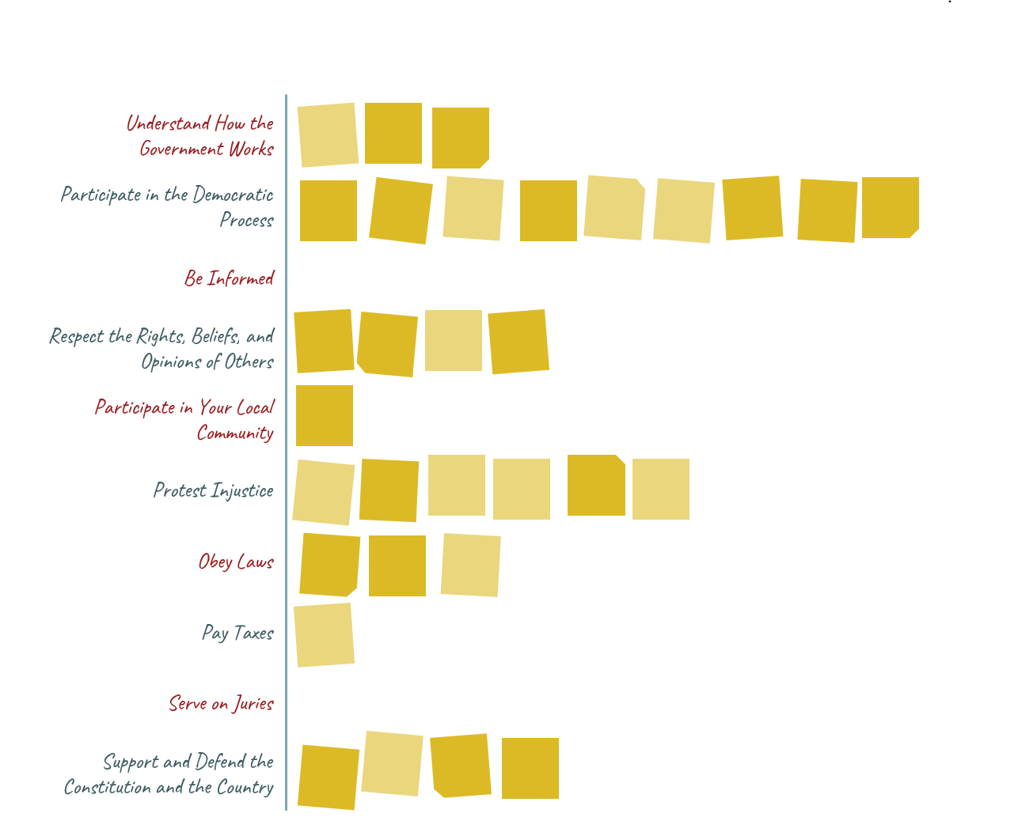
Sticky Bars Example Chart

