Slide 2
What Does It Mean to Be a Good Citizen?
Responsibilities and Rights of U.S. Citizens

Slide 3
Word Cloud
Please go to menti.com and use the code to join.
Submit at least one answer to the question “What does it mean to be a good citizen of our democracy?”
Notes:
The teacher needs to create their own Mentimenter presentation using the word cloud option. The teacher could then edit this slide to include the code students should use to join the presentation.

Slide 4
Essential Questions
What does it mean to be a good citizen of our democracy?
What are the responsibilities and rights of citizens in our democracy?

Slide 5
Learning Objectives
Identify and describe the responsibilities of citizens of the U.S.
Evaluate and explain what it means to be a good citizen of our democracy.

Slide 6
Text-to-Text Article Analysis
Please read “Responsibilities of U.S. Citizens.”
Read through a second time. This time, please highlight information that helps to answer the question, “What does it mean to be a good citizen of our democracy?”
For any information you highlight, please make notes in the margins explaining your reasoning.

Slide 7
Share Ideas
When your group is called on, please share one of the ideas that you highlighted along with your reasoning.

Slide 8
Text-to-Text Article Analysis
Please read “President Obama’s Farewell Address.”
Read through a second time. This time, please highlight information that helps to answer the question, “What does it mean to be a good citizen of our democracy?”
For any information you highlight, please make notes in the margins explaining your reasoning.

Slide 9
Share Ideas
When your group is called on, please share one of the ideas that you highlighted along with your reasoning.

Slide 10
Text-to-Text Four Corners
How are these articles similar or related? Explain.
What specific lines and details of these texts echo each other or connect? Explain.
If the creators of these texts were to have a conversation, what is one important thing they might say to each other? Explain.
What questions do these texts raise for you? What reactions do you have to them, either individually or together? Explain.

Slide 11
Share Ideas
After discussing one of the Four Corners questions with your group, select a representative to share the group’s response with the class.

Slide 12
Responsibilities of Citizenship Graphic Organizer
Using information from both texts that you read and analyzed, work with your group to complete the graphic organizer.

Slide 13
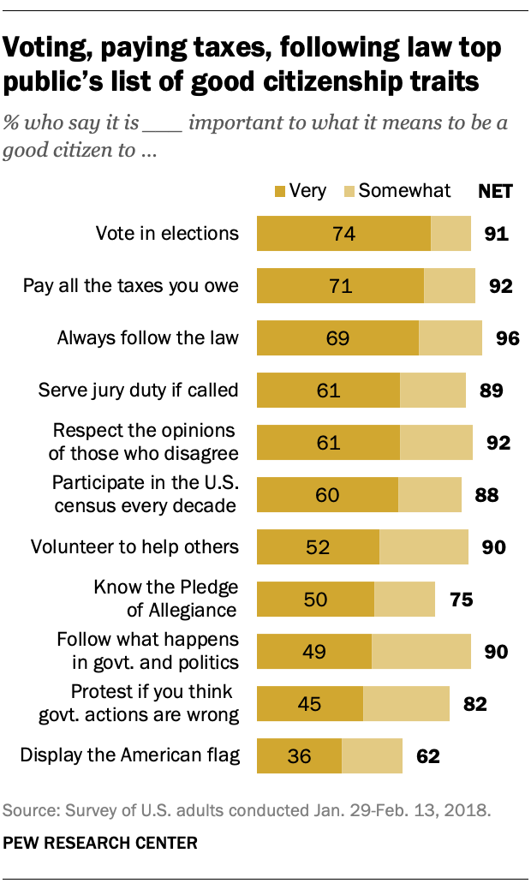
Notes:
source: https://www.pewresearch.org/politics/2018/04/26/9-the-responsibilities-of-citizenship/

Slide 14
Text-to-Texts, -World, and -Self
Look at the results from the Pew Research Center study about the responsibilities of citizenship.
After reviewing the data, craft a text-to-texts response and either a text-to-world or text-to-self response. (Use the questions on the handout to prompt you.)

Slide 15
Sticky Bars
Considering all the information you have analyzed, choose the two responsibilities of citizenship you believe are the most important for a thriving democracy.
Explain your reasoning on the two sticky notes provided.
Then post your sticky notes to the graph.

Slide 16
