Slide 2
Ichabod and Brom: Two Wild and Crazy Guys
Characters’ Differing Perspectives

Slide 3
Guiding Questions
What are superstitions?
How do people react to superstitions?

Slide 4
Very Superstitious!
Posters with images and brief descriptions of superstitions are hanging around the room.
You have two sticky notes. Use one to list superstitions that are familiar. Use the other to list superstitions that are not.

Slide 5
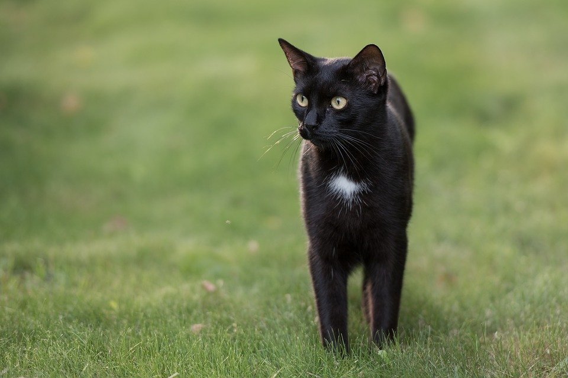
Don’t let a black cat cross your path.
Notes:
Suetot. (2018, September 14). [Animal]. https://pixabay.com/photos/cat-black-cat-grass-kitten-nature-3672086/

Slide 6
Don’t walk under a ladder.
Notes:
Pixabay. (n.d.). Ladder [Image]. https://pixabay.com/vectors/ladder-step-builder-tool-30182/

Slide 7
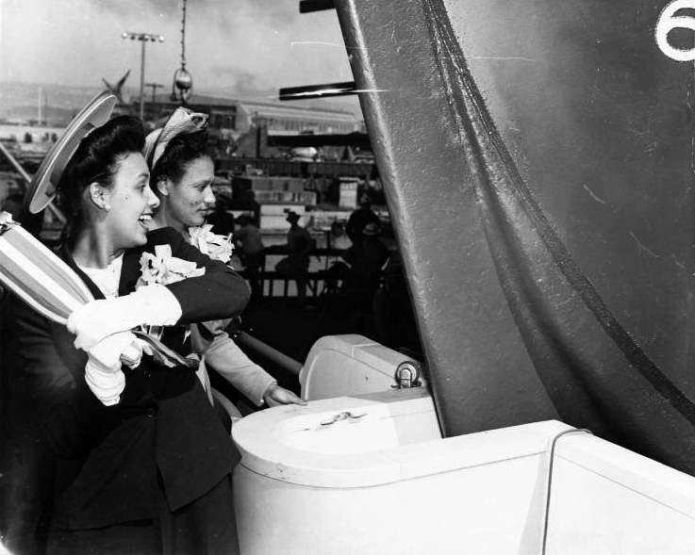
Christen a new boat or ship with Champagne.
Notes:
Joseph, E. F. (2008, January 29). Lena Horne launching SS George Washington Carver [Digital image]. Wikimedia Commons. https://commons.wikimedia.org/wiki/File:Lena_Horne_launching_SS_George_Washington_Carver.jpg

Slide 8
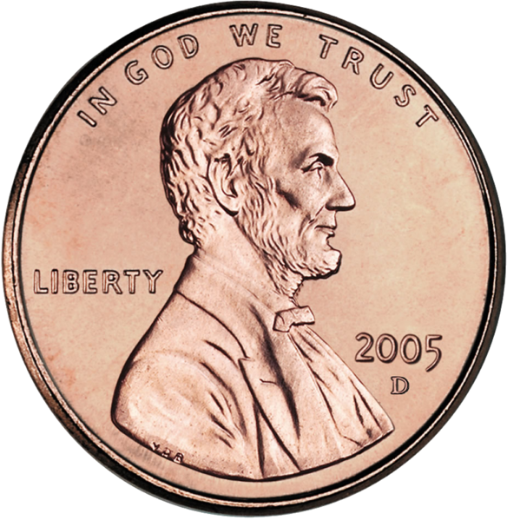
Find a penny, pick it up, and all the day you’ll have good luck!
Notes:
United States Mint. (2006, April 6). [2005 US cent, obverse side]. Wikimedia Commons. https://commons.wikimedia.org/wiki/File:2005-Penny-Uncirculated-Obverse-cropped.png

Slide 9
Friday the 13th is an unlucky day.
Notes:
Free SVG. (2019, March 12). Friday the 13th. https://freesvg.org/friday-the-13th (public domain)

Slide 10
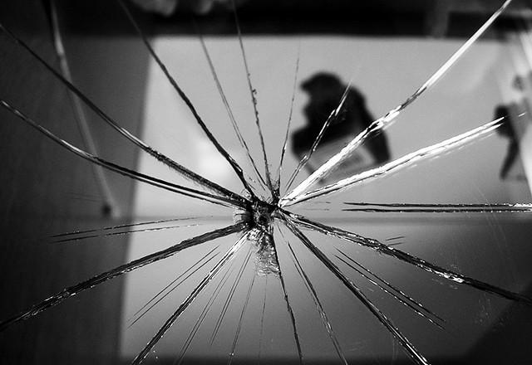
Breaking a mirror means seven years of bad luck.
Notes:
McGilchrist, R. (2007, November 23). Broken Reflection [A broken mirror in our dinning room. There is a short-story behind this...]. Flickr. https://www.flickr.com/photos/shinealight/2249017849

Slide 11
Essential Question
How does perspective affect meaning?

Slide 12
Learning Objectives
Identify various superstitions and explain their meanings.
Compare and contrast how different characters react to superstitions.
Hypothesize how you would react to various superstitions.

Slide 13
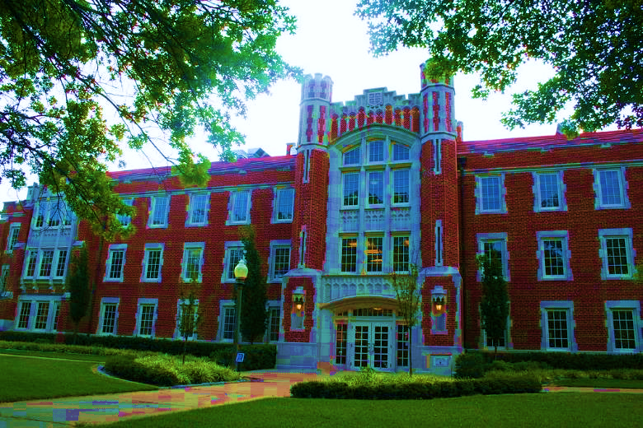
Jigsaw: “The History Behind OU’s Ghost Stories”
Each group member should read one of the stories from the article “The History behind OU’s ghost stories.”
When everyone has finished reading, take turns telling your stories to your other group members.
Notes:
Image Source: [T3h wookiee]. (2007, April 21). University of Oklahoma, Ellison Hall [Digital image]. Wikimedia Commons. https://commons.wikimedia.org/wiki/File:EllisonHall.jpg

Slide 14
The Legend of Sleepy Hollow
As you read “The Legend of Sleepy Hollow,” use Categorical Highlighting to highlight details about Ichabod in one color and details about Brom in another color.

Slide 15
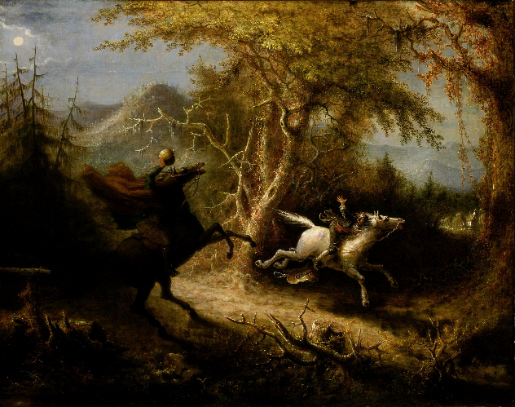
Compare and Contrast: Ichabod and Brom
Work with your partner to fill out a Venn diagram comparing and contrasting Ichabod and Brom.
Notes:
Image Source: Quidor, J. (n.d.). The Headless Horseman Pursuing Ichabod Crane [Digital image]. https://en.wikipedia.org/wiki/The_Legend_of_Sleepy_Hollow#/media/File:John_Quidor_-_The_Headless_Horseman_Pursuing_Ichabod_Crane_-_Google_Art_Project.jpg

Slide 16
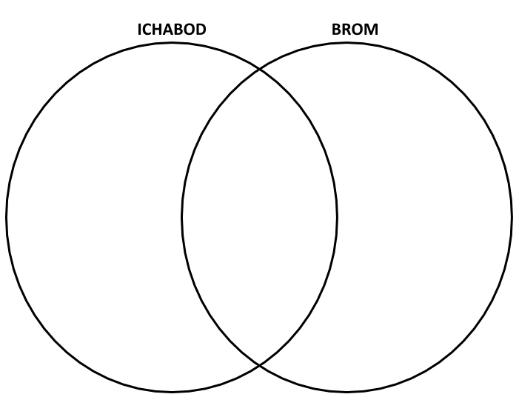
Venn Diagram
Similar characteristics of Ichabod and Brom
Unique characteristics of Ichabod
Unique characteristics of Brom

Slide 17
If you were walking around the OU campus late and night and came across one of the haunted buildings, would you react more like Ichabod or more like Brom?

Slide 18
Philosophical Chairs: Planning
Use text-based evidence to support your reasons for how you might respond to each of the myths.

Slide 19
Philosophical Chairs: Rules of Engagement
Choose a side.
Be sure you understand the central statement before you begin.
Take turns discussing which character you’d most likely respond like.
Before you speak, summarize the previous speaker’s argument.
Make sure to provide textual evidence to support your reasons.
Keep an open mind!

Slide 20
Philosophical Chairs: Agreement Statements
I agree because _____.
That reminds me of _____.
I like how you said _____.
Can you tell me more about _____?
I’m not sure I understand _____.

Slide 21
Philosophical Chairs: Disagreement Statements
I disagree with _____ because_____.
I’m not sure I agree with what _____ said because _____.
I can see that _____; however, I disagree because _____.

