Slide 1
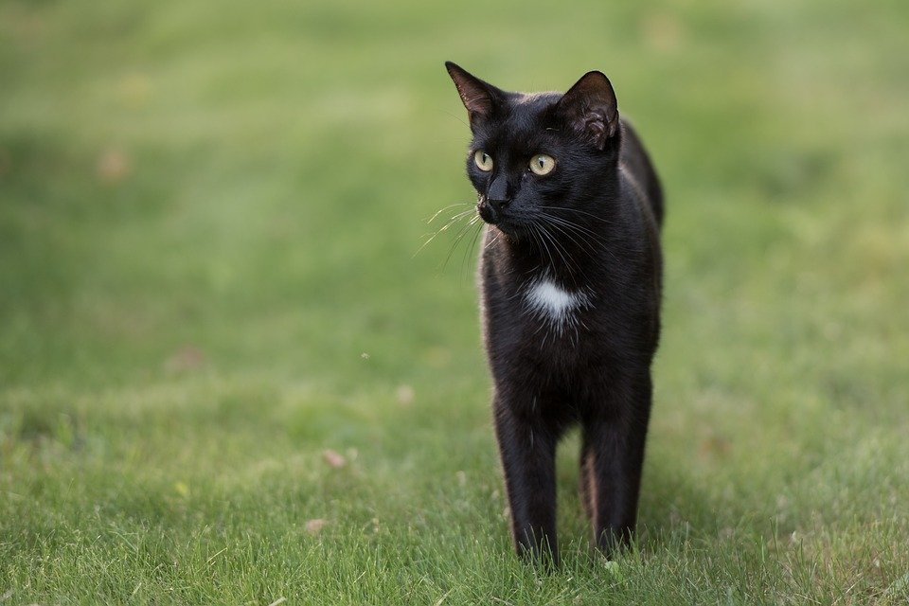
Don’t let a black cat cross your path.
Notes:
Suetot. (2018, September 14). [Animal]. Retrieved June 23, 2020, from https://pixabay.com/photos/cat-black-cat-grass-kitten-nature-3672086/

Slide 2
Don’t walk under a ladder.
Notes:
Pixabay. (n.d.). Ladder [Image]. https://pixabay.com/vectors/ladder-step-builder-tool-30182/

Slide 3
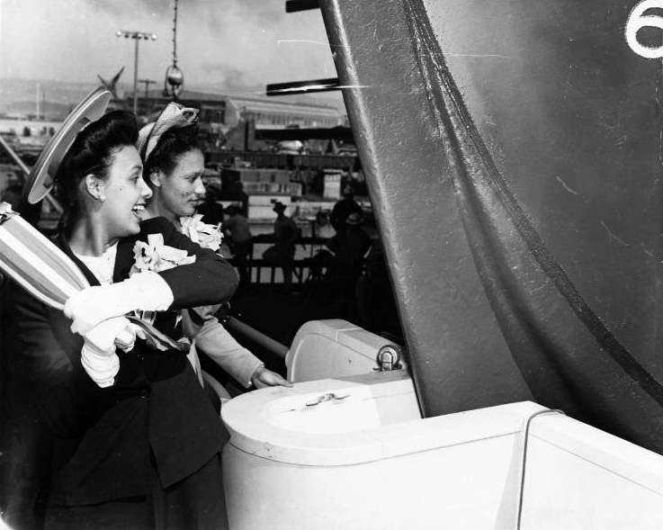
Christen a new boat or ship with Champagne
Notes:
Joseph, E. F. (2008, January 29). Lena Horne launching SS George Washington Carver [Digital image]. Wikimedia Commons. Retrieved June 23, 2020, from https://commons.wikimedia.org/wiki/File:Lena_Horne_launching_SS_George_Washington_Carver.jpg

Slide 4
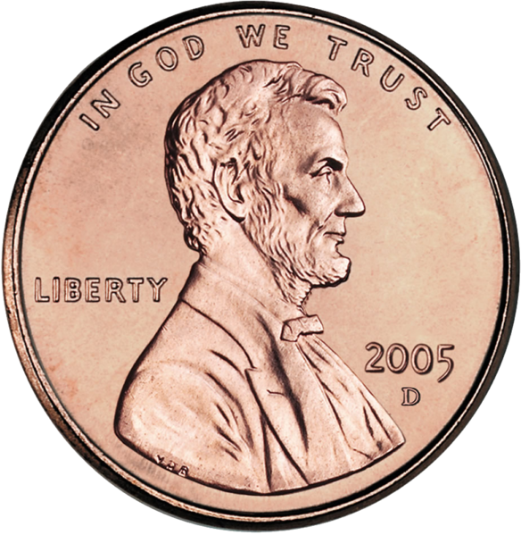
“Find a penny, pick it up, and all the day you’ll have good luck!”
Notes:
United States Mint. (2006, April 6). [2005 US cent, obverse side]. Wikimedia Commons. Retrieved June 23, 2020, from https://commons.wikimedia.org/wiki/File:2005-Penny-Uncirculated-Obverse-cropped.png

Slide 5
Friday the 13th is an unlucky day.
Notes:
Free SVG. (2019, March 12). Friday the 13th. https://freesvg.org/friday-the-13th (public domain)

Slide 6
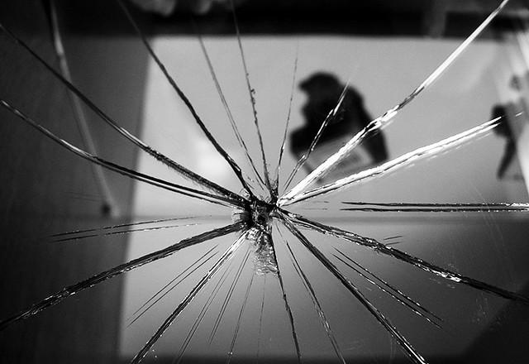
Breaking a mirror means seven years of bad luck.
Notes:
McGilchrist, R. (2007, November 23). Broken Reflection [A broken mirror in our dinning room. There is a short-story behind this... When we moved into this house (maybe 8 years ago) we were hanging pictures on the otherside of the wall, and didn't realize how much space was between the wall and the mirror. Unfortunately the nail went right through and shattered the glass... and for 8 years it's been like that.]. Flickr. Retrieved June 23, 2020, from https://www.flickr.com/photos/shinealight/2249017849

