Slide 2
Ichabod and Brom: Ghostfacers
Credibility and The Legend of Sleepy Hollow

Slide 3
How Believable Are They?
As you watch, think about the following:
Do you believe these storytellers? Why or why not?
What makes these stories believable or not believable?
What do you like or dislike about these stories?
Be prepared to share your responses with the class.

Slide 4
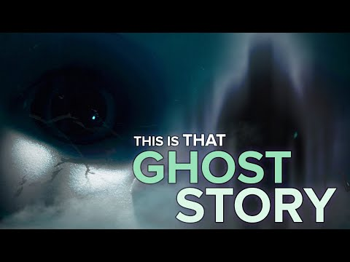
Notes:
Video Source: BuzzFeed Unsolved Network. (2019, June 22). People tell their spookiest ghost stories [Video]. YouTube. https://www.youtube.com/watch?v=1D1BqTYQ_rg

Slide 5
Fist to Five
On a scale of 0 to 5, how much do you believe these two stories?

Slide 6
How Believable Were They?
Now that you’ve watched:
Did you believe these storytellers? Why or why not?
What made these stories believable or not believable?
What did you like or dislike about these stories?

Slide 7
Essential Question
How do you determine credibility?

Slide 8
Lesson Objectives
Evaluate whether a story or text is credible.
Craft a story using the elements of credibility.
Provide feedback about the credibility of peers’ stories.

Slide 9
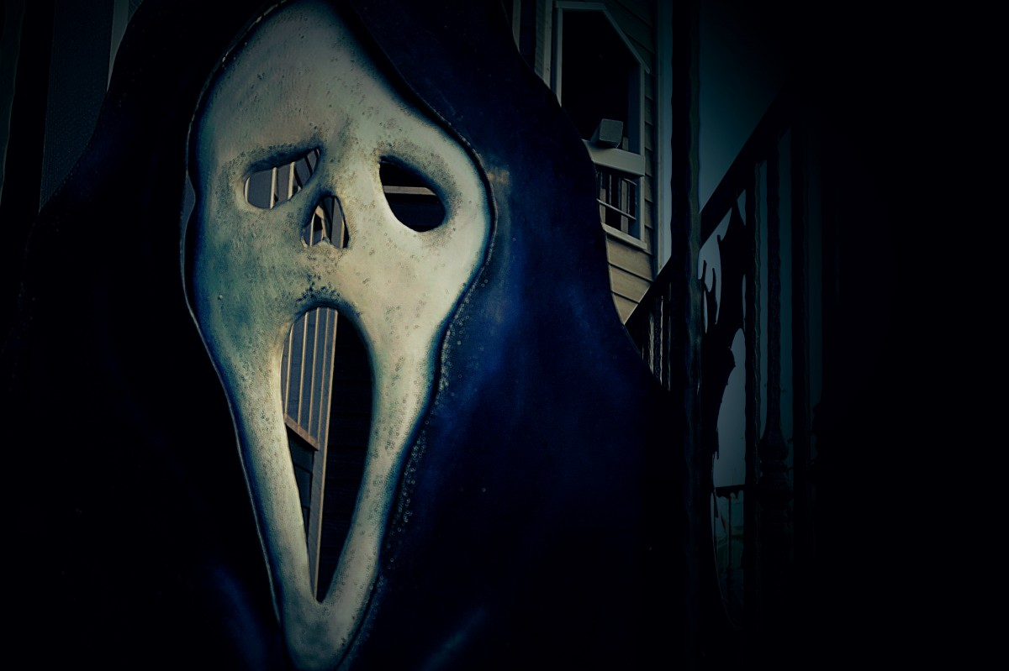
Credible Ghost Hunters?
Read the article “Ghost Hunters Sound Credible with a Little 'Science.’”
As you read, think about this question: What does this article tell you about credibility?
Notes:
Article Link: https://www.livescience.com/24266-ghost-hunters-sound-credible-with-a-little-science.html
Image Source: Hazelwood, S. (2018, October 15). Ghost Face [Digital image]. https://pxhere.com/en/photo/1453425

Slide 10
A-CLAP
.
Authority
Currency
Leaning
Accuracy
Purpose

Slide 11
A: Authority
Is there an author, editor, institution, or a publisher provided?
Does the individual or organization list their qualifications or credentials?

Slide 12
C: Currency
Is there a date that shows when the source was published or last updated?
Keep in mind that not knowing the date of publication for factual or statistical information can call its accuracy into question.

Slide 13
L: Leaning
Look for objective sources that present information with a minimum of bias and without the intention to persuade.
If a debatable issue is covered, are both sides presented?

Slide 14
A: Accuracy
Based on the reading you have already done on the subject, can you corroborate this information with other sources?
Is factual information referenced in footnotes or a "Works Cited" list?

Slide 15
P: Purpose
Judge whether the source is geared toward a scholarly or general audience. Is the information relevant to your needs?
If online, use the URL or other linked websites to help you determine its purpose.

Slide 16
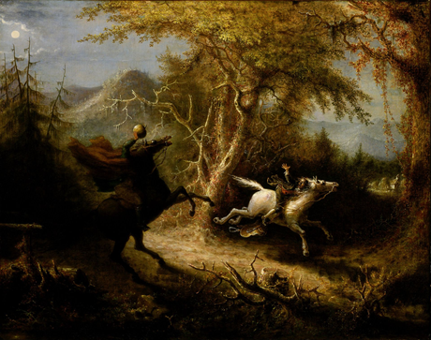
“The Legend of Sleepy Hollow”
Notes:
Image Source: Quidor, J. (1858). The Headless Horseman pursuing Ichabod Crane [Digital image]. Wikipedia. https://en.wikipedia.org/wiki/The_Legend_of_Sleepy_Hollow#/media/File:John_Quidor_-_The_Headless_Horseman_Pursuing_Ichabod_Crane_-_Google_Art_Project.jpg

Slide 17
A-CLAP
.
Authority
Currency
Leaning
Accuracy
Purpose

Slide 18
“The Legend of Sleepy Hollow”
Is this story believable?
Is the ghost story shared in this story believable?
How does hearing stories second-, third-, or fourth-hand take away from their credibility?

Slide 19
Your Turn to Tell…
Use Flipgrid to record yourself telling a ghost story.
It can be a firsthand account or one you’ve heard.

Slide 20
Notes:
Video Source: Howcast. (2008, October 15). How to tell a ghost story [Video]. YouTube. https://www.youtube.com/watch?v=GiXeORXuh7U

Slide 21
Listen and Decide
In Flipgrid, listen to three classmates’ stories.
Use what we’ve discussed to determine the stories’ credibility.
Take notes on the second page of your A-CLAP handouts.
Record feedback for each story.

