Slide 2
The Sirens
Is It a Bird or Is It a Fish?

Slide 3
Essential Questions
How does perspective affect meaning?

Slide 4
Lesson Objectives
Students will analyze texts and videos.
Students will read “The Siren” excerpt from The Odyssey.
Students will discuss in a Socratic Seminar the physical description of a siren.

Slide 5

I Used to Think
What is a siren?
In the “I Used to Think” column of the handout, sketch what you think
a siren looks like.
Notes:
Source: https://learn.k20center.ou.edu/strategy/137

Slide 6
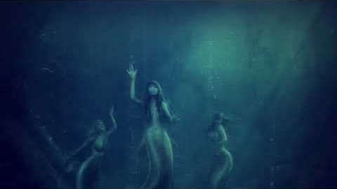
Song of the Sirens
Notes:
SingingIntrovert (Producer). (2018, July 18). Song of the Sirens [Video]. YouTube. https://www.youtube.com/watch?v=dtPDLZyRL3o

Slide 7
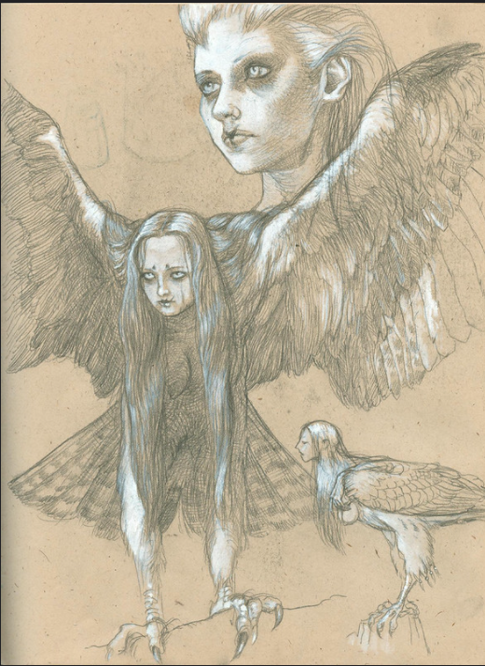
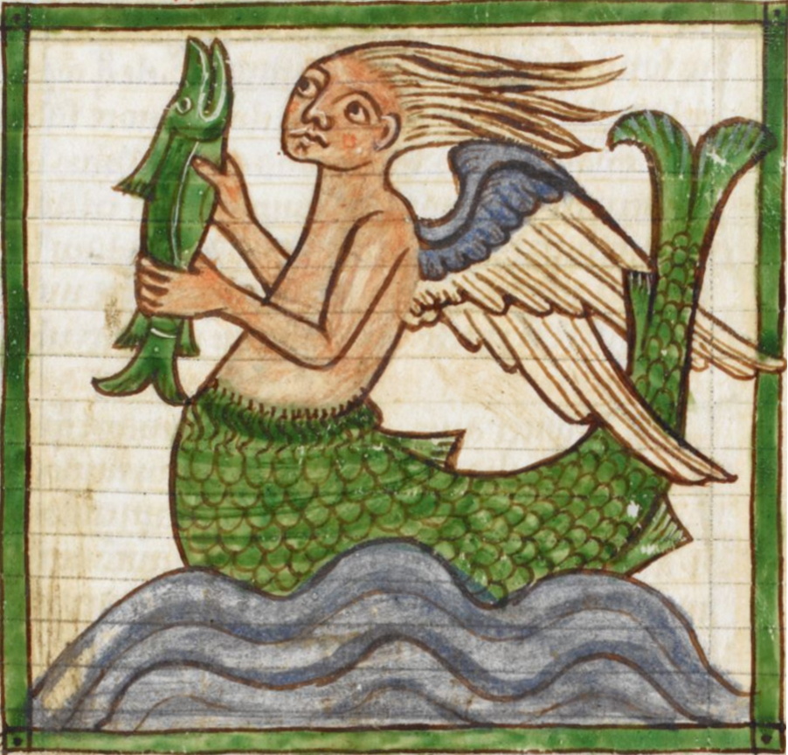
What is a Siren? Bird? Or Fish?
Notes:
Source: Komoda, K. (2012, June 26). 1998-Harpies. [Drawing]. Flickr. https://www.flickr.com/photos/39573281@N06/9848944926r
Licensed under CC- BY-NC-NC 2.0
Source: Wikimedia Commons. (2015). Sirens in medieval art. [Image]. Wikimedia. https://commons.wikimedia.org/w/index.php?search=sirens+bestiary&title=Special%3ASearch&profile=default&fulltext=1&ns0=1&ns6=1&ns12=1&ns14=1&ns100=1&ns106=1#/media/File:Siren_3244.jpg

Slide 8

What is a Siren?
As you read the assigned article, complete a T-Chart noting
support for the Siren being part
bird or part fish.
Notes:
Source: https://learn.k20center.ou.edu/strategy/86
Article reference: Cartwright, M. (2020, October 20). Siren. World history encyclopedia. https://www.ancient.eu/Siren/

Slide 9
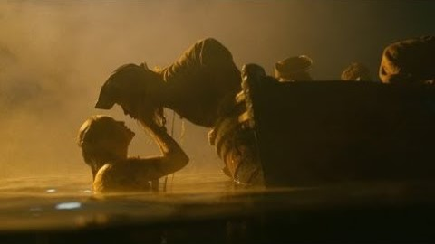
Pirates Meet Mermaids at Whitecap Bay
Notes:
Guardian Images (Producer). (2018, May 10). Pirates Meet Mermaids at Whitecap Bay, Part 1. [Video]. YouTube. https://youtube/0KQcsWPoazc
Excerpted from Pirates of the Caribbean: On Stranger Tides (2011) directed by Rob Marshall

Slide 10

The Truth Behind the Mermaid Myth
Notes:
Source: Bright Side (Producer). (2018, September 8). The Truth Behind the Mermaid Myth. [Video]. YouTube. (149) The Truth Behind the Mermaid Myth - YouTube

Slide 11

The Odyssey: The Sirens
As you read from the excerpt from The Odyssey, complete the following:
Highlight portions of the text that support your opinion.
In the margins, explain why you selected those passages.
Use your notes in your I Used To Know Chart
Notes:
Source: https://commonlit-private-assets.s3.amazonaws.com/lesson_template_pdfs/pdfs/000/002/143/original/Excerpt_from_The_Odyssey__The_Sirens-teacher.pdf?X-Amz-Algorithm=AWS4-HMAC-SHA256&X-Amz-Credential=AKIAVWWGJUDZHQYRJAEU%2F20210614%2Fus-east-1%2Fs3%2Faws4_request&X-Amz-Date=20210614T152507Z&X-Amz-Expires=3600&X-Amz-SignedHeaders=host&X-Amz-Signature=7540d0f9b80f92734d70d14fff5ff7cf5f9b6236d1e48c61823530f09f5f9bcc
Source: https://learn.k20center.ou.edu/strategy/128

Slide 12
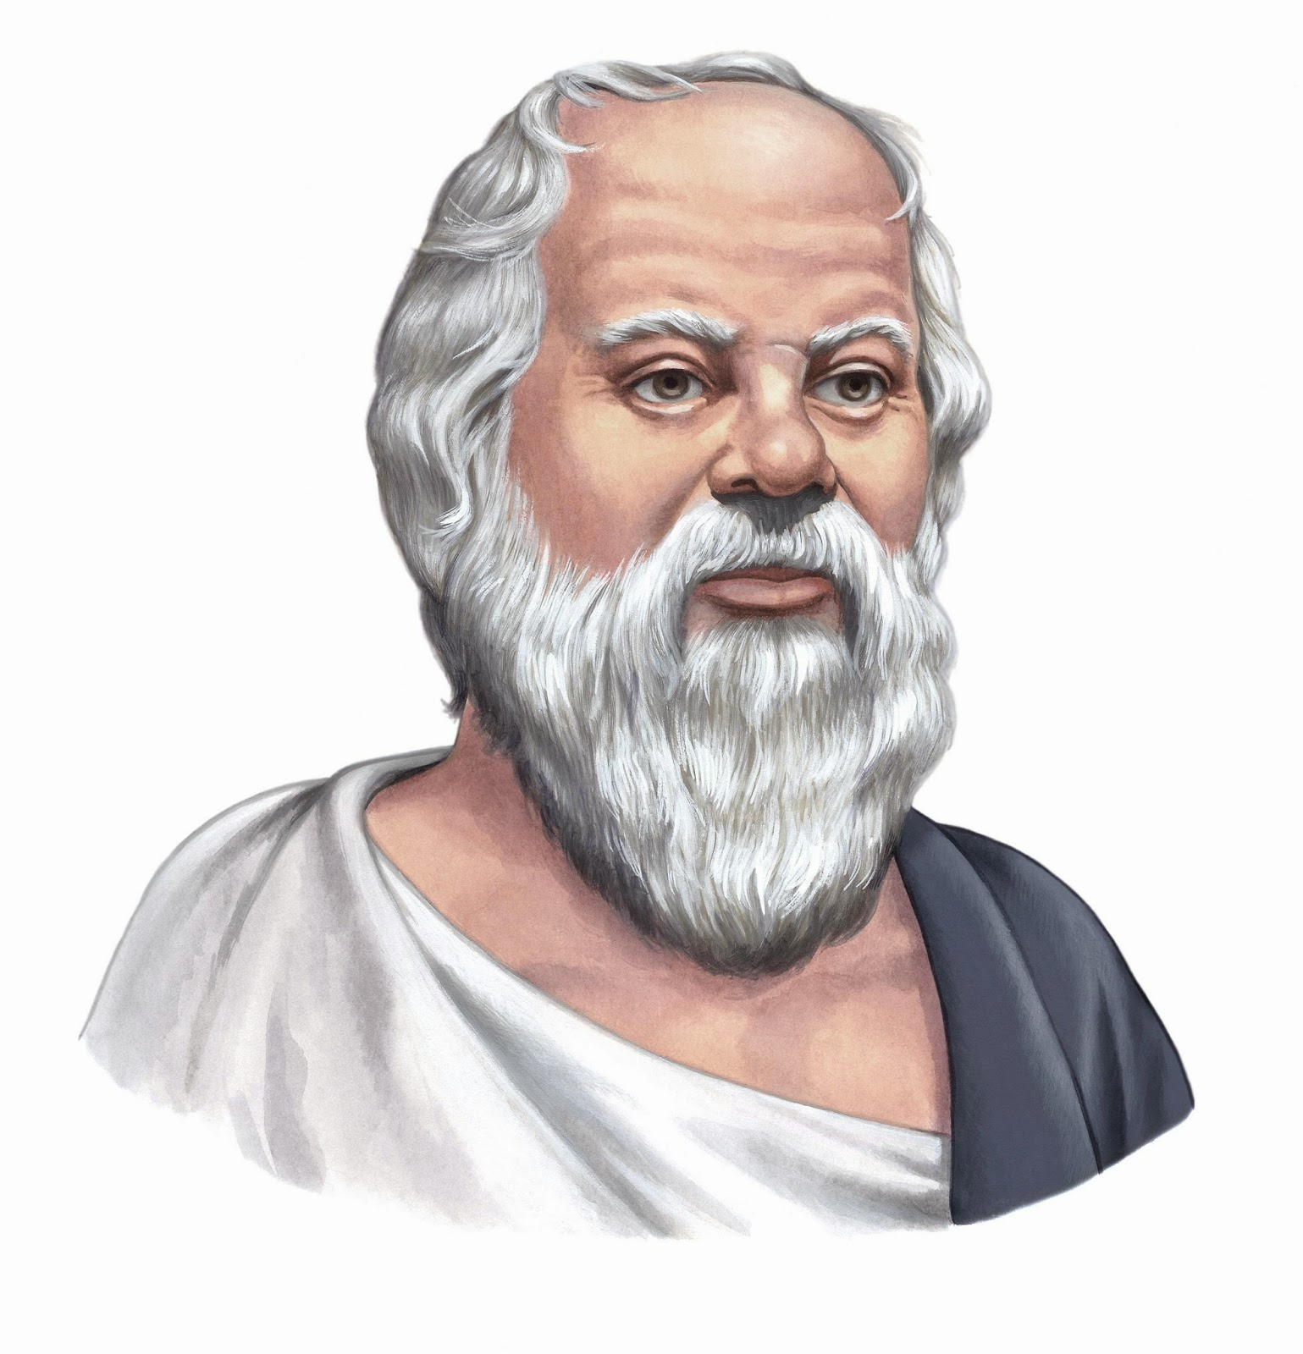
Socratic Seminar: Preparation
Come prepared to answer the question “What is a siren?”
Have your text and video support ready.
Write 1-2 questions of your own that will help you or your classmates understand what a siren is.
Notes:
Kedumuc10. (2016, June 5). Socrates-Tiếng Việt. [Image]. Wikimedia. https://commons.wikimedia.org/wiki/File:Socrates-tranh-ve.jpg

Slide 13

So...Is the Siren a Bird or a Fish?
Notes:
Source: Komoda, K. (2012, June 26). 1998—Harpies. [Drawing]. Flickr. https://www.flickr.com/photos/39573281@N06/9848944926r
Licensed under CC- BY-NC-NC 2.0
Source: Wikimedia Commons. (2015). Sirens in medieval art. [Image]. Wikimedia. https://commons.wikimedia.org/w/index.php?search=sirens+bestiary&title=Special%3ASearch&profile=default&fulltext=1&ns0=1&ns6=1&ns12=1&ns14=1&ns100=1&ns106=1#/media/File:Siren_3244.jpg

Slide 14
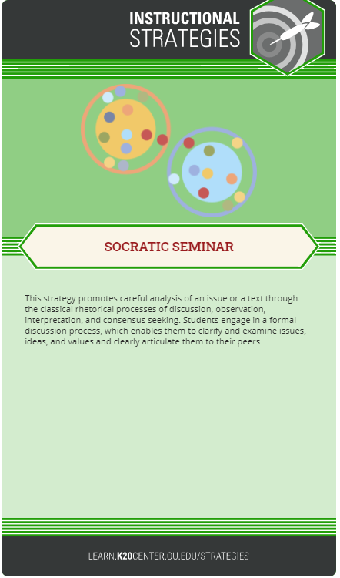
Socratic Seminar: Round 1
Divide into two groups:
  Group 1: Inner Circle
  Group 2: Outer Circle
Round 1:
  Inner Circle discusses issues outlined in the handout. (15-30 minutes)
  Outer Circle silently observes dialogue and records observations.
Note: This exercise is NOT a debate. There is no “winner” or “loser” in the discussions.
Notes:
Source: https://learn.k20center.ou.edu/strategy/781

Slide 15
Socratic Seminar: Round 2
Change roles.
  Inner Circle discusses issues outlined in the handout. (15-30 minutes)
  Outer Circle observes dialogue and records observations.
Reminder: This exercise is NOT a debate. There is no “winner” or “loser” in the discussions.
Notes:
https://learn.k20center.ou.edu/strategy/86

Slide 16

The Roles of the Inner and Outer Circles
Inner Circle
Outer Circle
Answers questions posed by teacher and classmates.
Contributes to ongoing discussion.
Quietly observes the inner circle.
Takes notes of the discussion.

Slide 17
…But Now I Know
What is a Siren?
In the “But Now I Know” column, sketch your final impression of a siren.
Did your opinion change or stay the same?
How were you influenced by the “Sirens” excerpt from “The Odyssey?
Notes:
Source: https://learn.k20center.ou.edu/strategy/137:

