Slide 2
Emission Spectra of Excited Gases
Light Emission Energetics and Spectra

Slide 3
Essential Question
How do excited gas atoms emit specific colors of light?
How can these specific colors be used to explore the composition of planetary atmospheres?

Slide 4
Lesson Objectives
Observe the different colors in emission spectra for different excited gases and compare the specific emitted wavelengths.
Explain how these specific emitted wavelengths are the result of energetic and physical transitions by electrons in excited atoms.
Apply emission spectra experience to predict and compare the spectra of atmospheres for solar system planets.

Slide 5


Neon Lights and Gases that Support Life
Look at the pictures and identify the “neon color(s).” Why is the word “neon” used to describe color?
A planet’s atmosphere is analyzed to determine if it could support life. What gases help support life?
Notes:
Image Source:
[pikisuperstar]. (n.d.). Neon alphabet [Image]. Freepik. https://www.freepik.com/free-vector/neon-alphabet_4171931.htm#page=1&query=neon%20alphabet&position=0
[katemangostar]. (n.d.). Multicolored firework brick background neon style [Image]. Freepik. https://www.freepik.com/free-vector/multicolored-firework-brick-background-neon-style_2553671.htm#page=1&query=multicolored%20firework%20brick&position=0

Slide 6

Materials and Safety
Describe or draw the spectra made by observing white and neon light with spectroscopes.
You will be using tools for electrifying gases in glass tubes. What are the safety concerns?
Notes:
Image Source: NASA Space Telescope Science Institute. (2019, June 6). Spectra showing different elements. Hubblesite. https://hubblesite.org/image/4511/category/115-spectra

Slide 7
Step 1: Practice Using the Spectroscope
Practice using the spectroscope by looking at sunlight (but don’t look directly at the sun!) and/or an overhead light. The spectroscope will turn the light into a rainbow spectrum.
Point the spectroscope slit at the light source and then, without moving the spectroscope, move your eye to the side to view the spectrum.
Get help if you can’t see the rainbows.

Slide 8
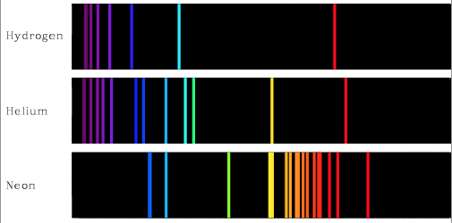
What Spectroscopes Show = Spectra
Notes:
Image Source: Noschese 180. (2014). Emission spectra. A picture-a-day for the school year. https://noschese180.files.wordpress.com/2014/12/ emission_spec.png

Slide 9
Step 2:
Look at the light emitted by gases in glass tubes. In the provided data table, record your observations under the following conditions:
Record the color of the gases when the electricity is off.
Describe the color you see without the spectroscope when electricity has been applied to the samples.
Use the spectroscope to observe lines of color emitted by the electrified gases. Use colored pens/pencils/markers to draw the spectrum and (if possible, with the spectroscope and as directed) record the wavelengths of the color lines in the spectra.

Slide 10
Step 3: Groups
When you are finished observing the tubes, form peer groups to compare data.
Help classmates who may have been rushed or missed a sample to complete their data set.

Slide 11
Give Your Table a Good Title!
Add a good scientific title to your data table.
Share your title with others.
In science, most titles:
Are descriptive (detailed and a little longer than you might expect).
Summarize a key result.
(What did you learn?)

Slide 12
Explain
On your Lesson Guide handout answer questions 1-10 under the Explain section.
Take chances and make hypotheses using your own words.

Slide 13
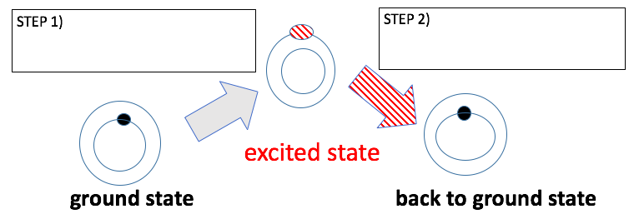
How Do Atoms Make Light?
What makes ground different from excited?
What is electricity’s role? When do we make light?
What should we call each step?

Slide 14
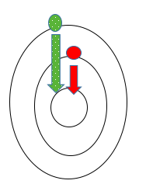

How are Different Colors Made?
Electrons in a Bohr Model
Different color = Different energy
High energy 🡪 Low energy
Notes:
Image Source: University of Texas. (n.d.). Line spectra in hydrogen. Chemistry 301 https://ch301.cm.utexas.edu/atomic/index.php#H-atom/linespectra.htm

Slide 15

Notes:
Video Source: NPR's Skunk Bear. (2017, July 3). The science of firework color [Video]. https://www.youtube.com/watch?v=dW5OBrB4MRM

Slide 16
Spectra Are Used to Study Planet Atmospheres
What would the spectra of these atmospheres look like?
Planet | Venus | Earth | Mars
Surface Pressure (relative to Earth) | 90 | 1 | 0.007
Carbon Dioxide (CO₂) | 96.5% | 0.03% | 95%
Nitrogen (N₂) | 3.5 % | 78% | 2.7%
Oxygen (O₂) | Trace | 21% | 0.13%
Argon (Ar) | 0.07% | 0.9% | 1.5%

Slide 17
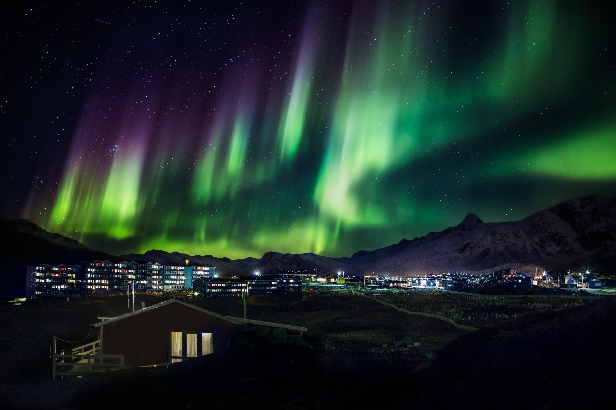
Learn About the Northern Lights
Which gases are excited to form these beautiful colors?
How do they get excited?
Notes:
Image Source: Pihl, M. (2013, October 2). Northern lights in Greenland. Wikimedia Commons. https://commons.wikimedia.org/wiki/File:Northern_lights_in_Greenland_(14990374447).jpg

Slide 18
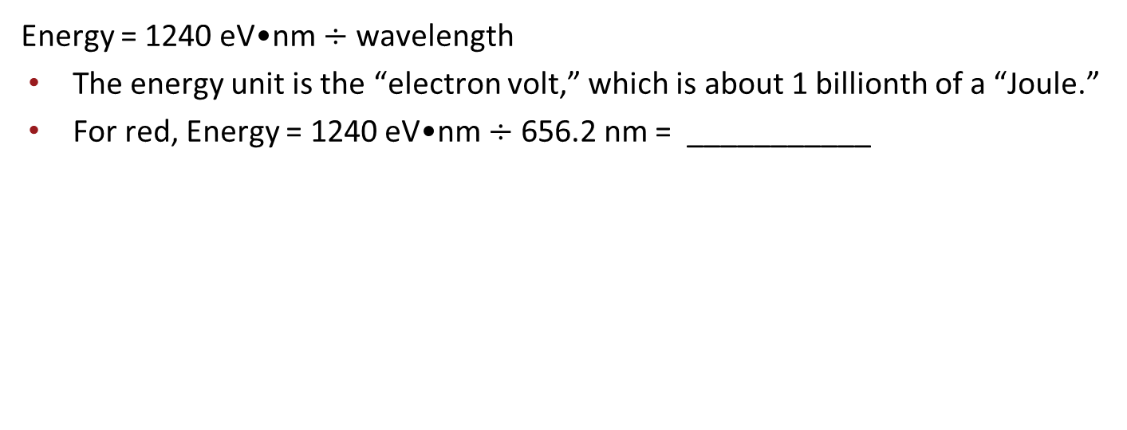
Calculating the Energy of a Photon of Light
Color of Hydrogen Emission Line | Wavelength (nm) | Energy (eV)
Red | 656.2
Blue-Green | 486.1
Blue-Violet | 434.0
Violet | 410.1

Slide 19
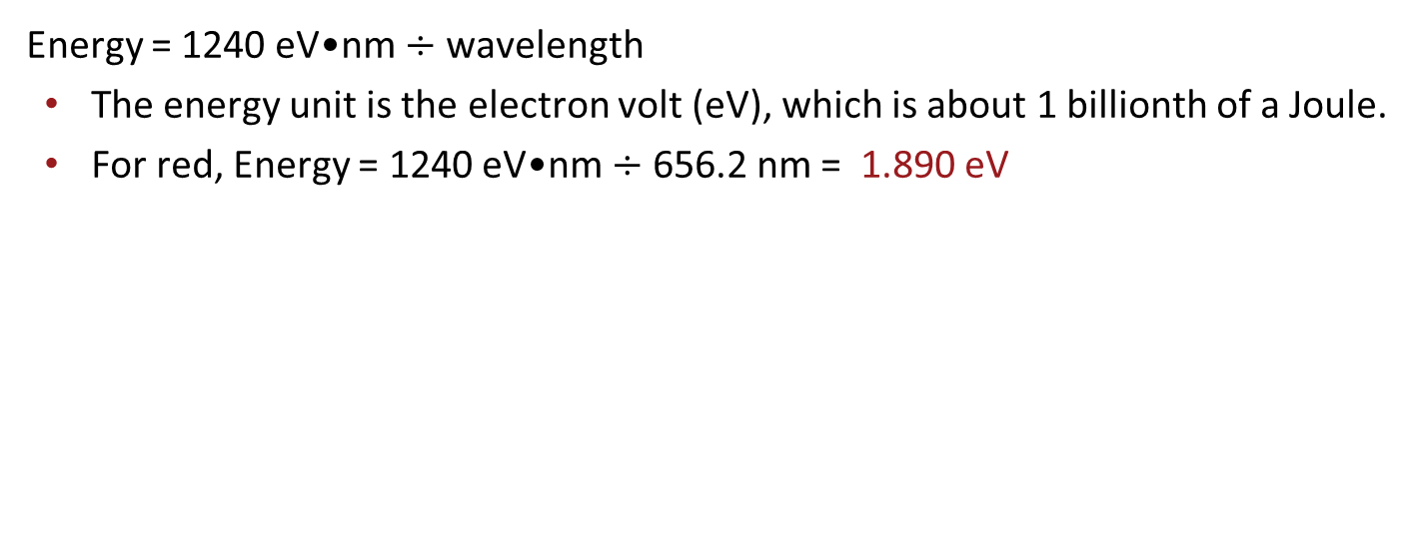
The Energy of a Photon of Light Depends on Color
Color of Hydrogen Emission Line | Wavelength (nm) | Energy (eV)
Red | 656.2 | 1.890
Blue-Green | 486.1 | 2.551
Blue-Violet | 434.0 | 2.857
Violet | 410.1 | 3.024

Slide 20

Three Stray, One Stays
Discuss your assigned Extend question within your group.
Choose one group member to “stay” and explain the answer to other students.
Other group members “stray,” each going to a different question group and taking notes about what is shared.
Return to your original groups to share what you’ve learned and prepare to share with the class.
Notes:
K20 Center. (n.d.). Three stray, one stays. Strategies. https://learn.k20center.ou.edu/strategy/85

Slide 21
Design a Gas Tube Sign for the School
Plan: What can and will your sign display?
Apply: What types of gas are you going to use?
Be Clear: Label your drawing to show the types of gas you chose.

