Slide 2
Authenticity and the Marzano Framework of TLE

Slide 3
Fold the Line
1
10
How much do you know about Marzano and Teacher Leader Effectiveness?
Using a sticky note, rank yourself on your level of knowledge about the Marzano Protocol.
1 – The Marzano what?
5 – I helped Marzano write the book on classroom strategies.
Notes:
Engage participants by using the instructional strategy fold the line. Grouping strategy for card sort.
The numbers can be changed to fit how many participants you have and how well versed they are in Marzano and TLE. You could change the number to 10 if you felt it would better represent your participants.

Slide 4
Session Objectives
We will be able to identify:
Ways in which authenticity can help us meet the Teacher Leader Effectiveness (TLE) requirements.
Specific classroom strategies that fit the authenticity and Marzano frameworks.
Specific connections between the authenticity framework and the content elements of Marzano’s Classroom Strategies and Behaviors.

Slide 5
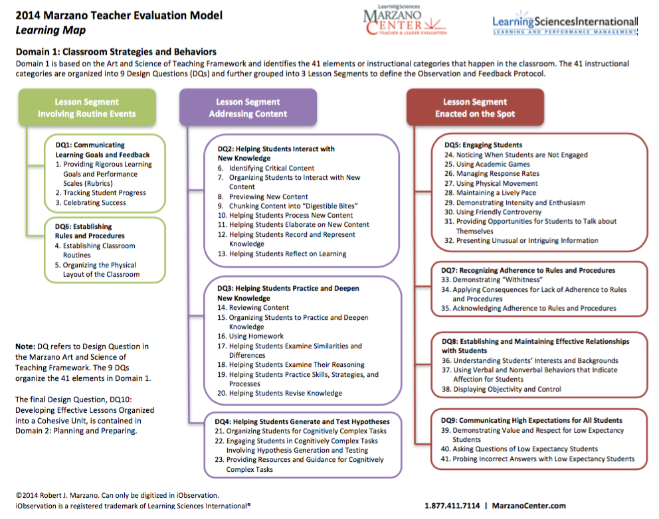
Marzano Art and Science of Teaching

Slide 6
Classroom Strategies and Behaviors
Elements Involving Routine Events
Elements Addressing Content
Elements Enacted on the Spot
DQ-1
What will I do to establish and communicate learning goals, track student progress, and celebrate success?
DQ-2
What will I do to help students effectively interact with new knowledge?
DQ-5
What will I do to engage students?
DQ-7
What will I do to recognize and acknowledge adherence and lack of adherence to classroom rules and procedures?
DQ-3
What will I do to help students practice and deepen their understanding of new knowledge?
DQ-6
What will I do to establish or maintain classroom rules and procedures?
DQ-8
What will I do to establish and maintain effective relationships with students?
DQ-4
What will I do to help students generate and test hypotheses about new knowledge?
DQ-9
What will I do to communicate high expectations for all students?
Notes:
Big ideas of slide before. They have a copy of those on their tables. We are going to look at 2,3,4 design questions – dq

Slide 7
Making Connections
Construction of Knowledge
(Higher order thinking)
DQ-2
What will I do to help students effectively interact with new knowledge?
Disciplined Inquiry
(Meaningful questions)
(Substantive conversation)
DQ-3
What will I do to help students practice and deepen their understanding of new knowledge?
Authenticity
Marzano
Value Beyond School
(Real world, personal connections)
DQ-4
What will I do to help students generate and test hypotheses about new knowledge?
Student-Centered Learning
(Student Autonomy)
(Active Learning)
Notes:
We are going to look at 2,3,4 because that is where instruction, authenticity and and learning happens. They have the most connections here. This is just to preface what connections we will be making.
We think… but highlight... Not read

Slide 8
Marzano Elements Card Sort
Pair an authenticity principle with a Marzano element.
Share which Marzano element(s) you chose to put with the authenticity principle.
Explain why you think they go together.
Why doesn’t everybody’s chart look the same?
Notes:
Explore card sort with Marzano Card Sort Mat.
Explain after sorting is complete. One group will share the first group of authenticity and the other groups will listen for similarities and differences. Then other groups share out the differences they had.
The next group will share out the second component of auth. And continue on with the same process until all components have been shared.
ONLY SHARE OUT THE NUMBERS not everything read out.

Slide 9
Teaching and Learning Strategies
Pull a Marzano element from the “hat.”
Brainstorm some authentic strategies you might use to address that element.
Notes:
Extend: Use one set from the card sort to complete the hat activity.
Stack the deck and make sure you can easily connect to authenticity.
Pass out the “Brief Definitions of Some Instructional Strategies” sheet after 20 to 30 seconds of struggle and the “Authenticity and Marzano’s Content Feedback Protocol” sheet if needed to scaffold more support for participants.

Slide 10
What is one element of Marzano that you feel more equipped to address authentically in your classroom?
Notes:
Evaluate: Presenter will use the Give Me Five Strategy. Presenter will get five volunteers to present or share out their answers.

Slide 11
Final thoughts and questions?

Slide 12
Resources
Card Sort instructional strategy. K20 Center. (n.d.). Card sort instructional strategies. Retrieved from https://learn.k20center.ou.edu/strategy/d9908066f654727934df7bf4f506976b
Fold the Line instructional strategy. K20 Center. (n.d.). Fold the line instructional strategies. Retrieved from https://learn.k20center.ou.edu/strategy/d9908066f654727934df7bf4f5079658
Give Me Five instructional strategy. K20 Center. (n.d.). Give me five. Instructional Strategies. Retrieved from https://learn.k20center.ou.edu/strategy/d9908066f654727934df7bf4f506b3f9
Marzano, R. (2013). Art and science of teaching/ask yourself: Are students engaged. ASCD: Technology-Rich Learning.
Marzano, R. (2014). Teacher evaluation model. Learning Map. Retrieved from http://www.marzanocenter.com/

