Slide 1
Authenticity and Chromebooks
Digital Literacy

Slide 2
GEAR UP for the FUTURE Goals
Increase cohort academic performance and preparation for postsecondary education (PSE).
Increase high school graduation and PSE participation.
Increase student educational expectations and increase student and family knowledge of PSE options, preparation, and financing.
Notes:
(5 min) Goals and objectives
Replace the goals on this slide with the goals for the participating schools’ specific GEAR UP grant.

Slide 3
Session Objectives
Explore various Google Workspace applications using a Chromebook.
Experience and analyze an authentic activity that integrates technology.
Identify how Google Workspace and similar tools can enhance or support components of authentic teaching.
Reflect upon how you can authentically apply Google Workspace applications in your classroom.

Slide 5
How Much Do You Know About Google Workspace?
Take a look at the statements on the handout.
Give yourself 1 point for each task that you can do. If you don’t know how to do the task, then don’t award a point.
At the bottom of the handout, add your points to find the total.
Maximum = 5
Minimum = 0
Notes:
Give participants a few minutes to review the handout and calculate their individual point totals.

Slide 6
Give Me Five!
Use your point total from the handout to find someone whose number combined with yours equals 5.
Example: You scored 5 points; find a partner who scored 0.
Example: You scored 2 points; find a partner who scored 3.
Get your partner and find a seat.
Notes:
Depending on the size of the group and participants’ overall familiarity with Google Workspace, you might need to instead have participants form groups of three.

Slide 8
Task Cards
Each card is associated with a different aspect of Google Workspace.
With your partner, work through the tasks on the cards.
Use the Note Catcher handout to jot down any helpful or pertinent information for your personal use.
Notes:
Working with the task cards should take no more than an hour.

Slide 9
Docs
Select New > Google Docs and enter a title.
Share the document with everyone in your group. Hint: To find a shared document, go to Drive > Shared with me.
Insert a table with information about animal traits (e.g., fur, feathers, and scales).
Have group members edit the table at the same time.
Add bullets or numbers.
Insert an image with a link to a webpage.
View revision history.
Make a comment.
From your own document, select Add-ons > Get Add-ons. Search for and install the Highlight Tool.
Explore how to use the Highlight Tool.

Slide 10
Slides
Select New > Slides and enter a title.
Create five slides about how to use Google Workspace in your classrooms.
Share the slide show with your group.
Hint: To find a shared document, go to Drive > Shared with me.
Edit a slide simultaneously with another group member.
Insert an image, video, and link (and make sure to cite the source).
Use an animation and a transition.

Slide 11
Sheets
Go to https://tinyurl.com/yy5ff6hu.
Make a copy of the “Campus Visit” Google Sheet.
Sort the information by teacher.
Fill one of the columns with a color.
Select Column E and create a graph.
Copy all the students of a particular teacher, add them to a second sheet in the same workbook file, and rename the sheet
Find the students’ average age.
Hint: Try using this data to follow the procedure on the Explore task card.
Notes:
SUM and Product tutorial: https://www.youtube.com/watch?v=pJsEyK5Ay_E

Slide 12
Drawings
Select New > More > Google Drawings.
Create a flowchart for a subject of your choice (for example, an organizational hierarchy or a progression of life events).
Give your drawing a title.
Include lines, shapes, text, and images.
Insert a link to a shape or text.
Share the drawing with group members to comment only.
Hint: To find a shared document, go to Drive > Shared with me.
Check out the graphic organizers here: https://www.controlaltachieve.com/2017/05/graphic-org-drawings.html. Make a copy of one and save it to your Drive.

Slide 13
Forms
Select New > More > Google Forms. Enter a title for your form.
Add five questions of your choice using at least three different question types.
Preview the form.
Share the form and have group members submit responses.
View a summary of responses.
View individual responses.

Slide 14
Explore
Open a new Google Doc and title it “World History Notes.”
Using a bulleted list, note anything that you know about Julius Caesar.
Click the Explore button in the bottom right corner of the window.
Use the Web tab to find more information about Julius Caesar.
Use the Images tab to drag and drop an image into your notes.
Use the Drive tab to search for any other notes that you might have.
Try out the Explore button in other Google apps! Try it with the Sheets task card data.

Slide 15
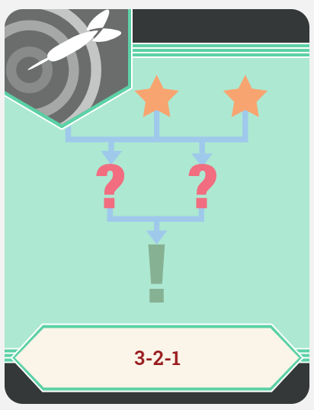
3-2-1
On a sticky note, write down:
3 things you learned about the Google Workspace tools.
2 questions you have.
1 thing you found interesting.
Notes:
Create a Parking Lot here, and then pull off some of the questions and discuss the answers.

Slide 16
Notes:
A mini-lesson is embedded within the Explain portion of this PD session.

Slide 17
Social Media: Can It Be a Positive Influence on Teens?
Mini-Lesson
Notes:
This is a mini-lesson with Google Workspace used in an authentic way.

Slide 18
Essential Questions
What do we mean by social media?
How do we encourage responsible use of social media?
How can social media affect students’ college and career readiness?

Slide 19
Standards
OAS Standards
AASL Standards
7.1.W.1 - Students will give formal and informal presentations in a group or individually, providing evidence to support a main idea.
7.1.R.3 - Students will engage in collaborative discussions about appropriate topics and texts, expressing their own ideas clearly while building on the ideas of others in pairs, diverse groups, and whole class settings.
Information Literacy: All subjects
Engaging learners in ongoing analysis of and reflection on the quality, usefulness, and accuracy of curated resources

Slide 20
Technology Standards
ISTE
Digital Literacy
Computational Thinker
Students collect data or identify relevant data sets, use digital tools to analyze them.
To be literate, competent citizens, students must understand how…
the Internet works.
to access web resources.
to evaluate web resources.
to behave in a responsible manner in the online community.

Slide 21
Card Sort
Access the digital Card Sort: https://tinyurl.com/socialmediacardsort
Match the social media icon to its correct name and description.
Are there any that you don’t know?
Notes:
Demonstrate the Google Draw Card Sort to model the directions.

Slide 22
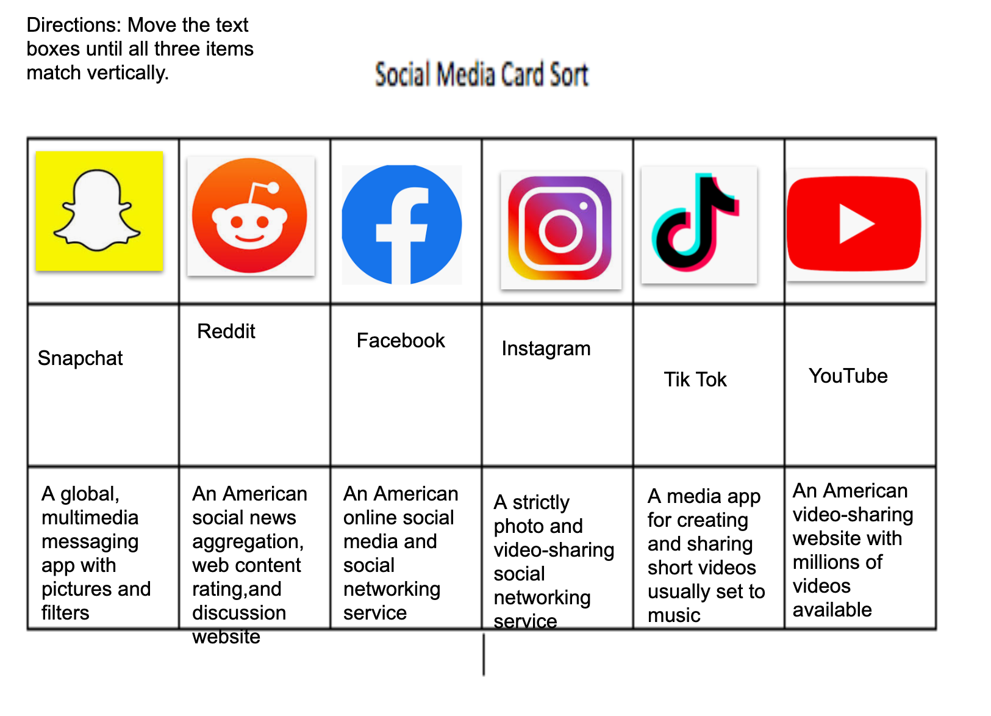
Card Sort Remix
How did you do on the Card Sort?
What do all of these types of social media have in common?

Slide 23
Collaborative Definition
Develop a definition for social media.
Elect one person in your group to add your definition to this Google Doc:
https://tinyurl.com/y5y396bm
Notes:
Pull up the Google Doc and model directions for participants.

Slide 24
I Notice, I Wonder
I Notice…
What do you notice about teens and social media as you watch the video? What stands out to you?
I Wonder…
What are you wondering about after watching the video?

Slide 25
I Notice, I Wonder
Notes:
Video Source: LivingFacts. (2019, May 10). How teens use social media [Video]. YouTube. https://www.youtube.com/watch?v=3KrioGgW44Q

Slide 26
Four Corners
Take a moment to contemplate this statement:
Social media is a positive influence on teens.
Move to the sign that best corresponds with how you feel about the statement.
Once you are in your groups, discuss why you came to that corner.
Elect a spokesperson. Share with the whole group.
Notes:
These groups can stay as is, or they can be further divided, depending on group number.

Slide 27
Collaboration & Presentation
In your groups, create a PSA presentation titled,
“How Teens Can Use Social Media Responsibly.”
For the presentation, you will:
Use at least one item from the Presentation Resources Google Doc for your evidence (http://k20.ou.edu/socialmedia-and-teens).
Include at least one Google Workspace application of your choice.

Slide 28
Gallery Walk
Elect a “docent” from your group to stay and explain your presentation to visiting groups.
Rotate clockwise through the presentations with your other group members. Leave a sticky note with your feedback.
When you return to your own presentation, discuss the feedback you received.
Notes:
Provide each group with a unique color of sticky notes.

Slide 29
Four Corners: Revisited
Now that you have created and viewed presentations related to teens’ use of social media, consider this statement again:
Social media is a positive influence on teens.
Have your thoughts changed?
Notes:
This piece could be the summative assessment.
Mention that in the classroom, students could go back and write a short essay based upon a prompt such as: “Under what conditions could Social Media…”

Slide 31
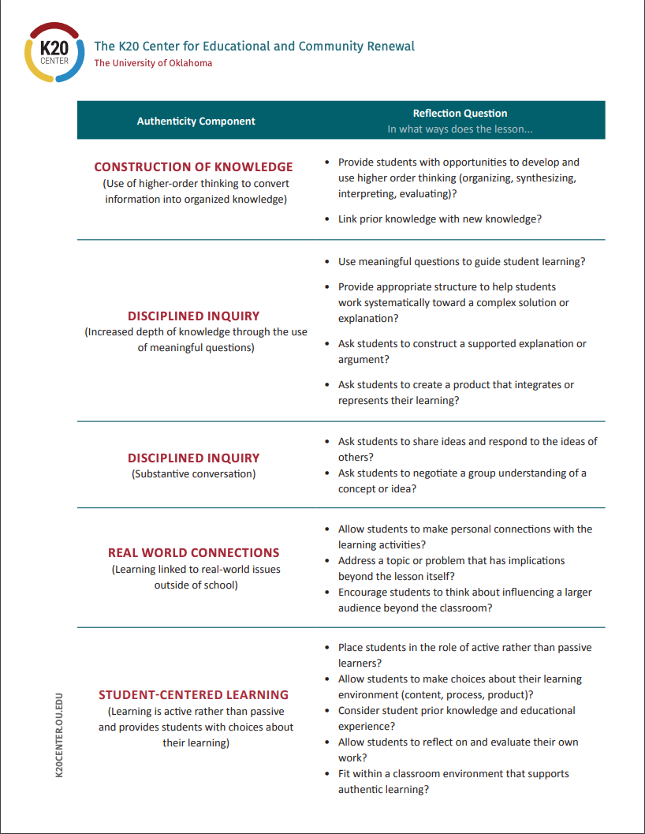
Authentic Lesson Reflection Tool
Notes:
Participants will be reflecting only on the social media mini-lesson, NOT on the entire PD.
Break this activity down into a jigsaw, assigning each group one section of the reflection tool.

Slide 32
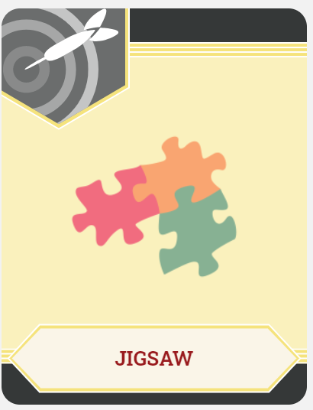
Authentic Reflection Jigsaw
With your group:
Discuss the authenticity element that you were assigned. Did the lesson demonstrate this component? If so, where?
How could this lesson be modified to make it even more authentic?
Could this lesson have been completed without the use of technology? How did technology contribute to this lesson?
Notes:
The groups are looking at these questions through the lens of their assigned authenticity component as a Jigsaw.

Slide 34
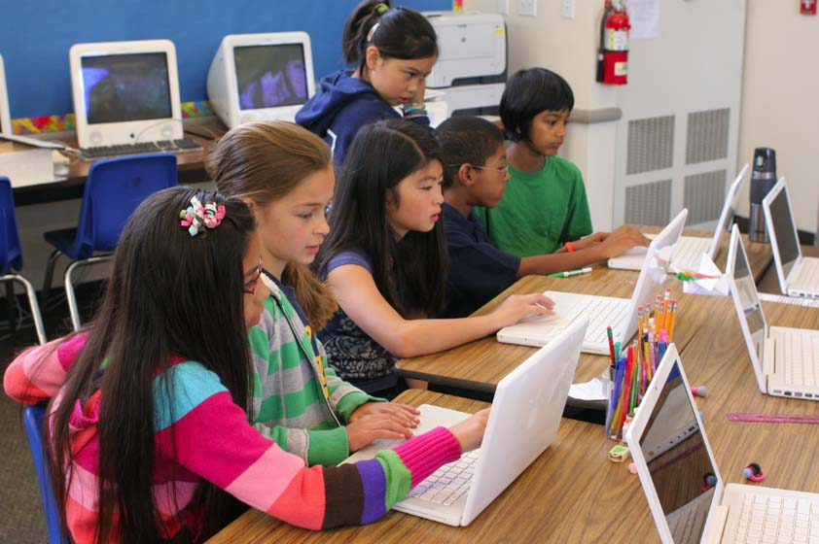
How Can I Incorporate This in My Class?
Think about a lesson that you will be completing with your students soon.
Brainstorm one way you can embed or incorporate Google Workspace and/or content from today’s session.
Share your thoughts with a new Elbow Partner.
This Photo by Unknown Author is licensed under CC BY-SA-NC

Slide 35
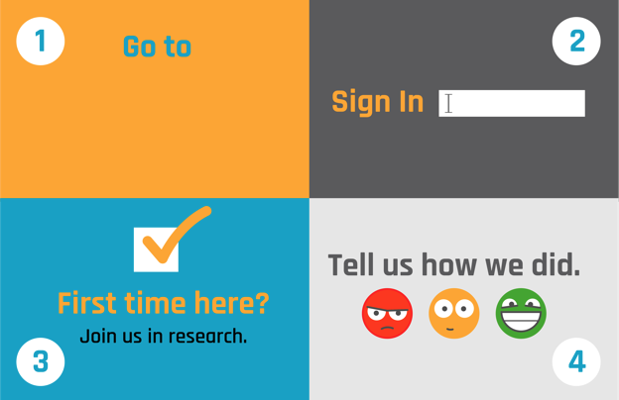
Rapid Feedback Form
Notes:
Insert the URL for the Rapid Feedback form in box 1.

