Slide 2
Fostering a Classroom Community in a Virtual Platform
Developing a Community of Inquiry

Slide 3
GEAR Up for the FUTURE Goals
Increase cohort academic performance and preparation for postsecondary education (PSE).
Increase high school graduation and PSE participation.
Increase student educational expectations and increase student and family knowledge of PSE options, preparation, and financing.

Slide 4
GEAR UP OKC Goals
Increase students’ engagement in learning.
Increase students’ academic preparation for PSE upon graduation.
Increase schools’ high school graduation and PSE enrollment rates.
Increase students’ and their families’ knowledge of PSE options, preparation, and financing.

Slide 5
GEAR UP for MY SUCCESS Goals
Increase cohort academic performance and preparation for PSE.
Increase high school graduation and PSE participation.
Increase student educational expectations and increase student and family knowledge of PSE options, preparation, and financing.

Slide 6
Icebreaker
Directions:
Name yourself using the format First Name, District.
  Example: Stephanie, Norman PS
Choose an animal that best represents you as an educator.
  Enter this in the chat and explain your choice.
Notes:
Insert QR Code and TinyURL on this slide. Put URL into CHAT for participants.

Slide 7

How am I Feeling? What am I Thinking?
Are you currently teaching or working in a virtual or blended environment?
Notes:
K20 Center. (n.d.). How am I feeling? What am I thinking? Strategies. https://learn.k20center.ou.edu/strategy/187
NOTE TO PRODUCER: Drop the Padlet information in the CHAT for participants.

Slide 8
Essential Question
How do you develop a Community of Inquiry (CoI) in a virtual classroom?

Slide 9
Learning Objectives
By the end of this session, you will:
Explore research regarding the importance of building community as it pertains to learning.
Analyze interactive strategies to determine their potential effectiveness in addressing challenges to building a classroom community in a virtual environment.

Slide 10
Three Presences that Make Up a Community of Inquiry
Cognitive Presence
Teaching Presence
Social Presence

Slide 11

Honeycomb Harvest
Read the statement and decide which presence is represented:
Cognitive Presence
Teaching Presence
Social Presence
Notes:
K20 Center. (n.d.). Honeycomb Harvest. Strategies. https://learn.k20center.ou.edu/strategy/61

Slide 12
Honeycomb Harvest
Participants are kept on task and engaged in productive dialogue.
Cognitive Presence
Teaching Presence
Social Presence

Slide 13
Honeycomb Harvest
I feel comfortable disagreeing with course participants while still maintaining a sense of trust.
Cognitive Presence
Teaching Presence
Social Presence

Slide 14
Honeycomb Harvest
It is clear how to participate in learning activities. Timeframes and due dates are communicated.
Cognitive Presence
Teaching Presence
Social Presence

Slide 15
Honeycomb Harvest
Combining new information helps me answer questions raised in course activities.
Cognitive Presence
Teaching Presence
Social Presence

Slide 16
Honeycomb Harvest
I feel like my point of view is acknowledged by other course participants.
Cognitive Presence
Teaching Presence
Social Presence

Slide 17
Honeycomb Harvest
I feel encouraged to explore new concepts.
Cognitive Presence
Teaching Presence
Social Presence

Slide 18
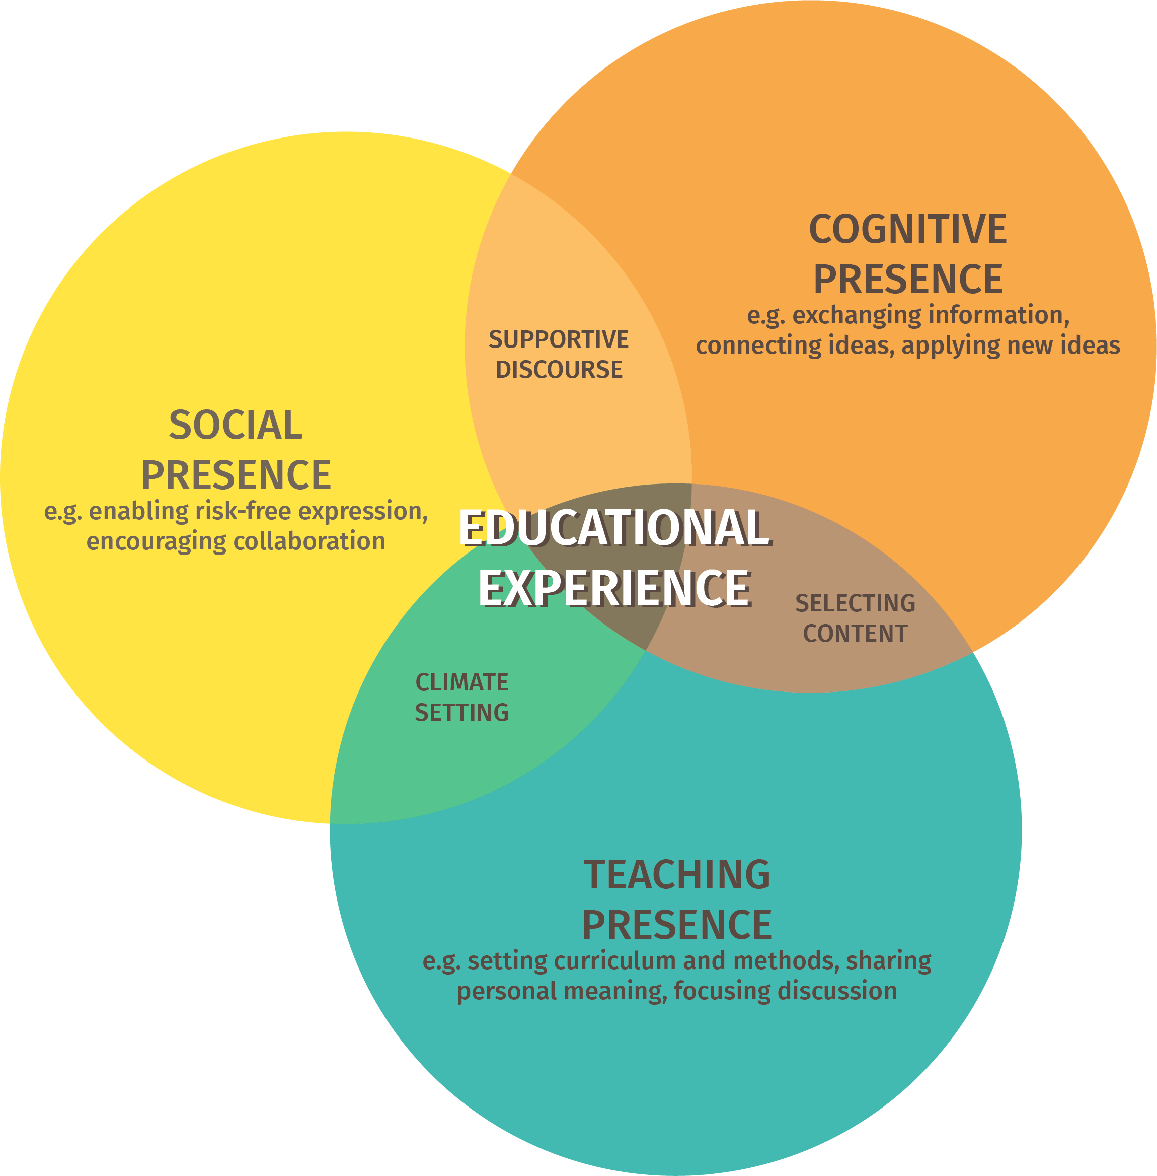
Community of Inquiry
The experience of living alongside students in a classroom.
The concept of developing a community of learners.
The idea that interaction alone does not develop engaged students.

Slide 19
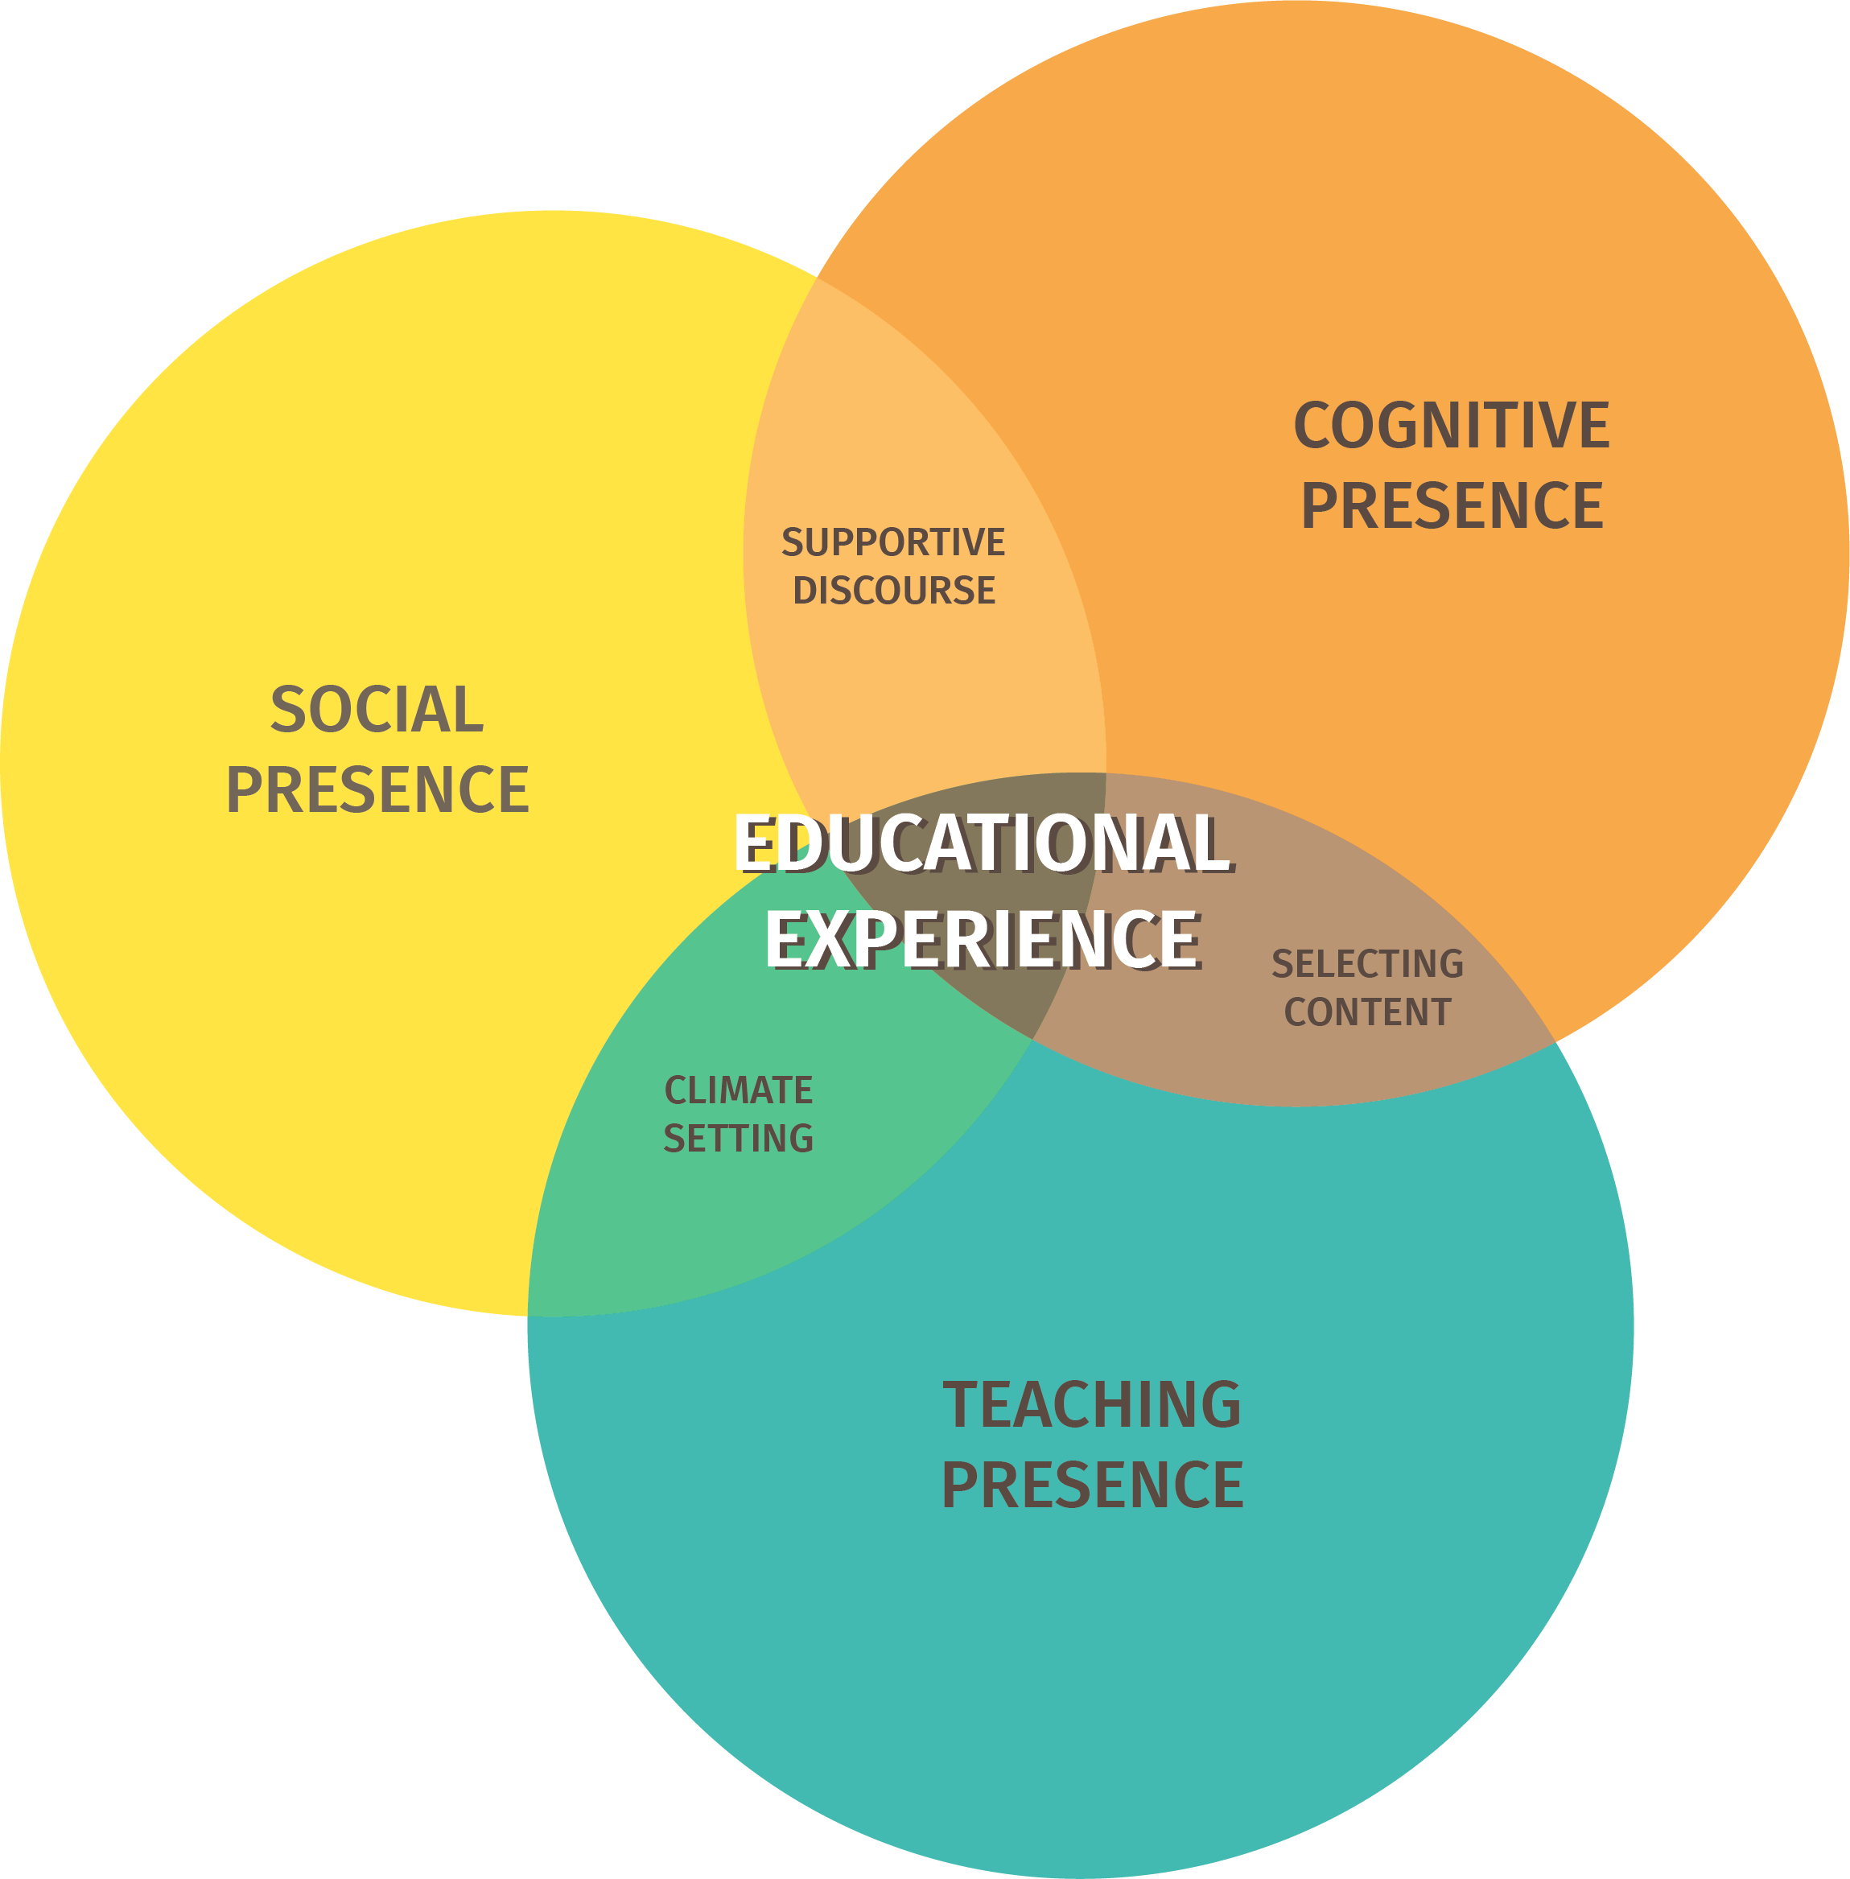
Community of Inquiry
The extent to which learners
are able to construct and
confirm meaning through sustained reflection and discourse.
The ability of participants to identify with the community (i.e. course of study), communicate purposefully in a trusting environment, and develop interpersonal relationships by way of projecting their individual personalities.
The design, facilitation, and direction of cognitive and social processes for the purpose of realizing personally meaningful and educationally worthwhile learning outcomes.

Slide 20
Social Presence
The ability of participants to identify with the group or course of study, communicate purposefully in a trusting environment, and develop personal affective relationships progressively by way of projecting their individual personalities.
~ D. Randy Garrison

Slide 21

Social Presence
Affective
  Expressing emotion, humor, emojis (with textual discourse).
Cohesive
  Learners provide additional readings, resources to help other students or the whole class.
Interactive
  Refers to other learners-complements or disagrees with other learners, disagrees with other learners, asks questions of other learners and/or the teacher.

Slide 22
Honeycomb Harvest
Read the statement and decide which presence is represented:
Cognitive Presence
Teaching Presence
Social Presence

Slide 23
Honeycomb Harvest
Participants are kept on task and engaged in productive dialogue.
Cognitive Presence
Teaching Presence
Social Presence

Slide 24
Honeycomb Harvest
I feel comfortable disagreeing with course participants while still maintaining a sense of trust.
Cognitive Presence
Teaching Presence
Social Presence

Slide 25
Honeycomb Harvest
It is clear how to participate in learning activities. Timeframes and due dates are communicated.
Cognitive Presence
Teaching Presence
Social Presence

Slide 26
Honeycomb Harvest
Combining new information helps me answer questions raised in course activities.
Cognitive Presence
Teaching Presence
Social Presence

Slide 27
Honeycomb Harvest
I feel like my point of view is acknowledged by other course participants.
Cognitive Presence
Teaching Presence
Social Presence

Slide 28
Honeycomb Harvest
I feel encouraged to explore new concepts.
Cognitive Presence
Teaching Presence
Social Presence

Slide 29



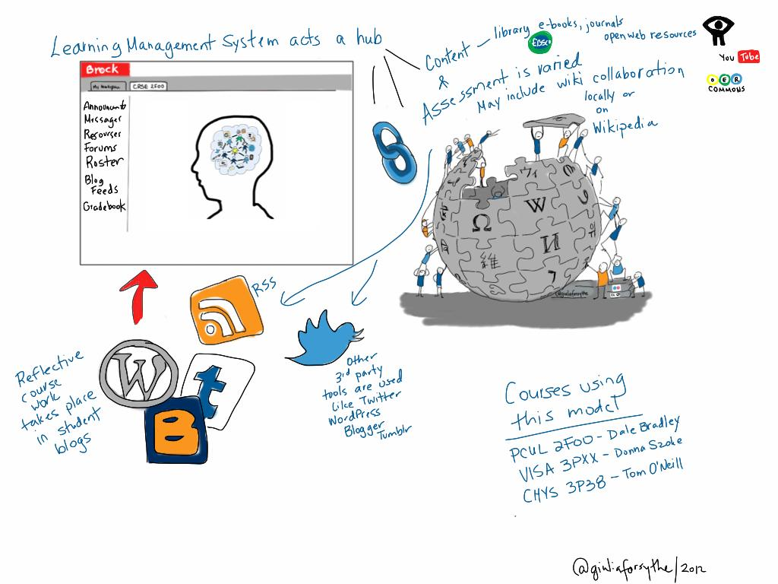
Modified Four Corners
1
2
Choose one image out of the four that best represents Social Presence.
3
4
Notes:
PRODUCER: Zoom poll needed here.

Slide 30

What are some barriers that you face with regard to Social Presence while establishing a Community of Inquiry?
Notes:
K20 Center. (n.d.). T-Chart. Strategies. https://learn.k20center.ou.edu/strategy/86
Link to T-Chart:

Slide 31
What are some strategies and solutions that could help with the barriers you are facing?

Slide 32
Questions & Answers

Slide 33
How does Social Presence in a virtual platform contribute to fostering a classroom community?
Notes:
PRODUCER: Drop the link/QR Code into CHAT for evaluation.

