Slide 2
Questioning Strategies to Support Young Learners

Slide 3
Would you let Goldilocks into your house?
Yes
No

Slide 4
Essential Question
How can we use questioning techniques to create an environment for differentiated learning?

Slide 5
Learning Objectives
We will examine and revise questioning techniques to create an environment for differentiated learning.
We will implement questioning strategies that help students ask more thought provoking questions.

Slide 6
What makes a question effective?

Slide 7
What Are Effective Questions?
Effective questions require more than just remembering a fact or reproducing a skill.
Students can learn by answering the questions, and teachers learn about students from their answers.
There may be several acceptable answers.
They stimulate reasoning and encourage students to think beyond literal answers.

Slide 8
All Questions Are Not the Same
Open and Closed Questions
Parallel Questions
Probing Questions
One of the most effective ways to differentiate instruction is by using different types of questions.

Slide 9
Common Math Question
Which of these shapes is a triangle?

Slide 10
Math Questions
What makes these shapes triangles?

Slide 11
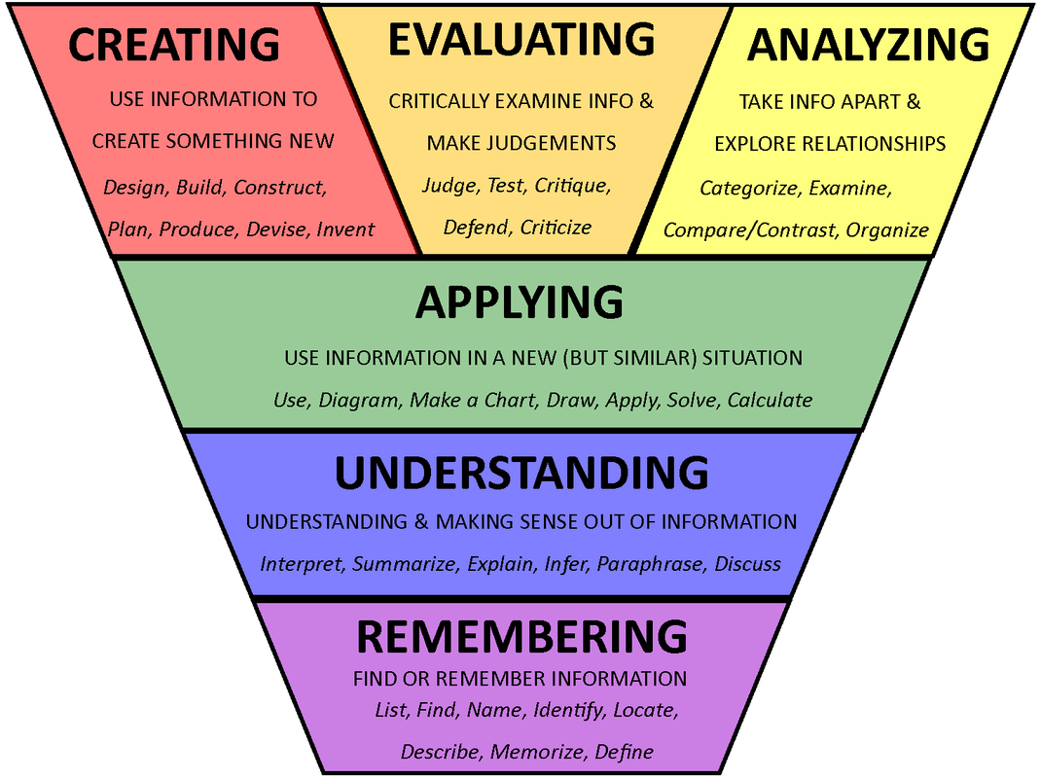
Bloom’s Taxonomy

Slide 12
Closed and Open Questions

Slide 13
Thinking About Closed and Open Questions
Closed Questions and Tasks
Open Questions
Count by twos until you get to twenty.
Color half of this picture of a cookie.
Who are the characters in this story?
What happened at the end of the story?
What numbers can you count by to land on twenty?
Half of the people in the family are men. What might a drawing of the family look like?
Which character in this book would get along well with the character in another book?
What do you think would happen if…?

Slide 14
What Do Closed and Open Questions Offer Students?
Closed Questions
Open Questions
A closed question can be used to start a conversation.
Can be used for quick quantitative data or polls.
Can assess what facts a student knows.
Are often quick and simple to answer.
Allows students to explain their thinking and students can often find their own errors.
Allows for several acceptable answers.
Requires more than remembering a fact.
Allows the teacher to see a student’s learning method or style.

Slide 15
Where on Bloom’s taxonomy would closed questions fall?
Where would open questions fall?

Slide 16
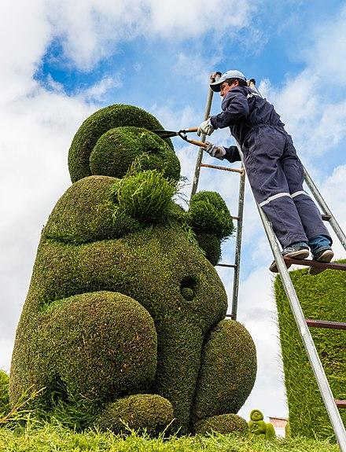
I Notice, I Wonder
What do you notice about this image?
What do you wonder about this picture? What questions do you have about it?

Slide 17
Parallel Questions

Slide 18
Parallel Questions
Set of tasks (usually 2-3).
Designed to meet the needs of students at different levels.
Share the same big idea.
Close enough in context that they can be discussed simultaneously.
Math Examples:
An object has a length of 5 paper clips. What might it be?
An object has a length greater than 5 paper clips. What might it be?
Would a clock ever say 6:63? Explain your thinking.
Would a clock ever say 2:03? Explain your thinking.

Slide 19
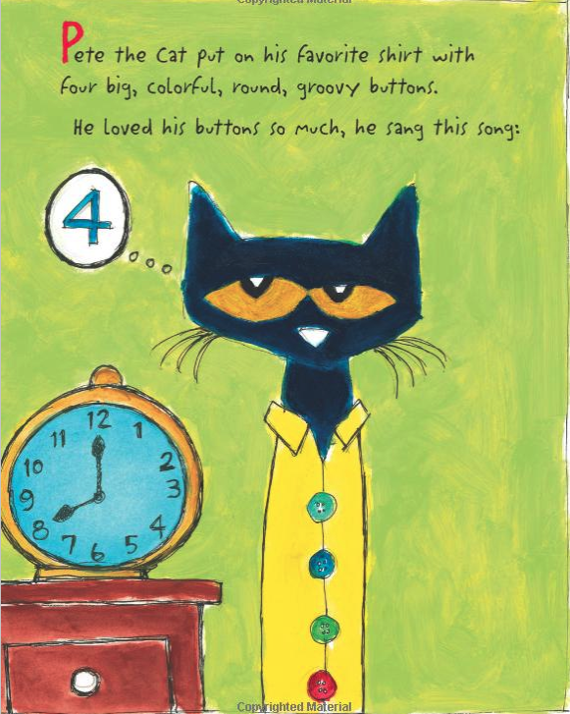
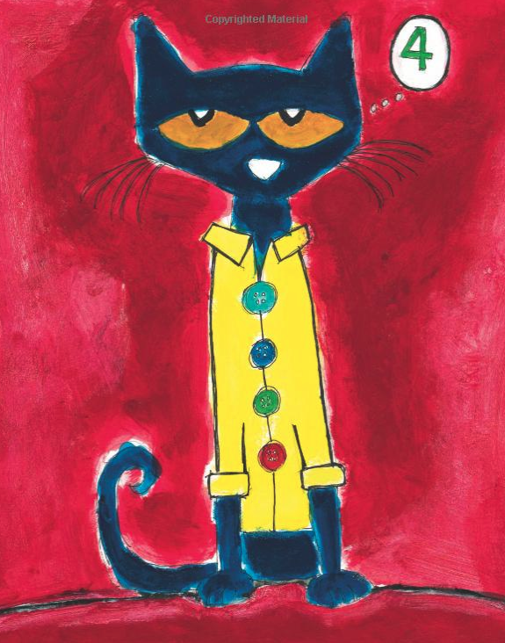
The Whole Thing and the Teeny Tiny Details
This WHOLE page is about...
What is this part about?
What do you think this part is about?

Slide 20
Probing Questions

Slide 21
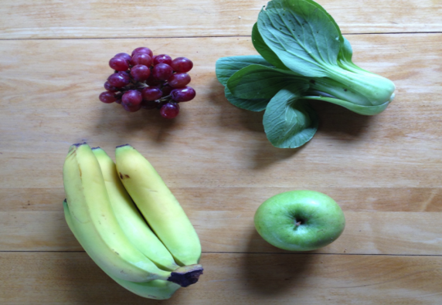
Not Like the Others

Slide 22
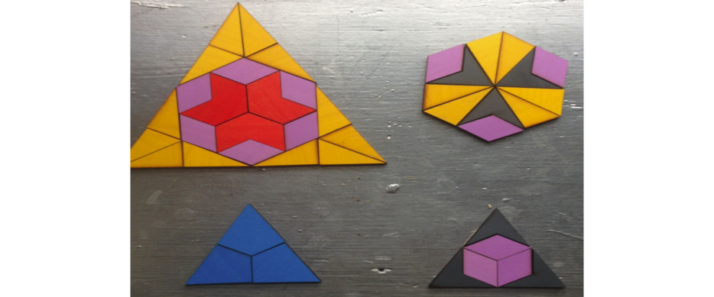
Not Like the Others
https://wodb.ca/index.html

Slide 23
Probing Questions
Examples of Probing Questions:
Why do you think that?
What is your prediction?
When have you done something like this before?
What would need to change to make this happen?
What would happen if...?
Designed to encourage deep thought about a specific topic.
Typically open-ended questions.
Intended to promote critical thinking.
Allow students to explore their personal thoughts and feelings about an idea or topic.

Slide 24
Squiggle
Draw a picture using one of these shapes as part of your drawing.
Write a word about your picture.
Write a sentence about your picture.

Slide 25
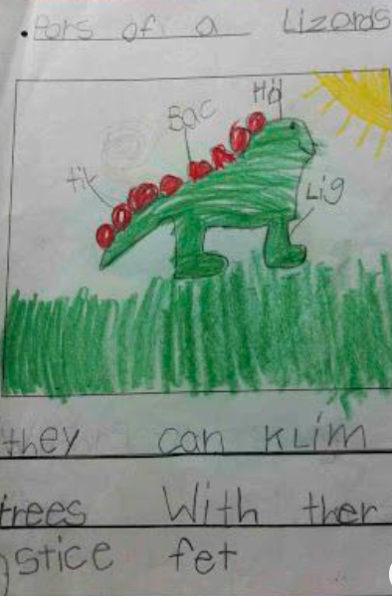
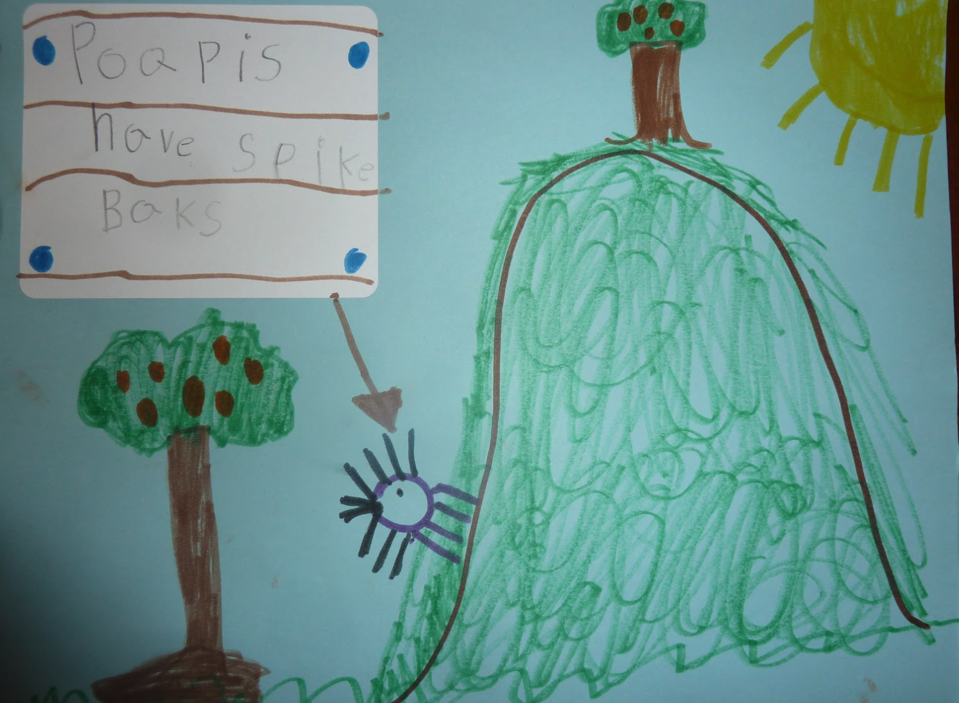
Squiggle Thoughts
They can climb trees with their sticky feet.
Do lizards stay in the sun a lot?
Porcupines have spiky backs.
Does it hurt to have spikes on your back?

Slide 26
Where on Bloom’s taxonomy would parallel and probing questions fall?

Slide 27
Creating More Effective Questions

Slide 28
From Closed to Open Questions
How much is two dimes and a nickel?

Slide 29
Create a Parallel Question/Task
Choose a number between 1 and 10. Show that number in as many ways as you can.

Slide 30
Create some probing questions to use with this closed question.
Do all apple trees have red apples?

Slide 31
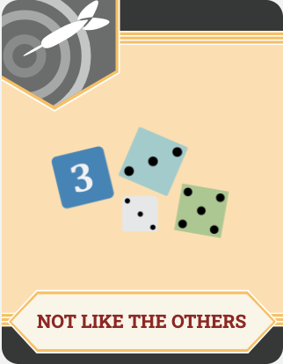
Strategies
Yes or No
I Notice, I Wonder
The Whole and the Teeny Tiny Details
Not Like the Others
Squiggles

Slide 32
Additional Resources
Open Question Examples for Math and Language Arts
Bloom’s Taxonomy Chart with Question Stems
List of Yes and No Questions
Which One Doesn’t Belong? website

