Slide 2
Making Learning Meaningful for All Students

Slide 3
Session Objectives
Identify components of culturally responsive teaching
Apply and incorporate culturally responsive teaching strategies

Slide 4
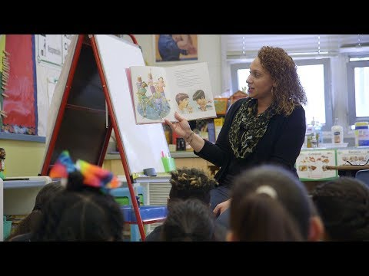
While watching the video, reflect on the following question:
How are the students' lives, cultures, and experiences reflected in the environment, curriculum, and instruction?
Notes:
Facilitators will ask participants to think about the following question while we are watching the video. After the video, the facilitators will ask participants to share their responses.

Slide 5
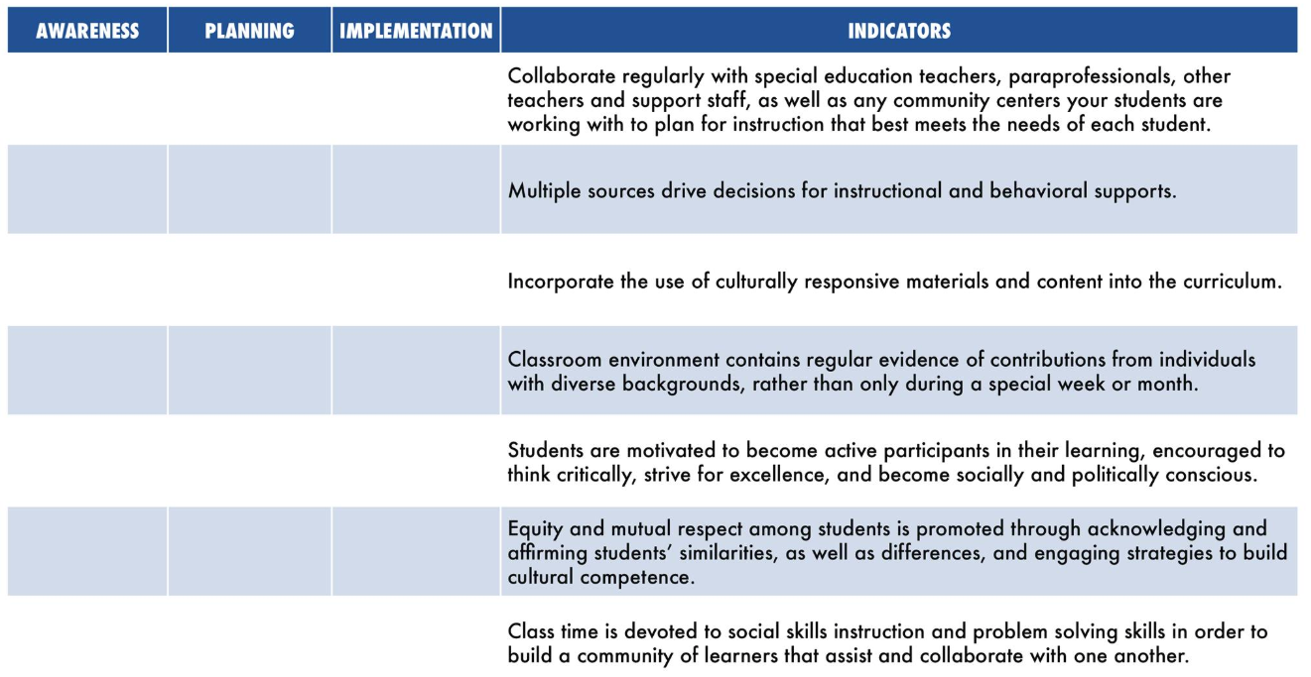
Culturally Responsive Self-Assessment
Notes:
Assessment statements from: https://www.deltafoundation.net/research-education/a-culturally-responsive-guide-and-self-assessment-for-educators

Slide 6
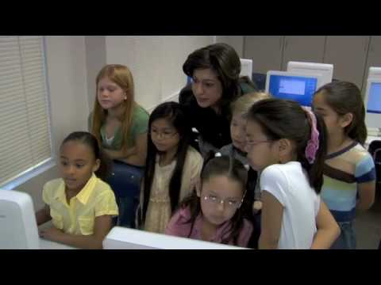
Notes:
Video: https://www.youtube.com/watch?v=nGTVjJuRaZ8

Slide 7
What Is Culturally Responsive Teaching?
Culturally responsive teaching is a pedagogy that recognizes the importance of including references to students’ cultures in all aspects of teaching.
Visible Culture
Art, music, craft, technology
Invisible Culture
Values, beliefs, feelings, opinions, perspectives, assumptions.
“Culturally responsive teaching is that, rather than always insisting that the students adapt to the culture of the school, the school needs to adapt and modify some of its sending messages.”
– Geneva Gay, University of Washington
Vestibulum congue
Notes:
Resource: https://www.brown.edu/academics/education-alliance/teaching-diverse-learners/strategies-0/culturally-responsive-teaching-0#ladson-billings

Slide 8
Why Use Culturally Responsive Teaching?
It raises expectations for all students.
It helps students feel valued and empowered.
It builds cultural competence.
It works well with Universal Design for Learning.
It supports social-emotional learning.
Invisible Culture
Values, beliefs, feelings, opinions, perspectives, assumptions.
Vestibulum congue
Source: understood.org
Notes:
Image: https://pixabay.com/photos/students-computer-young-boy-99506/
Resources: https://www.understood.org/en/school-learning/for-educators/universal-design-for-learning/what-is-culturally-responsive-teaching?utm_source=google&utm_medium=paid&utm_campaign=evrgrn-may20-edu&gclid=CjwKCAjww5r8BRB6EiwArcckC0ZpSqLWY4v35zjKNMVfjSjodKBBj7GfTUBOzmE4FKjpIJibASAtyxoCxSYQAvD_BwE

Slide 9
Getting Started
Identify your students’ assets.
Student strengths and interests
What are their strengths, both individual and across groups?
What are students’ talents, skills, and responsibilities outside of school?
Funds of knowledge
All students bring funds of knowledge—in what ways can you highlight your students’ cultures, such as historical figures, accomplishments, and awards?
Culture and cultural values
Keep in mind that students might come from collectivist cultures that focus on the well-being of the group, not the individual.
Language
Be mindful of different communication styles, patterns, and norms that your student use.
Source: understood.org
Notes:
Identifying student strengths/interest can be done using questionnaires or surveys. Talking to other colleagues that know the students can also be a great way to get to know your student. Pay attention to their conversations topics and activities that students find interesting and most engaging.

Slide 10
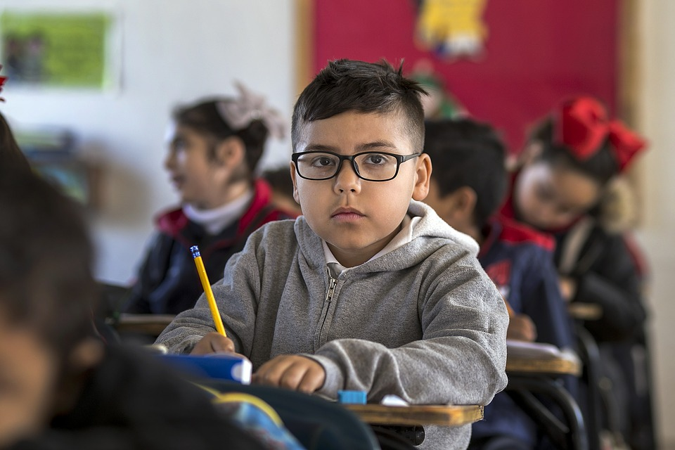
Getting Started
Create a supportive classroom environment.
Develop authentic, caring relationships.
Learn to pronounce students’ names correctly.
Give students a chance to share what is happening in their lives.
Create a welcoming classroom.
What do you have on your walls? Can all of your students find relatable visuals?
Include different kinds of diversity in classroom materials: ethnicities, languages, abilities, gender identities, and socioeconomic experiences.
Avoid stereotypes or insulting depictions of diverse communities.
Source: understood.org

Slide 11
Getting Started
Examine the curriculum.
Where can you raise expectations for students?
Identify the skills that your students need to complete high-level work in your content area. Provide explicit instructions and include examples to help students be successful.
Provide students with ample time to master new skills.
Create a culture that understands that mistakes are part of the learning process.
Look for ways to increase relevance.
Activate students’ background knowledge when introducing a new topic.
Use inquiry-based learning approaches to invite students to identify a question or a problem to solve.
Provide students with opportunities to research issues in their own communities.
Encourage students to present their work publicly to classmates, families, community members, or media.
Source: understood.org
Notes:
Image: https://pixabay.com/photos/education-people-school-child-3189934/

Slide 12
Getting Started
Continue your own learning.
Explore resources to deepen your own understanding.
Look for trustworthy, research-based examples of critical race theory across the curriculum that reflect the diverse student populations you serve.
Consider finding a partner or mentor for shared discussion. Online communities of educators can also be a great resource.
Source: understood.org
Notes:
Image: https://pixabay.com/photos/laptop-computer-browser-research-2562325/

Slide 13
POMS: Point of Most Significance
Which point made during today’s session helped you better understand culturally responsive teaching?
Share your thoughts in the chat in Whova.

