Slide 2
Inquiry in Social Studies

Slide 3
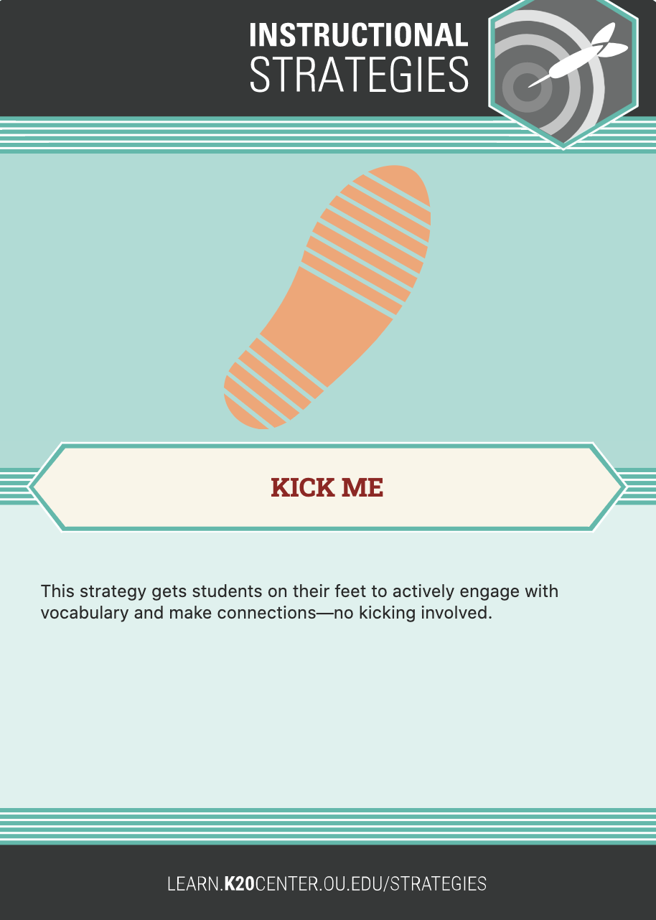
“Kick Me”
Each of you have a nametag on your back that identifies you as a political figure. Some are historical; some are contemporary.
Find a partner and ask them “yes” or “no” questions to help figure out your persona.
Once you figure out who you are, find a group that has a thematic connection to your persona.
Notes:
K20 LEARN (ou.edu)

Slide 4
How can you use this strategy in your classroom?
Help students create and solidify definitions of key terms/people.
Help students identify themes and/or associations between the terms/people.
Have students generate questions related to the terms that can be used in a research project.

Slide 5
“Kick Me” Groupings
Legislative | Executive | Judicial
Nancy Pelosi | Barack Obama | Ruth Bader Ginsburg
Mitch McConnell | Bill Clinton | Thurgood Marshall
Newt Gingrich | George W. Bush | Sandra Day O’Connor
Paul Ryan | Ronald Reagan | Sonia Sotomayor
John Boehner | Theodore Roosevelt | Antonin Scalia
Tom Cole | Jimmy Carter | Clarence Thomas
Stephanie Bice | Harry Truman | John Roberts
Tammy Duckworth | Richard Nixon | John Marshall
Alexandria Ocasio-Cortez | Abraham Lincoln | William H. Taft
Carl Albert | Franklin Delano Roosevelt | Oliver Wendell Holmes, Jr.

Slide 6
Essential Question
?
How can we promote inquiry in the social studies classroom?

Slide 7
Objectives
Participate in strategies that promote inquiry and discourse in the classroom
Connect inquiry and discourse to social studies instruction
Model the implementation of strategies that engage students in inquiry and discourse

Slide 8
“Kick Me” Strategy
“Kick Me” is a strategy used to actively engage students with vocabulary in order to make connections.
How does this strategy enable students to perform the following:
Identify themes and/or associations between the terms/people?
Generate questions related to the terms that can be used in a research project?
How can you use this strategy as a teaching tool?
Notes:
K20 LEARN (ou.edu) (Kick Me Instructional Strategy)

Slide 9
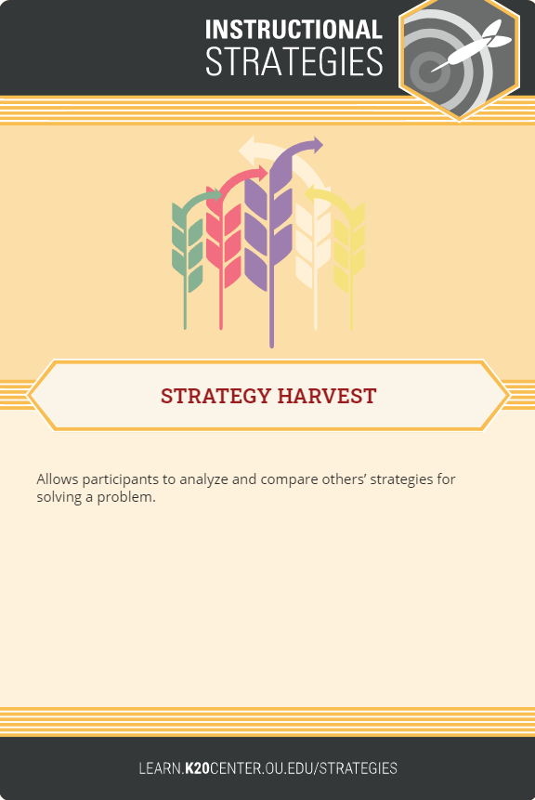
“Strategy Harvest”
“Strategy Harvest” enables students to analyze a topic or solve a problem by working collaboratively to come to a conclusion or reach a solution.
One partner writes down the process used to figure out the persona assigned in “Kick Me.”
The other partner asks questions and provides feedback to identify the process steps.
Partners switch roles and repeat the process.
Partners share their strategies with the whole group.
How can you use this strategy in your classroom?

Slide 10
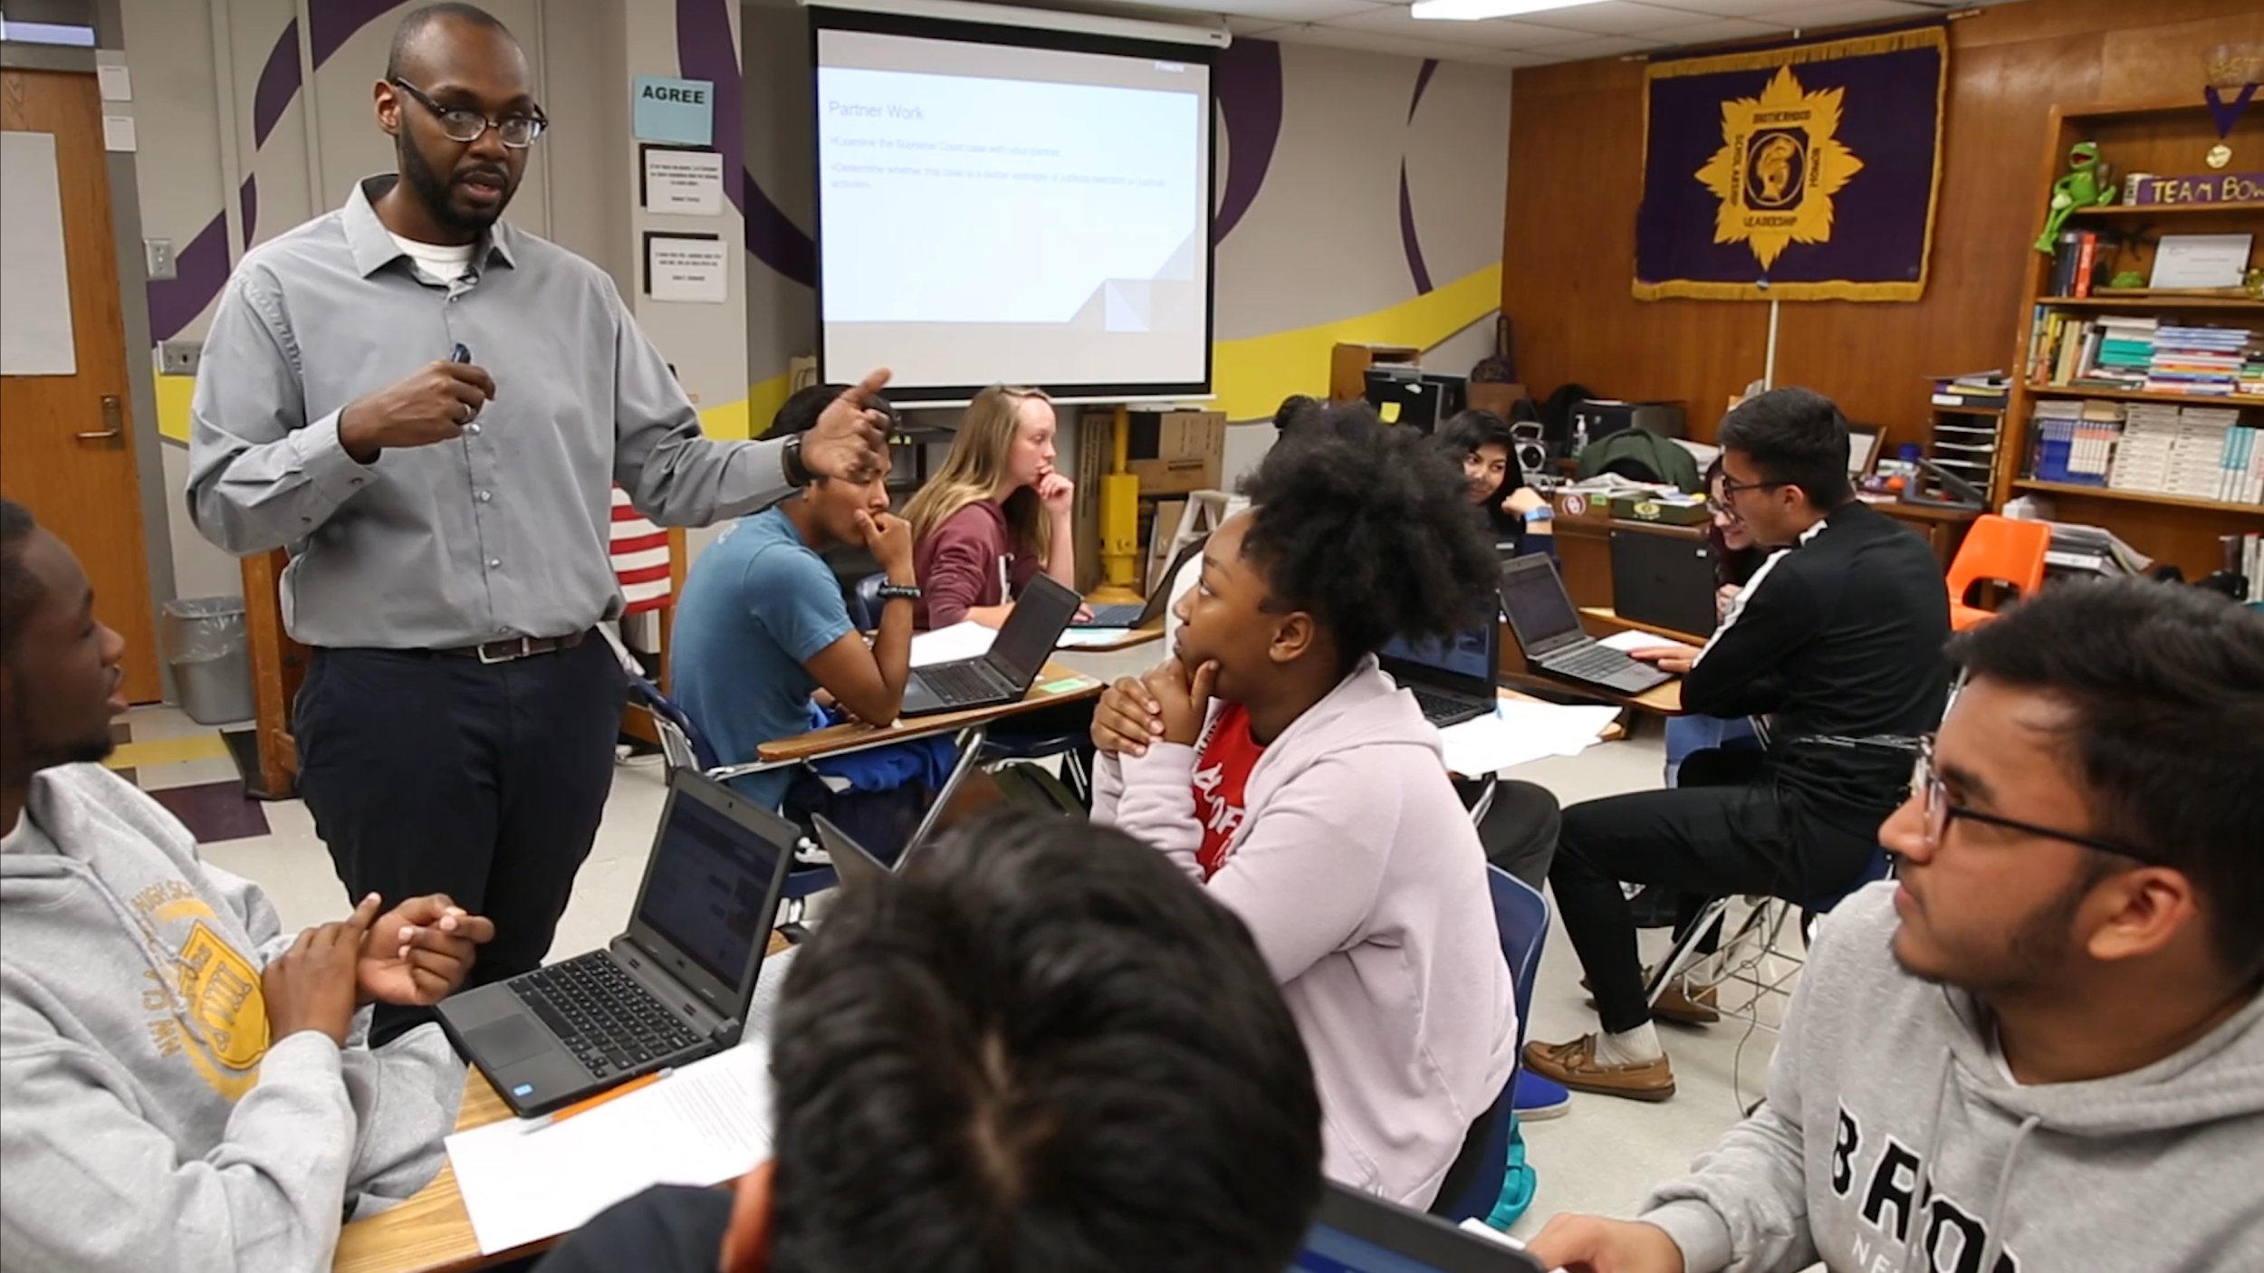
Notes:
Before identifying the photo, have participants explore the scene using the questions below.
Ask participants to use the following questions to explore the scene depicted in the photo:
What do you see or notice first? Share your observations about the image.
Break the image down into parts. What is happening in each quadrant? What does the placement of objects or people in the photo tell you about the scene?
What other clues in the photo help you understand the scene? How would you characterize the interrelationships depicted in the image?
What is the image about? What is it an example of? Can you summarize the scene in one sentence?
What would you title the image?
~Source: K20 Center photo. Social studies classroom in Oklahoma City, OK.

Slide 11
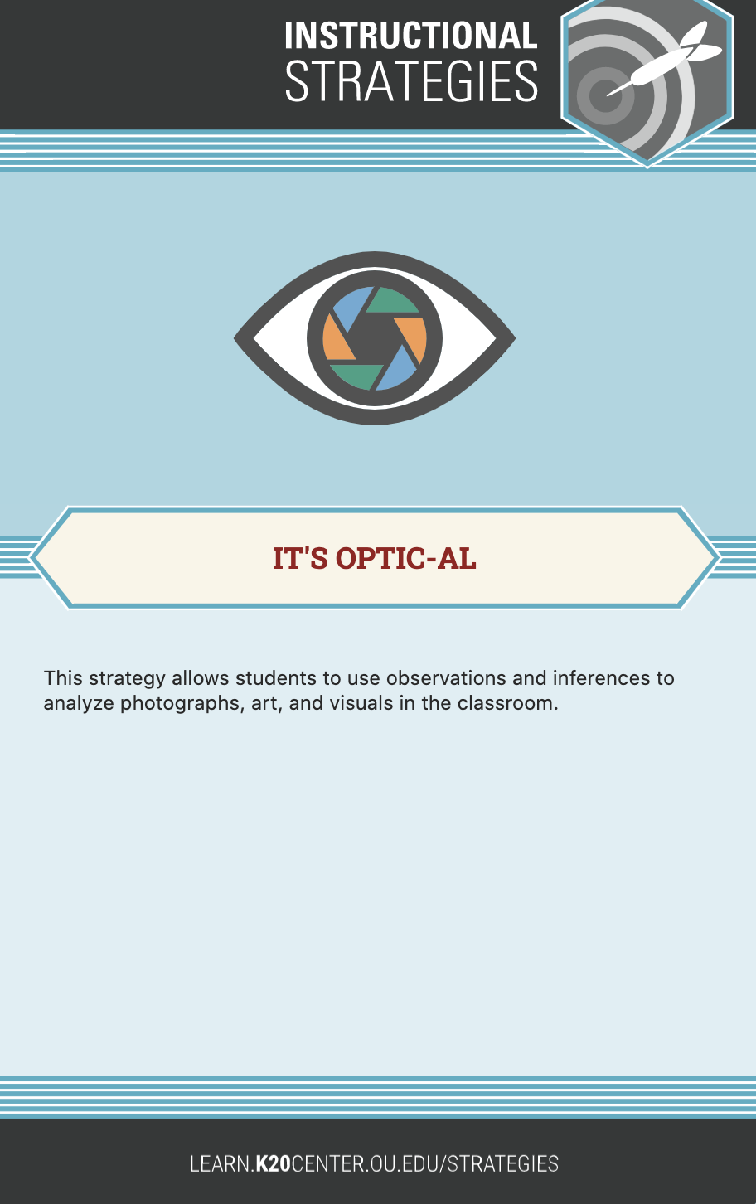
“It’s OPTIC-AL”Strategy
O - Observations: What is happening in the photo?
P - Parts: Describe the placement of objects in the photo.
T - Title: What does the title tell you about the photo?
I - Inferences: What clues in the photo help you to understand the scene?
C - Conclusion: Draw a conclusion to the meaning or the message.

Slide 12
It’s OPTIC-AL
This strategy is designed to generate observations and draw inferences in order to analyze photographs, art, and visuals.
How does this strategy help students:
Analyze visual evidence?
Draw inferences?
Generate questions about the topic?
How can you use this strategy in your classroom?
Notes:
K20 LEARN (ou.edu)

Slide 13
Inside Out
Innermost Circle: Prior Knowledge of Inquiry
What are the goals? What are the most important features?
Second Circle: Partner Share
Read: Disciplined Inquiry
As you read, think about the goals, features, and characteristics of inquiry in the classroom.
Outer Circle: New information you and your partner learned through reading and research.

Slide 14
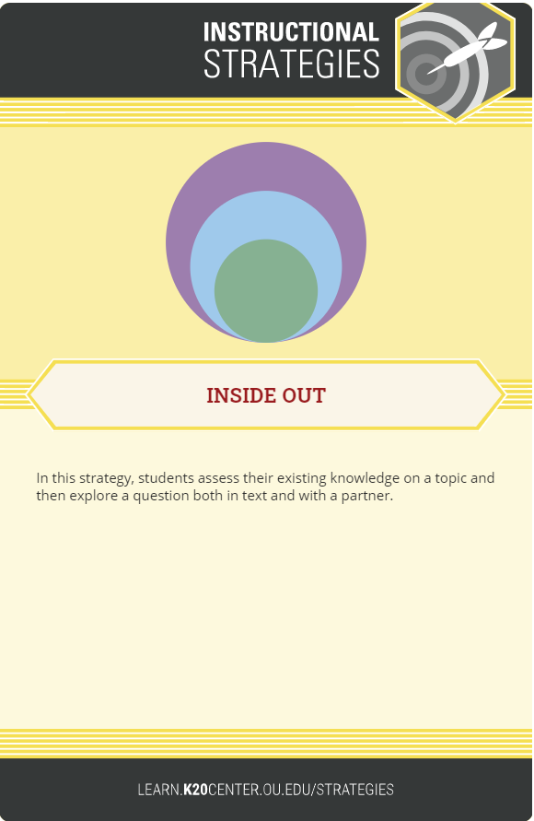
Inside Out: The Gettysburg Address
Using the Gettysburg Address as your primary text,
work with your partner to complete the Inside Out activity.
Follow the steps below:
Write what you already know about the Address and the Civil War in the inner circle.
Add anything you have learned from your partner to the second circle.
Read the Gettysburg Address.
Write down any new information you both learned in the outer circle.

Slide 15
Inside Out: Disciplined Inquiry
Write down everything you already know about inquiry in the classroom in the inner circle.
What are the goals?
What are the most important features?
What benefits will students derive?
With your Elbow Partner, complete the middle circle.
Read the Disciplined Inquiry article.
Join the larger group and complete the outer circle.
Share out the group’s understanding of inquiry as a tool in the classroom.
How can you use this strategy in your classroom?

Slide 16
INQUIRY
Student-centered and question-driven, inquiry incorporates the following elements:
Inquiry engages students.
Inquiry empowers students to explore multiple sources of information.
Inquiry inspires students to gather resources from those sources.
Inquiry fosters investigation and discussion.
Inquiry facilitates connecting ideas.

Slide 17
Option 1
I Think/We Think

Slide 18
I Think/We Think
On the back of your Strategy Harvest handout, write down what you think inquiry would look like in your classroom.
Hypothesize with your partner about what inquiry would look like.
Share out.
Notes:
Milton
Stop video at 4:18 when showing it without sound.

Slide 19
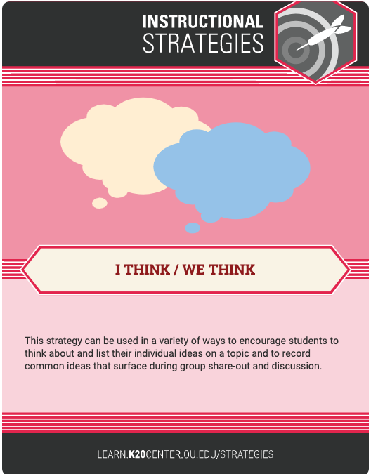
I Think/We Think
I Think/We Think is a strategy designed to encourage observation, guided inquiry, and discourse.
How does this strategy foster the following:
Help students identify things they already know and understand about a topic?
Help students generate questions related to the topic?
How can you use this strategy in your classroom?
Notes:
Milton
What other videos do you use on a regular basis that you could substitute for the Tulsa video.

Slide 20
Option 2
Think-Pair-Share

Slide 21
Think-Pair-Share
Consider the following question: How could I promote inquiry in my classroom?
Discuss your answer to that question with your elbow partner.
Share out with the whole group.

Slide 22
Think-Pair-Share
Think-Pair-Share is a strategy designed to encourage inquiry and discourse.
How does this strategy foster the following:
Help students pick out things they already know and understand about a topic?
Help students generate questions related to the topic?
How can you use this strategy in your classroom?

Slide 23
Exit Ticket
On a sticky note, answer this question…
How will you promote inquiry in your classroom?

