Slide 1
Introducing Phenomena Virtually
Navigation:
Even-numbered slides show a phenomenon for life science, physical science, or earth science (MS: 2-6; HS: 8-12).
Odd-numbered “virtual engagement” slides are for your ideas (MS: 3-7; HS: 9-13).
Instructions:
Pick one of the Middle School or High School phenomena.
On the odd-numbered slide after your phenomenon, select a blank cell in the table and describe how you would engage students with the phenomenon virtually.
Some suggested tools and easily modified strategies can be found in the resource list.

Slide 2
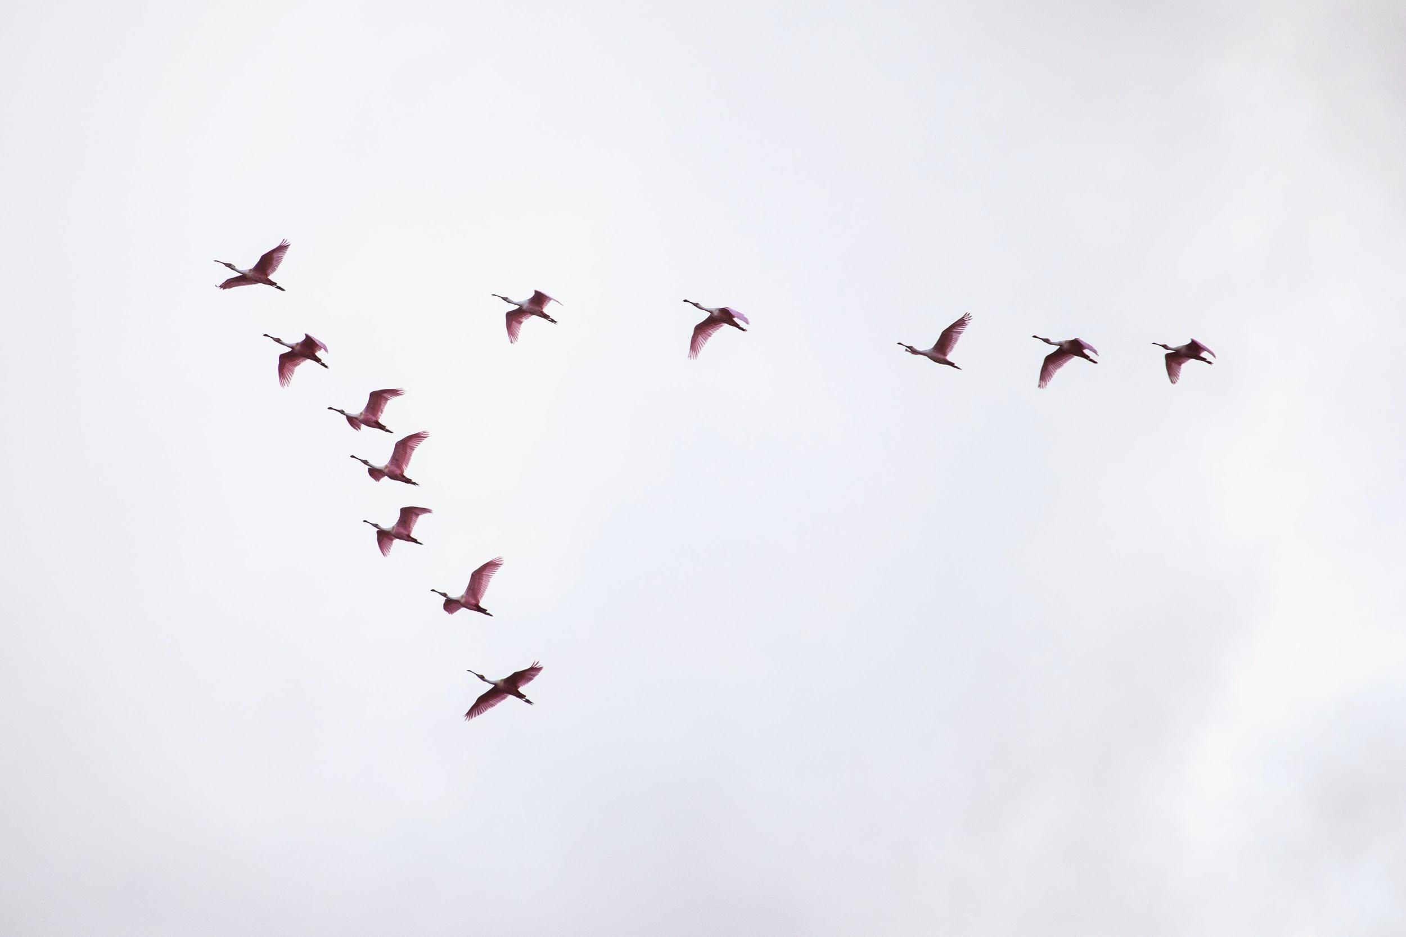
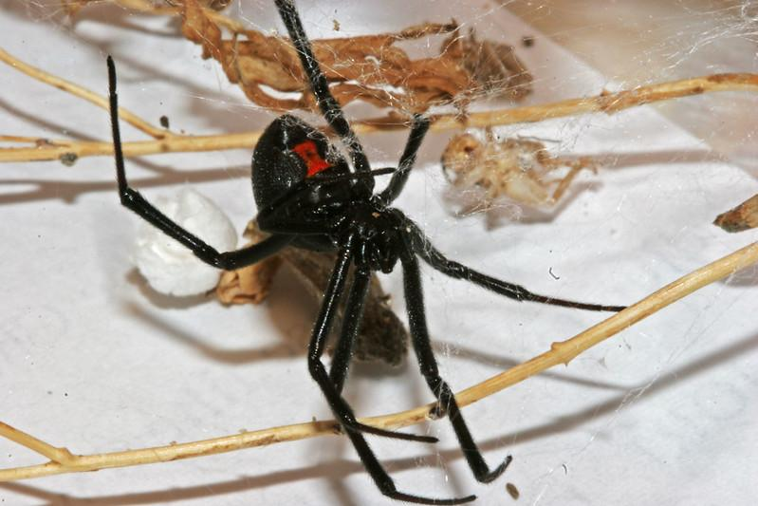
Middle School Life Science
Natural selection and behaviors that increase survival and reproduction
Some strategies for surviving winter
Migration
(seasonal travel to warmer regions)
“Antifreeze”
(storage of excess glucose in cells to keep an organism from freezing)
Diapause
(similar to hibernation)
Notes:
(birds) Photo by Julia Craice on Unsplash
(frog) Photo by Heather Shaffery
https://www.nationalgeographic.com/animals/2007/02/frog-antifreeze-blood-winter-adaptation/
(spider) Photo by Andrey Zharkikh https://flic.kr/p/dzMRB3 (CC 2.0, w/attribution)
https://www.thoughtco.com/types-of-diapause-1968243

Slide 3
Middle School Life Science Virtual Engagement
Antifreeze—Driving Discussion Board to generate questions and then have them draw out what they believe is occurring. Have students share images and similarities and differences in a Google slide or Padlet.
Migration—As a starting point, one helpful resource would be a live map of current bird migration routes that show the traffic rate. It can help students get visual ideas on how the process works.
Google Maps could be used to show migration patterns of waterfowl. I haven’t done this but I think the students would enjoy it

Slide 4
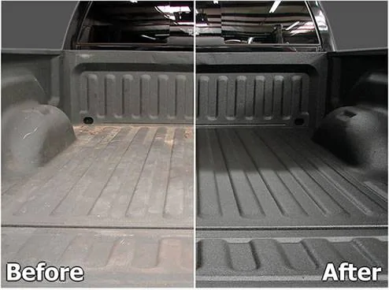
Middle School Physical Science
Atomic composition of matter and/or chemical reactions
Indestructible coating: polyurea truck-bed liner
Notes:
Veritasium. (2016, Dec 5). Indestructible Coating?! [Video]. YouTube. https://www.youtube.com/watch?v=DWkYRh6OXy8 (bottom picture, screenshot)
https://pictures.dealer.com/l/lakenormancdjcllc/0413/951c33afbcbf85301c54477c7e5ff8bcx.jpg (top picture)

Slide 5
Middle School Physical Science Virtual Engagement
My students love doing a mini-presentation with Google Slides. You could have them research their own examples 🤓
Notes:
K20 Center. (2021, September 21). K20 Center 7 minute timer. https://www.youtube.com/watch?v=gWwvdLxwV9c

Slide 6
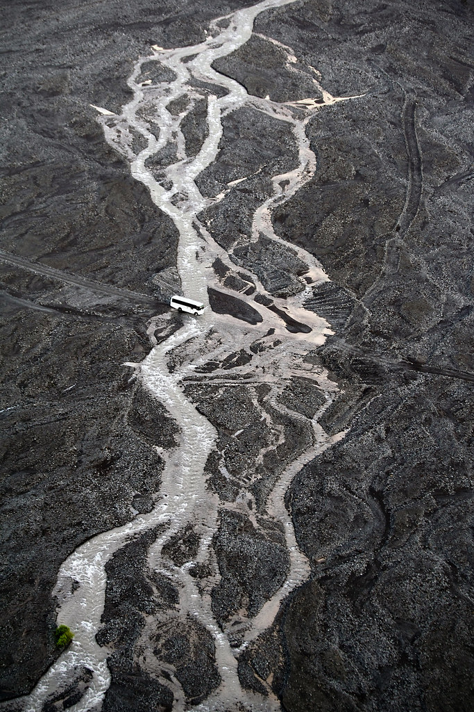
Middle School Earth and Space Science
Role of water on Earth’s surface
Meandering rivers
Notes:
https://live.staticflickr.com/7400/10903525885_7e8656577a_b.jpg

Slide 7
Middle School Earth & Space Science Virtual Engagement
That meandering rivers idea: There are some time lapse videos of rivers shifting. Which I learned about in my OK History class talking about where on the Red River is the OK & TX border. And since the river meanders, what that means about our state’s borders. | Building on the shifting river idea, I would bring in videos of houses falling in rivers when the river has shifted.

Slide 8
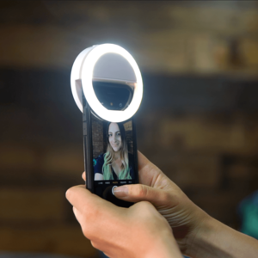
High School Physical Science
Light waves and properties of light
Why does light always ruin my photos and selfies?
Notes:
Phenomena for NGSS. (2020, March 26). Wait—what’s the phenomenon? Good selfies?!? Now that is some science that I could get behind… NGSS. https://www.ngssphenomena.com/ourvoice/2020/3/27/virtualscienceeducationselfiesandlight/
Phenomena protocol for home/school connection. https://docs.google.com/document/d/1Ja5JQH8wmnrtpWc9Z_sCG7rda0-9wyqYuJehuPVCmZ0/edit

Slide 9
High School Physical Science Virtual Engagement
Padlet or Flipgrid to explain your own problem! The kids would love this one. | I’d have students create 2-3 Flipgrid videos in which they use different lighting to demonstrate how light can have a negative impact on their selfies. They could also share selfies with different amounts of light on Padlet, or they could view their selfies on Instagram with a creative hashtag (e.g., #badselfie, #selfiescience, etc.). | Having students use different photo filters to change the way light is perceived in their selfies can help them get there. Manipulating the images to reduce glare, reduce light, change shadows, change colors etc. An understanding of how light works and how it is perceived goes a long way in finding solutions to problems that occur because of lighting.

Slide 10
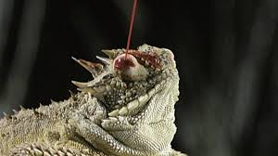
High School Biology
Evolution and natural selection related to structure and function
Why does this lizard squirt blood out of its eyes?

Slide 11
High School Biology Virtual Engagement
By engaging them in concepts of adaptations and functionality (have them identify their own anatomy). Have them identify the relationship of predator and prey then compare the relationship to arms race between countries/nations. Finally discuss the phenomenon and how this adaptation is used for survival. (I’m still not sure what virtual resources can be used.)

Slide 12
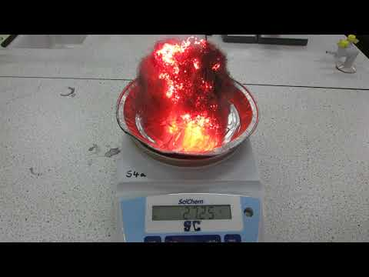
High School Chemistry
Chemical reactions and rate of change
What happens to the mass in this chemical reaction?
Notes:
Baldwin, N. (2018, February 8). Burning iron wool and change in mass MVI 0995 [Video]. YouTube. https://www.youtube.com/watch?v=TsnLmgWXw-E

Slide 13
High School Chemistry Virtual Engagement
Real-time graphing of mass changes during the chemical reaction (in Desmos).

