Slide 2
More Than Just a Score
Meaningful Test Prep

Slide 3
Essential Question
What are the goals of test prep?

Slide 4


Instructional Strategies
Notes:
Pass out Instructional Strategy note sheet and Meaningful Test Prep handout.

Slide 5

Always, Sometimes, or Never True
Independently read through the statements on the handout
“Always, Sometimes, Never True"
Mark Always, Sometimes, or Never and then justify your answer in the space provided.
Notes:
Use the Poster paper to tally answers?

Slide 6
Lesson Objectives
Determine the effectiveness of traditional test prep strategies.
Make connections between effective test preparation and authentic teaching practices.

Slide 7
Inside Out
Text
1 minute
Peer
Individually write:
What practices do you use within your classroom that prepares students for tests?
Individual
Notes:
1 minute - individual writes the most meaningful test prep strategies
3 minutes - share with a partner and add things you did not already have
5 minutes - read the text and fill in any gaps of knowledge you might have

Slide 8
3 minutes
Text
Peer write:
Share with a partner and add ideas that you did not list.
What things did you both write down?
Peer
Individual
Notes:
1 minute - individual writes the most meaningful test prep strategies
3 minutes - share with a partner and add things you did not already have
5 minutes - read the text and fill in any gaps of knowledge you might have

Slide 9
5 minutes
Text
Text write:
What does the data say about effective test prep practices?
Peer
Individual
Notes:
1 minute - individual writes the most meaningful test prep strategies
3 minutes - share with a partner and add things you did not already have
5 minutes - read the text and fill in any gaps of knowledge you might have

Slide 10
Effective?
Narrow vs. Broad
                “A challenging academic atmosphere and a class curriculum that teaches critical thinking gives students the best shot at succeeding on the ACT.”
Notes:
Ask participants what else might encouraging critical thinking in the classroom prepare students for? Other standardized tests? Other post secondary options? Career readiness? Citizenship?

Slide 11
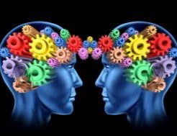



Authentic Teaching
Construction of Knowledge
Disciplined Inquiry
Implicit View of Students
Value Beyond School
Notes:
Which instructional practices from the text promotes authentic instruction and how?

Slide 12
Remix! Always, Sometimes or Never . . .
Revisit the “Always, Sometimes or Never True?” handout.
Look specifically again at numbers two, three, and five.
Based on what the research says, does your stance stay
the same? Has it changed? How has it changed/not changed and why?

Slide 13
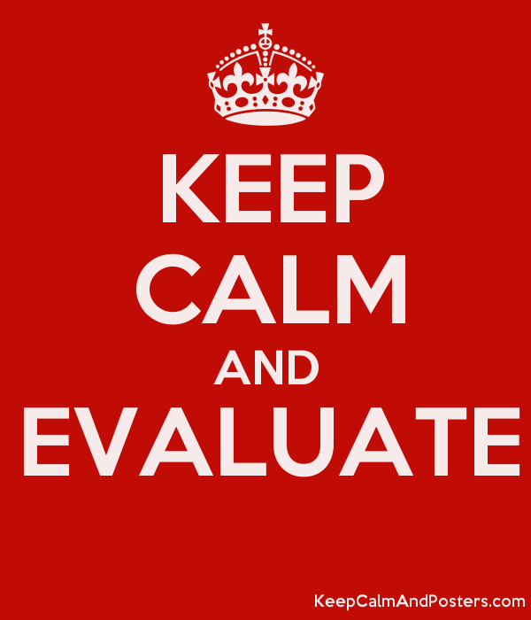

Slide 14
Resources
Allensworth, E., Correa, M., and Ponisciak, S. (2008). From high school to the future: ACT preparation—too much, too late. University of Chicago: Consortium on School Research. https://consortium.uchicago.edu/publications/high-school-future-act-preparation-too-much-too-late
K20 Center. (n.d.). Always, sometimes, or never true. Strategies. https://learn.k20center.ou.edu/strategy/145
K20 Center. (n.d.) Inside out. Strategies. https://learn.k20center.ou.edu/strategy/93
K20 Center. (2015). Research in focus: Test prep strategies that work. The University of Oklahoma. https://k20center.ou.edu/wp-content/uploads/2020/02/Test-Prep-Research-Brief-K20-CENTER-2015-02-25.pdf

