Slide 2
Collaborative Word Clouds
Steps:
Choose one person to be the scribe for the group. Have that person go to https://www.wordclouds.com/ (or a similar word cloud creator).
Have that person share their screen. To share a screen, click the GREEN “Share Screen” button at the bottom of the Zoom screen.
Ask each person to choose a word or phrase to summarize or respond to the reading. The scribe types the word or phrase into the word cloud by clicking on “Wizard” and then clicking “Type or paste text.”
The scribe then clicks “Apply,” creating the word cloud. To save the word cloud, click on “File,” then “Save as image.” The image can be saved as a JPEG or PNG to be added to the slide.
Finally, choose a reporter to share out about this strategy to the whole group.
Notes:
Look at Collaborative Word Clouds strategy first.
Instructions on the slide show the steps in using Collaborative Word Clouds in a digital classroom.
Consider what is the best way to use word clouds as a discussion strategy.
Students can use them to summarize, explain, elaborate, or argue.
There are several word cloud generators: Mentimeter, AnswerGarden, Wordle, Nearpod.
Have the students share their words to the generator; then the word cloud is created.
Share the word cloud with students.
Invite the class to discuss what they notice.
Have them focus on the words that dominate the image.
Ask students to conclude why some words are larger than others.
Ask students if there are words missing.
Have them discuss their “takeaway” from the word cloud?
As a tool for reflection, students are able to come back to and synthesize the information gathered from the group.

Slide 3
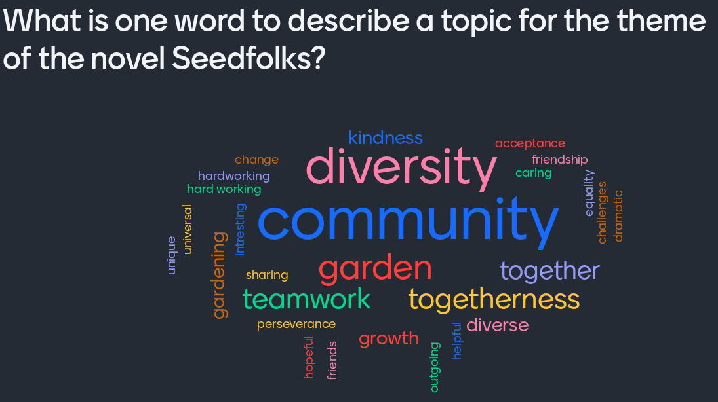
What is one word to describe the theme of the novel Seedfolks?
Notes:
This word cloud comes from a middle school literature class.
The class had read “Seedfolks” and was reflecting on the novel post-read.
After this word cloud, students took their reflections a step further with one-sentence summaries based on the themes chosen.

Slide 4
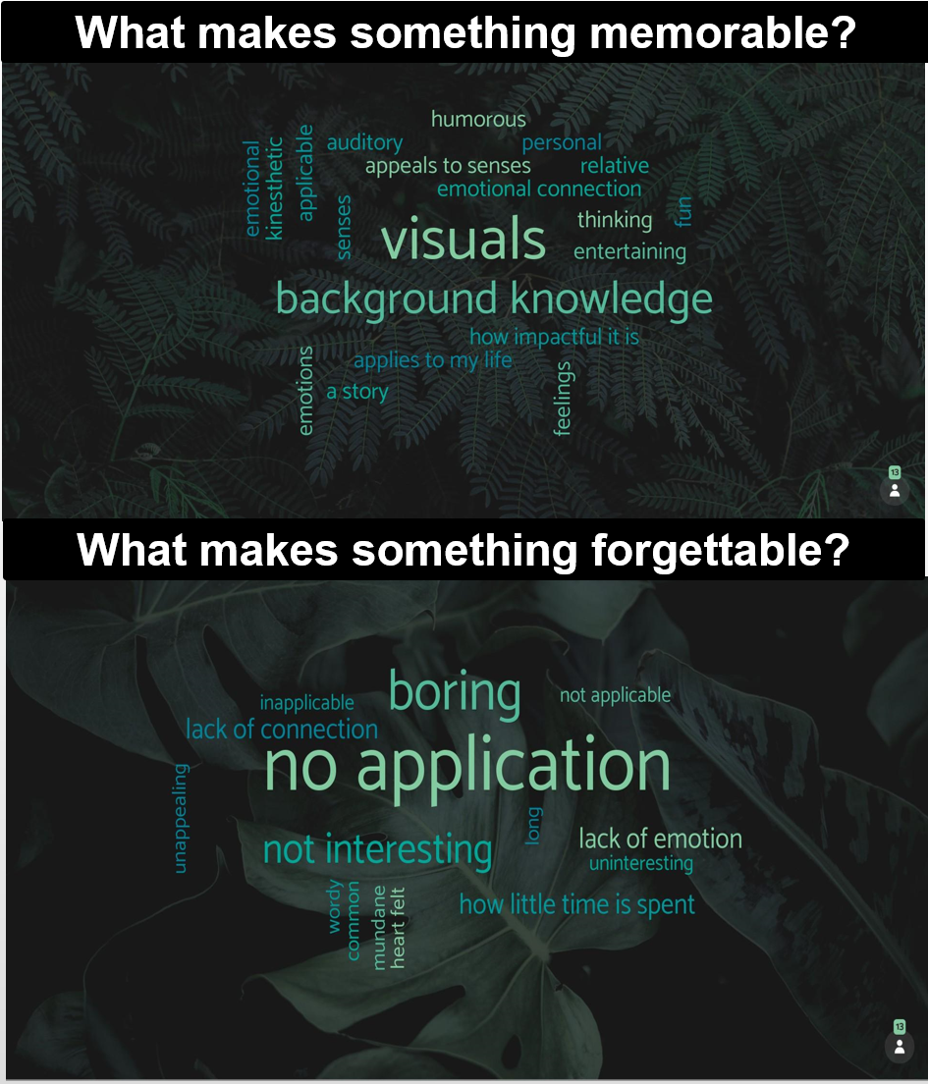
Capturing Themes in Word Cloud
Notes:
Here are two additional samples that show us other ways to bring ideas forward and show big repeating ideas.

Slide 5

Chalk Talk
Silent discussion strategy
Students write thoughts and respond to each other
Responses can be images or words
Create separate boards for each question or prompt
Notes:
Chalk Talk is a silent discussion strategy in which students write their thoughts on a discussion board together, sharing their thoughts and responding to each other.
The responses can be written or images.
Each question/prompt is on a separate board for students to respond to.
K20 Center. (n.d.). Chalk Talk. Strategies. https://learn.k20center.ou.edu/strategy/197

Slide 6
Chalk Talk
Steps:
This is a silent discussion strategy.
Go to the slide labeled “Chalk Talk.” Read the discussion prompt.
Make a copy of the sticky note by right clicking on the sticky note. Right clicking will enable a box to pop up with options. Choose “Copy.” Then, with your mouse, click somewhere else on the slide. Right click again so that the box of options pops up again. Click “Paste.” A new sticky note should appear.
Type your response into the sticky note. You can click on the sticky note and move it around on the board to place it where it will not be blocking others’ responses.
Take a moment to read others’ responses.
Notes:
For this strategy, share your takeaway from the video.
In order to do this, you will need to access the document titled Chalk Talk. https://bit.ly/35miYK1
There are sticky notes on the left side of this document slide.
Right click on the sticky note to make a copy for yourself.
After your right click, paste your new note on the slide. .
Click inside the new sticky note inside the new sticky note to change the text .
Type your response.
Write your takeaway from the video.
Take a moment to read others’ responses.
Comment on others’ responses as well.
This activity lasts 4 minutes.
K20 Center. (n.d.). Chalk Talk. Strategies. https://learn.k20center.ou.edu/strategy/197

Slide 7
What is your takeaway from the video?
CHALK TALK STRATEGY
(COPY A STICKY NOTE)
Example response here. Just right-click on one of the stickies to the left, click “Copy,” then paste it to the board.
Type here
Type here
Notes:
**Will need to click update to see participant responses** [Comment on participant responses?] Example RESPONSES:
This reminds me of my students who wait until the last minute to respond on the discussion board--it makes it really hard to have a good conversation.
I wonder how I should best engage as the teacher in a discussion board without taking over the conversation?
My kids totally do the same thing as the ones in the video: LOL, Agreed!, winky face.

Slide 8
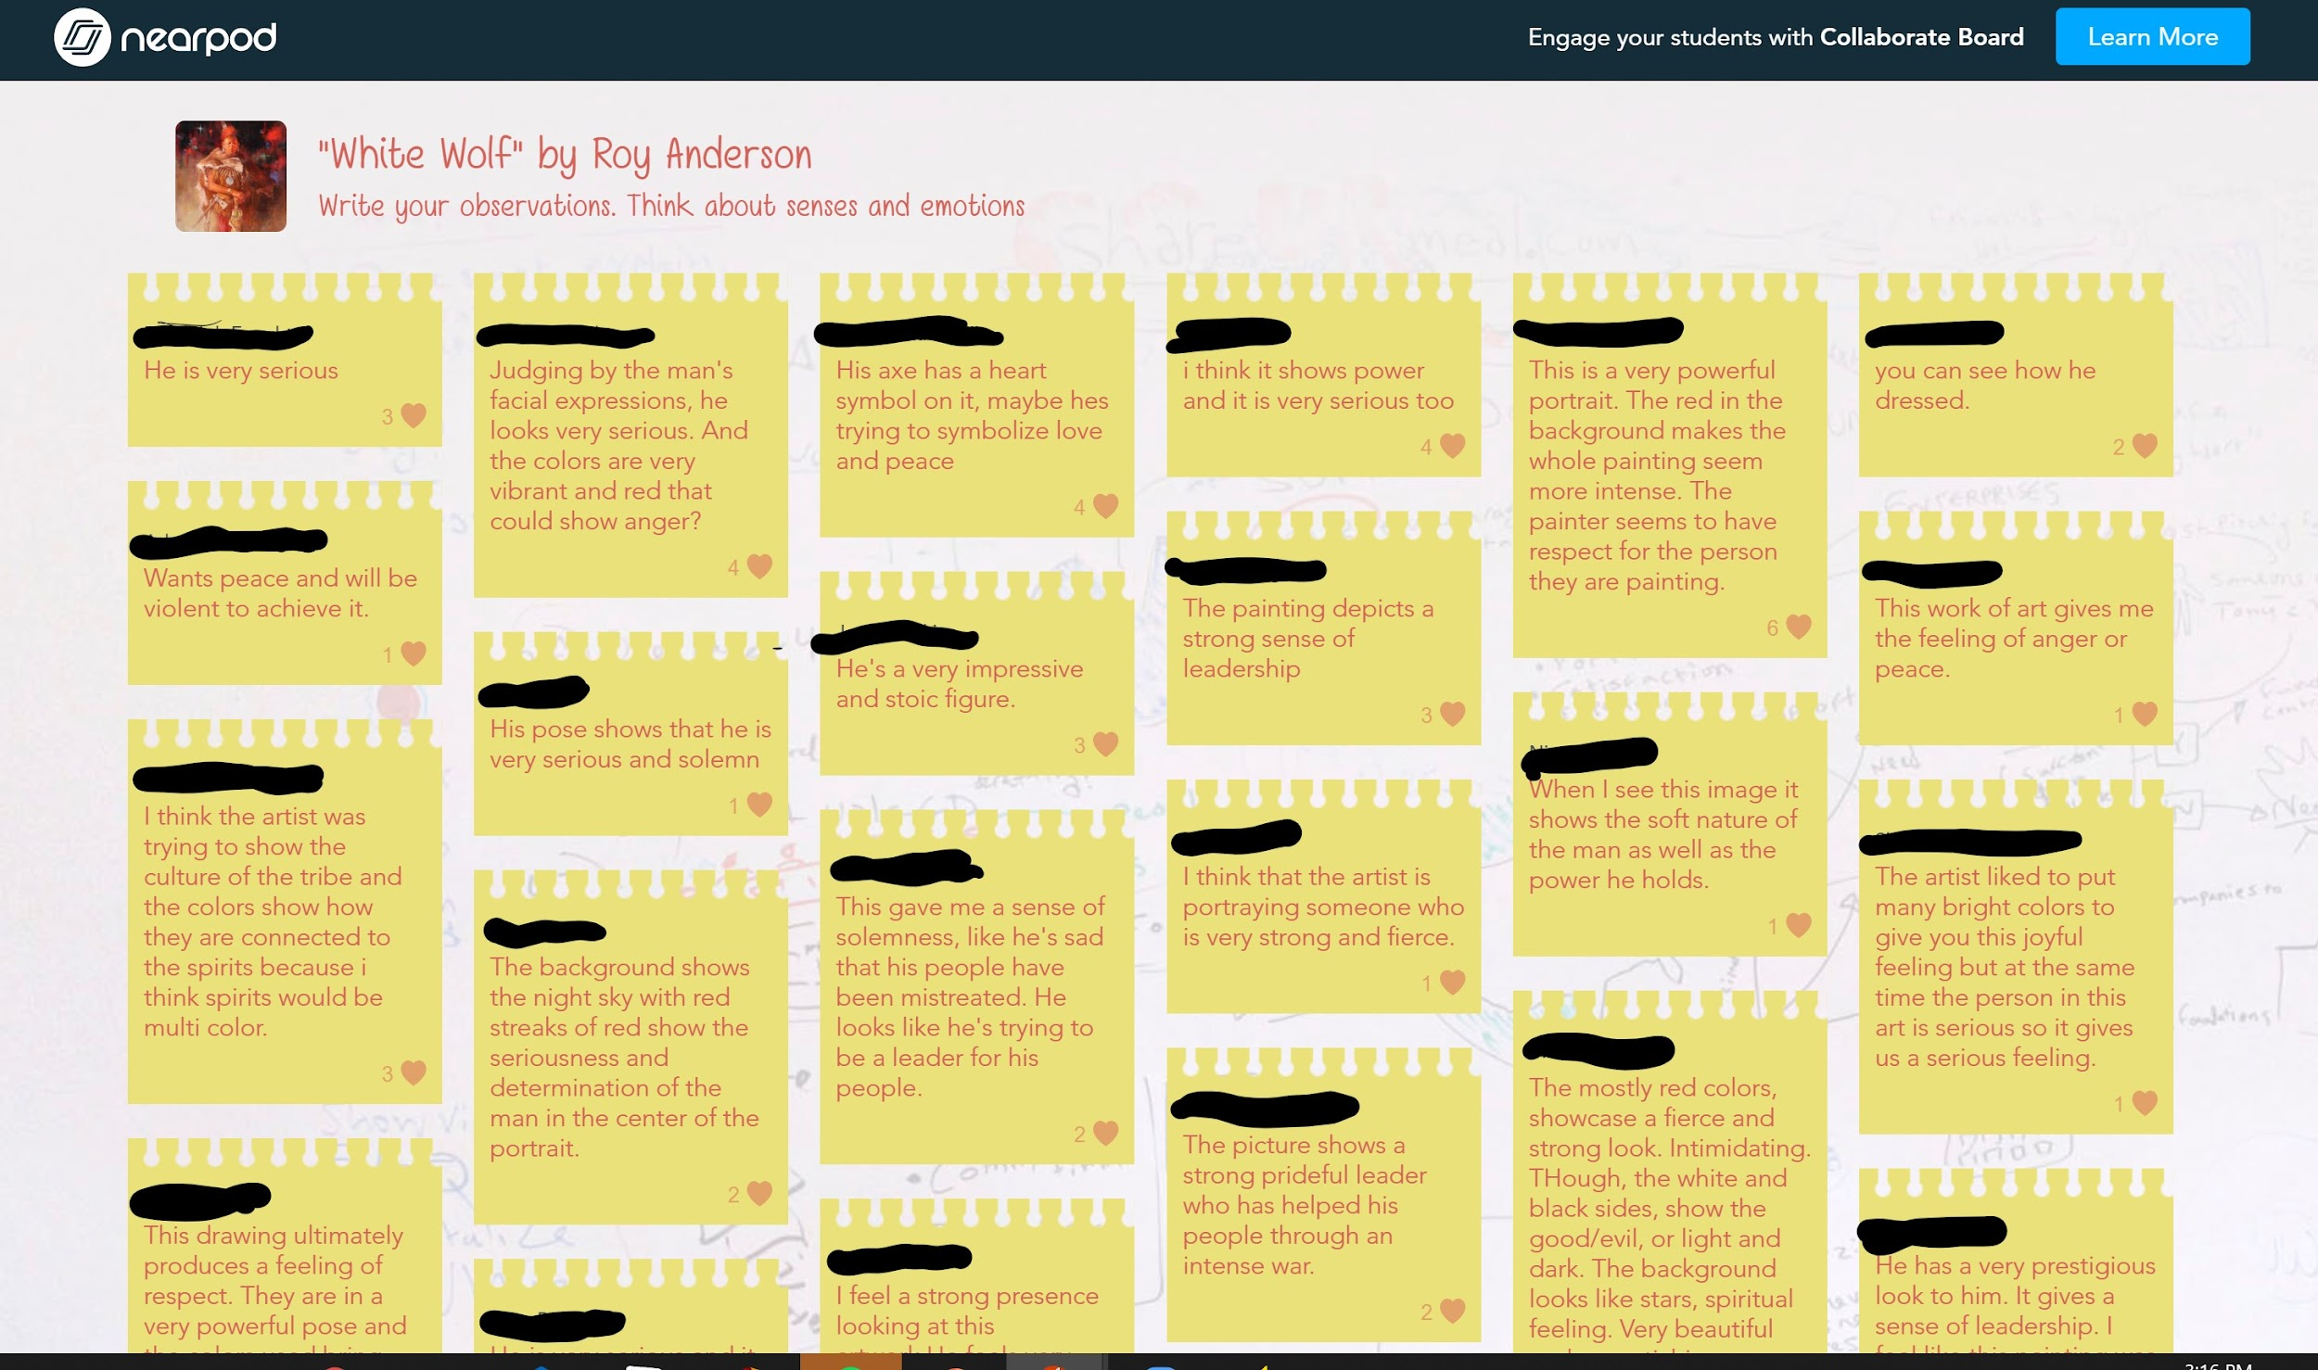
Notes:
In this example, the teacher used Nearpod to do multiple Chalk Talk boards with the students. The teacher did this activity with the whole class and synchronously, and used images as prompts, asking the students to connect the images to what they knew from the texts they had read. As you can see, with Nearpod, the students were able to “like” each others’ comments.

Slide 9

I Think/We Think
Steps:
This is a two-part strategy. Open up the linked graphic organizer.
Complete the section labeled “I Think” by typing in your response to the prompt.
After a couple of minutes to give everyone a chance to write their responses, take turns sharing out.
In the discussion, come to a consensus on the prompt. Write this in the “We Think” section.
Choose someone to be the reporter for the group to share out about this strategy to the whole group.
Notes:
I Think/We Think is a two-part strategy that provides students with a chance to first prepare their thoughts in writing before participating in the discussion.
Then, they share their thoughts with the group during the discussion.
Finally, the group must come to a consensus as to their answer to the question or prompt to share out.
It is helpful to come back together as a whole group and have groups share out their responses and discuss/reflect at the end to punctuate the learning.
K20 Center. (n.d.). I Think/We Think. Strategies. https://learn.k20center.ou.edu/strategy/141

Slide 10
What are your takeaways from the reading?
I THINK | WE THINK
Type your thoughts here. | Type your group’s consensus here.
Notes:
A graphic organizer like this is one example of how you can set up the strategy for your students.
It can be as simple as having your students draw a T-chart on their papers if you are in person, but being online requires some more preparation.
Creating editable slides or documents can allow students to quickly provide their ideas. T
To create something like this, you could use Google Drawings to create the I Think/We Think Chart as an image, saved it as an image, then added it to this slide as a background.
Then, we just added text boxes over the two boxes you see on the screen that said “Type your thoughts here.”
If I were going to share this slide with students, I could then put it in Google Classroom or Canvas to be shared out as an assignment so that they could each have their own copy.

Slide 11
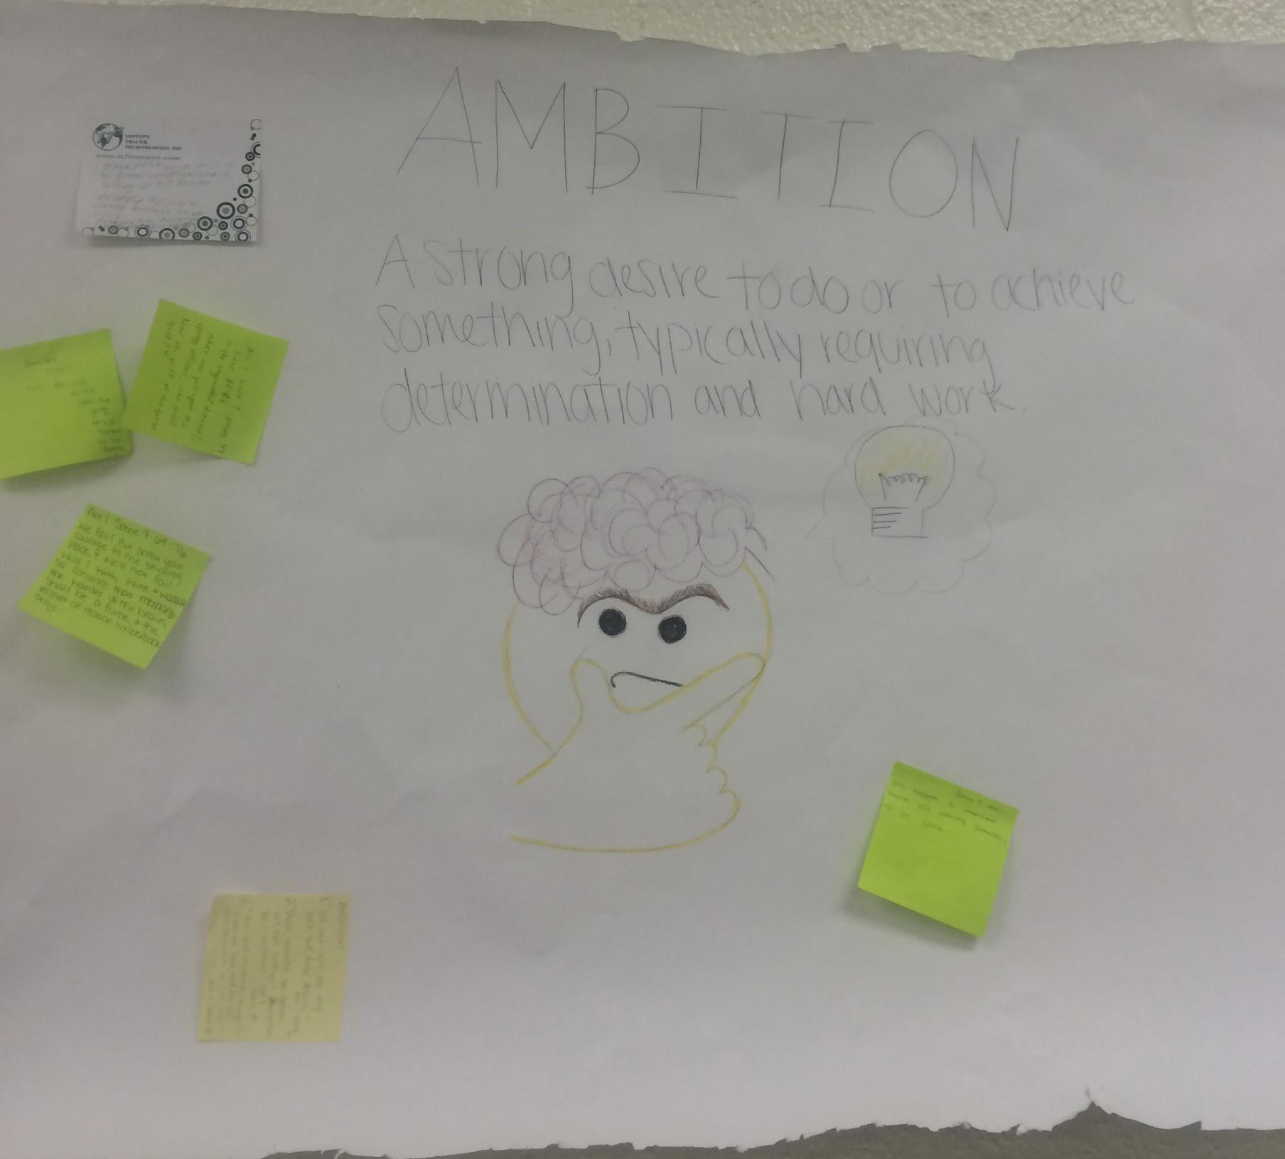
I Think/We Think Example
Students wrote their “I Think” response on a sticky note and brought this to the group; the group created a “We Think” poster.
Notes:
[Read slide] There is a video on the K20 website that also sheds light on this strategy if you want to see more.
EXAMPLES: Prediction activities (what is going to happen in the text); theme statements; best text examples to support a claim; Hero v. Villian/Main Character v. supporting: Who really is the hero vs the villain in the story? Who really is the main character vs. a supporting character in the story?

Slide 12
First Turn/Last Turn
Steps:
This is a two-part strategy. In your text, highlight two to four things that were important to you.
As a group, each person should take a turn. When it is your turn, you should share out the section you highlighted. You should not comment on it; you should only read it.
Then, everyone else should take a turn responding to what you read.
Once everyone has had a chance to comment, you get to end with the final comment.
The process starts over with someone else’s highlighted section until everyone has had their turn.
Notes:
The final strategy we want to share with you is First Turn/Last Turn.
This strategy is very structured and is focused around a piece of text that the students have read.
It starts off with students annotating the text--you can have them annotate for something specific or one or two things that were important.
Then, in the group, the first person will read their highlighted text.
They won’t say anything else--they can’t comment or explain.
Everyone else will take a turn responding to that piece of text the person read.
They can explain why they think it was chosen, how they responded to the text, and what they noticed about it.
Once everyone else has commented, the person who read the text finally gets to explain why they chose it.
Then, the process starts over with someone else reading their section until everyone has had their turn.
K20 Center. (n.d.). First Turn/Last Turn. Strategies. https://learn.k20center.ou.edu/strategy/50

Slide 13
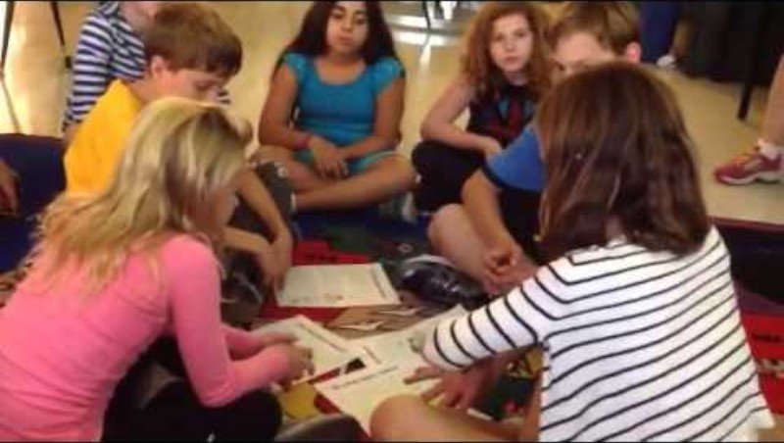
First Turn/Last Turn
Notes:
Here’s a video on First Turn /Last Turn. As you watch, think about how this might work in your classroom.
http://www.youtube.com/watch?v=chbBSQpaY0I

