Slide 2
Discussion Strategies for Online Learning (ELA)
In-Person Presentation
Notes:
Welcome! We are so excited that you are here for Online Discussion Strategies in English Language Arts!

Slide 3
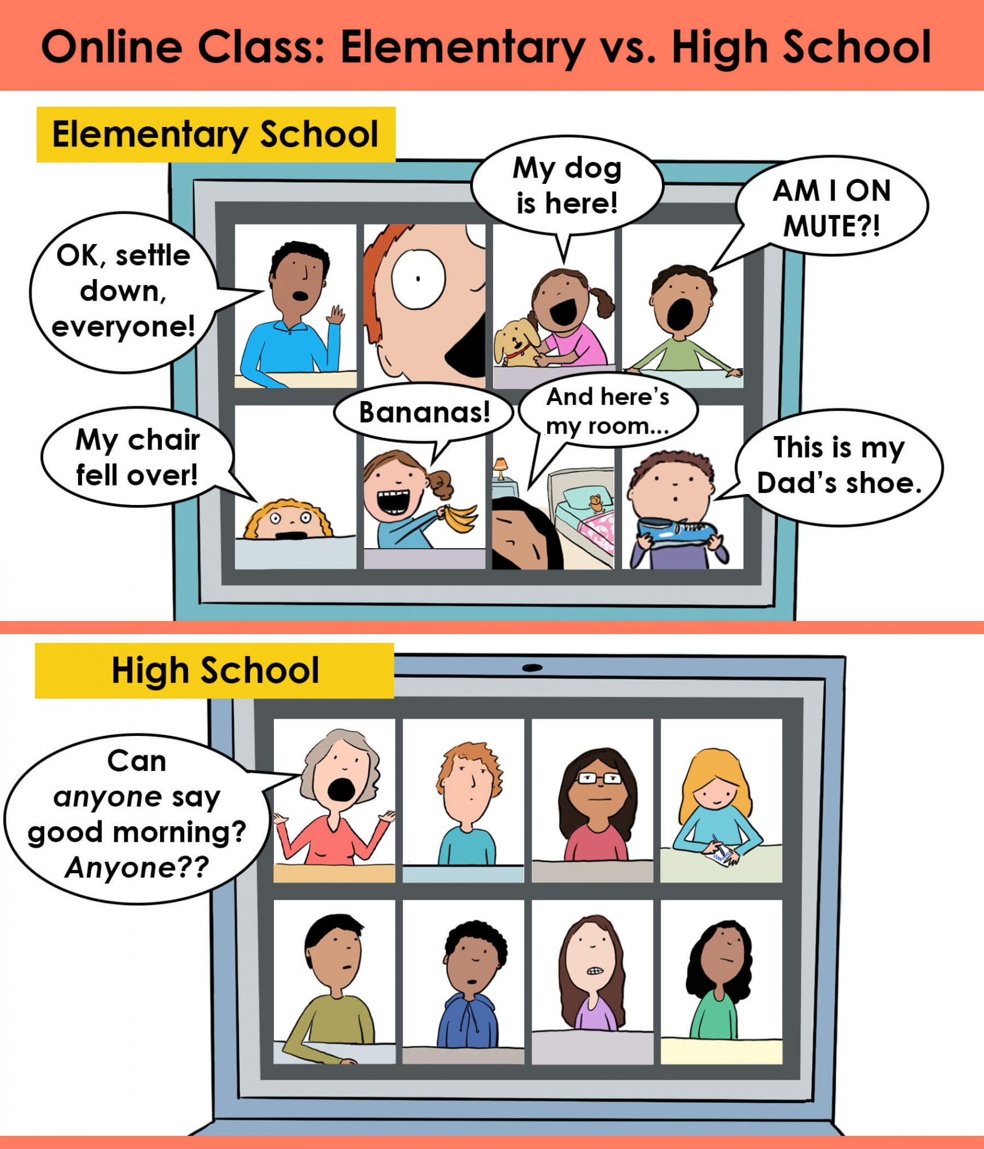
On a scale of 1-5, how do you identify with this image?
1 - Not at all
5 - Completely
Notes:
Set up a poll before the session.
Ask participants to look closely at this cartoon and determine how much they honestly relate to the image.
On a scale of 1-5, please rate how much you identify: 1 being not at all, and 5 completely.
If you are joining us and viewing this presentation later, please think about what your response is, but you won’t be able to respond to the live poll.
Share poll results.
Respond to the results.
Hedger, A. (2020, September 17). A tale of two Zooms. [Digital Image]. Hedger Humor. https://www.hedgerhumor.com/a-tale-of-two-zooms/

Slide 4
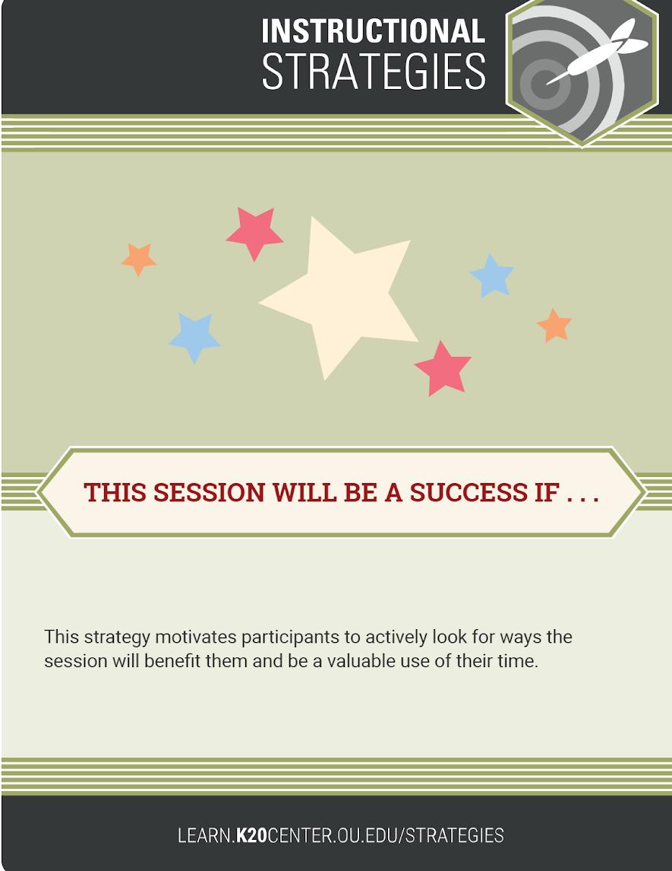
This Session Will Be a Success If...
Take a moment to complete the above sentence.
Please share your sentence with us.
Notes:
K20 Center. (n.d.). This session will be a success if . . . Strategies. https://learn.k20center.ou.edu/strategy/122
Introduce a discussion of the importance of student discussion to ELA.
Discuss briefly the struggles teachers have in facilitating discussions in the online environment.
Have participants share their answers to the Strategy Card: This Session Will Be a Success If…
Some previous responses to this statement: Sally from Nobel says “...if I can learn new ways to get my kids ‘talking’ while I’m teaching online., Tiffany from Tulsa says “...if I take away a new strategy that I can use in person AND online.” Hopefully this session can address that!“
Remind participants to check out the new LEARN website for additional strategies and lessons.

Slide 5
Essential Questions
What does discussion look like in an online ELA classroom?
What does active engagement in discussion look like online?

Slide 6
Session Objectives
Implement a variety of synchronous and asynchronous discussion strategies to improve and enhance substantive student conversations.
Notes:
During this session, we will be showing four strategies you can use in your classrooms that can be used in both synchronous (or face to face) and asynchronous settings that can help to enhance substantive student conversations.

Slide 7
Cognitive Load: A Consideration
New Tech Tools + New Academic Skills + Communication Skills =
3 x Cognitive Load
Consider teaching the new tech tool first in a non-taxing activity.
Notes:
It may be helpful to remember that our students are digital natives, but they are digital consumers and not digital creators in the educational sense.
They often struggle with the tech tools we ask them to use academically.
To help with the cognitive load, which can be three times as high in a discussion setting, consider introducing the tech tool in a fun setting first, before having students use it to showcase or practice an academic skill or through discussion.
Consider having them make a Flipgrid just introducing themselves or use Padlet to persuade why they need new airpods.

Slide 8

Notes:
Our first task is to have participants actually try out some strategies.
In order to try this out, participants will respond to a video.
Have participants watch this video.
Have them think about the “big takeaway” as they watch.
Robins, S. (2015, July 10). Teacherless online classroom - Discussion bored (sic). [Video].YouTube. https://www.youtube.com/watch?v=oqVTr8MZicQ&feature=emb_title

Slide 9
Discussion Strategies That Foster Engagement
  Collaborative Word Clouds
  Chalk Talk
  I Think/We Think
  First Turn/Last Turn
  Find information slides at https://bit.ly/GroupStrategySlides
Notes:
The four strategies we want to share with you today are:
Collaborative Word Clouds
Chalk Talk
I Think/We Think
First Turn/Last Turn
Each of these strategies can work in face-to-face environments, but we want to focus on how best to use these in the online classrooms and platforms. These strategies are useful either way.
Access a “note catcher” to jot down ideas or thoughts as we go.
As we talk about each strategy, if you have any questions, please let us know.

Slide 10
Group Strategies
Break into four groups (or more, if needed).
Select one of the four strategies to explore.
Use the video as your text.
Use the linked Group Strategy Slides below to complete the activities associated with your strategy.
  Group 1: Collaborative Word Cloud (Slides 1-4)
  Group 2: Chalk Talk (Slides 5-8)
  Group 3: I Think/We Think (Slides 9-11)
  Group 4: First Turn/Last Turn (Slides 12-13)
Share out with full group when activities have been completed.
Notes:
Robins, S. (2015, July 10). Teacherless online classroom - Discussion bored (sic). [Video].YouTube. https://www.youtube.com/watch?v=oqVTr8MZicQ&feature=emb_title

Slide 11
Collaborative Word Cloud Steps
Choose one person to scribe for the group.
Go to https://www.wordclouds.com/ (or a similar word cloud creator).
Have the scribe share their screen.
To share a screen, click the GREEN “Share Screen” button at the bottom of the Zoom screen.
Invite each person to choose a word or phrase that summarizes or responds to the reading.
Scribe will type words into the word cloud by clicking on “Wizard” and clicking “Type or paste text.”
Scribe will select “Apply,” creating the word cloud.
Save word cloud by selecting “File;” then “Save as image.” The image can be saved as a JPEG or PNG to be added to the slide.
Finally, choose a reporter to share out about this strategy to the whole group.
Notes:
K20 Center. (n.d.). Collaborative Word Clouds. Strategies. https://learn.k20center.ou.edu/strategy/103
The first strategy we will explore is Collaborative Word Clouds. On slide 11, there are instructions that show the steps in using Collaborative Word Clouds in a digital classroom.
This may be something you have used before. They are fun to create and can be an excellent discussion strategy.
Word clouds are useful for getting students to summarize their ideas into one word.
They can then explain or elaborate on why they chose that word for the word cloud.
Have the students share their words to the generator, then the word cloud is created.
Once you share the word cloud with the students, as a class, have them discuss what they notice.
Which words are dominant?
Why?
What does this tell us?
Are words are missing that should be included?
What is your takeaway from this word cloud?
The discussion can be an important reflection that enables students to come back to and synthesize the information gathered from the group.
There are a number of options for generating word clouds:
Wordclouds.com
Mentimeter
Answer Garden
Wordle
Nearpod

Slide 12
Collaborative Word Clouds
Synchronous Settings
Whole group or breakout rooms
Build in processing time
Practice your chosen generator
Asynchronous Settings
Students post word in chat, Google Form, Doc
Share teacher-generated word cloud
Discussion board reflection
Notes:
In a face-to-face, synchronous setting, there are some considerations for planning a lesson with collaborative word clouds.
Will you do this with the whole group or do you plan to have small groups each do their own collaborative word clouds?
We want to remind you of cognitive load here: If students haven’t done a collaborative word cloud before with the whole class, doing so in small groups or in breakout rooms might not be the best time to introduce the activity.
It might be best to first do the activity as a whole class so students understand the technology and what to expect with the discussion.
In terms of the discussion, remember to build in processing time. It will take time for students to think about the word they want for the collaborative word cloud.
If you want students to be thoughtful in choosing their word, you will want to build in that time.
Consider providing that time before the activity begins synchronously, or in class. Otherwise, you won’t get the buy-in. Everyone will be frustrated..
Practice using whatever word cloud tool you chose beforehand. This will give you confidence before class time.
In the asynchronous setting, to make a collaborative word cloud discussion be most effective, have students post their chosen word either in a chat, Google form, or shared document for you.
This process enables you to create the collaborative word cloud.
Once you have the word cloud, you could share it to the LMS for students to view.
Consider having a discussion board reflection for students, as you would face to face, asking them what they notice.
This strategy could be a discussion board post or a Flipgrid response to the collaborative word cloud.

Slide 13
Chalk Talk Steps
Chalk talk is silent discussion strategy.
Go to the slide labeled “Chalk Talk:” https://bit.ly/35miYK1
Read the discussion prompt.
Make a copy of the sticky note by right clicking on the note.
  A box will pop up with options.
  Choose “Copy.”
  Click elsewhere on the slide.
  Right click again to access options.
  Click “Paste.”
  A new sticky note should appear.
Type your response on the sticky note.
Click on note to place it on the board where it will not be blocking others’ responses.
Take a moment to read other responses.
Use link to access sample strategy: https://bit.ly/35miYK1
Notes:
For this strategy, share your takeaway from the video.
In order to do this, you will need to access the document titled Chalk Talk.
When you have accessed this document, you will see that there are sticky notes to the left of the slide.
By right clicking on the sticky note, you can make a copy of the sticky note for yourself.
Right click and paste, for a new sticky note.
Once you have copied and pasted a new sticky note for yourself, you can click inside the sticky note to change the text and type your response.
Share your takeaway from the video.
Take a moment to read others’ responses.
Comment on other responses as well.
Time allowed for this strategy: Approximately 4 minutes.

Slide 14
Chalk Talk
Synchronous Settings
    Whole group or breakout rooms
    Number of prompts or questions
    Build in reflection time at the end
Asynchronous Settings
Avoid the “required responses” trap
Alternatives to whole-group reflection
Notes:
Consider the available time you have and whether your students have done this type of activity before.
Have they participated in Chalk Talk or breakout rooms before?
Could they complete this activity in breakout rooms, or is it better to complete this activity as a whole group for discussion?
Consider also the number of prompts or questions you have for this particular activity (consider your learning goal here).
Build in reflection time at the end. It could either be a verbal reflection or a written reflection to guide students to make meaning over the discussion they just had. What mindsets did you notice? What patterns emerged? What challenged your thinking? What did this make you wonder?
Reflection can be individual or done as a whole class.
In the asynchronous setting, it can be easy, as we saw in the video, to get stuck in the trap of “Write your response and then respond to two discussion posts.”
The problem with this kind of assignment is that it is not how we would expect our students to interact face to face. I would not tell my students that they had to respond to two people in a face-to-face discussion, nor would I accept “I agree” as an appropriate response.
Consider rewording, as writer and educator John Orlando suggests, “one or two original thoughts” instead of specifying whether or not these must be original or reply posts. The article is cited below.
A final suggestion for asynchronous use of chalk talk is to think of alternatives to whole group reflection.
Provide reflection time after the discussion.
One way to help students better process this in an asynchronous setting, especially with discussion posts, is to consider writing or recording a summary of important or interesting points that emerged in the Chalk Talk.
This idea comes from Flower Darby in Small Teaching Online.
She suggests posting this summary or sending it as a concluding announcement as a way to reinforce the learning that happened to help students discern what was most relevant and to retain the most important information from the discussion.
Darby also suggests that this can increase motivation by calling out individuals with exemplary posts as a way of identifying those with comments that were done insightfully or that went above and beyond.
Share the examples.
Have students respond to anticipation guide questions/statements as prompts;
Pull important quotes from the text to have students respond to; pull images or memes to have students make connections to the text they are reading.
Have students respond to character analysis statements.
These are just some suggestions for ways to increase the functionality and use of the Chalk Talk strategy.
Orlando, J. (2017, March 16). What research tells us about online discussion. Faculty focus. https://www.facultyfocus.com/articles/online-education/research-tells-us-online-discussion/

Slide 15
I Think/We Think Steps
  I Think/We Think is a two-part strategy.
  Open up the linked graphic organizer.
  Complete the section labeled “I Think” by typing in your response to the prompt.
  After everyone has had a chance to write their responses, members take turns sharing out.
  In the discussion, members should come to a consensus on the prompt.
  Write this in the “We Think” section.
  Choose someone to be the reporter for the group to share out about this strategy to the whole group.
Notes:
I Think/We Think is a two-part strategy that provides students with a chance to first prepare their thoughts in writing before participating in the discussion.
Then, they share their thoughts with the group during the discussion.
Finally, the group must come to a consensus as to their answer to the question or prompt to share out.
It is helpful to come back together as a whole group and have groups share out their responses and discuss/reflect at the end to punctuate the learning.

Slide 16
I Think/We Think
Synchronous Settings
Breakout rooms or brainstorming session
Use of chat function
Asynchronous Settings
Shared documents
Small group discussion boards
Reflection
Notes:
For synchronous settings, decide whether you want to use I Think/We Think as a whole class brainstorming session or as smaller groups in breakout rooms.
Consider the purpose of the activity and the prompt/question you are providing.
Either way, in a synchronous session, the chat feature can be useful for those students who might not feel completely comfortable or able to speak out verbally during the discussion.
Using the chat feature OR having a shared Google Doc for those students to place their thoughts can allow less verbal students to participate in the discussion.
In an asynchronous setting, the use of a shared document for the group enables students to participate together.
Ensure that you provide specific times during which students must complete parts of the I Think/We Think so that group members are able to asynchronously participate. For example, “All members must write their thoughts on the shared document by noon Friday. You will then have until 3pm Tuesday to read your peers’ comments and write a reflection.”
Another way to set up the I Think/We Think is to use small group discussion boards in your LMS if those are available.
Building in time for reflection is integral, especially in the asynchronous space.
Provide an activity that enables students to reflect on the discussion and what they learned from it.

Slide 17
First Turn/Last Turn Steps
First Turn/Last Turn is a two-part strategy.
Using a common text, group members highlight two to four significant passages.
Each member will share out the section they highlighted.
The member should only read the highlight, not comment on it.
All other group members will take turns responding to the highlight.
Once everyone has had a chance to comment, the original reader end with a final comment.
The process repeats as each member reads their highlight.
When all members have read, the activity is complete
Notes:
The final strategy is First Turn/Last Turn.
This strategy is highly structured and focuses on a common text that the group members have read.
It starts with all members highlighting a portion of the text that seems significant.
They can annotate for something specific or one or two things that were important.
Then, in the group, the first person will read their highlighted text.
They will only read aloud the highlighted text. They do not comment or explain.
Everyone else takes a turn responding to the piece of text the person read.
They can explain why they think it was chosen, how they responded to the text, and what they noticed about it.
Once everyone else has commented, the person who read the text finally gets to explain why they chose it.
Then, the process starts over with someone else reading their section until everyone has had their turn.

Slide 18
First Turn/Last Turn
Synchronous Settings
Breakout rooms or whole group
Chat function
Silent version
Asynchronous Settings
Choices: Flipgrid, Padlet, discussion boards
Notes:
The video is of students who are generally younger than the students that many of you teach, but it demonstrates that middle and high school students are also able to readily engage with this strategy as well.
https://www.youtube.com/watch?v=chbBSQpaY0I
In synchronous settings, breakout rooms can help you create small groups for First Turn/Last Turn.
If you would prefer to use the strategy with a whole class of students, consider choosing only a few students to share their highlighted text unless you have a small class.
Consider using the chat function to provide multiple ways for students to participate in the discussion.
Video conferencing can make it especially difficult for students to feel comfortable sharing verbally.
Consider using the strategy silently, using a shared document, slide, or Padlet with students to have them share their thoughts about the chosen piece of text.
In an asynchronous setting, you could consider how you choose to have your students participate.
Breaking your students into small groups can allow them to interact with each other through the LMS.
Using Flipgrid could allow them to video record as an option. Padlet or discussion boards can allow students to share their thoughts in writing.
Consider what tools your students are comfortable using.
Remember cognitive load and practice using the tool first.
Remember in an asynchronous setting to set clear due dates for participation.
For First Turn/Last Turn, you will want to set a due date for students to post their chosen highlighted text, another due date for them to respond to their group mates' text choices, and a final due date for them to explain their own text choices.
EXAMPLES: Have students choose what supports the text’s claims; if teaching logos, ethos, pathos, find examples of those in the text; examples that show the characterization; examples that show the tone or mood; examples that help show the setting or help set the scene;
Lindauer, B. (2014, September 25). First Turn - Last Turn. [Video]. YouTube. https://www.youtube.com/watch?v=chbBSQpaY0I

Slide 19
Share Out: Strategy Reflection
Which of these would you like to implement in your classes?
  Collaborative Word Clouds
  Chalk Talk
  I Think/We Think
  First Turn/Last Turn
What text or topic could you use it with the strategy you chose?
Would you use the strategy synchronously or asynchronously?
Notes:
We hope that you have been able to take away some ideas about these four strategies for use in your own classrooms. We want to hear from you!
Collaborative Word Clouds, Chalk Talk, I Think/We Think, and First Turn/Last Turn are all strategies that can be reimagined for the online classroom in multiple ways.
Which of these four strategies would you like to implement in your classes?
Do you have a text or topic in mind?
Do you plan to use the strategy synchronously or asynchronously?
While participants are typing in ideas: Share examples already given (“When you were in the classroom, how did you use ____ ?”).

Slide 20
After exploring the discussion strategies we have shared today, have your perceptions changed?
On our scale of 1-5, how do you identify with this image?
1 - Not at all
5 - Completely
Notes:
Use the poll as a post-session assessment. Set this up before the session.
Ask participants to determine whether or not their perceptions have changed after the session. Ask whether they feel the image still represents their classes.
Open the poll: “On a scale from 1-5, how do you feel your classrooms will feel in the future?”
Ask participants to reflect on how their numbers may have changed.

Slide 21
Resources
Darby, F. (2019). Small teaching online: Applying learning science in online classes. Jossey-Bass.
Hedger, A. (2020, Sept 27). A tale of two Zooms [Digital Image]. Hedger Humor. https://www.hedgerhumor.com/a-tale-of-two-zooms/
K20 Center. (n.d.). Chalk talk. Strategies. https://learn.k20center.ou.edu/strategy/197
K20 Center. (n.d.). Collaborative word clouds. Strategies. https://learn.k20center.ou.edu/strategy/103
K20 Center. (n.d.). First turn/last turn. Strategies. https://learn.k20center.ou.edu/strategy/50
K20 Center. (n.d.). I think/we think. Strategies. https://learn.k20center.ou.edu/strategy/141
K20 Center. (n.d.). This session will be a success if... Strategies. https://learn.k20center.ou.edu/strategy/122
K20 Center. (2016, July 18). Whys and Norms - K20 LEARN. [Video]. YouTube. https://www.youtube.com/watch?v=ERt_L_QURWg
Lindauer, B. (2014, Sept 25). First turn-last turn. [Video]. YouTube. https://www.youtube.com/watch?v=chbBSQpaY0I
Orlando, J. (2017, Mar16). What research tells us about online discussion. Faculty Focus. https://www.facultyfocus.com/articles/online-education/research-tells-us-online-discussion/
Robins, S. (2015, July 10). Teacherless online classroom-Discussion bored (sic). [Video]. YouTube. https://www.youtube.com/watch?v=oqVTr8MZicQ&feature=youtu.be
Young, J. (2020, Oct 1). Sudden shift to online learning revealed gaps in digital literacy, study finds. EdSurge. https://www.edsurge.com/news/2020-10-01-sudden-shift-to-online-learning-revealed-gaps-in-digital-literacy-study-finds
Notes:
These are the resources we used in our presentation if you are interested in learning more.

