Slide 2
Discussion Strategies for Online Learning (ELA)
Virtual Presentation
Notes:
Welcome! We are so excited that you are here for Online Discussion Strategies in English Language Arts!

Slide 3
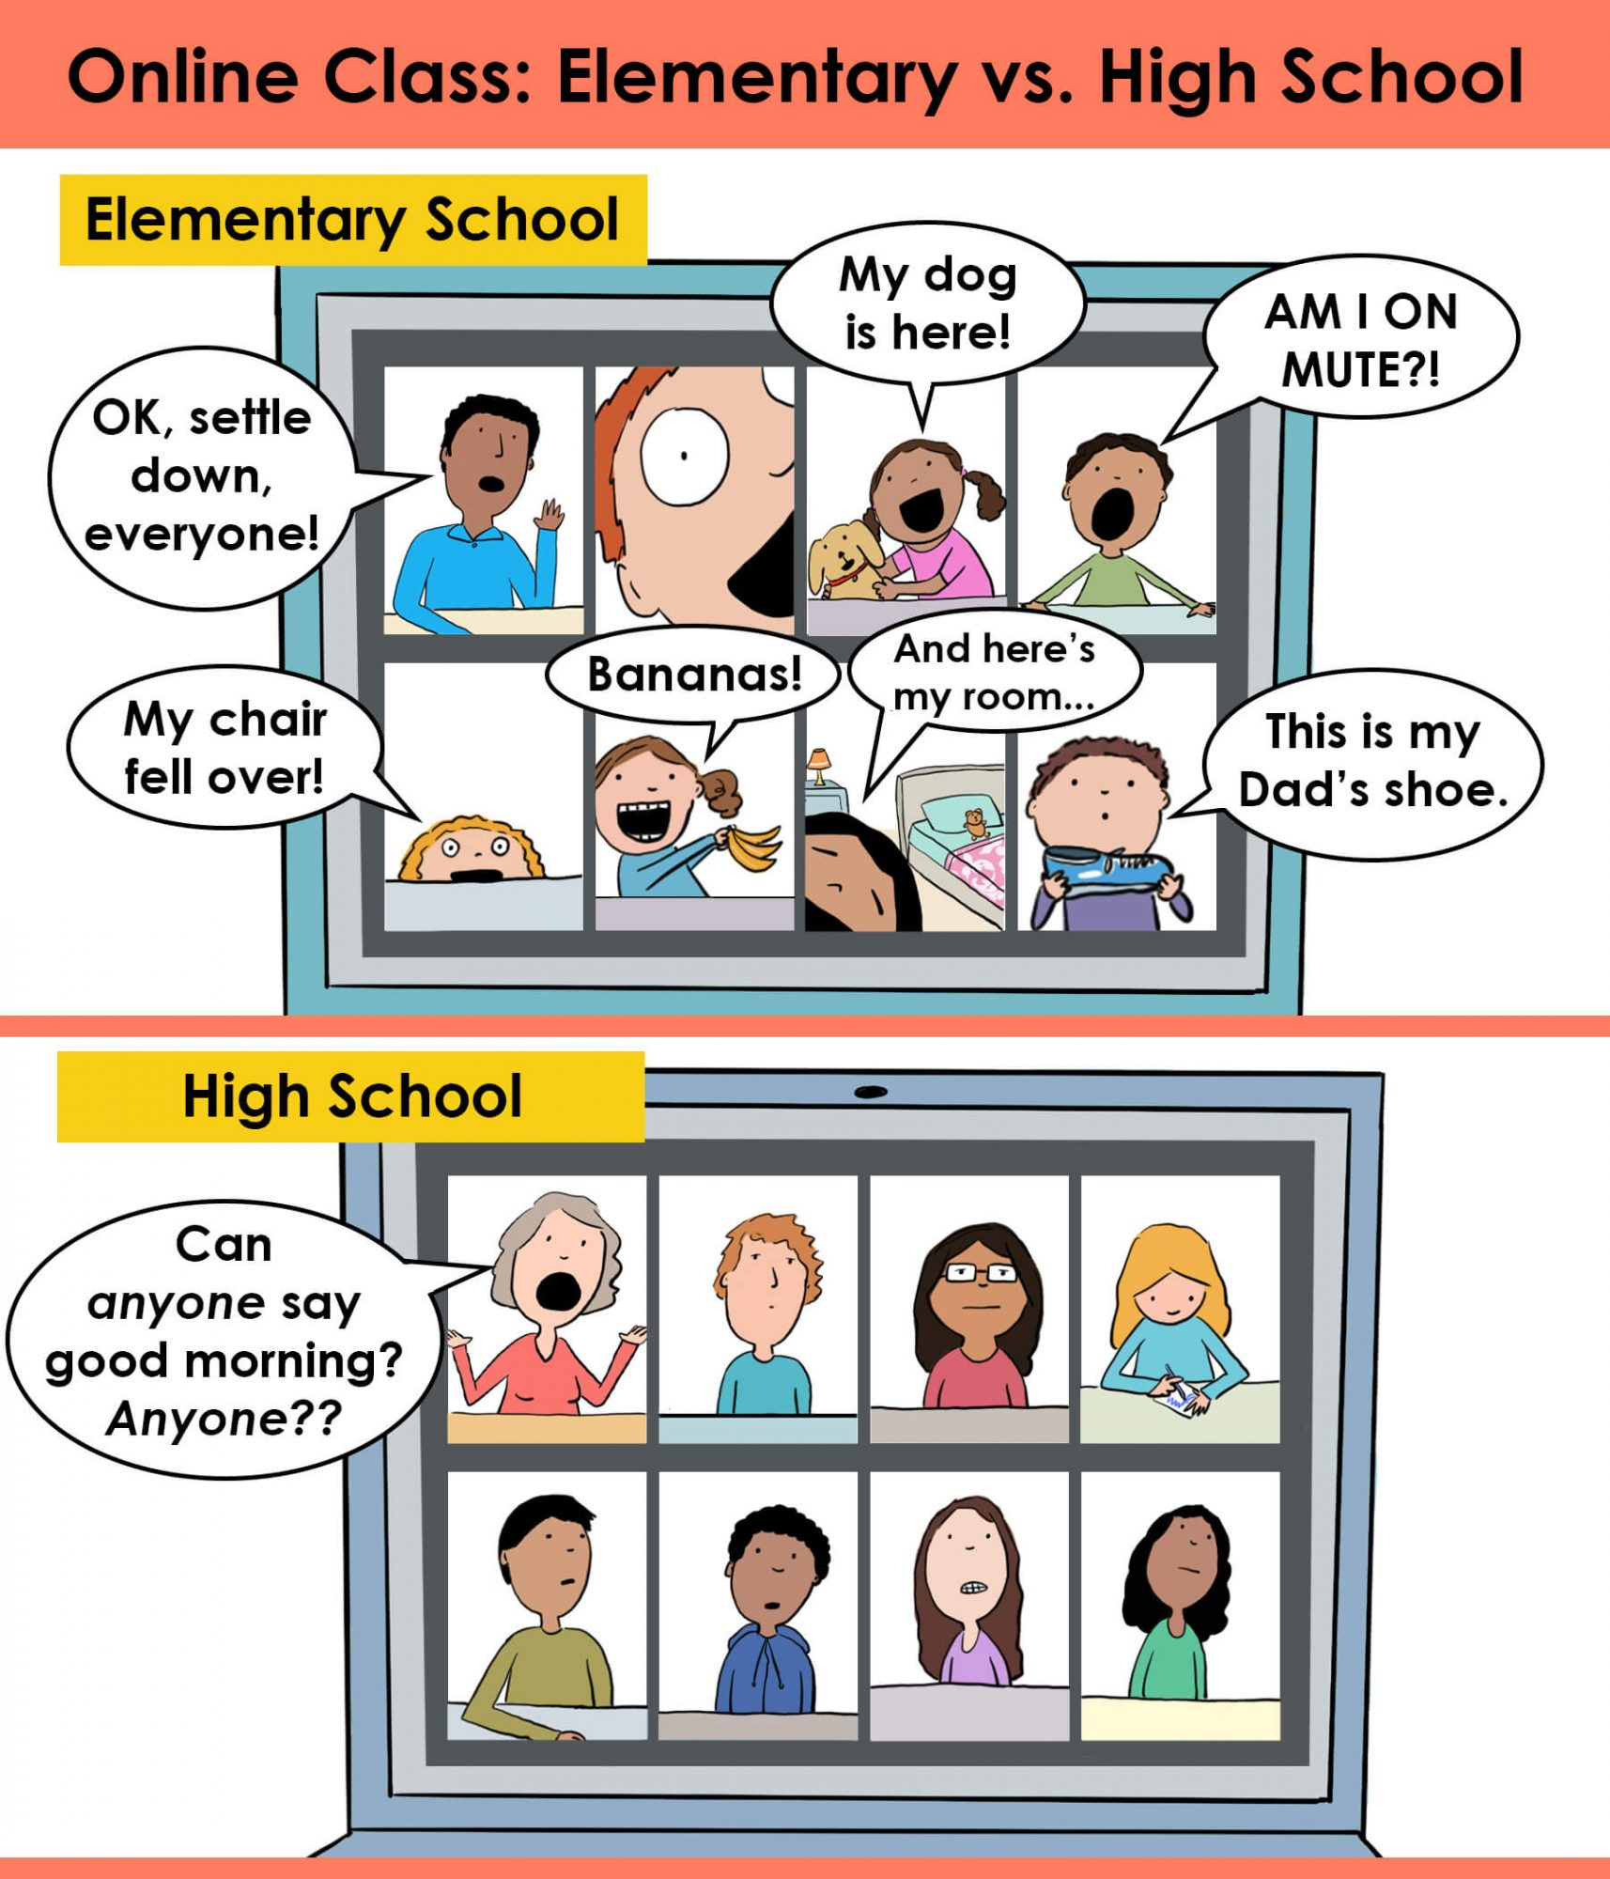
Quick Poll:
On a scale of 1-5, how much do you identify with this image?
1= Not at all
5= Completely Identify
Notes:
Set up a poll to use before the session.
Look at the cartoon. Determine where you fall on the scale of 1-5: 1=not at all. 5=Completely Identify.
Show poll results.
Discuss/respond to outcomes.
Hedger, A. (2020, September 17). A tale of two Zooms. [Digital Image]. Hedger Humor. https://www.hedgerhumor.com/a-tale-of-two-zooms/

Slide 4
This PD Will Be a Success If...
Take a moment to complete the sentence above. Please share your sentence with us.
Notes:
K20 Center. (n.d.). This PD will be a success if . . . Strategies. https://learn.k20center.ou.edu/strategy/122
Student discussion is critical to the ELA classroom. We want to identify which strategies foster the most effective environment for discussion.
Reflect on this strategy card: This PD will be a success if…
Tell us what will make this session successful for you.
Check out the new LEARN website for additional strategies and lessons.

Slide 5
Essential Questions
What does discussion look like in an online ELA classroom?
What does active engagement in discussion look like online?

Slide 6
Session Objectives
Implement a variety of synchronous and asynchronous discussion strategies to improve and enhance substantive student conversations.
Notes:
During this session, we will share four strategies to use in the ELA classrooms. They can be used in both synchronous (or face to face) and asynchronous settings. The strategies are designed to enhance substantive student conversations.

Slide 7
Cognitive Load: A Consideration
New Tech Tools + New Academic Skills + Communication Skills =
3 x Cognitive Load
Consider teaching the new tech tool first in a non-taxing activity.
Notes:
Remember that while our students are digital natives, they are digital consumers and not digital creators in the educational sense.
Students often struggle with tech tools we ask them to use academically.
To help with the cognitive load, which can be three times higher than a discussion setting, consider introducing the tech tool in a fun setting first before having students use it to showcase or practice an academic skill or through discussion.
Have students make a Flipgrid just introducing themselves or use Padlet to persuade their parents that they need new airpods.

Slide 8
Notes:
This video provides insight into the usefulness of some of the strategies we believe help generate classroom discussion.
Watch this video, and as you watch, think about what the big takeaway is.
Video: Robins, S. (2015, July 10). Teacherless online classroom - Discussion bored (sic). YouTube. https://www.youtube.com/watch?v=oqVTr8MZicQ&feature=emb_title

Slide 9
Discussion Strategies
Collaborative Word Clouds
Chalk Talk
I Think / We Think
First Turn / Last Turn
Notes:
Four effective strategies for sparking lively and effective classroom discussion include the following:
Collaborative Word Clouds
Chalk Talk
I Think/We Think
First Turn/Last Turn
Each of these strategies can work in face-to-face environments, but the focus of this presentation is how best to use these in the online classrooms and platforms.
Use your Note Catcher to jot down ideas or thoughts as we go.
Share your questions and thoughts with the group as we progress through each strategy.

Slide 10
Collaborative Word Clouds Steps
Choose one person to scribe for the group.
Have the scribe go to https://www.wordclouds.com/ (or a similar word cloud creator) and share their screen.
To share a screen, click the GREEN “Share Screen” button at the bottom of the Zoom screen.
Each group member chooses a word or phrase to summarize or respond to the reading.
The scribe types this into the word cloud by clicking “Wizard;” then clicking “Type or paste text.”
The scribe clicks “Apply,” creating the word cloud.
To save the word cloud, click on “File;” then “Save as image.” The image can be saved as a JPEG or PNG to be added to the slide.
Choose a reporter to share out to the whole group.
Notes:
The first strategy is Collaborative Word Clouds.
Review instructions for using Collaborative Word Clouds in a digital classroom.
Determine ahead of time how you want to use word clouds as a discussion strategy: summary; explain; elaborate.
There are a variety of generators to create word clouds: Mentimeter, AnswerGarden, Wordle, Nearpod, and others available online.
Have students share their words to the generator to create the word cloud.
Discuss the word clouds: guide students in analyzing what is there and what is not there.
Identify the takeaway from the word cloud.
Guide students into reflecting and synthesizing what they have learned.

Slide 11
Notes:
This sample word cloud comes from a middle school literature class. Having read Seedfolks, the class reflected on themes from the novel.

Slide 12
What makes something memorable?
What makes something forgettable?
Notes:
These two examples illustrate how students can bring ideas forward and show big repeating ideas.

Slide 13
Collaborative Word Clouds
Synchronous Settings
Whole group or breakout rooms
Build in processing time
Practice the using the word cloud generator before class
Asynchronous Settings
Students post words in chat, Google Form, Doc
Share teacher-generated word cloud
Host discussion board reflection
Notes:
In a face-to-face, synchronous setting, there are some considerations for planning a lesson with collaborative word clouds.
Which is more effective: whole group or small groups?
Remember the cognitive load. If students haven’t already built a collaborative word cloud before with the whole class, doing so in small groups may be taxing.
Consider doing the activity as a whole class so that students understand the technology and what to expect with the discussion.
Build in processing time in the lesson. Students need time to think about the word they want to contribute.
Consider providing time before the activity begins synchronously or during class. Otherwise, it is unlikely you will get student buy-in.
Practice beforehand using whatever word cloud tool you chose to gain confidence.
In the asynchronous setting, have students post their chosen word either in a chat, Google form, or shared document for you.
Once you have their words, create the collaborative word cloud.
Share it to whatever LMS you are using for students to view.
Consider having a discussion board reflection for students to discuss the collection of words.
This could be a discussion board post or a Flipgrid response to the collaborative word cloud.

Slide 14
Chalk Talk
Silent discussion strategy
Students write thoughts and respond to each other
Responses can be either images or words or both
Create separate boards for each question or prompt
Notes:
Chalk Talk is a silent discussion strategy where students write their thoughts on a discussion board independently of one another.
They share their thoughts and respond to each other.
The responses can be written or images.
Each question/prompt is on a separate response board.

Slide 15
Chalk Talk Steps
Chalk Talk is a silent discussion strategy.
Go to the slide labeled “Chalk Talk:” https://bit.ly/35miYK1
Read the discussion prompt.
Make a copy of the sticky note by right clicking on the note. Right clicking opens a box of options.
Choose “Copy.” Then, with the mouse, click elsewhere on the slide.
Right click again so that the box of options pops up again.
Click “Paste.” A new sticky note should appear.
Type your response on the sticky note.
Move the sticky note around on the board to place it where it will not block other responses.
Take a moment to read other responses.
Notes:
For this strategy, you will share your takeaway from the video.
In order to do this, you will need to access the document titled Chalk Talk on the next slide.
There are sticky notes to the left of the slide.
Right click on the sticky note to make a copy of the sticky note for yourself.
If you right click and choose paste, you will have a new sticky note.
Once you have copied and pasted a new sticky note for yourself, you will be able to click inside the sticky note to change the text and type your response.
Write your takeaway from the video.
Read others’ responses.
Comment on others’ responses.
Time allowed: Approximately 4 minutes.

Slide 16
What is your takeaway from the video?
CHALK TALK STRATEGY
(COPY A STICKY NOTE)
Example response here. Just right-click on one of the stickies to the left, click “Copy,” then paste it to the board.
Type here
Type here
Type here
Type here
Notes:
Right click on the sticky note to make a copy of the sticky note for yourself.
If you right click and choose paste, you will have a new sticky note.
Once you have copied and pasted a new sticky note for yourself, you will be able to click inside the sticky note to change the text and type your response.
Write your takeaway from the video.
Read other responses.
Comment on other responses.
Time allowed: Approximately 4 minutes.

Slide 17
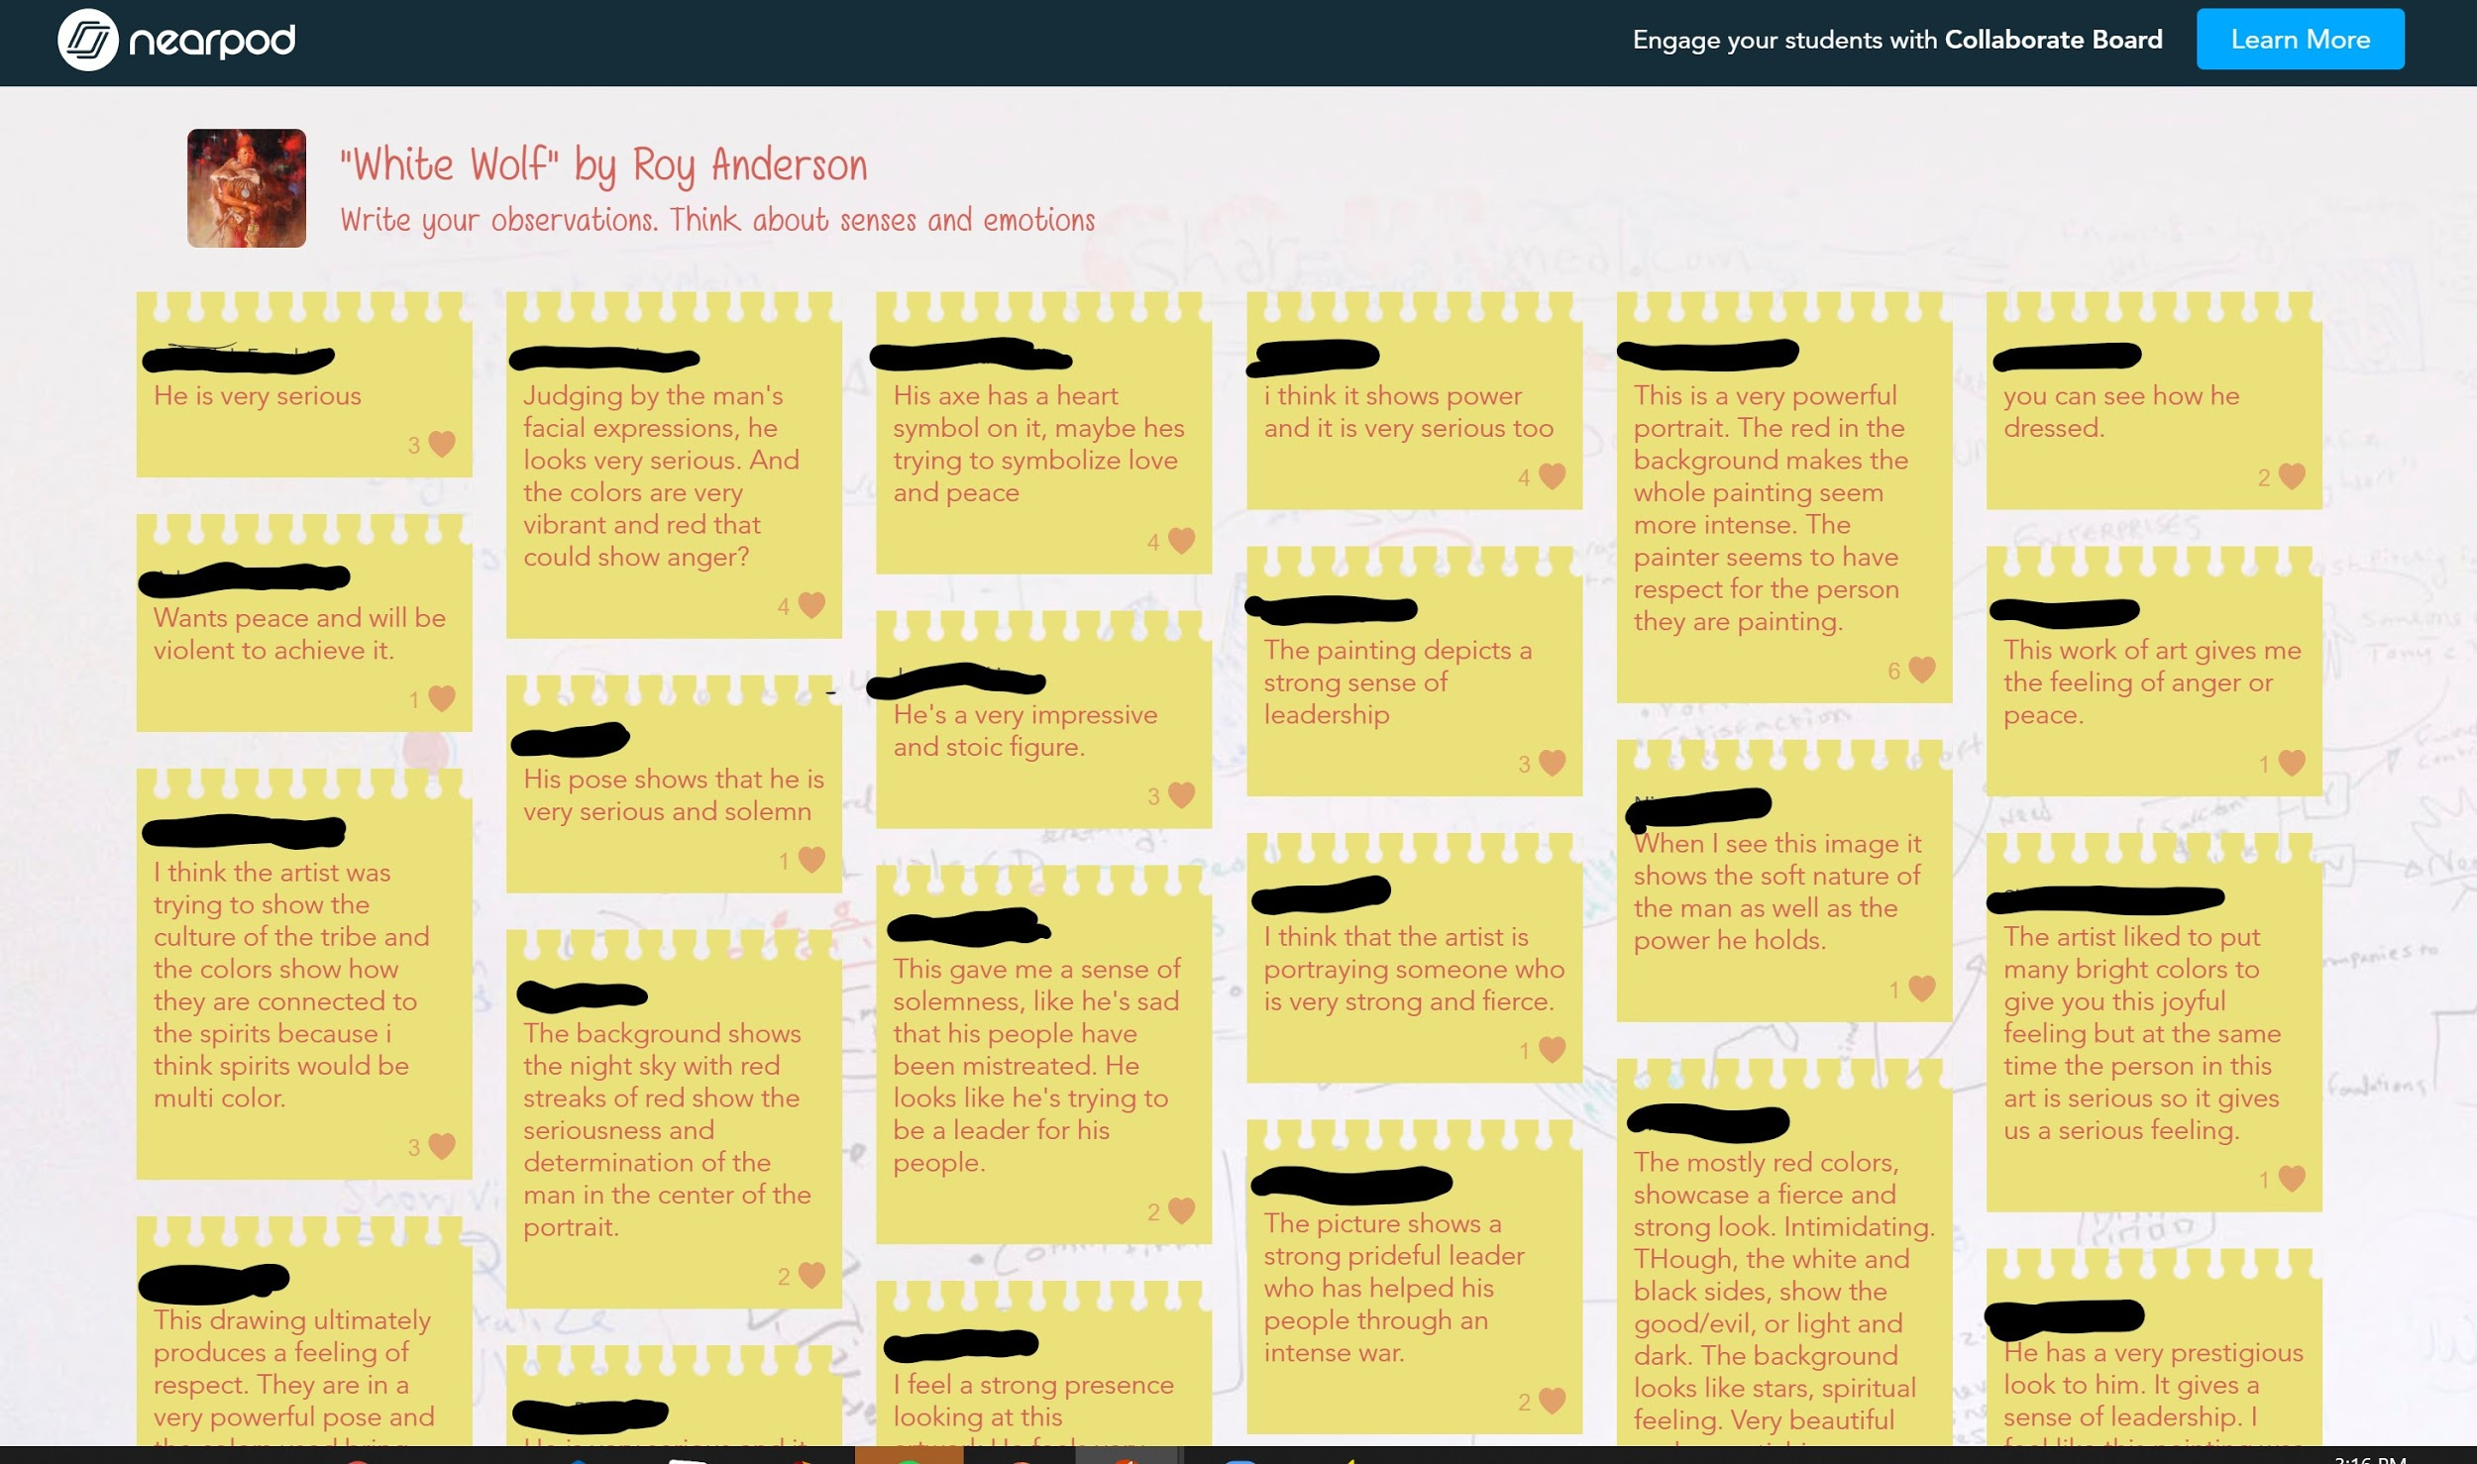
Notes:
In this example, the teacher used Nearpod to do multiple Chalk Talk boards with the students.
The teacher did this activity with the whole class and synchronously.
They used images as prompts, asking the students to connect the images to what they knew from the texts they had read.
With Nearpod, the students were able to “like” each others’ comments.

Slide 18
Chalk Talk
Synchronous Settings
Whole-group vs breakout rooms
Number of prompts or questions
Add in reflection time at the end
Asynchronous Settings
Avoid the “required responses” trap
Alternatives to whole-group reflection
Notes:
Consider the time you have and whether your students have done this type of activity before.
Have they participated in Chalk Talk or breakout rooms before?
Could they succeed in breakout rooms for this activity, or would it be best to complete this activity as a whole group for discussion?
Consider the number of prompts or questions you have for this particular activity
Consider your learning goal.
Build in reflection time at the end.
Reflection can be either a verbal reflection or a written reflection: What mindsets did you notice? What patterns emerged? What challenged your thinking? What did this make you wonder?
Reflections can be either individual or done as a whole class.
In the asynchronous setting, it can be easy to get stuck in the trap of “Write your response and then respond to two discussion posts.”
This “required response” is not a viable strategy for learning.
In face-to-face settings, students do not have to respond to two people simultaneously. They cannot simply respond “I agree” as a verbal response.
Reword to elicit “one or two original thoughts.” (Orlando).
Do not specify that these must be original or reply posts.
Reflection time after discussion is essential.
Consider writing or recording a summary of important or interesting points that emerge in the Chalk Talk (Darby, F.).
Posting a summary or sending it as a concluding announcement reinforces the learning.
This strategy helps students discern what was most relevant and to retain the most important information from the discussion.
Call out individuals with exemplary posts as a way of identifying insightful comments that go above and beyond. (Darby, F)
Darby, F. (2019). Small teaching online: Applying learning science in online classes. Jossey-Bass.
Orlando, J. (2017, March 16). What research tells us about online discussion. Faculty focus. https://www.facultyfocus.com/articles/online-education/research-tells-us-online-discussion/

Slide 19
I Think/We Think Steps
I Think/We Think is a two-part strategy.
Open up the linked graphic organizer in the next slide.
Complete the section labeled “I Think” by typing in your response to the prompt.
When everyone has written their responses, take turns sharing out.
In the discussion, ask participants to reach a consensus on the prompt.
Write this in the “We Think” section.
Choose someone to be the reporter for the group to share out this strategy to the whole group.
Notes:
I Think/We Think is a two-part strategy that provides students with a chance to first prepare their thoughts in writing before participating in the discussion.
Then, they share their thoughts with the group during the discussion.
Finally, the group must reach a consensus about the question or prompt to share out.
It is helpful to come back together as a whole group and have groups share out their responses and discuss/reflect at the end to punctuate the learning.

Slide 20
What are your takeaways from the reading?
I Think
Type your thoughts here.
We Think
Type your group’s consensus here.
Notes:
This is table is one example of a graphic organizer that will help get students started.
It can be as simple as having students draw a T-chart on their papers if your class is in person. Being online, however, requires more preparation.
Use editable slides or documents to enable students to quickly provide their ideas.
Use Google Classroom or Canvas for assignments so that students each have their own copy.

Slide 21
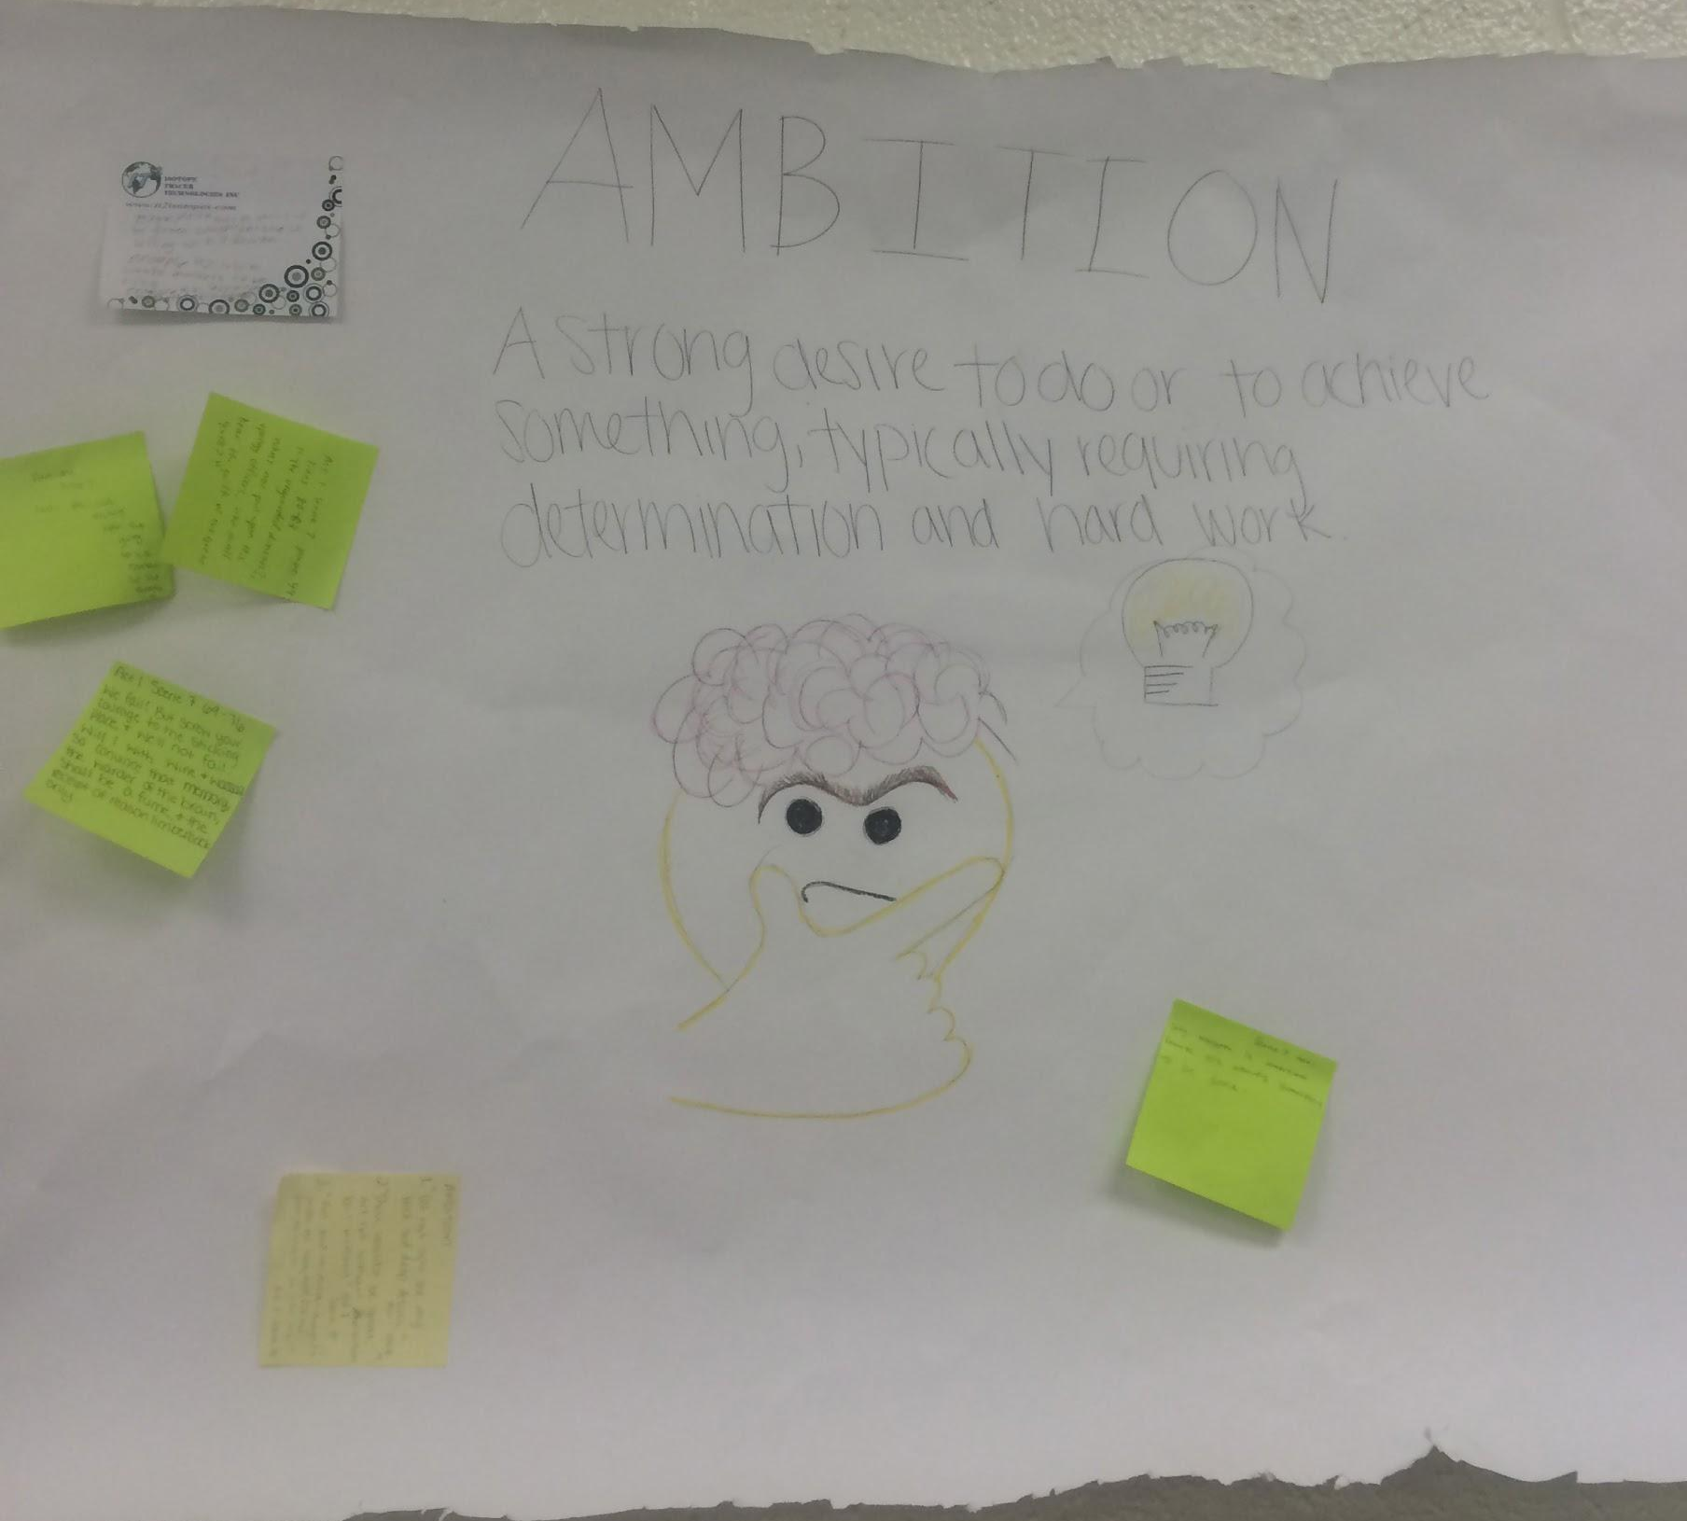
I Think/We Think Example
Students wrote their “I Think” response on sticky notes and brought this to the group. The group created a “We Think” poster.

Slide 22
I Think/We Think
Synchronous Settings
Set up breakout rooms or brainstorming sessions
Use the chat function
Asynchronous Settings
Shared documents
Small group discussion boards
Reflection
Notes:
For synchronous settings, consider whether you want to use I Think/We Think as a whole class brainstorming session or whether you want to break students into smaller groups.
Consider the purpose of the activity and the prompt/question you are using.
Either way, in a synchronous session, the chat feature can be useful for students who might not feel completely comfortable or able to speak out verbally during the discussion.
Using the chat feature OR having a shared Google Doc for those students to place their thoughts can enable less verbal students to participate in the discussion.
In an asynchronous setting, using a shared document for the group enables students to participate together.
Ensure that you provide specific times during which students must complete parts of the I Think/We Think so that group members are able to asynchronously participate.
Another way to set up the We Think is to use small group discussion boards in your LMS, if those are available.
Establishing time for reflection is integral, especially in the asynchronous space.
Provide an activity that enables students to reflect on the discussion and what they learned from it.

Slide 23
First Turn/Last Turn Steps
First Turn/Last Turn is a two-part strategy.
Ask participants to highlight two to four significant things in the common text.
As a group, each person, one at a time, takes a turn reading their highlighted passage.
Readers do not comment or explain the passage.
When the reading is done, each group member responds to what has been read.
Once everyone has had a chance to comment, the initial reader ends with a final comment.
The process starts over with someone else’s highlighted section until everyone has had their turn.
Notes:
The final strategy we want to share with you is First Turn/Last Turn.
This strategy is very structured and is focused on a text that students have read.
It starts off with students annotating the text.
The annotations can be specific or more general.
One group member will read their highlighted text.
They won’t say anything about their highlight. They cannot comment or explain.
Everyone else will take a turn responding to that text the first speaker highlighted.
They can explain why they think it was chosen, how they responded to the text, and what they noticed about it.
Once everyone else has commented about a particular section, the person who initially read the text explains why they chose it.
The process starts over with someone else reading their section.
The process continues until everyone has had a turn to share their text.

Slide 24
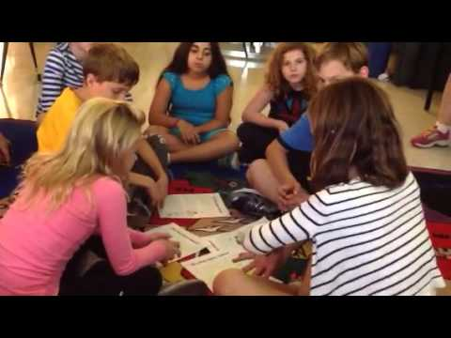
First Turn/Last Turn Example
Notes:
Here’s a video on First Turn/Last Turn. As you watch, think about how this might work in your classroom.

Slide 25
First Turn/Last Turn
Synchronous Settings
Breakout rooms or whole group
Chat function
Silent version
Asynchronous Settings
Choices: Flipgrid, Padlet, discussion boards
Notes:
The video illustrates that this particular strategy is relevant to students of all ages. Middle and high school students respond equally well.
In synchronous settings, breakout rooms can help you create small groups for First Turn/Last Turn.
If you would use the strategy with a whole class of students, consider choosing only a few students to share their highlighted text unless you have a small class.
Consider using the chat function to allow students multiple ways to participate in the discussion.
Video conferencing can make it especially difficult for students to feel comfortable sharing verbally.
Consider using the strategy silently, using a shared document, slide, or Padlet with students to have them share their thoughts about the chosen piece of text.
In an asynchronous setting, consider how students will participate.
Assign students to small groups to enable them to interact with each other through the LMS.
Use Flipgrid to give them video recording as an option.
Padlet or discussion boards encourage students to share their thoughts in writing.
Consider what tools your students are comfortable using.
Factor in the concept of cognitive load and practice using the tool first.
In an asynchronous setting establish clear due dates for participation.
For First Turn/Last Turn, consider setting a due date for students to post their chosen highlighted text, another due date for them to respond to their group mates' text choices, and a final due date for them to explain their own text choices.

Slide 26
Share Out in the Chat
Which of the strategies would you like to implement in your classes:
Collaborative Word Clouds
Chalk Talk
I Think/We Think
First Turn/Last Turn
What text or topic could you use your preferred strategy with?
Would you use it synchronously or asynchronously?
Notes:
All four of the strategies we’ve explored can be reimagined for the online classroom in multiple ways.
Give us your feed back. We want to hear from you.
Which of these four strategies would you like to implement in your classes?
Do you have a text or topic in mind?
Do you plan to use the strategy synchronously or asynchronously?
While participants are typing in ideas: Share examples already given (“When you were in the classroom, how did you use ____ ?”).

Slide 27
How have your thoughts changed? On a scale of 1-5, how much do you identify with this image? 1= Not at all 5 =Completely Identify
Notes:
Use poll again. Set up before the session.
Have your thoughts changed after exploring the discussion strategies.
Does this image still represent your class?
How have your perceptions been affected?

Slide 28
Resources
Darby, F. (2019). Small teaching online: Applying learning science in online classes. Jossey-Bass.
Hedger, A. (2020, Sept 27). A tale of two Zooms [image]. Hedger Humor. https://www.hedgerhumor.com/a-tale-of-two-zooms/
K20 Center. (n.d.). Chalk talk. Strategies. https://learn.k20center.ou.edu/strategy/197
K20 Center. (n.d.). Collaborative word clouds. Strategies. https://learn.k20center.ou.edu/strategy/103
K20 Center. (n.d.). First turn/last turn. Strategies. https://learn.k20center.ou.edu/strategy/50
K20 Center. (n.d.). I think/we think. Strategies. https://learn.k20center.ou.edu/strategy/141
K20 Center. (n.d.). This session will be a success if... Strategies. https://learn.k20center.ou.edu/strategy/122
K20 Center. (2016, July 18). Whys and norms - K20 LEARN. [Video]. YouTube. https://www.youtube.com/watch?v=ERt_L_QURWg
Orlando, J. (2017, Mar 16). What research tells us about online discussion. Faculty focus. https://www.facultyfocus.com/articles/online-education/research-tells-us-online-discussion/
Robins, S. (2015, July 10). Teacherless online classroom - Discussion bored (sic). YouTube. https://www.youtube.com/watch?v=oqVTr8MZicQ&feature=youtu.be
Young, J. (2020, Oct 1). Sudden shift to online learning revealed gaps in digital literacy, study finds. EdSurge. https://www.edsurge.com/news/2020-10-01-sudden-shift-to-online-learning-revealed-gaps-in-digital-literacy-study-finds
Notes:
These are the resources we used in our presentation if you are interested in learning more.

