Slide 2
Aspects of Student Engagement: Cognitive
K20 Center

Slide 3
Essential Question
What does cognitive engagement look like?
What are strategies that support it?

Slide 4
Learning Objectives
Summarize the aspects of student cognitive engagement.
Analyze factors contributing to cognitive engagement.
Generate strategies for improving student engagement.

Slide 5

Sometimes, Always, or Never True
Let’s categorize statements about student engagement as Always, Sometimes, or Never True.
As each statement is presented, select the answer that you feel is most correct.
  ASN Student Engagement - Mentimeter
Notes:
There are many ideas about student engagement that we carry with us as educators. Some are mostly true, partially true, and, unfortunately, some that are just not true at all. We will begin this session by sorting through some of these ideas using a Mentimeter quiz.
You will want to copy this presentation to your own account and update the link for your participants. To do this, while logged in to your Mentimeter account, go to this link: https://www.mentimeter.com/
Select “Copy to Your Account” in the bottom-right corner.
First make sure all of your participants can access the Menti by sharing a link on a slide and/or in the chat feature if you are presenting through a virtual platform.
The Menti includes statements of common assumptions, misconceptions, and folk wisdoms about student engagement. As each statement appears allow participants to select if each statement is Always, Sometimes, or Never True.
After collecting responses for each statement, ask one volunteer from an outlying response to give their reasoning for selecting.
Let participants know we will be looking at what research says works later in the session.

Slide 6
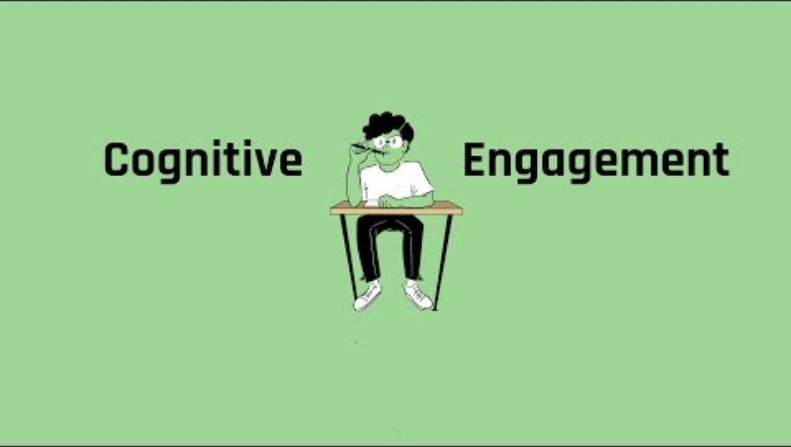
Cognitive Engagement
Notes:
Today we will be talking about cognitive engagement.
Here is a brief video to formalize the definition.
Show the KISSCE video about the respective type of engagement in order to formalize a definition. hhttps://www.youtube.com/watch?v=JHNFhmYhzaE

Slide 7

Honeycomb Harvest
Move the honeycombs so that the sides touch where you see relationships between the concepts provided.
  Activity: https://docs.google.com/document/d/1DmrPp31YHESxGkvpOUj_1HZshHn2eXyqBLlbnMfemAE/copy
Notes:
First make sure all of your participants can access the document (the link on the slide will force a copy).
Now we will look at statements that indicate student engagement and consider their relationships to one another.
In the document link provided, you can move the hexagons anywhere on the page that you like.
We call this activity a Honeycomb Harvest and it’s basically a mind mapping activity.
Place statements that you would consider related to one another so that they are touching.
After sorting, you will be put into pairs and discuss differences and similarities in how you’ve arranged your statements.
Share your reasoning with your partner for why you arranged them as you did.
Each group (or a couple of volunteers if it’s a very large session) shares with the whole group something they sorted differently and a summary of their discussion on it.
After groups share out, the Facilitator will explain that these statements came from a research-grounded instrument for measuring student engagement.
KISSCE (K20 Inventory for Student School and Career Engagement)

Slide 8
Analyzing Scenarios
As you read, think about the statements in the Honeycomb Harvest for cognitive engagement.
Is there one or two that stand out as key indicators of the struggle in this scenario?
What is the role of cognitive engagement in your scenario?
Notes:
Assign individuals to small groups.
Give each group one of the scenarios in the Cognitive Engagement Scenarios document to read and review
There are three individual scenarios described in the handout. Engagement Scenarios link: k20.ou.edu/ces

Slide 9
KISSCE
(K20 Inventory for Student School and Career Engagement)
Cognitive Engagement
I try to match what I already know with things that I am trying to learn for school.
I try to think through topics and decide what I’m supposed to learn from them.
When learning new information, I try to put ideas in my own words.
When I study, I figure out how the information might be useful in the real world.
When studying, I try to combine different pieces of information from course material in new ways.
When learning things for school, I often try to associate them with what I learned in other classes.
I try to see similarities and differences between things I am learning for school.
I make up my own examples.
Notes:
KISSCE slide here for reference.

Slide 10
Scenario #1: John Smith High School has recently deployed a student engagement survey to begin an intervention to increase student engagement. When you visit the school, you notice:
Few teachers greet students at their door during the passing period.
Students are actively participating in topic group discussions.
Teachers seem to be more like authoritarian figures, barking orders in the halls.
Students can recite answers but seem to have difficulty summarizing their learning in their own words.
Teachers report that students oppose writing in math class, asking “Why are we doing this. This isn’t English?”
The results of the survey were eye-opening.
Some of the stand-out results include:
My teachers treat all my friends fairly. (38%)
My teachers respect me as an individual. (42%)
When learning new information, I try to put the ideas in my own words. (21%)
When learning things for school, I often try to associate them with what I learned in other classes. (27%)

Slide 11
Scenario #2: During an observation of Mrs. Harvey’s Science class at John Smith High School, you notice:
Some students loudly exclaim, “This is boring!”
Student conversation is not allowed.
Classroom tasks involve rote memorization, no novelty or authenticity.
Student writing consists of note-taking and cloze-style worksheets.
Responses of note from the student engagement survey for Mrs. Harvey’s students include:
My teachers treat all my friends fairly. (38%)
My teachers respect me as an individual. (42%)
When learning new information, I try to put the ideas in my own words. (21%)
When learning things for school, I often try to associate them with what I learned in other classes. (27%)

Slide 12
Scenario #3: Sally Doe, a student in Ms. Harvey’s Science class at John Smith High School, was willing to sit down for a short interview with you. During this interview, she revealed that:
“In this class, it’s all about memorizing stuff to pass a test. It’s just not interesting to do the same thing every week.”
“I don’t really get what Mrs. Harvey wants
from us. I thought this was a science
class, not English. She tries to get us to
do some writing every once in a while.”
“Mrs. Harvey is normally using her
computer when we come into class. I feel
like she doesn’t even notice me until she
calls my name during roll.”
“We never get to talk or do group projects
in this class. I learned a lot more in my
science class last year because I got to talk to people more often.”
A small sample of Sally’s responses on the student engagement survey reveal her perceptions:
My teachers treat all my friends fairly. (3/9)
My teachers respect me as an individual. (4/9)
When learning new information, I try to put the ideas in my own words. (2/9)
I try to think through topics and decide what I’m supposed to learn from them. (2/9)

Slide 13

Why-Lighting
As you read the provided research brief, highlight key words and strategies for increasing student engagement.
Notes:
Hand out the Research Brief that examines what impacts student engagement. Ask each participant to highlight key words and strategies for increasing student engagement.

Slide 14
Revisit Honeycomb Harvest
Add the words/strategies you highlighted to your Honeycomb Harvest wherever you feel they most strongly connect.
Notes:
After they have analyzed the Research Brief, have participants add the words/strategies they highlighted to their Honeycomb Harvest wherever they feel they most strongly connect.

Slide 15

Choice Board
In small groups, create a Google Slides presentation that represents your ideas about how to improve engagement in the scenario we looked at today.
Notes:
Class Choice Board: http://k20.ou.edu/secb
One of the 10 Always, Sometimes, or Never True statements, with an explanation of why it is or is not true in the case of this scenario.
A list of at least three actions that could be taken by the teacher to improve engagement in this scenario.
Two found images that represent the specific scenario before engagement strategies have been implemented and after.
A crafted catchphrase or very short poem that summarizes the core significance or meaning of cognitive engagement.
A symbolic drawing with a color scheme that represents the core message of learners’ analysis of the scenario.
A K20 resource that could be used to improve engagement in this scenario.

Slide 16
Share Out
Present your slide and share out to the whole group.

Slide 17
Further K20 Resources
For Teacher Professional Learning
Growing Student Achievement Through Teacher-Student Relationships
https://learn.k20center.ou.edu/professional-learning/40
Building a School and Classroom Community
https://learn.k20center.ou.edu/professional-learning/16
Owning the Learning: Intentional Student Choice
https://learn.k20center.ou.edu/professional-learning/1
Authenticity, It’s Not Just a Fairytale
https://learn.k20center.ou.edu/professional-learning/24
Power Tools for Comprehension: Strategically Supporting Authentic Learning https://learn.k20center.ou.edu/professional-learning/36
For Student Learning
How Do My Choices Affect My Future?
https://learn.k20center.ou.edu/lesson/219
Career-Focused Lessons (ICAP)
Notes:
Consider following this session with professional learning activities included here.

