Slide 2
Aspects of Student Engagement: Behavioral
K20 Center

Slide 3
Essential Question
What does behavioral engagement look like?

Slide 4
Learning Objectives
Summarize the aspects of student behavioral engagement.
Analyze factors contributing to behavioral engagement.
Generate strategies for improving student engagement.

Slide 5

Sometimes, Always, or Never True
Let’s categorize statements about student engagement as always, sometimes, or never true.
As each statement is presented, select the answer that you feel is most correct.
  [copy and paste updated Mentimeter link for learners here]
Notes:
There are many ideas about student engagement that we carry with us as educators some of which are mostly true, partially true, and unfortunately some that are just not true at all. We will begin this session by sorting through some of these ideas using a Mentimeter quiz.
https://www.menti.com/b6b2wj2b98
You will want to copy this presentation to your own account and update the link for your participants. To do this, while logged in to your Mentimeter account, go to this link: https://www.mentimeter.com/s/3e7e21fdabc173b95c8a3a4b310e24e7/8e279c77603f/edit and select “Copy to Your Account” in the bottom-right corner.
First make sure all of your participants can access the Menti by sharing a link on a slide and/or in the chat feature if you are presenting through a virtual platform.
The Menti includes statements of common assumptions, misconceptions, and folk wisdoms about student engagement. As each statement appears allow participants to select if each statement is Always, Sometimes, or Never true. After collecting responses for each statement, note the difference between the most popular/selected response and the correct response. Let participants know we will be looking at what research says works later in the session.
(Write approximately 10 statements. Does kahoot allow wait time between questions? Preferably choose a platform that allows processing time between each statement.)

Slide 6
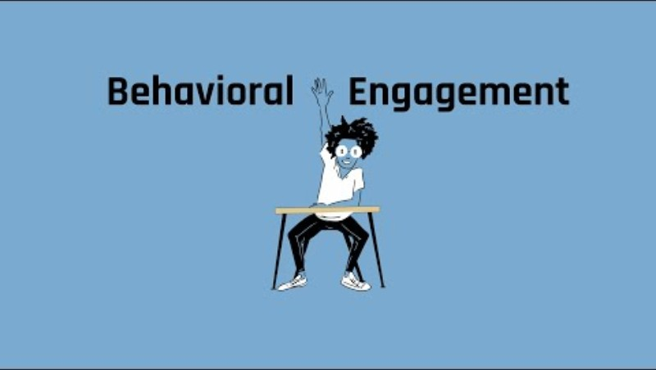
Behavioral Engagement
Notes:
This lesson focuses on behavioral engagement. This brief video will aid us in formalizing the definition of behavioral engagement. Show the KISSCE video about the respective type of engagement in order to formalize a definition. https://www.youtube.com/watch?v=lsH2_Ufk8JI

Slide 7

Honeycomb Harvest
Move the honeycombs so that the sides touch where you see relationships between the concepts provided.
  Activity: k20.ou.edu/hhbe
Notes:
First make sure all of your participants can access the document (the link on the slide will force a copy).
The first step is to examine statements that indicate student engagement and consider their relationships to one another. In the document link provided you can move the hexagons anywhere on the page that you like. We call this activity a Honeycomb Harvest, a mind mapping activity. Place statements that you would consider related to one another so that they are touching. After sorting, learners will break into pairs and discuss differences and similarities in how the statements have been arranged. Share your reasoning with your partner explaining why you arranged them as you did.
Each group (or a couple of volunteers if it’s a very large session) shares with the whole group something they sorted differently and a summary of their discussion on it.
After groups share out, the Facilitator will explain that these statements came from a research grounded instrument for measuring student engagement, KISSCE (K20 Inventory for Student School and Career Engagement).

Slide 8
Analyzing Scenarios
As you read, think about the statements in the Honeycomb Harvest for behavioral engagement.
Is there one or two that stand out as key indicators of the struggle in this scenario?
What is the role of behavioral engagement in your scenario?
Notes:
Assign individuals to small groups. Give each group one of the scenarios in the Behavioral Engagement Scenarios document to read and review
There are three individual scenarios described in the handout. Engagement Scenarios link: k20.ou.edu/bes

Slide 9
KISSCE
(K20 Inventory for Student School and Career Engagement)
Behavioral Engagement
I try hard to do well in school.
In class, I work as hard as I can.
When I’m in class, I just act like I’m working.
When I’m in class, I participate in class activities.
I take an active role in extracurricular activities in my school.
When I’m in class, my mind wanders.
I pay attention in class.
When I run into a difficult homework problem, I keep working at it until I’ve solved it.

Slide 10
Scenario #1: Anywhere High School has recently deployed a student engagement survey to begin an intervention to increase student engagement. When you visit the school, you notice:
Extra help is offered but few students attend.
Students often check in to school late.
At school events, few students participate or attend.
Students rarely wear school apparel or show school pride.
The results of the survey were eye-opening.
Some of the stand-out results include:
I try hard to do well in school. (42%)
Most mornings I look forward to going to school. (21%)
I take an active role in extra curricular activities in my school. (47%)
I like my school. (35%)

Slide 11
Scenario #2: During an observation of Mr. Williams’ class at Anywhere High School, you notice:
Many students’ papers have doodles instead of work.
Students rarely raise their hands or ask questions.
Students are overheard saying “This is too hard, I quit.”
Students are overheard saying “I hate this school.”
Responses of note from the student engagement survey for Mr. Williams’ students include:
When I’m in class, I just act like I’m working. (56%)
I enjoy learning new things in class. (24%)
When I run into a difficult ho mework problem, I keep working at it until I think I’ve solved it. (34%)
I’m happy to be at this school. (40%)

Slide 12
Scenario #3: Brian Doe, a student in Mr. Williams’ English class at Anywhere High School, was willing to sit down for a short interview with you. During this interview, he revealed that:
“Sometimes Mr. Williams talks for so long I stop listening.”
“I don’t think I will ever use anything Mr. Williams teaches us.”
“Mr. Williams’ class is boring, so I don’t do the assignments.”
“I tried to convince my mom to let me stay home.”
A small sample of Brian’s responses on the student engagement survey reveal his perceptions:
When I’m in class my mind wanders. (58%)
I think what we are learning in school is interesting. (22%)
When I’m in class, I participate in the class activities. (47%)
Most mornings I look forward to going to school. (21%)

Slide 13

Why-Lighting
As you read the provided research brief, highlight key words and strategies for increasing student engagement.
Notes:
Hand out the Research Brief that examines what impacts student engagement. Ask each participant to highlight key words and strategies for increasing student engagement. Research Brief link: http://k20.ou.edu/serb

Slide 14
Revisit Honeycomb Harvest
Add the words/strategies you highlighted to your Honeycomb Harvest wherever you feel they most strongly connect.
Notes:
After they have analyzed the Research Brief, have participants add the words/strategies they highlighted to their Honeycomb Harvest wherever they feel they most strongly connect.

Slide 15

Choice Board
In small groups, create a Google Slides presentation that represents your ideas about how to improve engagement in the scenario we looked at today.
Notes:
Class Choice Board: http://k20.ou.edu/secb
Assign groups to present their ideas about how to improve engagement in their scenario.
Each group’s slide should include 3 of the 6 options below:
One of the 10 Always, Sometimes, or Never True statements, with an explanation of why it is or is not true in the case of this scenario.
A list of at least three actions that could be taken by the teacher to improve engagement in this scenario.
Two found images that represent the specific scenario before engagement strategies have been implemented and after.
A crafted catchphrase or very short poem that summarizes the core significance or meaning of behavioral engagement.
A symbolic drawing with a color scheme that represents the core message of learners’ analysis of the scenario.
A K20 resource that could be used to improve engagement in this scenario.

Slide 16
Share Out

Slide 17
Further K20 Resources
For Teacher Professional Learning
Growing Student Achievement Through Teacher-Student Relationships
https://learn.k20center.ou.edu/professional-learning/40
Building a School and Classroom Community
https://learn.k20center.ou.edu/professional-learning/16
Owning the Learning: Intentional Student Choice
https://learn.k20center.ou.edu/professional-learning/1
Authenticity, It’s Not Just a Fairytale
https://learn.k20center.ou.edu/professional-learning/24
Power Tools for Comprehension: Strategically Supporting Authentic Learning https://learn.k20center.ou.edu/professional-learning/36
For Student Learning
How Do My Choices Affect My Future?
https://learn.k20center.ou.edu/lesson/219
Career-Focused Lessons (ICAP)
Notes:
Consider following this session with professional learning activities included here.

