Slide 1
College Knowledge: Creating a Climate of High Expectations

Slide 2
How Will I Use This?
Notes:
Reference the Instructional Strategy Notes Sheet as a preview to the session’s strategies. Encourage participants to think about classroom use of these strategies.

Slide 3
Commit and Toss
On the slip of paper you were provided, jot down your answer to:
“What is a college-going culture?”

Slide 4
So, what is a College-Going Culture?
Cultivates aspirations and behaviors conducive to preparing for, applying to, and enrolling in college
Is inclusive to ALL students
Is supported systemically (school has a stated college-going mission)
Is supported by all stakeholders, not just the counselor
(Corwin and Tierney, 2007)

Slide 5
Objectives
Participants will:
Understand the importance of creating a college-going culture
Assess the current college-going culture baseline of your site
Create a list of strategies which signal a college-going culture

Slide 6
Why is a College-Going Culture Important?
Challenges Facing Low-Income Students
Students make college decisions based on perceptions of aid availability
A high school’s culture of preparation makes a difference in students’ access to information about college and financial aid
Students need accurate and timely information
One-on-one support cannot be supplanted by group seminars
Support is needed after applying for college
Parents also require information on college and aid
(De La Rosa & Tierney, 2006)
Notes:
A high schools culture makes a difference. You make a difference.
Highlight the two or three that are important to your school, but do not read all of these to participants.

Slide 7
Video: Leading Success Module 3: Creating a College-Going Culture
Fostering a culture of expectations and opportunity.
Watch the video for examples of:
Visual
Auditory
Practices/Rituals
Systems/Structures
Notes:
Click the link under the title of this slide to access the video.
Video can be found at https://www.nassp.org/professional-learning/online-professional-development/leading-success/module-3-—-creating-a-college-going-culture

Slide 8
College-Going Culture Carousel
1. With your color coded group, spend three minutes at your first “station” brainstorming ideas that could be used to signal a College Going Culture.
Visual
Auditory
Practices/Rituals
Systems/Structures
2. When the timer goes off rotate to the next station and try to add more ideas!
3. Put a checkmark next to a practice that you like the most for your school. The ideas with the most checkmarks can be developed for your site.

Slide 9
Strategies
Visual:
Examples include . . .
College posters visible by all grades
Posting of scholarship information
Posting of a list of college acceptances
Auditory:
Examples include . . .
Announcements about student college acceptances, scholarship winners, SAT/ACT date reminders
Conversations with students about college readiness and preparation, including mentoring
College talk among teachers and students
Practices/Rituals:
Examples include . . .
Celebrations for academic achievement
Honors luncheon
National Honor Society inductions
Systems/Structures:
Examples include . . .
Open access to AP courses
Guidance counselors being required to conduct lessons on college going in grades 9–12
Students encouraged to take a minimum of four years of math, science, and foreign language
Notes:
Are there some strategies here that you didn’t list? Or consider?
It is not necessary to read, but rather allow participants to look for difference between this list and their personal list.

Slide 10
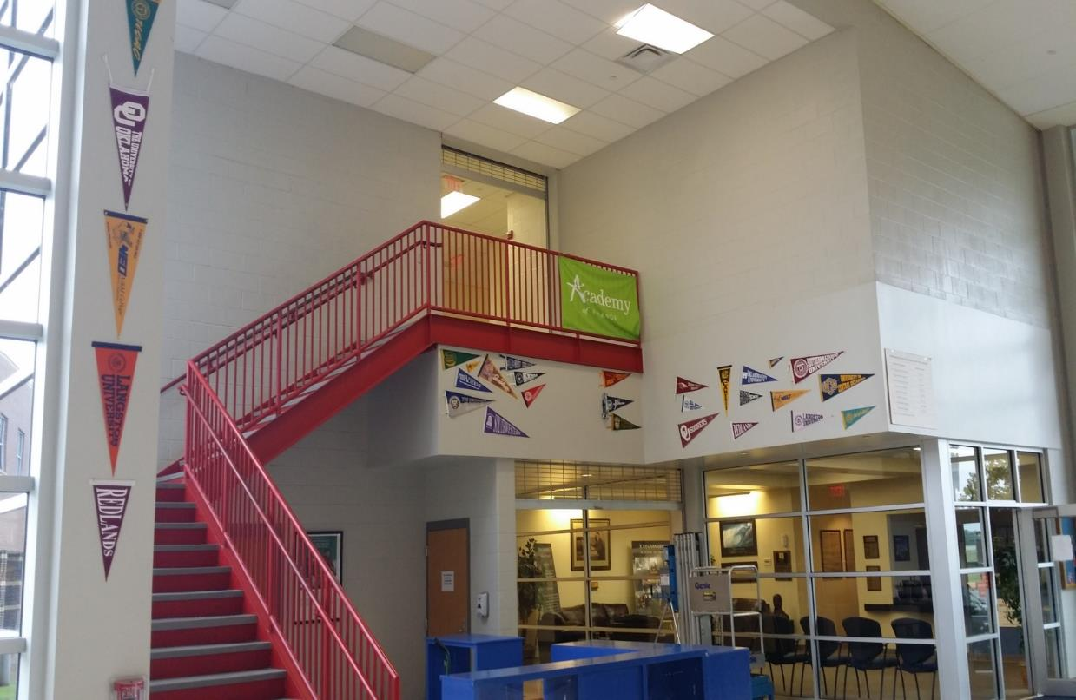
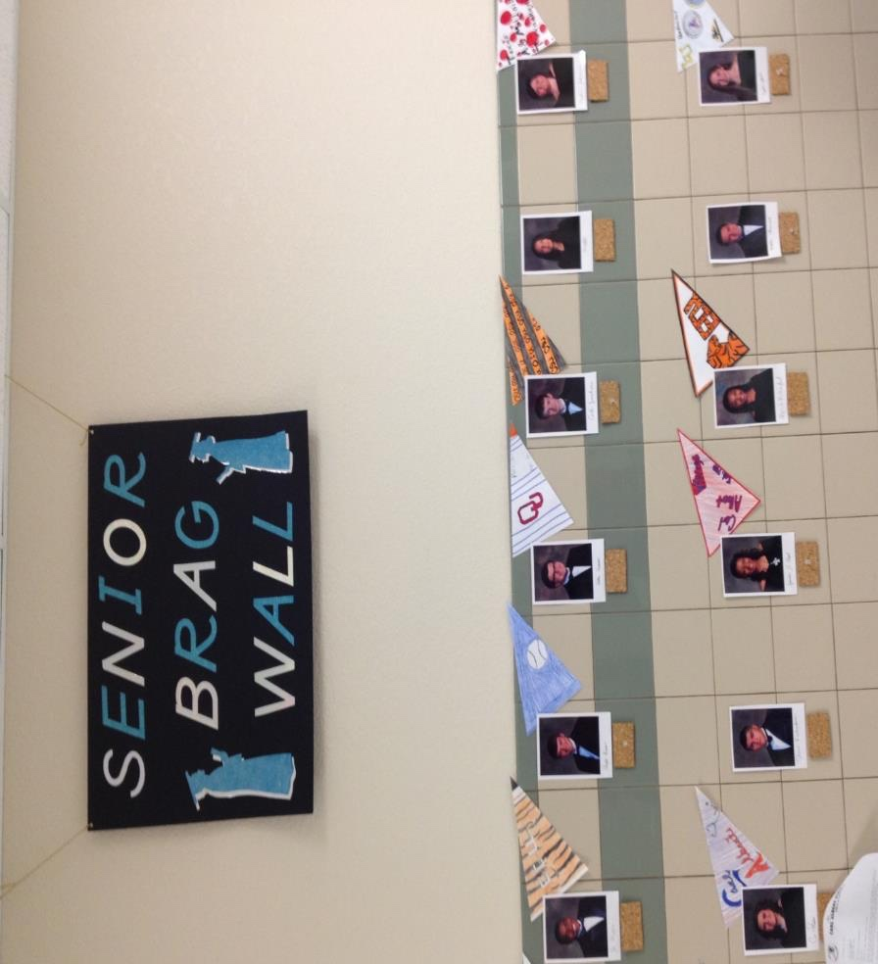
Visuals:

Slide 11
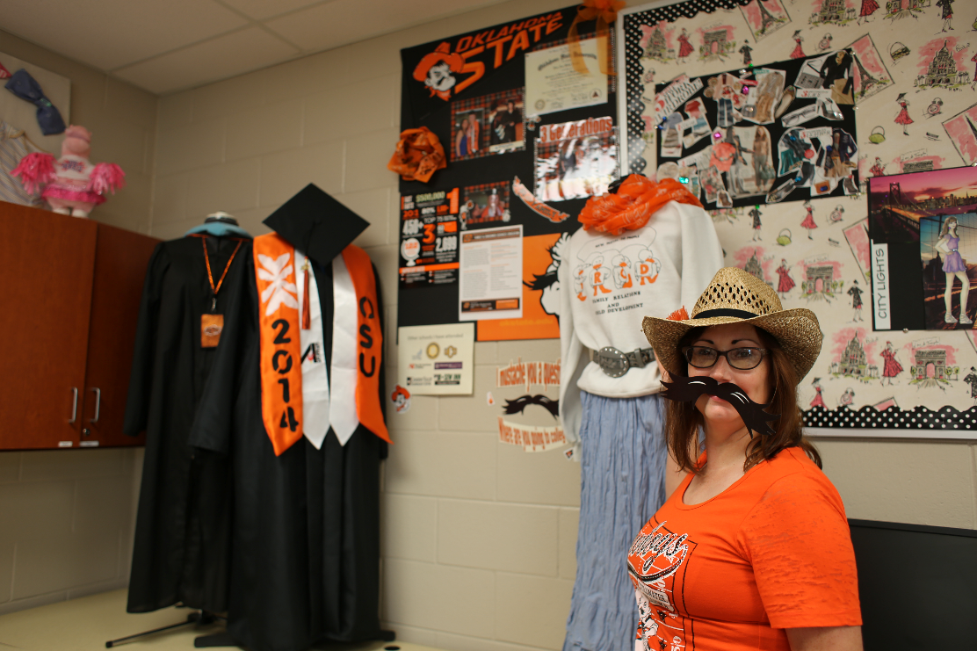
College swag board challenge

Slide 12
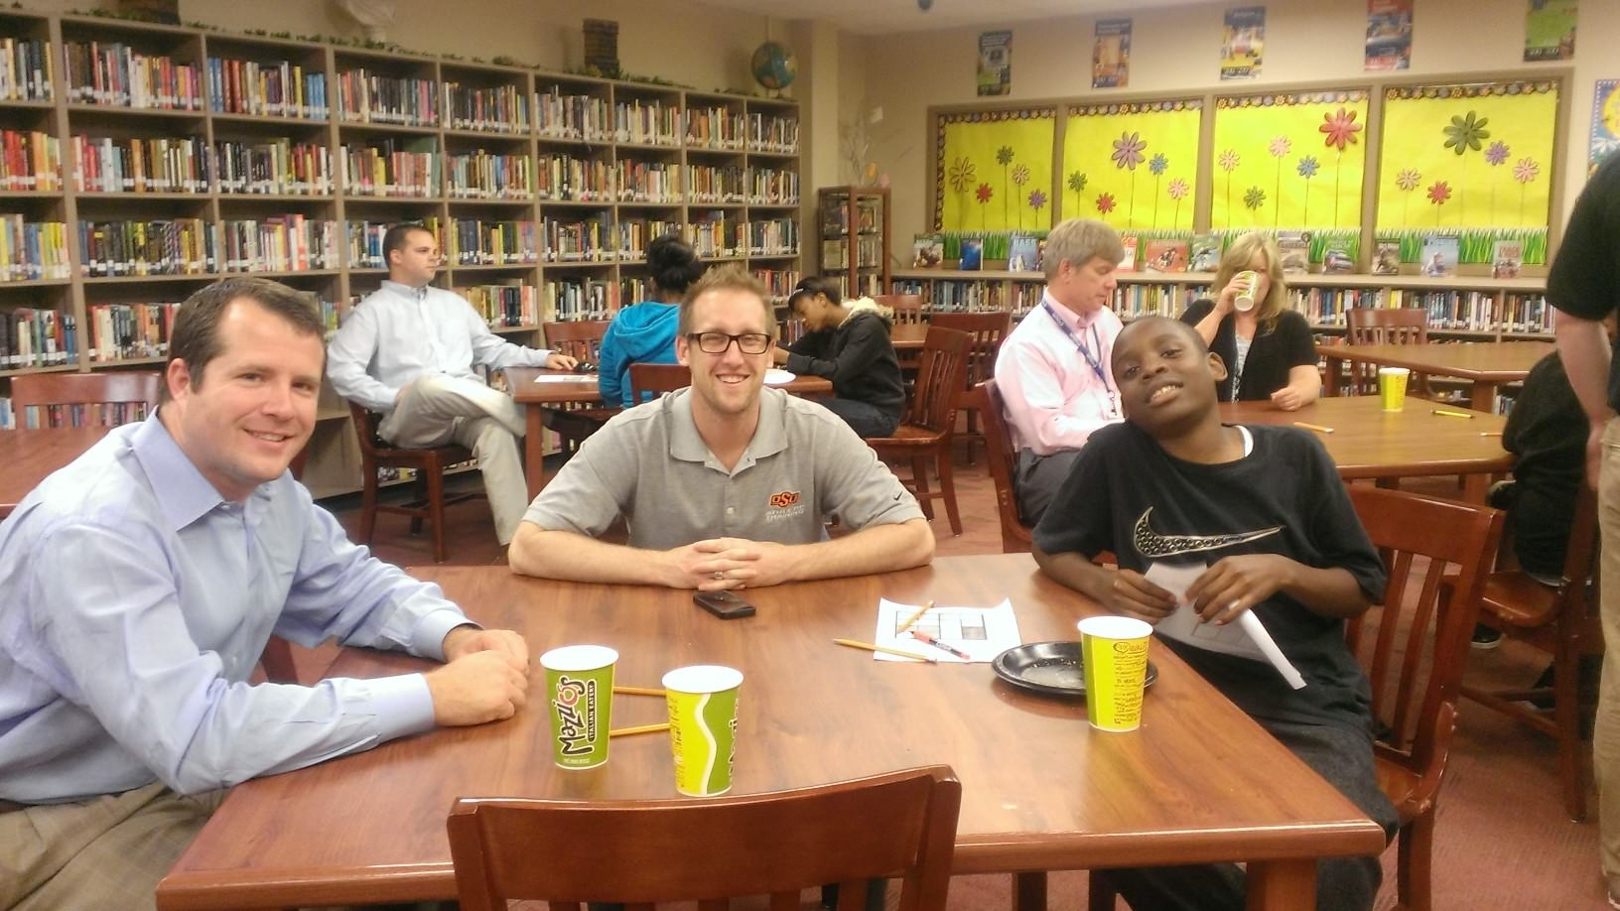
Auditory:
College conversations about readiness and preparation
Notes:
This could be with a mentor or teachers and staff in the building

Slide 13
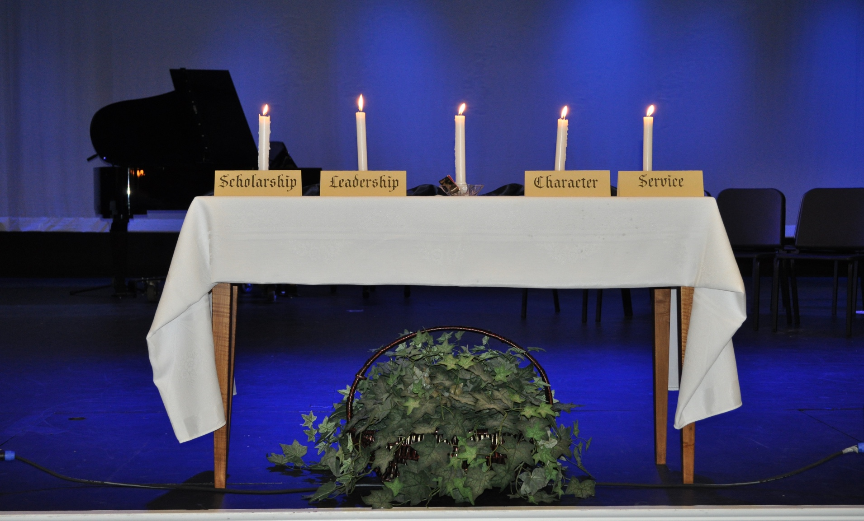
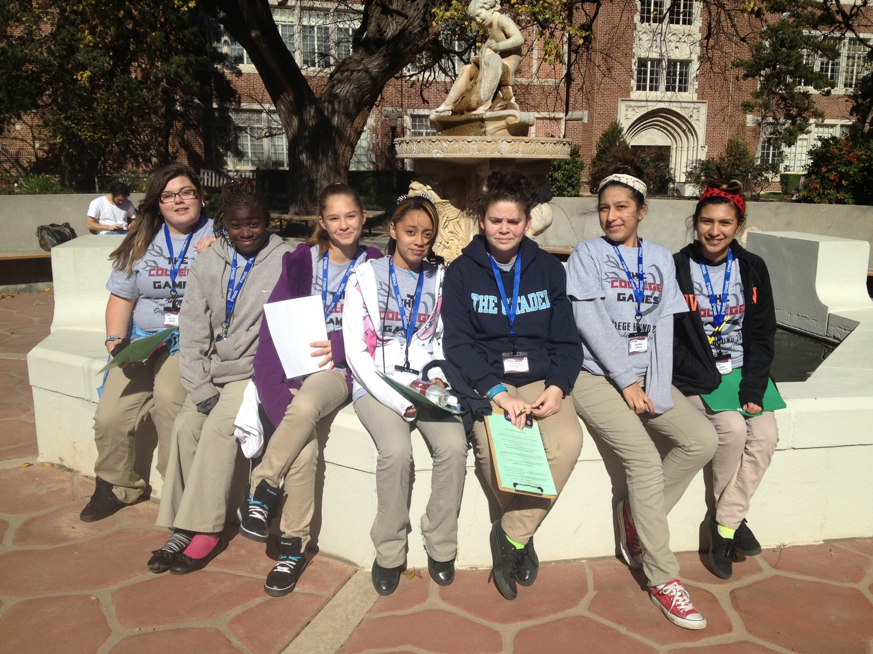
Practice and Rituals:
College Campus Visits

Slide 14
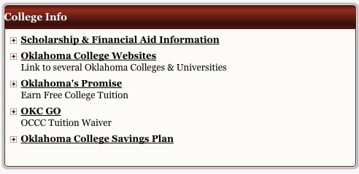
Systems and Structures:
Notes:
Teachers/Counselors website was a resource for her students. She used “Remind” to send out reminders to students and listed important college resources and dates on her website. Or a site or district based programs that can be used to send out reminder and mass messages (Google Classroom, Infinite Campus, etc.)

Slide 15
College-Going Culture Rubric
Evaluate your school for each of the principles listed. Assign a number, 1-4, and list it on the line.
Add your scores at the bottom, next to COLLEGE-GOING CULTURE BASELINE, and divide by nine.

Slide 16
Think-Pair-Share
Reflect on the scores you have assigned to each principle.
With an elbow partner, share your highest scored item and explain why. Then share your lowest scored item and pick a strategy from the gallery walk that could address it.
Notes:
Pick a strategy from the gallery walk that could address the lowest scoring category.

Slide 17
Higher Order Thinking
Disciplined Inquiry
Authentic Teaching
Value Beyond School
Implicit View of Students
Notes:
Distribute rubric and have them discuss how they would use these strategies to support authenticity in their classroom.

Slide 18
References
Center for Educational Outreach at UC Berkley. (n.d.). College-going culture rubric: The 9 elements to support and encourage a college-going culture. Retrieved from http://www.sjsu.edu/counselored/docs/9_Steps_to_Building_a_College_Culture.pdf
College Going Culture Video- NASSPtv. (2014, December 16). Mod 3 Video 1: Culture From Within [Video file]. Retrieved from https://www.nassp.org/professional-learning/online-professional-development/leading-success/module-3-%E2%80%94-creating-a-college-going-culture?SSO=true
Corwin, Z. B., & Tierney, W. G. (2007). Getting there– and beyond: Building a culture of college going in high schools. Los Angeles, CA: Center for Higher Education Policy Analysis (CHEPA).
De La Rosa, M. L., & Tierney, W. G. (2006). Breaking through the barriers to college: Empowering low income communities, schools and families for college opportunity and student financial aid. Los Angeles, CA: Center for Higher Education Policy Analysis (CHEPA).

