Slide 2
Immersing Students in Emerging Technology
VR in the Classroom

Slide 3
Objectives
Participate in a VR-enhanced lesson
Identify various VR-enhanced activities and lessons to use in the classroom
Implement VR in the creation of a classroom activity

Slide 4
Essential Question
How does the use of virtual reality in the classroom help students create real-world connections?

Slide 5

I Think/We Think
How can integrating technology in the classroom engage your students?
For the prompt, write your response first in the “I Think” column.
Get with a partner or group and share what you’ve recorded. After your partner/group’s members share, record your common thoughts in the “We Think” column.

Slide 6
Become an Explorer
Guide participants through a Google Expedition

Slide 7
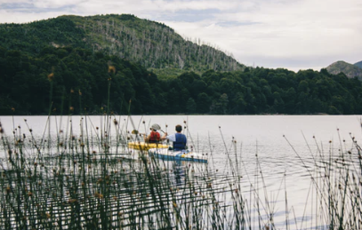
Guide vs Explorer
Notes:
Image credit: Photo by kaluci on Unsplash

Slide 8
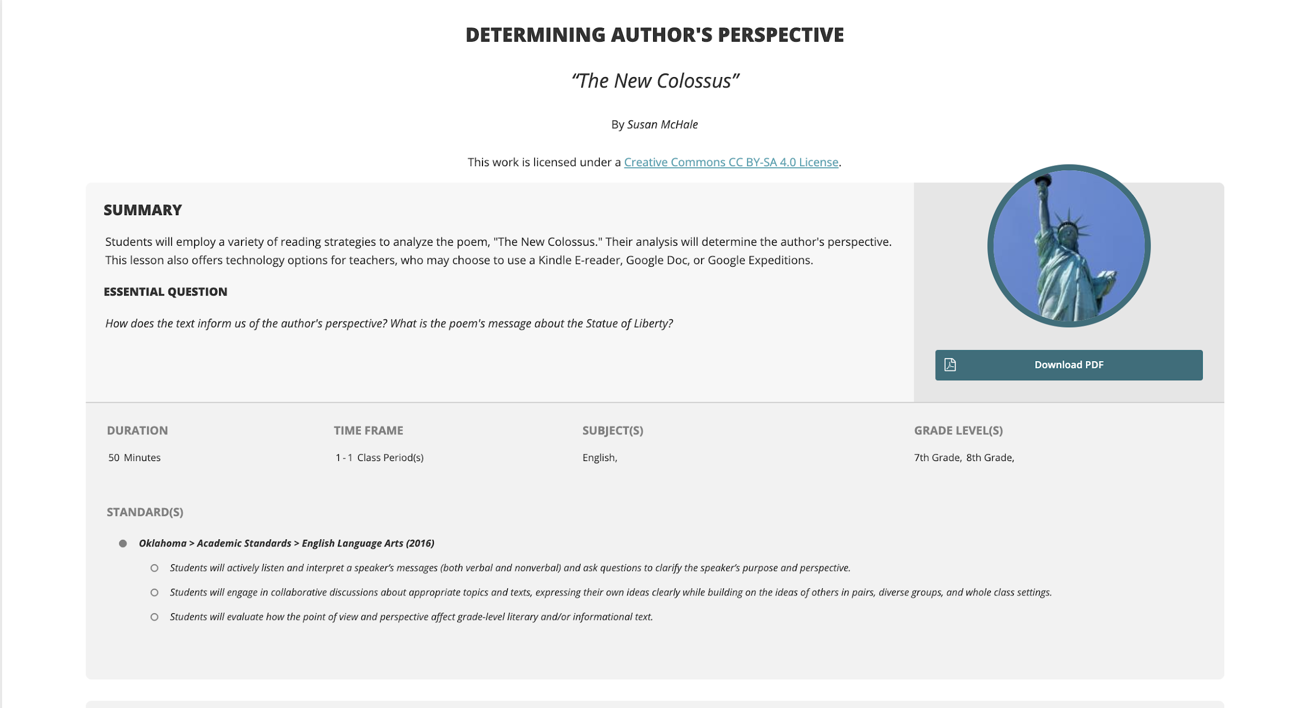
Experience VR
Notes:
Go through the lesson with the participants. If time is short, go through at 30,000 foot view.

Slide 9
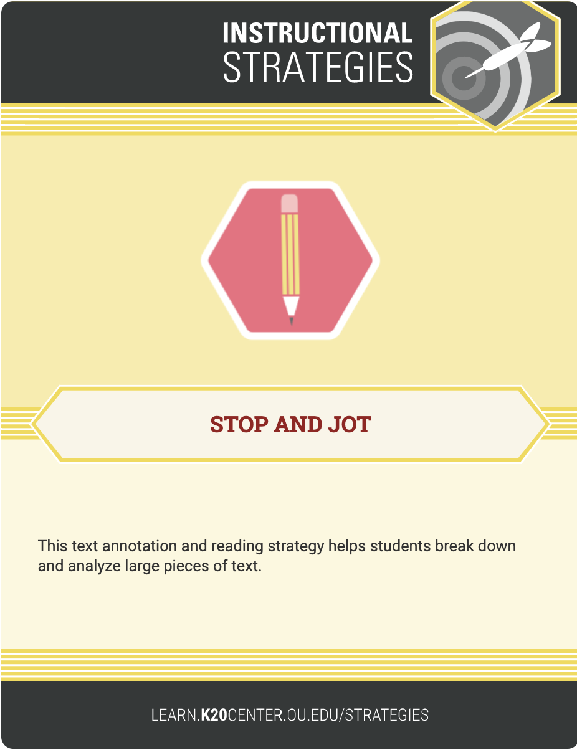
Stop & Jot
As you explore the resources on the next slide, take time to Stop & Jot, making notes about what you learn from each resource.
Use this Doc to help organize your notes or use the printed yellow copy.
Notes:
Strategy to use as participants explore resources.

Slide 10
Find Resources for Your Class
Explore the following resources and find 1 resource you can share at the end of this section.
MERGE Miniverse
CoSpaces Edu
Google Expeditions
Google Expeditions AR & VR lessons
Google Poly
Notes:
Give participants option of places to find and build their own resources.

Slide 11
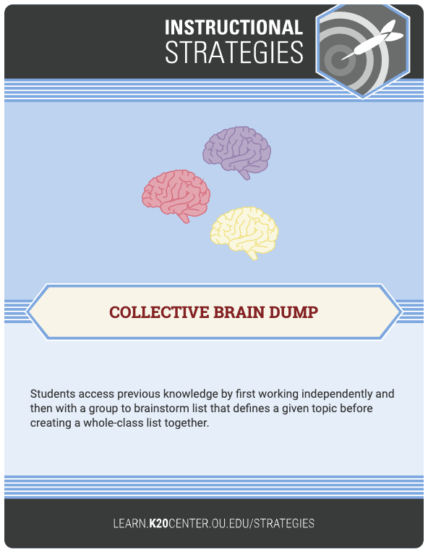
Collective Brain Dump
What did you find?
Add it to our Padlet here:
Notes:
After participants have found resources to use to create and build activities as part of a lesson, use this for opportunity to share resources.

Slide 12
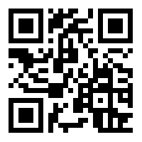
Share your ideas
Using this link or QR Code, share at least 1 idea about how you plan to use Google Expeditions in your classroom on our Padlet.
https://padlet.com/

Slide 13
Create Lesson
Using the resources from this session and the Padlet, begin to create an activity or lesson to use in your classroom.
Here’s a 5E lesson template to organize your activity or lesson.
Notes:
Protected work time with 5E lesson plan organizer. Goal to have product to show in digital gallery.

Slide 14
Going Further
Working with a partner and using the headsets and iPods, try out the lesson you found with the actual devices.

Slide 15
Find Your Lesson
Search for your lesson on the Discover tab.
Once you find a lesson, click on Download to View or Guide.
Then click Guide.
Once you start the expedition, have your explorers (students)join by having them click on Class and Explore.
Practice walking through each part of the expedition.

Slide 16
What else do you need to be successful?

Slide 17
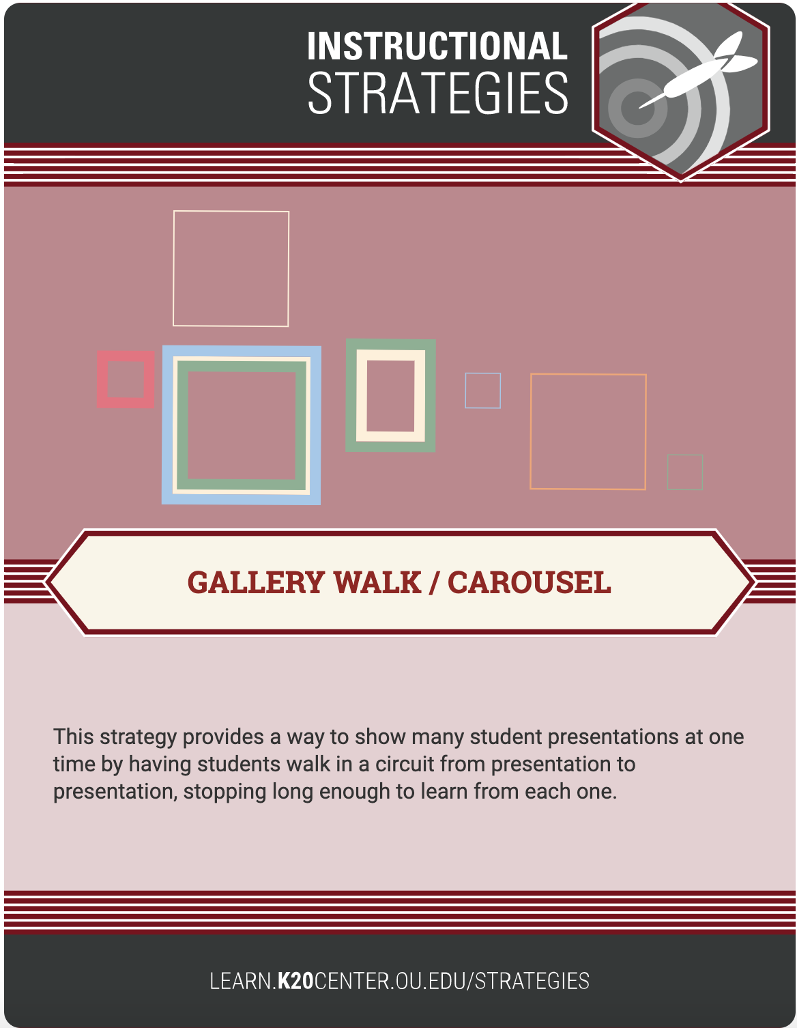
Digital Gallery Walk
Add the lesson you created to our Digital Gallery Walk document by clicking on the hyperlink above.
Notes:
Add resources to Digital Gallery Walk. Then allow time to participants to explore the DGW or Doc to find other activities

Slide 18
Digital Gallery Walk Extension
While digitally “walking” through the Gallery Walk, consider these questions:
What other technologies could we integrate?
How could we make this activity more authentic?
Notes:
Self-Assessment
Make any modifications to activity, if time permits
Compare with authentic reflection tool, if time permits.

Slide 19
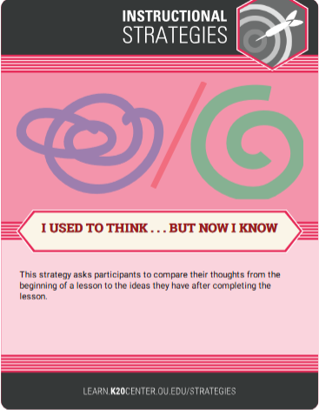
I Used to Think…But Now I Know
“That VR-enhanced lessons…”
I Used to Think…
In the first column, record something you about previously thought about
VR-enhanced lessons/activities.
But Now I Know…
In the second column, write what you have learned during this activity.

Slide 20
Strategies Revisited
Stop & Jot
Collective Brain Dump
Gallery Walk
Authentic Reflection Tool
I Used to Think…But Now I Know
I Think/We Think

Slide 21

Rapid Feedback Slide

Slide 22
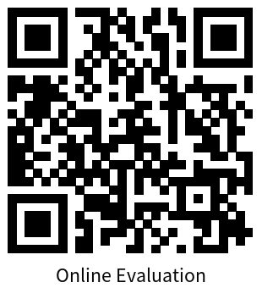
Rapid Feedback
Scan this QR Code
Go to this link.
trek.k20center.ou.edu/today
Notes:
Link must be updated

Slide 23
Additional Resources
Facebook Group—MERGE Educators
Twitter Hashtag—#MergeVR

