Slide 2

All Around Swivl™ Bots
Capturing Practice &
Growing through Reflection

Slide 3
Essential Question
How can technology be used to improve an instructor’s reflective practice?

Slide 4
Learning Objective(s)
Identify professional and classroom uses of the Swivl™ robot.
Contextualize the bot’s role in the reflective teaching process.
Generate ways to incorporate the bot into an upcoming lesson or activity.

Slide 5

Getting to Know You
Fist to five: What do you know about Swivl™ bots?
1 = No knowledge
2 = Little knowledge
3 = Some knowledge
4 = Knowledge plus experience
5 = Could teach others how to use them
Notes:
Using Fist-to-Five means no materials are needed and provides a wider range of teacher responses.
Strategy source: K20 Center. (n.d.). Fist to five. Strategies. https://learn.k20center.ou.edu/strategy/68

Slide 6

Swivl™ Bots in Action
Notes:
Play the video on the slide or go to the following link: https://www.youtube.com/watch?v=QwebkHu8B3U
Source: Great Hearts Academies. (2017, February 7). Swivl in Use [Video]. YouTube. https://www.youtube.com/watch?v=QwebkHu8B3U

Slide 7
Play Time: Preparation
Go to one of the stations. Work with your group to complete the following tasks. (These must be done in order.):
Task 1: Do you have a Swivl account?
Yes → Log in. (If you attended ADEPT this past summer, you have one already.)
No → Go online (cloud.swivl.com) and create one by selecting “Sign Up.”
If the Swivl Capture app is not already installed on your device, download it before continuing.

Slide 8
Play Time: Action
Remember to complete the rest of the tasks in order:
Task 2: Practice setting up your device with the Swivl.
Task 3: Practice recording and uploading video to your Reflectivity account.
Task 4: Access your recordings in your Reflectivity library.

Slide 9
What is a Swivl bot?
A Swivl is a robotic “cameraman” for use in classrooms and professional settings. Download the free app and dock your device on a Swivl base.
The robot records as you move
and talk, and then it saves the video straight to your Reflectivity account.

Slide 10
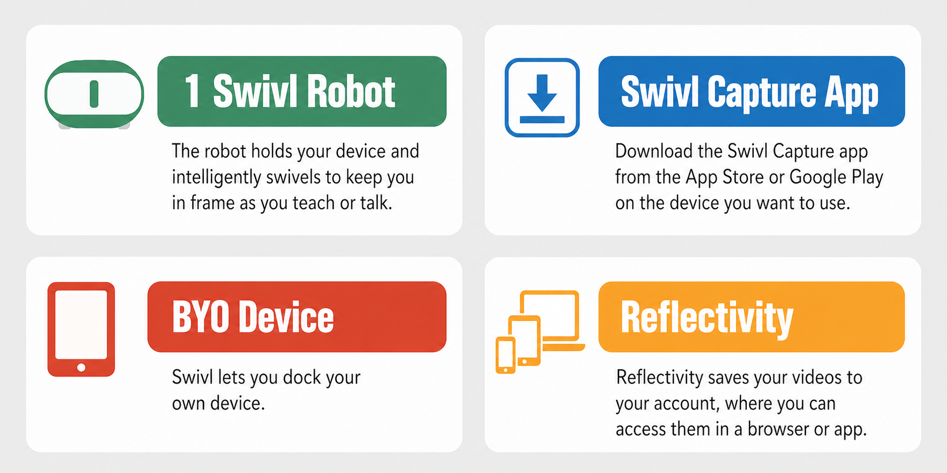
Advantages: Technology Terms

Slide 11

T is for Technology: ABC Graffiti/Chain Notes
How can Swivl be used in the classroom?
Take 30 seconds to jot down your ideas on the ABC Graffiti handout.
When time is called, pass your sheet to the person on your right.
Repeat.
Notes:
K20 Center. (n.d.). ABC graffiti. Strategies. https://learn.k20center.ou.edu/strategy/96
K20 Center. (n.d.). Chain notes. Strategies. https://learn.k20center.ou.edu/strategy/52

Slide 12
Uses for Swivl and Reflectivity
Professional Growth
Classroom Learning
Coaching
Peer feedback
Self-reflection
Student-teacher observations
Remote observations
Teacher training recordings
Best practices video library
Record student projects
Peer (or group) feedback
Student self-reflection
Record lectures and labs
Remote student learning
Capture student learning
Support classroom management
Notes:
Discuss the Swivl bot as a positive resource, not a punitive one.
The K20 Center uses Swivl bots to help coach teachers in using authentic teaching and learning skills in the ADEPT program.
Teachers using the Swivl bot can capture videos of labs or lessons and send to fellow teachers in Oklahoma or in other states and ask for feedback.
It is also possible to use the Swivl bot as a tool for teacher evaluations when traveling is a concern.

Slide 13

How am I feeling? What am I thinking?
Divide a sticky note in half.
On one half, draw an image of how you feel about Swivl.
On the other half, write a sentence about your thoughts on using Swivl.
Place your sticky notes on a wall or whiteboard to share with the group.
Notes:
K20 Center. (n.d.). How am I feeling? What am I thinking? Strategies. https://learn.k20center.ou.edu/strategy/187

