Slide 2
Productive Math Mindsets- Everywhere!

Slide 3
Objectives
Analyze characteristics of growth mindset in math classrooms.
Identify growth mindset learning strategies in your curriculum.

Slide 4

Seven Mindset Messages
All students can learn math to the highest levels.
Mistakes are valuable.
Questions are important.
Math is about creativity and making sense.
Math is about connections and communicating.
Value depth over speed.
Math class is about learning, not performing.
Boaler, J. (2015). Mathematical mindsets: Unleashing students' potential through creative math, inspiring messages and innovative teaching. John Wiley & Sons.

Slide 5
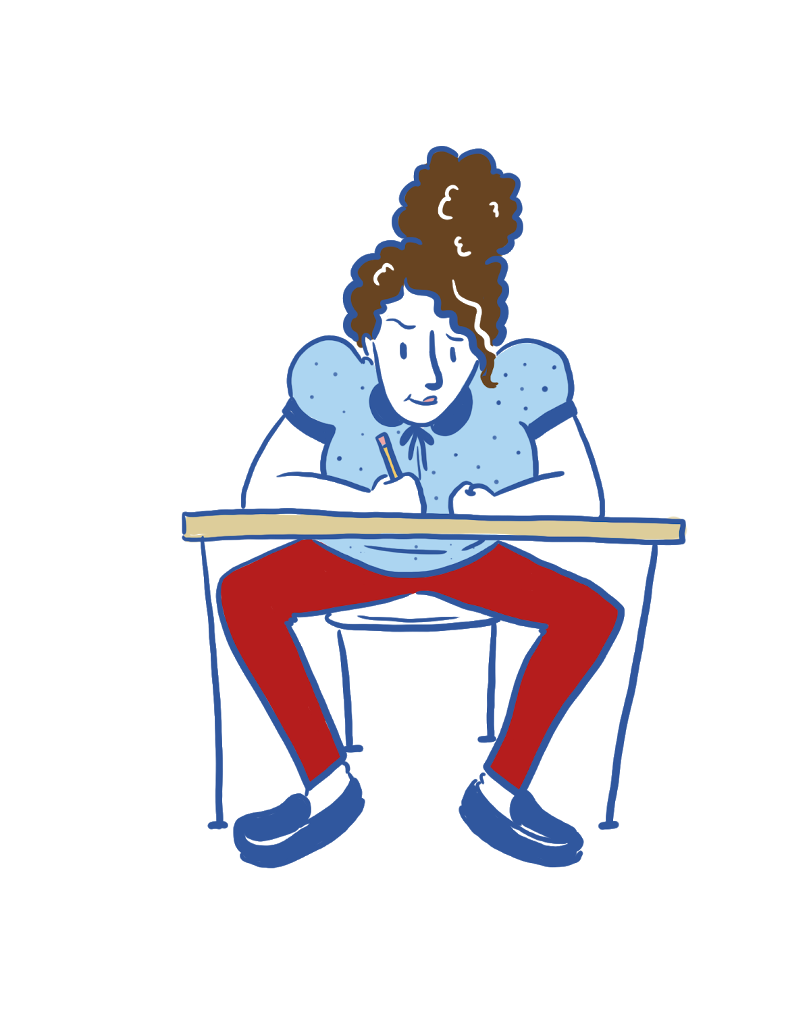
Amber
Comes in for non-required tutoring frequently.
Doesn’t always get the best grades, but takes initiative to reflect on her mistakes.
“Math is really hard—that’s why I need to keep practicing. I know one day this will get easier for me.”
Notes:
Read aloud the characteristics
Ask if they already have in mind a student that is similar to Amber. Isn’t it easy to put a face to a name?
What strategies/activities are you already doing well to support your students like Amber? Which messages would you like to grow more in?

Slide 6
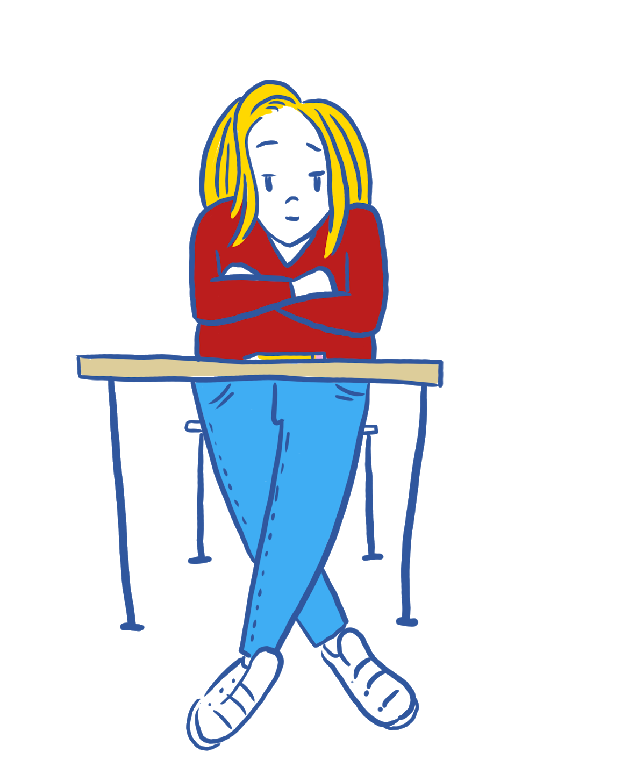
Mariah
Has a 98% average in the class, but never asks for help or answers a question.
Has been labeled as gifted; does very well, but struggles the moment she doesn’t understand something.
“I have to get this done correctly the first time. Otherwise, someone will think I don’t know what I am doing!”
Notes:
Read aloud the characteristics
Ask if they already have in mind a student that is similar to Mariah. Isn’t it easy to put a face to a name?
What strategies/activities are you already doing well to support your students like Mariah? Which messages would you like to grow more in?

Slide 7

Alex
Is always polite and seems to be on task.
Consistently gets bad grades on assignments and tests.
“I don’t get these problems and I never will. Why should I even bother?”
Notes:
Read aloud the characteristics
Ask if they already have in mind a student that is similar to Alex. Isn’t it easy to put a face to a name?
What strategies/activities are you already doing well to support your students like Alex? Which messages would you like to grow more in?

Slide 8
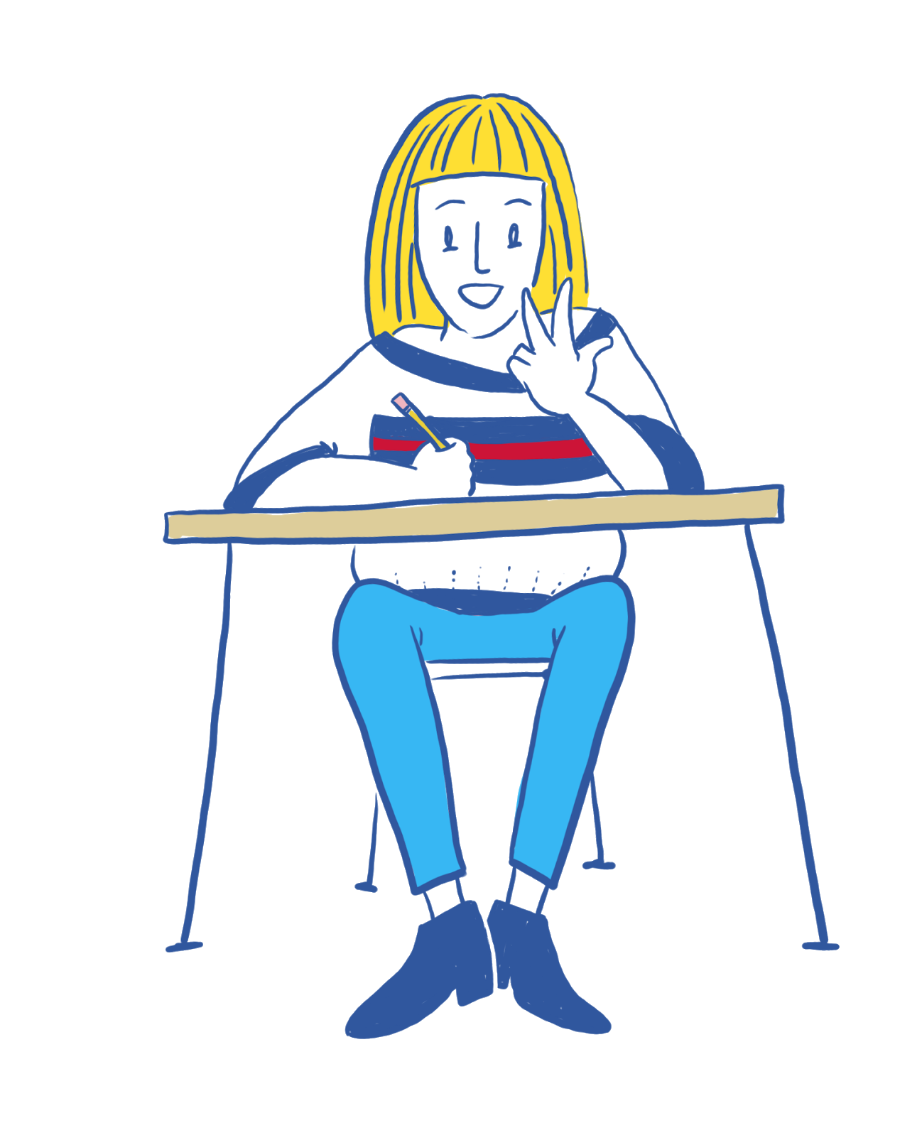
Brittany
Does well, but makes sloppy mistakes because she wants to rush through her work.
Understands the concepts easily and gets good grades regularly.
“My teacher said I need to show my work when I am doing math. Although this comes easily to me, I know that I need to work out the problems on paper. This way, if I make a mistake, I can find it and fix it!”
Notes:
Read aloud the characteristics
Ask if they already have in mind a student that is similar to Brittany. Isn’t it easy to put a face to a name?
What strategies/activities are you already doing well to support your students like Brittany? Which messages would you like to grow more in?

Slide 9
All students can learn math to the highest levels. | Mistakes are valuable. | Questions are important. | Math is about creativity and making sense. | Math is about connections and communicating. | Value depth over speed. | Math class is about learning, not performing.
This is a belief; it builds and builds over time. Every chance you get, encourage students’ beliefs that they can succeed. Switch your praise to focus on students’ work and effort rather than their “ability” or “smarts.” | Deeper learning happens from reflecting on a process to improve. Help students believe that they are on a path of growth and learning and that mistakes are not signs that they aren’t good enough. | Students asking their own math questions keeps them engaged and wanting to learn more. However, it can feel intimidating to be asked any math question. Build students’ self-confidence in not knowing all the answers to allow space for more of their questions. | Math is more than just formulas to be remembered. Visual representations of math processes spark connections between topics. Student- constructed representations are the most beneficial. Catchy phrases alone do not deepen knowledge. | Every subtopic in mathematics is connected, but learning to see that connection is a skill. Communication means more than speaking, so be creative in ways that students “show.” Student-selected representations of knowledge help both them and you to see their learning. | No matter how the standards are interpreted, depth always matters more than breadth. The things we remember most are those that have deep meaning or high impact—math is no different. Being bold enough to make that your focus can require a scary leap of faith. | The phrase “show your work” is overused for a reason; the process matters more than the answer. Grade for reflection rather than for achievement. It might take longer but is more valuable for your students.
Notes:
Give high-level thoughts for each message. This is our chance to show our humility of acknowledging our strengths and struggles.
Remind participants that they have this in the handout for their deep reading later.

Slide 10
All students can learn math to the highest levels | Mistakes are valuable | Questions are important | Math is about creativity and making sense | Math is about connections and communicating | Value depth over speed | Math class is about learning, not performing
Walking the Line: the Math Spectrum | My Favorite Mistake | Click Battle: Desmos | Sum of Exterior Angle Theorem: Geogebra | Card Sort | Nine Digit Fraction: NCTM Illuminations | (Dead Link) Compound Interest Simulator: NCTM Illuminations
Notes:
Explain that we have picked an activity that supports each growth mindset message.
Tell participants to pick one (or two) activities to go look at and read through the activity, looking for ways it supports that particular message

Slide 11


Slide 12
Amber, Mariah, Alex, & Brittany: Revisited
Our students all have strengths and needs.
Based on your exploration of the activities, which one would you be most likely to incorporate into your classroom to support the growth mindset of your students?
Why did you pick this activity?
Enter your answers in the chat box.
Notes:
Read through the comments as they come in and maybe give verbal thoughts on the responses as they come in
Remind participants that all of the information from this session is on the handout we provided to them and that this is just a starting place of exploring and supporting growth mindset in our math students.

Slide 13





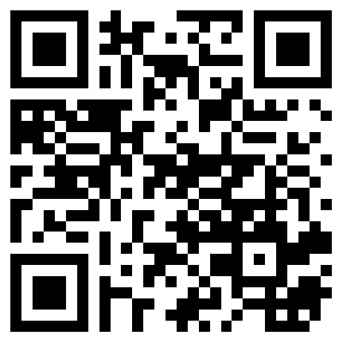
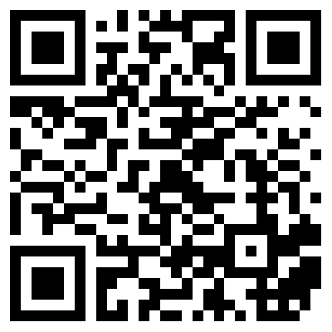
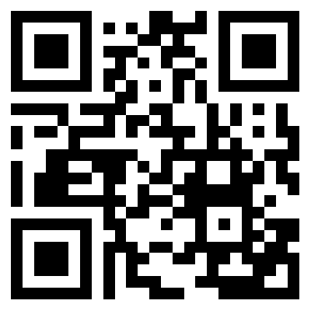
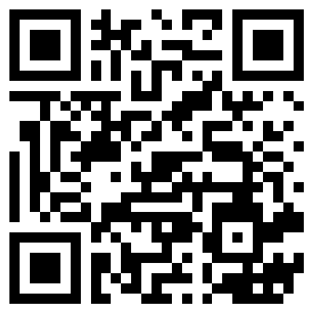
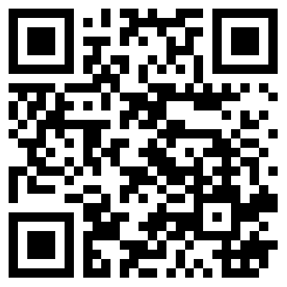
Follow us on Social Media!
Facebook.com/ K20Center | YouTube.com/ K20Center | Twitter.com/ K20Center | LinkedIn.com/ showcase/ K20-Center | Instagram.com/ K20Center

