Slide 2
A Classroom Framework
For Supporting
Student Well-being

Slide 3
Essential Question
What are the benefits of students’ feeling safe in
the classroom?

Slide 4
Learning Objectives
Analyze how the teaching Applied Educational Neuroscience framework can transform practice into more trauma-informed classroom strategies.
Reflect on how to integrate the framework into the classroom.

Slide 5
Student Safety Reflection and Discussion
Visit the four posters and answers each of the questions on one of the provided sticky notes.
Notes:
Introduce participants to the Chalk Talk strategy. As a whole group, begin a discussion using the Chalk Talk strategy with the four question prompts:
What are the benefits of students’ feeling safe in the classroom?
What experience have you had as a student in the classroom that made you feel safe?
What do you currently try to do to help your students feel safe?
Is providing a safe classroom different for a remote learning class?
Ask each participant to contribute by placing a sticky note with their responses to each question on its respective chart paper. You can also have participants contribute on a shared document if you prefer.
Alternatively, you can create a copy of the following Google Slides link and share your copy with participants:
https://docs.google.com/presentation/d/12Tx7rxEAU6bcDI8xMv_d5cDIlGK5yuGBfYMO7bGPviE/copy
After the discussion, highlight some key words and responses that elicit themes that align with the Pillars of the Applied Educational Neuroscience framework:
The educator’s own moods and reactions to their environment (attachment/touch points)
A co-regulated brain and body that feel calm and alert (co-regulation)
Emotional attunement between students and caregivers (educator brain and body state)
Understanding one’s own brain anatomy and mental behaviors (teaching neuroanatomy)

Slide 6
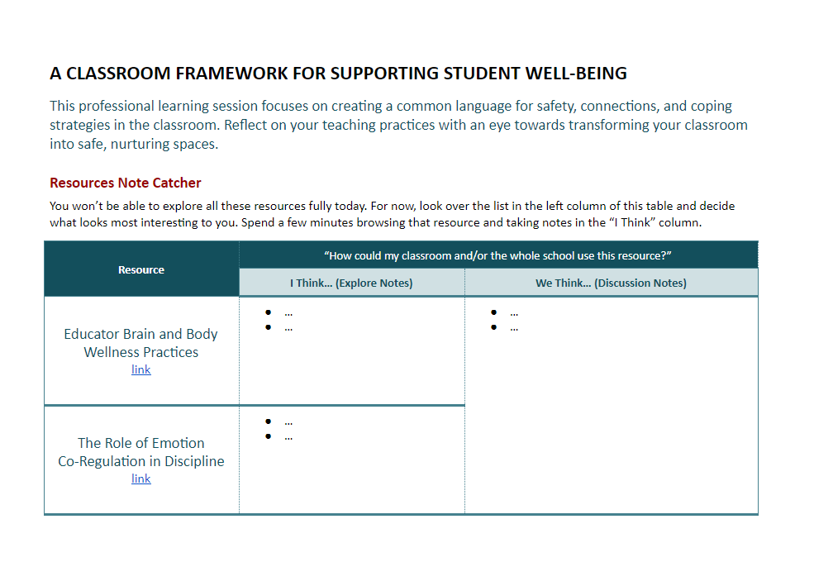
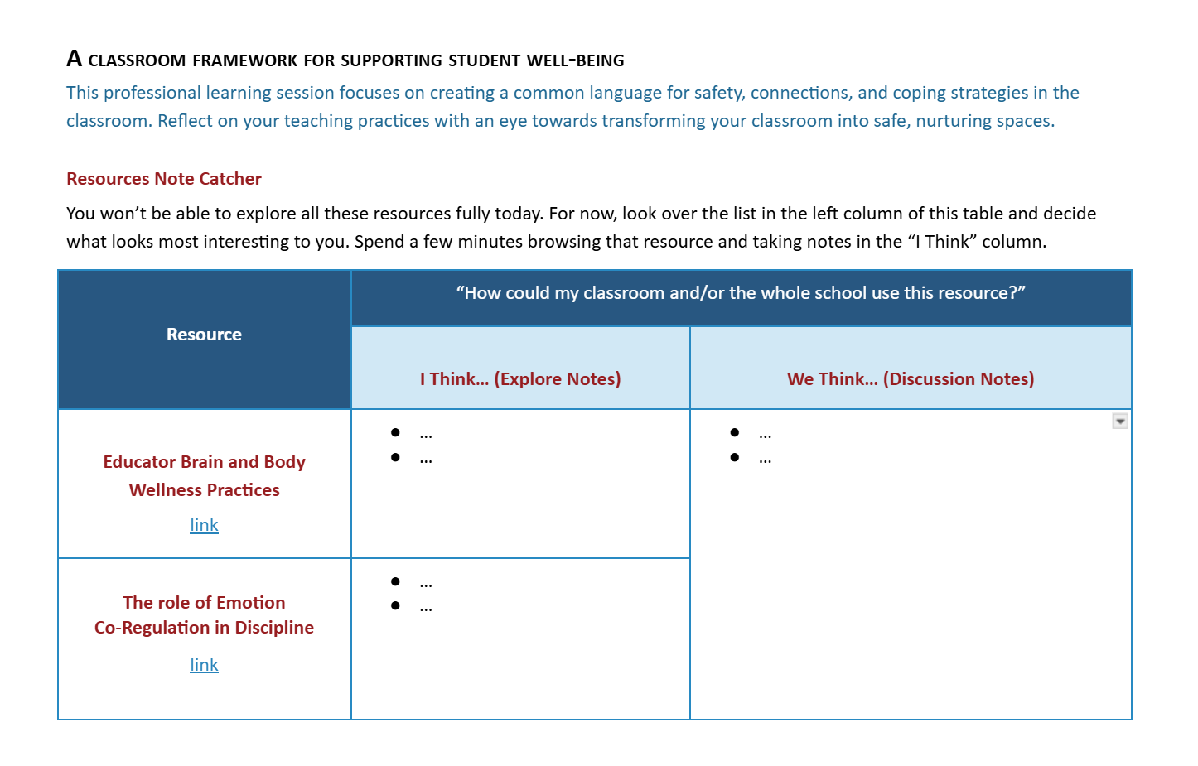
Participant Notebook
https://tinyurl.com/4fk76kx2
Browse the resources in
the table.
Take notes.
Share your discoveries with the group.
Notes:
Invite participants to explore a curated bank of resources related to the Applied Educational Neuroscience framework. Distribute digital copies of the Participant Notebook using the link in this slide.
Provide 10-15 minutes for participants to explore the resources on pages 1-3 of the Participant Notebook. Next, ask participants to take notes in the Note Catcher space next to each resource about what they have explored. Let them know ahead of time that they will be asked to describe something they found that is helpful to them. Remind participants that they should be prepared to share with the whole group (or a small group if there are too many participants to share out).

Slide 7
Share Out
Take notes in the right column as others share what they found from the resources.

Slide 8
The Four Pillars of Trauma-Informed Teaching
EDUCATOR BRAIN STATE The educator’s own moods and reactions to their environment. Being aware of our brain states as educators and being self-disciplined with our own responses. | CO-REGULATION Relational discipline. A co-regulated brain and body feel calm and are in a state of relaxed alertness, which is shared through social relationships in the classroom. | ATTACHMENT TOUCH POINTS Deepening connections through emotionally available conversations between students and caregivers who are emotionally attuned. | TEACHING NEUROANATOMY Understanding one’s own brain anatomy. When staff and students understand their own brain anatomy, it puts science beneath behaviors and changes responses to those behaviors.
Notes:
Direct participants to the one-page overview of the Applied Educational Neuroscience framework on page 4 in their Participant Notebooks. Briefly introduce each pillar before watching the video on the next slide.

Slide 9

The Four Pillars of Trauma-Informed Teaching
Applied Educational Neuroscience
Notes:
Direct participants to page 5 of the notebook and invite them to take notes as they watch the video. Ask participants to think about how resources from the Explore phase might fit into these categories. (1:50-5:58 is the most essential portion of this video to understanding the framework.)

Slide 10
The Framework of Applied Educational Neuroscience
Educator Brain State ... | Co-Regulation ...
Attachment/Touch Points ... | Teaching Neuroanatomy ...
Notes:
Ask participants to share teaching practices that could be adopted to support each pillar. At this point, consider editing this slide to add participants’ contributions to the chart as they share ideas about practices that would fit in each category of the framework. If you are facilitating face-to-face, you can also make a physical chart on an overhead projector or whiteboard space, hand-writing responses.
In a distance learning or virtual learning setting, you can have participants raise their hands in Zoom (or a similar video call client) or send their ideas in the chat channel. Be sure to copy these ideas into the chart.

Slide 11
How will you support student well-being in your classroom?
Make a plan using the prompts in your participant notebook.
Notes:
Have participants spend a few minutes making a goal for what they will take into their classrooms based on what they have learned. Direct them to the final page of their Participant Notebook. Walk through the question prompts with them and invite any questions before providing time for them to reflect individually.
What will you do to support student well-being in your classroom?
Why will this activity or strategy support student well-being? In what way does it connect to the framework?
How and when will you implement this goal? (During what part of your day, week, etc. will you be using this strategy?)
Who or what will you look to if you have difficulty?
If time permits, ask for volunteers who’d like to share their goal with the group.

