Slide 2
Level Up for College and Career Readiness

Slide 3
Essential Question
How can Level Up esports promote a college- and career-going culture in your school?

Slide 4
Who Could Benefit?
Respond to the questions below in the chat.
What percent of students (at your site) do you think are not involved in any extracurricular activities?
What percentage of your students play electronic games?

Slide 5
Who is a “Gamer?”
Half of men and a comparable number of women say they have played video games on a computer, TV, game console, or portable device like a cellphone.
However, men are more than twice as likely as women to identify as “gamers.” Some 50% of men and 48% of women play video games, while 15% of men and 6% of women say the term “gamer” describes them well.

Slide 6
Stoplight Strategy
Based on your knowledge of esports and how it can promote a college- and career-going culture, set your Zoom background to either red, yellow, or green.
Red = I know almost nothing about esports.
Yellow = I know a little about esports and could describe it.
Green = I’m familiar enough with esports that I can explain how it supports college and career readiness.
Notes:
Or participants can add the color to their name in zoom. Yellow goes first, sharing what they know. Red goes next with questions, then green follows up with things they can add.

Slide 7
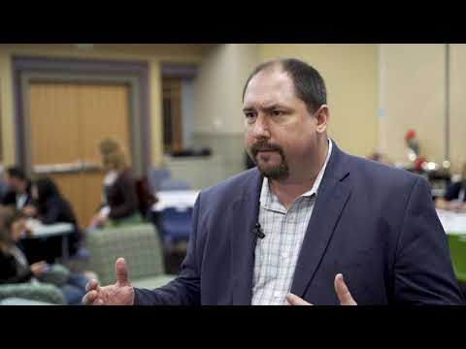
Expanding Student Opportunities
This story from Grapevine-Colleyville ISD highlights some of the benefits of introducing an esports club to extracurriculars.

Slide 8
Objectives
Describe the basic history and cultural significance of esports (professional gaming).
Connect participation in esports to college and career readiness.
Utilize knowledge of esports to increase engagement.
Recognize challenges and obstacles and be prepared to address common issues.

Slide 9
Why-Lighting
As you read the provided infogram, highlight any information that was surprising or new to you, especially information that answers these questions:
What is esports?
Where did it come from?
Who/What careers are involved?
How can it help students?
Notes:
Hand out the infographic sheet.
https://infogram.com/1p93kkn3k233e6i71l17lgxzlmc3q7g5xxz?live (link to infographic)

Slide 10
H5P: Benefits, Challenges, and Troubleshooting
For each section on the infographic, list benefits, challenges, and potential troubleshooting in the Level Up H5P Card Sort slide. Show your potential solutions to the proposed challenges by placing a sticky note in the appropriate section.
Notes:
Link to H5P Card Sort:https://docs.google.com/presentation/d/1E1b29XcGBJk8c9chY3n5S6g8NJ2x2J5sWKeb80kNL8s/copy 7-8 min

Slide 11
Share Out
Please share out the benefits, challenges, and potential troubleshooting you put on your Level Up H5P Card Sort slide.

Slide 12
Connecting Esports to your Content
In this 3-2-1 activity, respond to the questions below:
What are three (3) things that are important to know in your content area?
What are two (2) things you see in esports that might support what you listed above?
What is one (1) way you can you support this in your content?
Notes:
https://docs.google.com/document/d/1Io4kQ9bmP-grkMsoO4KkYbatzAdwiPulS9-sEqdSjl4/copy

Slide 13
Wrapping Up
Think about a student or group of students in your school that a Level Up program could benefit. In the chat, respond to:
What is one aspect of esports that you think will benefit this student/students the most?

