Slide 2
Changing the Outcome by Measuring It
Emerging EdTech in the STEM Classroom

Slide 3

First Word, Last Word
One group member will fill in the first word of the acrostic, then pass it to the next group member.
Groups share out and discuss completed acrostics.
Notes:
Divide participants into four groups and ask them to complete the acrostic.
One member will do the first letter/word and then pass to the next group member for the next letter/word
Have groups share to the whole room their completed acrostics.
K20 Center. (n.d.). First Word, Last Word. Strategies. https://learn.k20center.ou.edu/strategy/148

Slide 4
Learning Objectives
Apply research-based practices to support the use of educational technology. (EdTech)
Through the lens of science and engineering practices, connect the impact of EdTech to a tech-driven world.
Identify potential hurdles for the student learning experience with EdTech.

Slide 5
Essential Question
How can a technology-enriched learning environment prepare students for post-secondary opportunities in a tech-driven world?

Slide 6
“You DON’T have to know everything for STE[A]M programs to work in your classroom! You only have to provide activities with clear instructions that are practical, fun, and doable under time constraints.”
(Bhounsule et al, 2018)
Notes:
1-2 minutes

Slide 7
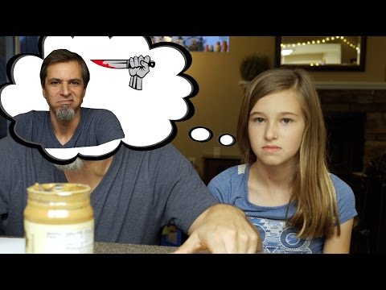
Peanut Butter Jelly Time
Some technology will only do what the code instructs it to do. So, when building code, it must be explicit and step-by-step.
Exact Instructions Challenge
Notes:
2-3 minutes

Slide 8
Breakout with EdTech
3 Stations
Swivl
Raspberry Pi coding with Scratch
3D Printing with TinkerCAD and Thingiverse
Notes:
20 to 30 min timer and when timer goes off rotate groups.
Each group will explore based on specific stations.
add images of each to fly into white space overlapping each other.

Slide 9
Rotation 1
20 minutes

Slide 10
Resource Note Sheet
What did you explore?
How might this EdTech connect to (or integrate with) my content area?
Notes:
after each station call time and reflect 5 mins then rotate to next station.

Slide 11
Rotation 2
20 minutes

Slide 12
Resource Note Sheet
What did you explore?
How might this EdTech connect to (or integrate with) my content area?
Notes:
after each station call time and reflect 5 mins then rotate to next station.

Slide 13
Rotation 3
20 minutes

Slide 14
Resource Note Sheet
What did you explore?
How might this EdTech connect to (or integrate with) my content area?
Notes:
after each station call time and reflect 5 mins then rotate to next station.

Slide 15

Four Corners
Choose which educational technology that you explored you like the most or think would be possible to implement in your classroom.
Go stand by that poster.
Notes:
K20 Center. (n.d.). Four Corners. Strategies. https://learn.k20center.ou.edu/strategy/138

Slide 16

I Notice...I Wonder...
On your poster, respond to the questions below:
What did you notice about the technology you explored?
What do you wonder about implementing these technologies in your classroom?
Notes:
3-5 minutes
Slide Note: If PBJ video is not shown then, skip the 3rd question on this slide.
Math connection:
***How could you calculate how far the robot is going to go? (radians)
K20 Center. (n.d.). I Notice... I Wonder... Strategies. https://learn.k20center.ou.edu/strategy/180

Slide 17
Posters – Continued
Below your I Notice...I Wonder…, record your responses to:
How can these technologies be implemented to help students prepare for a tech-driven world?
What are some potential hurdles in their implementation and do you have ideas for mitigating their effect?

Slide 18
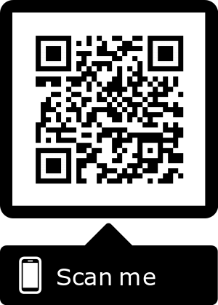
NSTA Science & Engineering Practices
How would these activities connect to the NSTA Science & Engineering Practices?
https://bit.ly/2xfJPpU
Notes:
Connect to Lesson Goals
• Narrative- “Students need to connect what we have done to
engineering practices and to real life…”
• NSTA Science and Engineering Practices- Teachers to connect
activity to 1-2 different standards.
• Reflection- How are students going to connect these practices to
their lives?
Strategy for Process
• Use think, pair, share to answer the first question and then use

Slide 19

Gallery Walk
On a sticky note, put what practice you think the technology meets and attach it to the poster of that technology.
Does everyone agree with the assessments?
Notes:
review the practices and then use 3 colors of stickies to represent the 3 featured tech tools
Yellow
Blue
green
Using the provided sticky notes, select the NSTA standard that is best supported by the each tech tool. Justify why on the sticky note. Explain and Model.
K20 Center. (n.d.). Gallery Walk. Strategies. https://learn.k20center.ou.edu/strategy/118

Slide 20

3-2-1
What are 3 classroom activities that you could enhance with these technologies?
What are 2 different ways that these technologies prepare students for a tech-driven world?
What is 1 hurdle that must be overcome when implementing these technologies into the classroom and how could you do it?
Notes:
3-2-1
• What are 3 activities with robotics you could use in your classroom? (CIRCLE ONE THAT YOU COULD IMPLEMENT IN THE NEXT TWO WEEKS)
• What are 2 different NSTA Science and Engineering Practices that
you could incorporate in a lesson?
• What is 1 question or problem that students might have, and how do
you plan on answering it?
Resources
• Share web and other resources with teachers (Format undecided:
handout, google drive, google classroom?)
TREK Evaluation
K20 Center. (n.d.). 3-2-1. Strategies. https://learn.k20center.ou.edu/strategy/50

Slide 21
Follow-up Session
Reflection upon implementation

Slide 22
Tell Us Everything!!!
What activity did you implement with students?
How did students approach the task?
What challenges did students experience?
How did they problem solve or “troubleshoot” these challenges?
How did the task promote student’s critical thinking?
How did the learning experience support NSTA practices?

