Slide 1
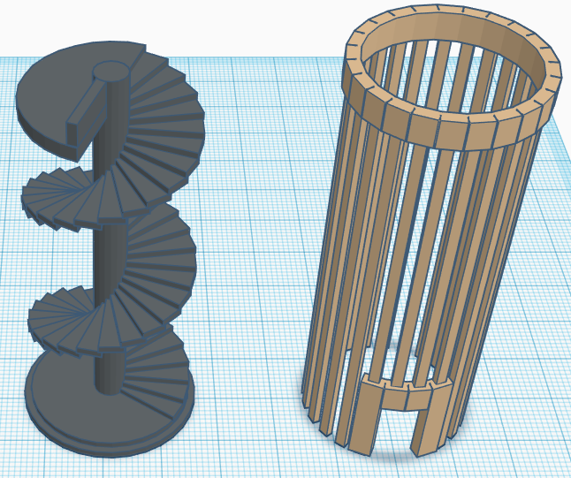
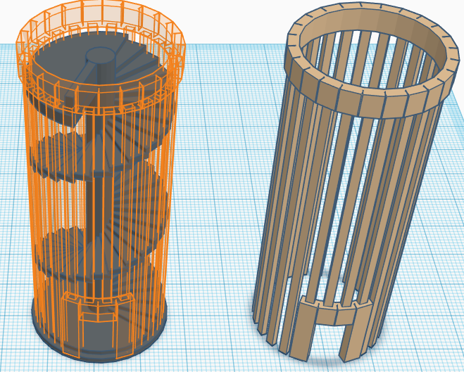
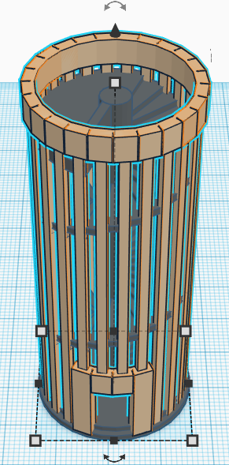

Learning the Moves
Make a Shape move along the workplane
1 Tinkercad Basics

Slide 2



Learning the Moves
Step One- Learning the Moves
  Select along the left side of your screen.
Step Two- Position the Shape on the Target
  Drag the brown object to the object outlined in orange.
  Select along the left side of your screen.
Step Three- Congratulations!
  Select and then select .

Slide 3
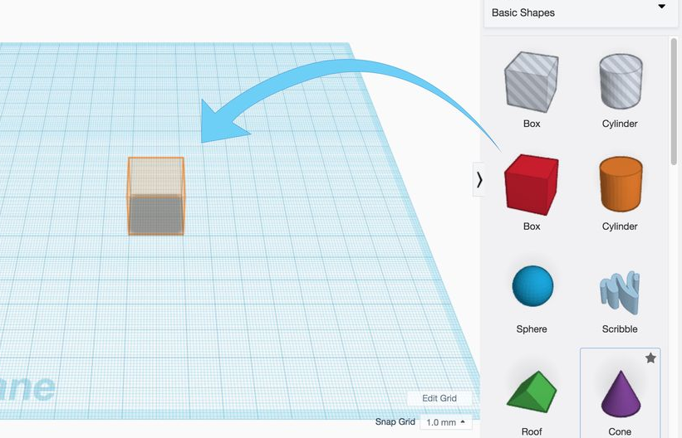
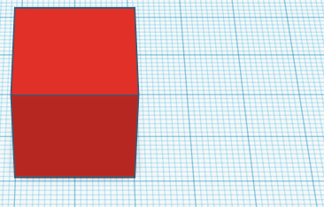
Place it!
Adding a Shape to the WorkPlaNe
2 Tinkercad Basics

Slide 4
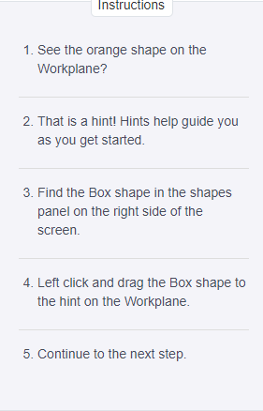
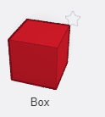
Place It!
Step One- Place It!
  You can find hints along the left side of your screen, under instructions.
  Select the red Box from the right side of your screen, and drag it to the orange shape on the workplane.
  Select along the left side
  of your screen.
  Congratulations! Select and then select .

Slide 5
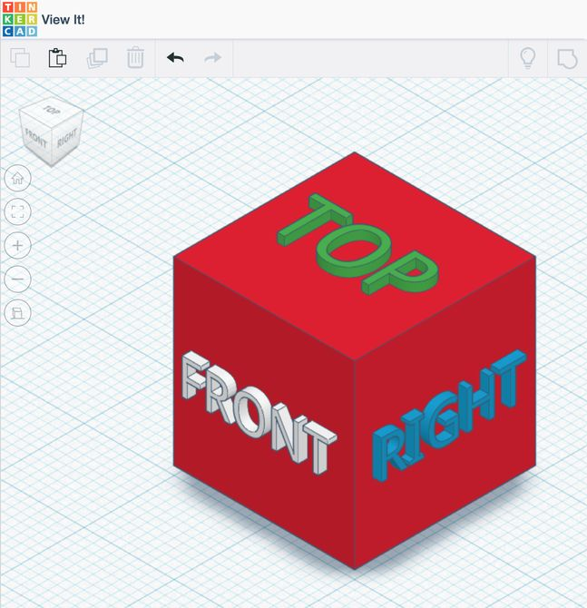
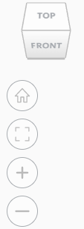
View It!
Change your View
3 Tinkercad Basics

Slide 6


View It!
Step One- View It!
  You can find hints along the left side of your screen, under instructions.
  You can click and drag the ViewCube or click once any side of the ViewCube to change your point of view in Tinkercad.
  Select along the left side of your screen.
Step Two- Learn to Zoom
  Practice zooming in and out.
    Use the scroll wheel on a mouse.
    Use the trackpad of a laptop.
    Use the (+) and (-) buttons below the ViewCube.
    Select along the left side of your screen.
Step Three- Let’s Look Around Faster
  Practice rotating using only your mouse or touchpad
    Press and hold the right mouse button while moving your mouse
    Press CTRL and Left Click while you drag OR tap with two fingers and drag.
Step Four- Good Work!
  Select and then select .

Slide 7
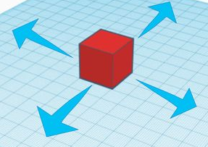
Move It!
Move Shapes Around the Workplane
4 Tinkercad Basics

Slide 8
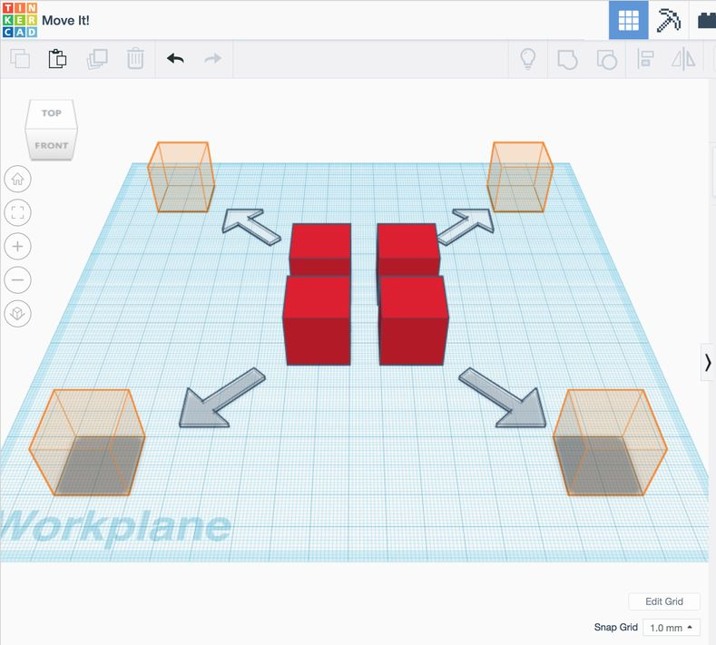
Move It!
Step One- Move it!
  Continue to the next step by clicking .
Step Two- Move Each Box
  Left click and drag each Red box to the orange Hint box.
  Continue to the next step by clicking .
  Congratulations, you did it! Select and then select .

Slide 9
Rotate It!
Rotate Shapes on the Workplane
5 Tinkercad Basics

Slide 10
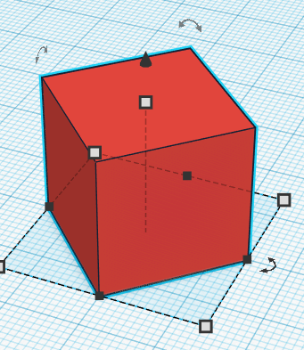
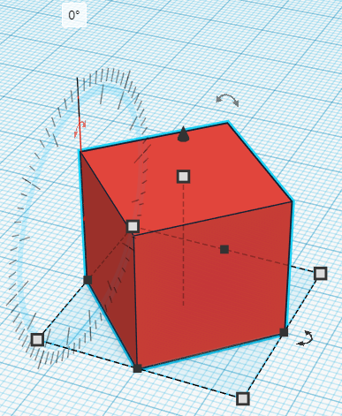
Rotate It!
Step One- Rotate It!
  Continue to the next step by clicking .
Step Two- Rotate Each Box
  By left clicking a box, you will enable the shape handles.
  Rotate your view to get the best view of the curved rotation handles, and use the curved arrows to rotate each shape 45 degrees to match the hint.
  Continue to the next step by clicking .
  Congratulations, you did it! Select and then select

Slide 11
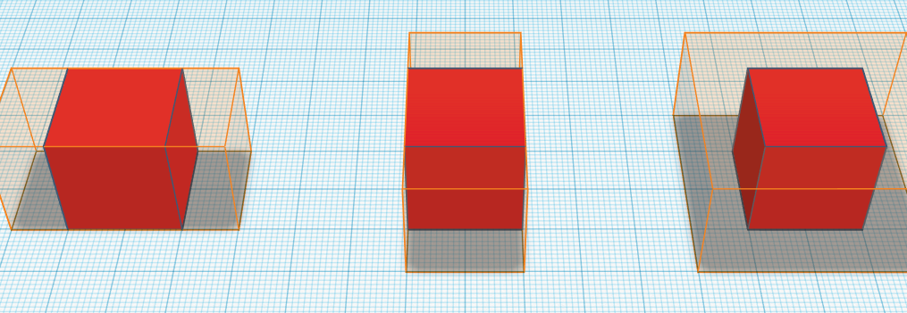
Size it Up!
Change the basic box shape
6 Tinkercad Basics

Slide 12
Size it Up!
Step One- Size It Up!
  Continue to the next step by clicking .
Step Two- Extend Each Block
  Select a box by left clicking on the shape- this will enable the shape handles.
  Use the black handles to size the shape in a single direction.
  Use the white handles to size in two directions at once.
  Continue to the next step by clicking .
  Congratulations, you did it! Select and then select

Slide 13
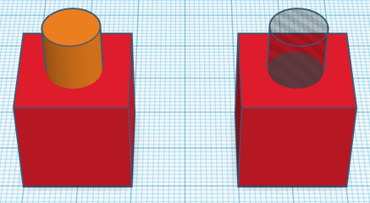
Group It!
Combine shapes
7 Tinkercad Basics

Slide 14
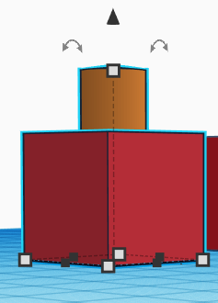
Group It!
Step One- Group It!
  Continue to the next step by clicking .
Step Two- Group Shapes on the Left
  Select the box on the left by left clicking on the shape.
  Hold SHIFT and also select the orange cylinder.
  With both shapes selected, click the group button on the toolbar. Both shapes should turn the same color.
  Continue to the next step by clicking .
Step Three- Group the Shapes on the Right
  Select the box on the right by left clicking on the shape.
  Hold SHIFT on the keyboard and also select the transparent cylinder.
  With both shapes selected, click the Group button on the toolbar. This time, the cylinder should leave a hole in the red box shape.

Slide 15
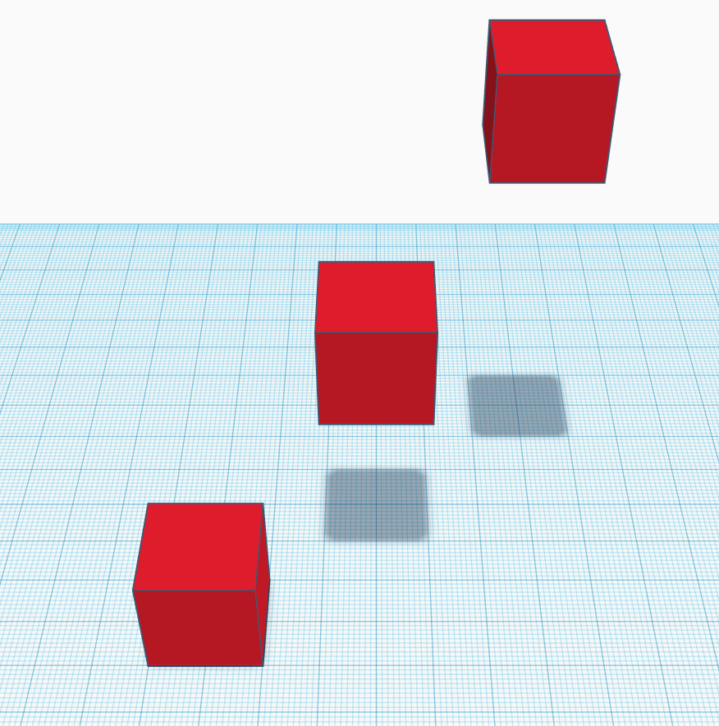
Align It!
Getting Shapes to Fit Together
8 Tinkercad Basics

Slide 16
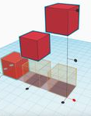
Align It!
Step One- Align It!
  Continue to the next step by clicking .
Step Two- Preview Shape Alignment
  Select all the box shapes by holding SHIFT on the keyboard and left clicking on each box shape.
  With all shapes selected, click the ALIGN button on the toolbar.
  The ALIGN handles will appear around the shapes.
  Hover your mouse over each of the black alignment handles to see a preview of the alignment.
  Continue to the next step by clicking .
Step Three- Align to the Bottom
  Clicking on any of the alignment handles will move the shapes into the align position.
  The undo button on the toolbar will let you you change back to the original position if needed.
  Try to align the Boxes on the Workplane aligned to the front box.
  Continue to the next step by clicking .

Slide 17

Play Time!
Putting it all together
9 Tinkercad Basics

Slide 18
Play Time!
Step One- Play Time!
  Put together all of your skills using the Tinkercad platform to design an object with your school’s name built into it!
  Start with the Basic Shapes column on the right side of your screen, and build and modify until you are happy with your creation.

