Slide 2
Mindset Makeover
Growth Mindset Impacts Teaching & Learning
Notes:
Briefly introduce the session and an facilitators for the session.
Add names and titles of facilitators to this slide below ”Growth Mindset Impacts Teaching and Learning”

Slide 3
Essential Question
How can our perceptions and beliefs affect our learning outcomes?

Slide 4
Over My Last Break I…
Binge watched Netflix
Visited the K20 Center LEARN Site
Played an instrument
Made my bed every morning
Traveled to another state
Exercised more than twice a week
Read a book
Hunted
Went to the movie theater
- Show the # of hours with your fingers
- Make a checkmark
- Air play your instrument
- Pat yourself on the back
- Yell out the state name
- Jog in place
- Pretend to read a book
- Shoot your bow and arrow
- Act out eating popcorn
Notes:
Adjust the statements (left) and actions (right) on the slide to relate to the participants. For example, change the starter statement to “Stand if you’ve…” or “Over the weekend I…” if your session does not follow a school break.”
If the statement on the left applies to participants, they will stand and then complete the action that appears on the right. Pause between statements to ask a few participants to share out specifics. For example, you may ask someone to tell you the name of the musical instrument they play or the book they are reading. Participants will sit back down after each statement and action is completed.
If time allows, briefly discuss, “How does this strategy build a foundation for relationships (trust, caring, affirmation, validation, building trust and rapport, etc.)?”

Slide 5
Self-Reflection
Think of a time when you believed you did not have a natural talent to succeed in an activity.
How did that belief influence your effort in that activity?

Slide 6
Self-Reflection
Now, think of an area in your life in which you have worked hard to succeed.
How many hours of work have you spent on improving your success in this area?

Slide 7
Revisit Essential Question
How can our perceptions and beliefs affect our learning outcomes?

Slide 8
Mindset Self Assessment
Notes:
Unpack with discussion of the results might be on a continuum and in context of a specific area.
Next, Have the participants take the Growth Mindset self-assessment.
There isn’t any need for anyone to share their results as this can be a sensitive moment for someone who believes they have a growth mindset, but scores high on fixed mindset. Be sure that you process the results of this self-assessment by discussing what the results mean. There is a continuum between growth and fixed mindset, and growth mindset theory suggests that you can grow in mindset as much as any other skill. It’s also helpful to note for participants that people can have different levels of growth mindset under different contexts. For example, many hold the belief that artistic talent or math ability are fixed, but many have a much more flexible mindset about their ability to learn to drive better or ride a bike with practice.

Slide 9
Objectives
Reflect on your own mindset and your current classroom practices to support a growth mindset.
Apply research-based practices to foster the development of students’ growth.
Create a plan of action to continue to foster a growth mindset.
Notes:
(Hugo will make t-shirts and implement lessons that support Growth Mindset – specifically in math using manipulatives.)

Slide 10
Statements to Stand by…
What if I told you … you will get better if you practice.
What we think. We become.
Hard work beats talent when talent doesn’t work hard.
Sometimes you win. Sometimes you learn.
Failure is not the opposite of success. It’s part of success.
Notes:
EXPLORE
Participants will form groups based on the statement they feel most drawn to. In groups, participants will review several research cards about a growth mindset.
Teachers:
● Provide time for students to work together
● Observe and listen to students as they interact
● Ask probing questions
Students:
● Think creatively within the limits of the activity
● Gather and synthesize information to compare to current knowledge and create new knowledge

Slide 11
Research Statements about Growth Mindsets
With your group, take turns reading each research statement aloud. Then discuss what you notice or wonder about each statement.
Discuss connections to growth mindset:
What is the importance of each statement or quote?
How do the statements support a growth mindset?
Notes:
Explore
Each group will have a stack of cards with quotations from the research printed on them. One person will read the quote, and the group will discuss that quote for a few minutes before going on to the next quote. Groups should feel free to move through to the next quote freely when discussion peters out naturally. However, they should be careful not to linger on one quote for too long and try to get through several quotes.
Note: The facilitator should help groups keep moving though by giving indicators to the room or individual groups such as, “By this time you should have discussed at least three quotes, move on to the next quote now if you haven’t.”
EXPLORE
Teachers:
● Provide time for students to work together
● Observe and listen to students as they interact
● Ask probing questions
Students:
● Think creatively within the limits of the activity
● Gather and synthesize information to compare to current knowledge and create new knowledge

Slide 12
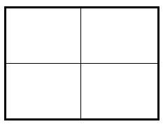


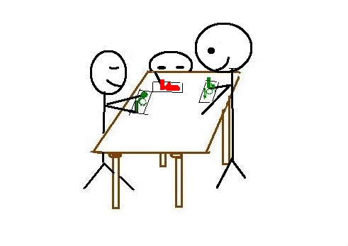
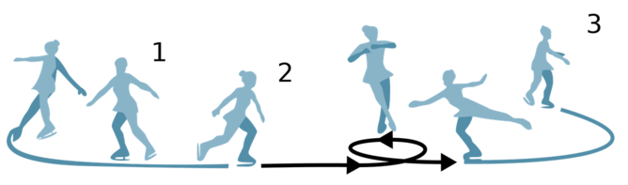
What does Growth Mindset Mean to You Now?
Color
Symbol
Divide poster paper into four quadrants.
Choose a color, a symbol, and an image.
Draw these in the corresponding quadrants.
Leave the bottom right quadrant blank for now.
Image
Notes:
Explain
This Photo by Unknown Author is licensed under CC BY-NC-ND
This Photo by Unknown Author is licensed under CC BY-ND
This Photo by Unknown Author is licensed under CC BY-NC-ND
This Photo by Unknown Author is licensed under CC BY-SA
This Photo by Unknown Author is licensed under CC BY-ND
This Photo by Unknown Author is licensed under CC BY-SA-NC
This Photo by Unknown Author is licensed under CC BY-SA
This Photo by Unknown Author is licensed under CC BY-SA
After discussing quotes, groups will summarize their discussion of the research by creating a CSI poster. Groups may choose to incorporate how the meme they chose holds up in light of the research. Posters will be shared with the whole group.
CSI: On chart paper, each group will divide the poster into quarters. In the top left, they will choose a color they feel represents the message of a growth mindset. Then they will draw a symbol for a growth mindset in the top right. At the bottom left, they will draw a scene that relates to both the growth mindset and their group’s chosen meme.
(Explain from the 5E)
Student: Uses evidence from previous activities for their explanations
Teacher: Explains concepts using students’ previous activities as a basis. Encourages students to explain concepts and ideas in their own words
CSI does this.. We do not need a new experience for them to explain… the video would be here to put faces with the research… what parts of growth mindset impacted these ppl and their ability to achieve great things after failure?

Slide 13
Tell us about your CSI.
Notes:
Have groups share their CSI poster with the whole session. They should explain why they chose their color, symbol, and image as a way to summarize their reading.

Slide 14
“[Giftedness] is a social comparison that causes students who arrive at school excited to learn - to quickly decide that they are not good enough.”
(Boaler, Jo. Limitless Mind. 2019, p. 88)
Notes:
Use this quote from Jo Boaler’s book Limitless Mind to set up the video about Giftedness.
The video is directly to connected to teaching practices that are harmful to all students but focuses on the impact labels, like giftedness, have upon students’ own mindset. “Teachers hold an incredible amount of influence. They can change the pathways of students, as many of the interviews I have shared have shown. They do this when they communicate to students that they believe in them, that they will value times of struggle and mistakes, that they they will honor different types of thinking and ways of approaching life. Parents play a similar role in valuing their children’s ways of being and unlocking their children to be the people they can be.” p. 98 (Boaler, 2019)

Slide 15

Notes:
Jo Boaler’s website: https://vimeo.com/241875015 it’s about labels and “giftedness” and how that impacts kids/students.

Slide 16
Reflecting
How has your thinking about failure and struggle changed considering this new information?
How does growth mindset change the way you treat yourself when you fail?
Notes:
Revisit mindset quiz and read the questions with the research (and video) in mind. This is an opportunity for a conversation about how some of their mindsets are beginning to change or shift.
NOTE: Either discuss the questions on this slide within small groups or as a whole group If it appears that participants may not want to share with small groups or as a whole group, create a digital reflection tool (like mentimeter) and the questions can be reflected through quiet processing and responses kept anonymous. Journals might be an option as well if technology is not available.

Slide 17
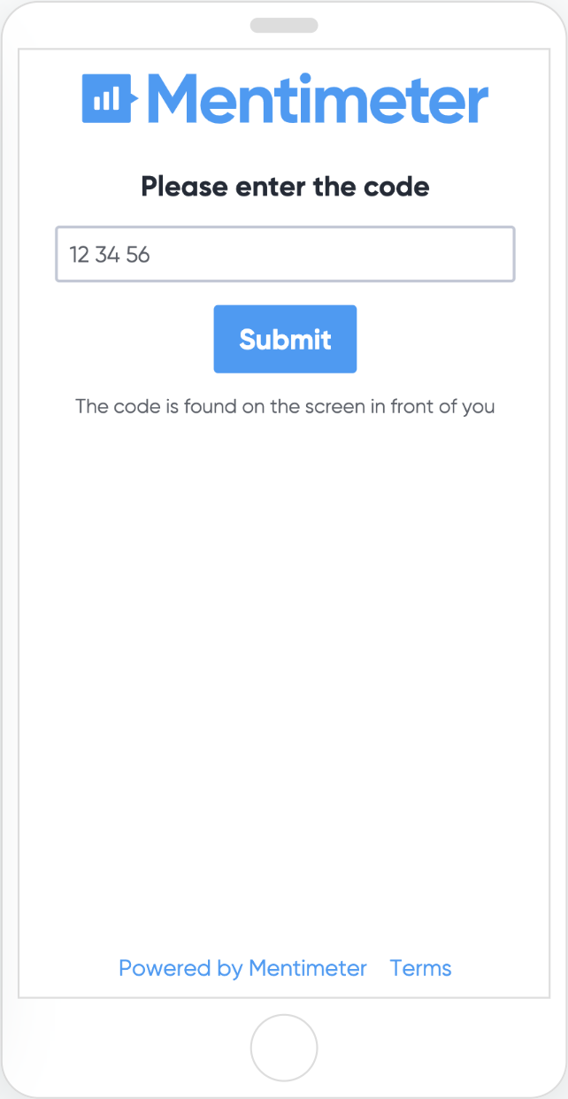
Go to www.menti.com and enter the code:
Notes:
Revisit mindset quiz and read the questions with the research (and video) in mind. This is an opportunity for a conversation about how some of their mindsets are beginning to change or shift.
NOTE: either discuss the questions on this slide within small groups or as a whole group If it appears that participants may not want to share with small groups or as a whole group, create a digital reflection tool (like mentimeter) and the questions can be reflected through quiet processing and responses kept anonymous. Journals might be an option as well if technology is not available.

Slide 18
Summarize Growth Mindset
In the bottom right quadrant, summarize growth mindset using at least 3 bullet points.
Notes:
Summarize the Growth Mindset theory into three bullet points in the bottom right quadrant of the CSI (Summary) poster. Share and discuss the summaries as well as address the reflection questions if, for some reason, they aren’t already addressed by participant’s summaries. Give the opportunity for participants to ask questions.

Slide 19
Sort Growth Mindset Statements
6 Value Statement Categories
Sort the activity descriptions into the 6 different categories
Teachers and students believe everyone can learn at high levels.
Communication and connection are valued.
The learning is visual.
The learning is open.
The environment is filled with wonder
and curiosity.
The classroom is a risk-taking,
mistake-valuing environment.
Notes:
Now that we’ve looked at theory, let's look more at practice. Hand out the card sort activity. First, hand out a set of six cards with growth mindset value statements on them (from youcubed.com).
Then, hand out a stack of activity descriptions that support the above values.
After participants are done sorting, debrief where they placed the cards and identify some that were either difficult to place and/or how some were sorted into different groups. Have groups share out why they sorted the way they sorted.
*connect to the classroom briefly: how might some of these look in your own classroom?

Slide 20
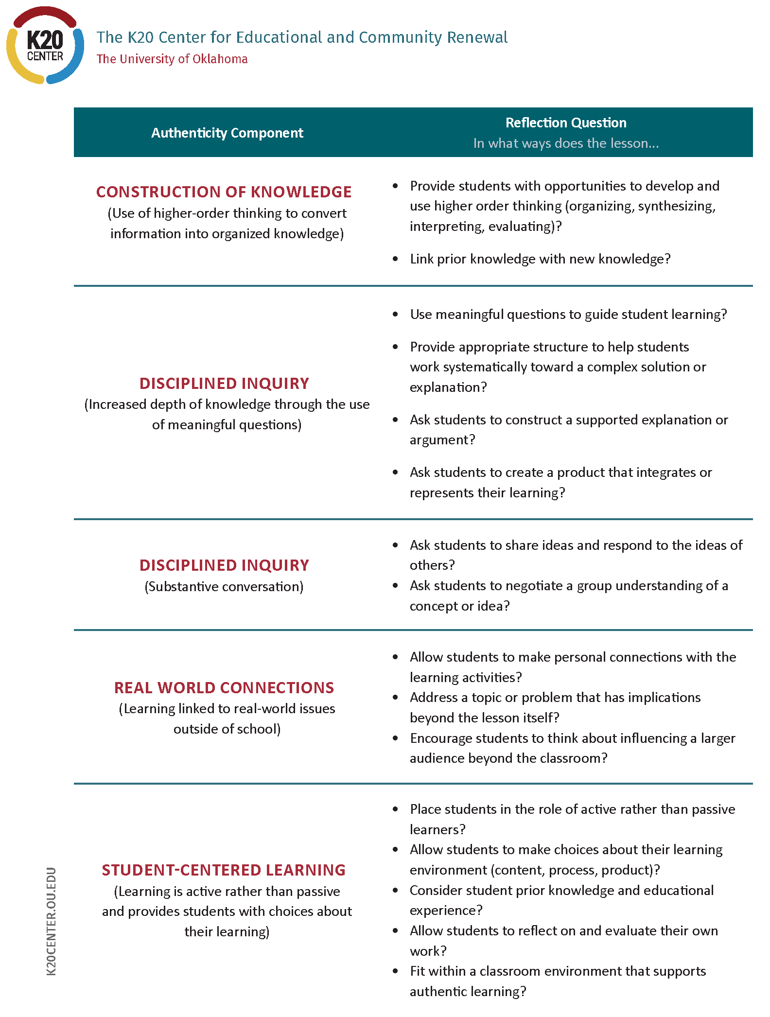
Growth Mindset Supports Authentic Instruction
For each of the five components within authentic teaching and learning, identify one activity statement to support that component.
Notes:
Use the sorted cards and without moving them discuss with your group how they connect and support authentic teaching and learning. (use the reflection tool or the old colorful reflection tool).
Find at least one statement that supports each of the 5 components of authentic teaching and learning .

Slide 21
Effort to Grow
Identify one of the activities from the card sort that you will challenge yourself to intentionally implement.
Write this on your magnet Pledge Card.
Notes:
After the card sorts are complete, have each person choose one of the activity descriptions from the card sort and write down on a pledge card for themselves how they will facilitate that activity in their classroom. Statements should be SMART (specific, measurable, achievable, relevant, and time-based). For example, if the participant chooses the activity statement, “Students feel comfortable when they are stuck or wrong,” a good pledge statement would read something like this:
Next time one of my students gives a “wrong” answer I will not tell them they are wrong. I will ask them to share how they came to that answer and celebrate their thinking process and hard work. I will coach them towards a correct answer by building on the thinking work they have already done.
Have them type their pledge into the TREK eval.

