Slide 2
Mindset Makeover
Growth Mindset Impacts Teaching and Learning

Slide 3
Essential Question
How can our perceptions and beliefs affect our learning outcomes?

Slide 4
Learning Objectives
Reflect on your own mindset and your current classroom practices that support a growth mindset.
Apply research-based practices to foster the development of student growth.
Create a plan of action to continue to foster a growth mindset.

Slide 5
During My Last Break I…
Binge watched Netflix
Visited the K20 Center LEARN Site
Played an instrument
Made my bed every morning
Traveled to another state
Exercised more than twice a week
Read a book
Hunted
Went to the movie theater
Show the # of hours with your fingers
Make a checkmark in the air
Air play your instrument
Pat yourself on the back
Yell out the state name
Jog in place
Pretend to read a book
Shoot a bow and arrow
Act out eating popcorn
Notes:
K20 Center. (n.d.). Snap, clap, pop. Strategies. https://learn.k20center.ou.edu/strategy/190

Slide 6
Self-Reflection
Recall a time when you believed you did not have the natural talent necessary to succeed in an activity.
How did that belief influence your effort in that activity?

Slide 7
Self-Reflection
Now, recall an area of your life in which you worked hard to succeed.
How many hours of work have you spent to achieve success in this area?

Slide 8
Revisit the Essential Question
How can our perceptions and beliefs affect our learning outcomes?

Slide 9
Mindset Self-Assessment

Slide 10
Revisit the Learning Objectives
Reflect on your own mindset and your current classroom practices that support a growth mindset.
Apply research-based practices to foster the development of students’ growth.
Create a plan of action to continue to foster a growth mindset.

Slide 11
Statements to Stand by…
What if I told you that you will get better if you practice.
What we think, we become.
Hard work beats talent when talent doesn’t work hard.
Sometimes you win. Sometimes you learn.
Failure is not the opposite of success; it’s part of success.
Notes:
K20 Center. (n.d.). Magnetic statements. Strategies. https://learn.k20center.ou.edu/strategy/166

Slide 12
Research Statements about Growth Mindsets
With your group, take turns reading each research statement aloud. Discuss what you notice or wonder about each statement.
Discuss connections to a growth mindset:
What is the importance of each statement or quote?
How do the statements support a growth mindset?

Slide 13


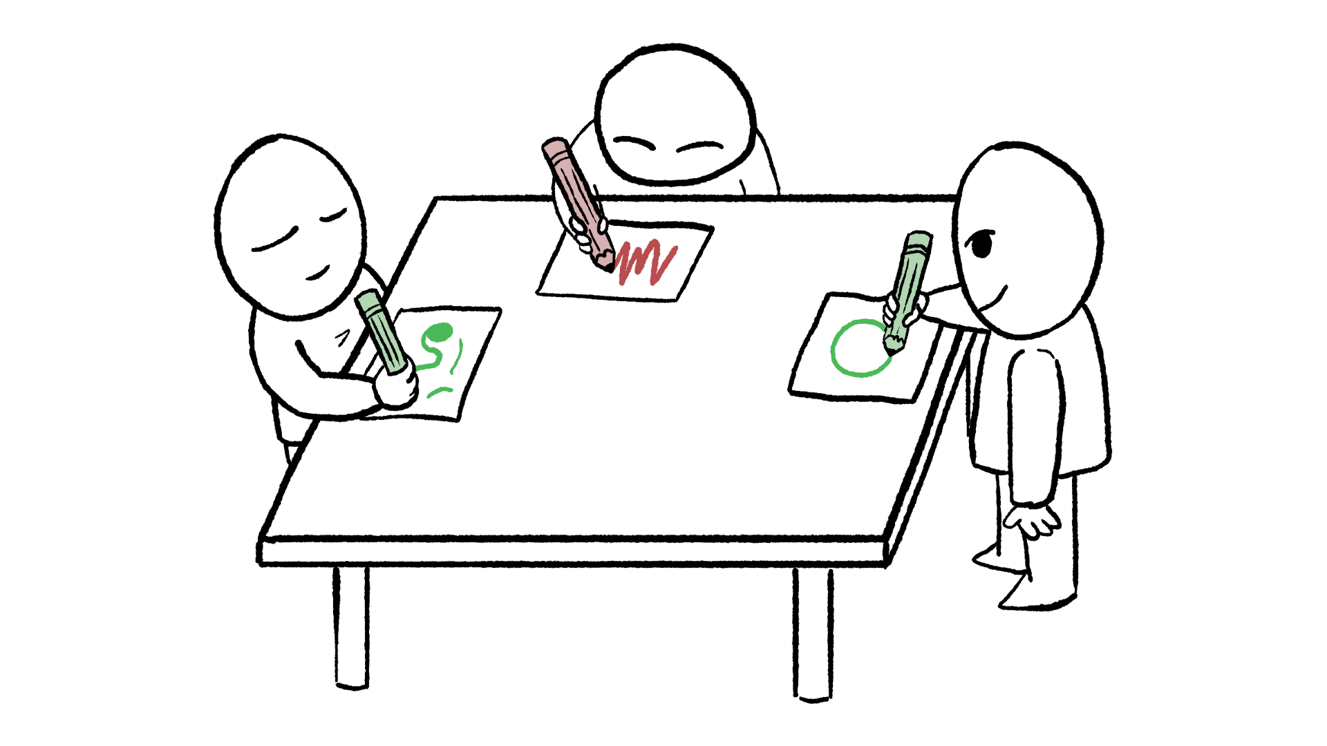
What does a growth mindset mean to you now?
Color
Symbol
Divide a poster paper into four quadrants.
Choose a color, a symbol, and an image.
Draw each in the corresponding quadrants.
Leave the bottom right quadrant blank.
Image
Notes:
K20 Center. (n.d.). Color, symbol, image. Strategies. https://learn.k20center.ou.edu/strategy/161
Actarux. (2007). Purple [Image]. Wikimedia Commons. https://commons.wikimedia.org/wiki/File:Purple.svg
Albingeorge. (2014). Indian election symbol book [Image]. Wikimedia Commons. https://commons.wikimedia.org/wiki/File:Indian_Election_Symbol_Book.svg

Slide 14
Share Your Poster
Share your Color, Symbol, Image poster with the whole group.
Explain why you chose each color, symbol, and image.

Slide 15
“[Giftedness] is a social comparison that causes students who arrive at school excited to learn—to quickly decide that they are not good enough.”
(Boaler, 2019, p. 88)
Notes:
Boaler, J. (2019). Limitless mind: Learn, lead, and live without barriers. HarperOne.

Slide 16
Rethinking Giftedness
Notes:
Boaler, J. & Constantinou, S. (2017, November 8). Rethinking giftedness [Video]. Vimeo. https://vimeo.com/241875015

Slide 17
Reflecting
How has your thinking about failure and struggle changed based on this new information?
How does growth mindset change the way you treat yourself when you fail?

Slide 18
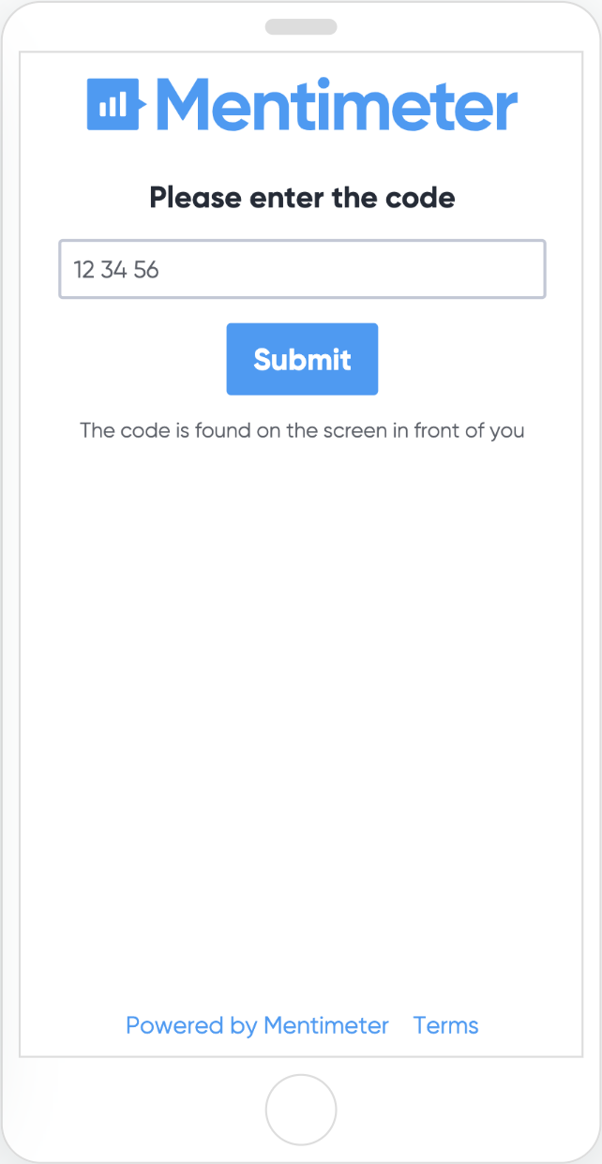
Navigate to www.menti.com and enter the code:

Slide 19
Growth Mindset Summary
Color
Symbol
In the bottom right quadrant, summarize what a growth mindset is using at least 3 bullet points.
Image
Notes:
K20 Center. (n.d.). Color, symbol, image. Strategies. https://learn.k20center.ou.edu/strategy/161
Actarux. (2007). Purple [Image]. Wikimedia Commons. https://commons.wikimedia.org/wiki/File:Purple.svg
Albingeorge. (2014). Indian election symbol book [Image]. Wikimedia Commons. https://commons.wikimedia.org/wiki/File:Indian_Election_Symbol_Book.svg

Slide 20
Growth Mindset Card Sort
6 Value Statement Categories
Sort the activity descriptions into the 6 different categories.
Teachers and students believe everyone can learn at high levels.
Communication and connection are valued.
The learning is visual.
The learning is open.
The environment is filled with wonder
and curiosity.
The classroom is a risk-taking,
mistake-valuing environment.

Slide 21
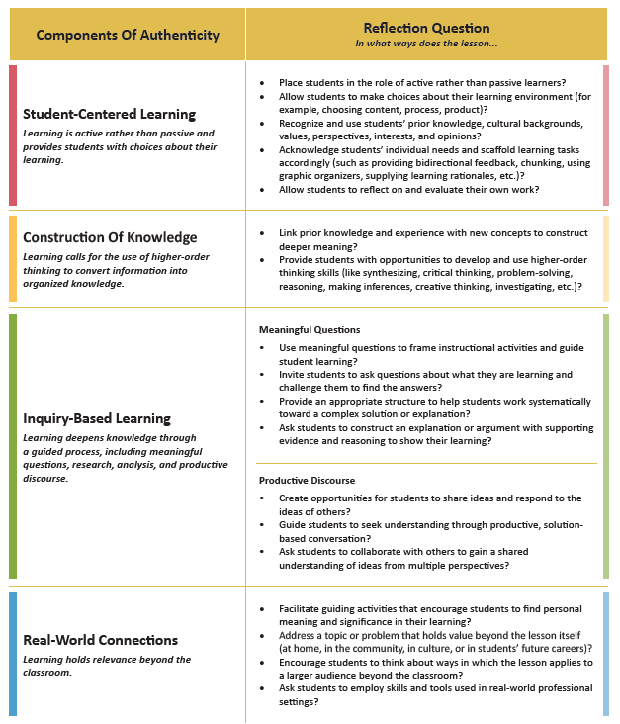
Growth Mindset Supports Authentic Instruction
Identify one activity statement to support each of the four components of authentic teaching and learning.

Slide 22
Effort to Grow
Identify one of the activities from the Card Sort that you will challenge yourself to intentionally implement.
Write this activity on your Pledge Card.

