Slide 2
Interactive Classrooms for All Contents

Slide 3
GEAR UP for the FUTURE Goals
Increase cohort academic performance and preparation for postsecondary education.
Increase high school graduation and postsecondary education participation.
Increase student educational expectations, and increase student and family knowledge of postsecondary education options, preparation, and financing.
Notes:
(5 min.) Goals and objectives

Slide 4
Objectives
Participants will explore various technology resources and their potential use in the classroom.
Participants will be able to choose at least one instructional technology tool and create an activity to highlight its application in the classroom.
Participants will apply their understanding of the SAMR model of technology integration to the chosen technology tool.
Notes:
(5 min.) Goals and objectives
Context

Slide 6
Self-Assessment
How comfortable are you using technology in the classroom?
Around the room, there are four signs with memes on them.
Move to the sign that illustrates how comfortable you are using technology in the classroom with your students.
Notes:
Give participants time to make their choices.
These groups will work together to complete the task cards. If groups are larger than 5, split them up into smaller groups.

Slide 7
Four Corners
With your group, discuss why you chose that sign.
Elect a leader to share out your group’s thoughts with everyone.
Notes:
Gauge the groupings. If groups are large, split them into smaller groups for the next activity.

Slide 9
Task Cards
Using Technology as an Educational Tool
With your group, work through the tasks on the cards.
Each card is associated with a technology resource that can be used in your classroom.
Use the note catcher to take down any helpful or pertinent information for your personal use.
Notes:
Use groups from the 4 corners activity. If one group is particularly resistant to technology, you can split them up among other groups.
Pass out the note catcher while they are working.
This should take approximately 30 minutes.

Slide 10
Pear Deck
Pear deck (n.d.). Pear deck. Pear deck. https://www.peardeck.com
Go to peardeck.com on your browser.
Scroll to the middle of the page to the “How Pear Deck Works” section. Watch the short introductory video to learn about what Pear Deck does.
Scroll to the next section, “Formative Assessment, Six Ways,” and watch the brief animation about you can use Pear Deck in your classroom.
To sign up, select “Teacher Login” at the top of the page.
You can either select “Log in with Google” or “Log in with Microsoft.”
Work through the prompted questions to set up your account.
Use your account to upload files and presentations.
Notes:
Image source: Pear deck (n.d.). Pear deck. Pear deck. https://www.peardeck.com

Slide 11
Fluany
Fluany. (n.d.). Fluany - everything you need to force your mind to learn. Fluany. https://www.fluany.com
Make sure you are signed into your Google account on Google Chrome.
Go to fluany.com.
Scroll through and read the information on the homepage about the Fluany browser extension.
At the top of the page, select “Add Fluany to Chrome.” Select “Add to Chrome” on the next page.
Try exploring the Fluany browser extension on your own.
Try creating your own study list.
Notes:
For both ELA and SS
Image source: Fluany. (n.d.). Fluany - everything you need to force your mind to learn. Fluany. https://www.fluany.com

Slide 12
EDpuzzle
Edpuzzle (n.d.). Edpuzzle | make any video your lesson. Edpuzzle. https://edpuzzle.com/
Go to edpuzzle.com on your browser.
Select “Sign up” in the upper right corner.
Select “I’m a Teacher.”
If you have a Google account, you can select “Sign in with Google.”
You may need to verify your email address.
Using the search bar in the upper left corner, search terms that are related to your content area.
Select an Edpuzzle from your search and watch.
To create your own content, select “My Content” from the left side of the screen, then “Add Content” from the right side of the screen.
Notes:
For SS only
Image source: Edpuzzle (n.d.). Edpuzzle | make any video your lesson. Edpuzzle. https://edpuzzle.com/

Slide 13
Sutori
Sutori (n.d.). Presentations for the classroom | Sutori. Sutori. https://www.sutori.com/
Go to sutori.com in your browser.
Select the “Sign up” button in the upper right corner. If you have a Google account, you can sign in with Google. Select your age group and role.
On the dashboard, select “Beginner’s Guide” to get acquainted with the site.
Scroll through the tutorial. Watch the videos and read to find out how Sutori works in the classroom.
To create your own, scroll up and select “Stories” at the top of the page.
To invite and manage students, select “Students” at the top of the page.
To access helpful resources and examples, select “Resources.”
Try to create your own Sutori story!
Notes:
For SS only
Image souce: Sutori (n.d.). Presentations for the classroom | Sutori. Sutori. https://www.sutori.com/

Slide 14
Webjets.io
Webjets Ltd. (n.d.). Webjets.io – The new way to collect, organize and share anything. Webjets.io. https://www.webjets.io/
Go to webjets.io in your browser.
Select “Sign up for free” in the upper right corner. If you have a Google account, you can sign in with Google.
Once you have signed in, click through the “Welcome to Webjets!” quick start guide on your screen. Select your occupation and press “Start” to bein.
Look for the “Welcome to Webjets” card on your screen. Work through all three tasks:
Drag a card from the toolbar at the bottom.
Copy and paste a URL to the board.
Drag and drop a file from your computer to the board.
Notes:
Image source: Webjets Ltd. (n.d.). Webjets.io – The new way to collect, organize and share anything. Webjets.io. https://www.webjets.io/

Slide 15
Hemingway Editor
Hemingway Editor. (n.d.). Hemingway Editor. Hemingwayapp. http://hemingwayapp.com/
Go to hemingwayapp.com in your browser.
Select the prewritten text in the middle of the page, from “Hemingway App makes your writing…” to “… compose something new,” and delete it.
Type in some text or copy and paste existing text into the editor.
Look at the information panel on the right side of the screen. What do you notice?
To write without seeing the information panel, select “Write” in the upper right corner. To bring the information panel back, select “Edit.”
Notes:
Image souce: Hemingway Editor. (n.d.). Hemingway Editor. Hemingwayapp.com. http://hemingwayapp.com/

Slide 16
Grasshopper
Google LLC. (n.d.). Grasshopper: learn to code for free – apps on google play. Play.google.com. https://play.google.com0.grasshopper&hl=en_SG
Go to grasshopper.app in your browser.
Select “What is Coding” at the top of the screen to read about the site and see more about why learning to code is important.
Select “Sign In” in the right-hand corner, and use your Google account to sign in.
To begin the first course, select “Fundamentals.”
Follow the prompts to begin learning how to code.
Try to code a flag!
Consider reviewing the names and descriptions of the other courses. Users—such as your students—must progress through each module. They cannot skip ahead.
Notes:
For both ELA and SS
Image source: Google LLC. (n.d.). Grasshopper: learn to code for free – apps on google play. Play.google.com. https://play.google.com/store/apps/details?id=com.area120.grasshopper&hl=en_SG

Slide 17
Chrome Music Lab
Google LLC. (n.d.). Chrome music lab. Musiclab.chromeexperiments.com. https://musiclab.chromeexperiments.com
Go to musiclab.chromeexperiments.com in your browser.
Select the “Melody Maker” icon from the options on the screen.
Using the grid, select notes from each column to hear each note.
Press the “Play” button at the bottom of the screen to play your “music.”
To auto-select paired notes, select the button next to “Play.”
To change the beat, adjust the slide bar.
For a challenge, use Melody Maker to create your own soundtrack for this task card!
Select the back button in the top left of the screen to go back to the home page.
“Kandinsky” lets you create music by drawing and animating shapes.
“Song Maker” lets you create music by selecting multiple notes on a grid.
“Rhythm” lets you explore percussion sounds to create mini-songs.
Notes:
For both ELA and SS
Image souce: Google LLC. (n.d.). Chrome music lab. Musiclab.chromeexperiments.com. https://musiclab.chromeexperiments.com

Slide 18
Google Science Journal
Google LLC. (n.d.). Science journal. Sciencejournal.withgoogle.com. https://sciencejournal.withgoogle.com/
Go to sciencejournal.withgoogle.com in your browser.
This app can be used on multiple devices, including cell phones and iPads.
On the homepage banner, select “Watch Video.”
Exit out of the video. Then, go to the navigation bar at the top of the homepage and select “Experiments.”
Browse this page to find an experiment you could do with your students.
Do you have Vernier sensors? Select “For Teachers” in the navigation bar.
Scroll to the middle of the page to learn how to connect the sensors with Google Science Journal.
Notes:
For SS only
Image souce: Google LLC. (n.d.). Science journal. Sciencejournal.withgoogle.com. https://sciencejournal.withgoogle.com/

Slide 19
Chemix
Codelite Ltd. (n.d.). Chemix – draw lab diagrams simply. Chemix.org. https://chemix.org/
Go to chemix.org in your browser.
Select “Sign in” in the upper right corner.
Choose from one of four different sign-in features.
While signing in is not necessary to use this application, it unlocks more features.
Using the apparatus icons on the left side of the screen, create an experiment setup that you would use in your classroom.
Select the “A” button at the top of the screen to label key parts of your experiment.
Use the “Download Image” option at the top of the screen to save it as a .jpg, .png, or .svg.
Try importing your image into a document.
Notes:
For SS only
Image source: Codelite Ltd. (n.d.). Chemix – draw lab diagrams simply. Chemix.org. https://chemix.org/

Slide 21
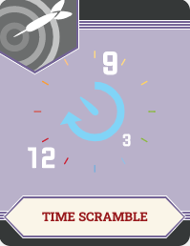
Time Scramble
Using the materials provided at your table, write down any ways you can incorporate the given resource in your classroom.
You have six minutes.
Notes:
You will need to choose six task cards for this activity.

Slide 22
Time Scramble
You have five minutes to:
review what is already on the list.
add everything you can think of.

Slide 23
Time Scramble
You have four minutes to:
review what is already on the list.
add everything you can think of.

Slide 24
Time Scramble
You have three minutes to:
review what is already on the list.
add everything you can think of.

Slide 25
Time Scramble
You have two minutes to:
review what is already on the list.
add everything you can think of.

Slide 26
Time Scramble
You have one minute to:
review what is already on the list.
add everything you can think of.

Slide 27
Time Scramble
Take a look at your completed list.
Do any activities stand out to you?
Share out!

Slide 28
Presentation
In your groups, create a short presentation that includes:
Your choice of technology resource.
A brief description of your technology resource.
How you would use this application in your classroom?
Notes:
Once participants are in their groups, have them create a presentation on poster paper. Give them approximately 20 minutes.

Slide 30
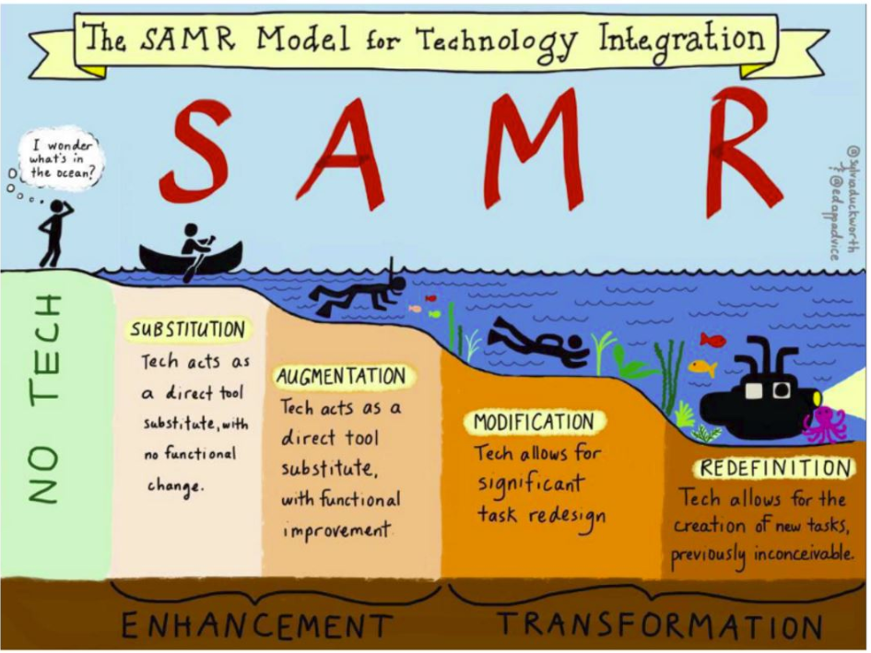
SAMR Recap
Duckworth, S. [@sylviaduckworth]. (2015, April 2). New #sketchnote The SAMR Model @karlyb @ICTEvangelist @ShakeUpLearning #elemchat @TheTechRabbi #ipaded #ipadedchat [Image attached] [Tweet]. Twitter. https://twitter.com/sylviaduckworth/status/583778319235031041
Technology Integration
Review the SAMR Model handout.
With your group, come up with an example of technology integration for substitution, augmentation, modification, and redefinition.
Notes:
Take time to make sure that groups understand how these tech integration levels might be manifested in the classroom. Ask for groups to share out as you go through the different levels.
Image source: Duckworth, S. [@sylviaduckworth]. (2015, April 2). New #sketchnote The SAMR Model @karlyb @ICTEvangelist @ShakeUpLearning #elemchat @TheTechRabbi #ipaded #ipadedchat [Image attached] [Tweet]. Twitter. https://twitter.com/sylviaduckworth/status/583778319235031041

Slide 31
Gallery Walk
With your group, rotate clockwise to another presentation.
Using your SAMR handout, choose one classroom use of the chosen tech, and determine its SAMR level of integration. Write this level of integration on a sticky note. Leave the note by the presentation.
Leave any additional comments on sticky notes in the same manner.
Leave any questions you have on sticky notes in the same manner.
Continue to rotate with your group until you arrive back to your original presentation.
Notes:
This should take approximately 15 minutes. Participants will need their SAMR handouts and sticky notes.

Slide 33
Six-Word Memoir
Select one of today’s resources.
Think about this question:
If you need to convince your students to use a new resource, how would you do it?
Write a Six-Word Memoir for your selected resource on a sticky note.
Share out!

