Slide 2
LEARN 5E INSTRUCTIONAL STRATEGIES
Professional Development

Slide 3
The 5E Lesson Model
What do you already know?
Red – The 5 what!?!
Yellow – I have heard of the 5E before, but I’m not really sure what it entails.
Green – I am pretty familiar with the 5E model and use it to structure my lessons.
Notes:
Participants self identify where they fit in the colors of green (expert), yellow (intermediate), or red (beginner/novice). Yellows share out what they know first. Then, greens fill in the blanks for anything missing. Reds and yellows have the opportunity to ask questions to learn a little more. Facilitators can fill in any additional blanks or answer questions if the ”experts” don’t know the answers.

Slide 4
5E Instructional Model
Take a moment to read through the 5E Lesson Framework handout to learn more about each 5E component.
Notes:
Participants will read through the 5E Instructional Model handout. This will give more clarity and a leveled understanding to each participant. Also, it will be a resource to use during the few activities.

Slide 5
Today We Will . . .
explore instructional strategies that meet the 5E Instructional Model;
identify how instructional strategies might create a student-centered learning environment; and
identify strategies that could be used in a 5E lesson within your content area.
Notes:
Briefly cover these with the group.

Slide 6
Sticky Bars
Engage Explore Explain Extend Evaluate
Reverse
To learn about instructional strategies that align with one of the 5E components, choose the sticky note in that corresponding column.
Notes:
Reverse Sticky Bars Strategy: Label a poster with the 5Es as a bar graph might be labeled. Then put different color Post-it notes above each E (for example, like the bars in a bar graph: Engage, pink; Explore, green; Explain, yellow; Extend, purple; and Evaluate, blue). Put only enough in each column to control group sizes and to ensure that there will be groups for each E. So, for example, if you have 20 participants, only place four stickies above each E component. If you have 34 participants, place seven stickies above each E component. (The slide shows an example of this structure.)
After reviewing the 5Es, participants chose one that they would like to explore from the “reverse” sticky bars strategy. Then, participants group with others who have the same color stickies and review the strategies provided or filtered on the K20 LEARN site (learn.k20center.ou.edu)
LEARN site and filter

Slide 7
5E Grouping and Task
Group with others who have the same color as you.
Review the instructional strategies provided on the K20 Center LEARN site (only works on Chrome Browser).
K20 Center LEARN site:
learn.K20center.ou.edu
Notes:
Reverse Sticky Bars Strategy: Label a poster with the 5Es like a bar graph might be labeled. Then put different color Post-It Notes above each E (for example, like the bars in a bar graph: Engage, pink; Explore, green; Explain, yellow; Extend, purple; and Evaluate, blue). Put only enough in each column to control group sizes and to ensure that there will be groups for each E. So for example, if you have 20 participants only place four stickies above each E component. If you have 34 participants, place seven stickies above each E component. (Slide 6 shows an example of this structure.)
After reviewing the 5Es, participants chose one that they would like to explore from the “reverse” sticky bars strategy. Then participants group with like color stickies and review the strategies provided or filtered on the K20 LEARN site (learn.k20center.ou.edu)
LEARN site and filter

Slide 8
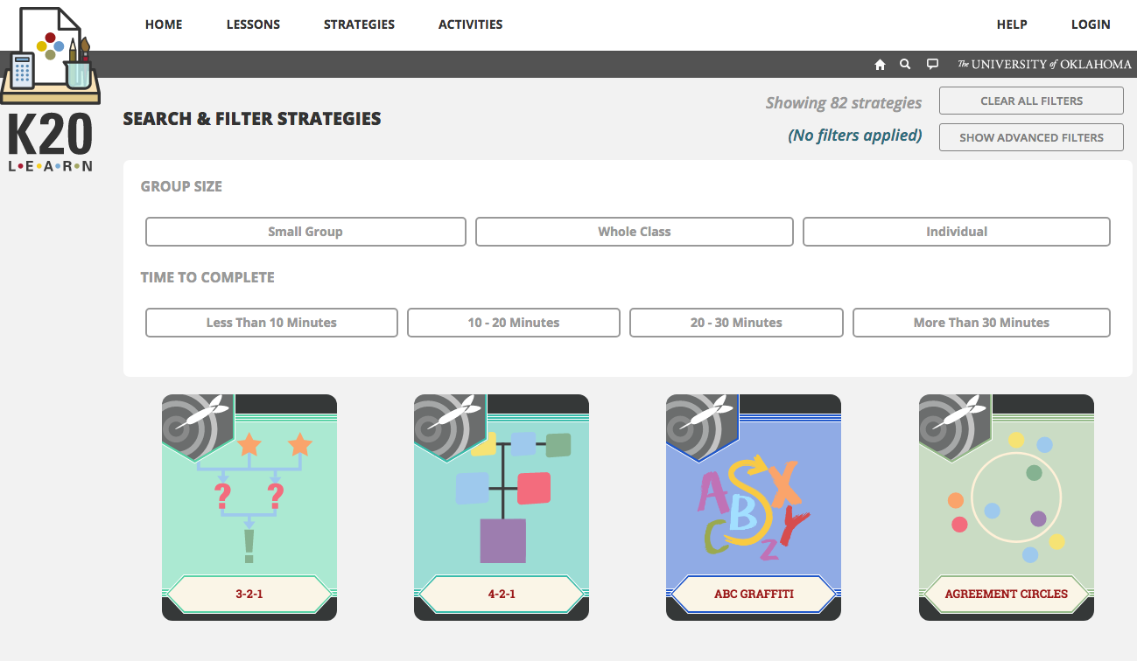
You can also filter by “Placement in Lesson”
Go to:
Learn.K20center.ou.edu
Notes:
Use the verbs from your reading and

Slide 9
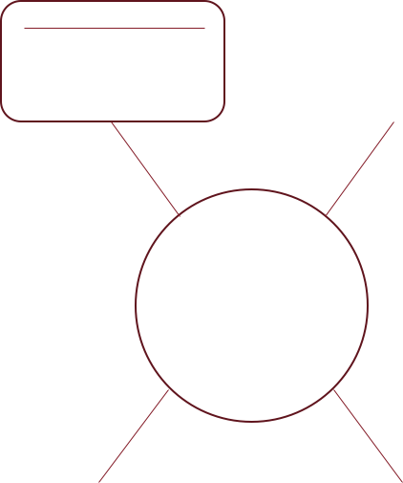
Instructional Strategies Quest
Commit & Toss
because it allows students to access prior knowledge
Use the resources provided to fill in this 5E Graphic Organizer:
The 5E Lesson Framework handout
Filtered strategies
How do your instructional strategies meet the criteria for the 5E component?
ENGAGE
Notes:
Use the resources provided (the 5E Model informational sheet and the filtered instructional strategies) to identify how these specific instructional strategies meet the criteria for the 5E component you are assigned. Use the graphic organizer to record your group’s findings.
Note: If time is not a concern, the instructional strategies may be filtered by participants online by clicking on the E component they are exploring. However, if time is a concern, then the presenter may give participants printed copies of the instructional strategies or provide a list of specific strategies they want groups to explore using the site. If the presenter provides a specific cards, there needs to be at least five cards for the groups to explore.

Slide 10
We Think
As a group, choose one strategy that you all agree meets the criteria for your 5E component.
You will share this strategy with the whole group.
Notes:
OPTIONAL: If you looking to extend this PD, give the groups a chance to model the strategy they chose for the whole group using content of their choice.

Slide 11
Card Sort
Sort the cards into the 5Es (white cards) by teacher actions and student actions.
Notes:
OPTIONAL: If you are looking to extend this PD, you can include a card sort here.

Slide 12
I Think
How could you use one of the strategies you explored in your own content area?
***This does NOT have to be the one that your group shared***
Notes:
Have teachers think of a lesson they are going to teach in order to embed a strategy in.
time to look on learn to search for strategies to use in their own content area.

Slide 13
I Notice, I Wonder
On the Instructional Strategy Note Sheet, record 3 ways the 5E Model supports student-centered learning (authentic teaching and learning) and anything else you wonder.
Notes:
This is the last slide for the presentation.

Slide 14
Follow-Up Reflection

Slide 15
SCORE
What is one Strategy you used to support authentic teaching and learning?
What was successful and needs to be Celebrated?
What Obstacle did you face and overcome?
What might you Refine in the future when using this strategy?
Extra notes or ideas?
Notes:
During a follow up session with participants ask them to reflect on the strategies they used. Participants may use the SCORE Reflection Note Sheet for recording thoughts and reflections.

