Slide 1
Notes:
Instructor/Facilitator Notes:

Slide 2
I Love HyperDocs
Notes:
Instructor/Facilitator Notes:

Slide 3
GEAR Up for the FUTURE Goals
Increase cohort academic performance and preparation for postsecondary education (PSE)
Increase high school graduation and PSE participation
Increase student educational expectations and increase student and family knowledge of PSE options, preparation, and financing
Notes:
Instructor/Facilitator Notes:

Slide 4
Essential Question
How can we incorporate great pedagogy, the best content, and meaningful technology into our classroom?

Slide 5
Objectives
Explain the purpose and structure of HyperDocs
Curate educational resources
Design a HyperDoc which integrates curated resources

Slide 6
Using X to Find Cool Things
Open your X account.
Search these hashtags/profiles
#hyperdocs
Sarah Landis
Teachers Give Teachers
Notes:
Instructor/Facilitator Notes:
X (formerly known as Twitter). (n.d.). https://twitter.com/home

Slide 7
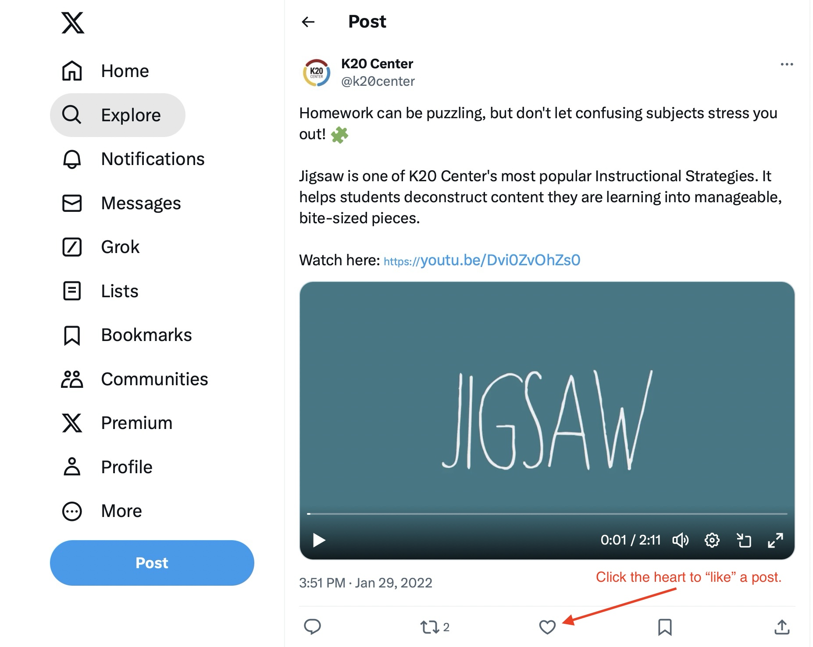
Don’t forget to “like” the posts with resources you want to use in your classroom.
Notes:
Instructor/Facilitator Notes:

Slide 8
#HyperDocs
Sarah Landis
Teachers Give Teachers
Hashtags & Profiles
Notes:
Instructor/Facilitator Notes:
X (formerly known as Twitter). (n.d.). https://twitter.com/home

Slide 9
HyperDocs Templates
https://tinyurl.com/yaeesler
Notes:
Instructor/Facilitator Notes:

Slide 10
Crowdsourcing
Use your note catcher to add and organize all templates, resources and ideas you liked.
Notes:
Instructor/Facilitator Notes:
Open up the note catcher doc to share with the participants what it looks like and how it’s used.

Slide 11
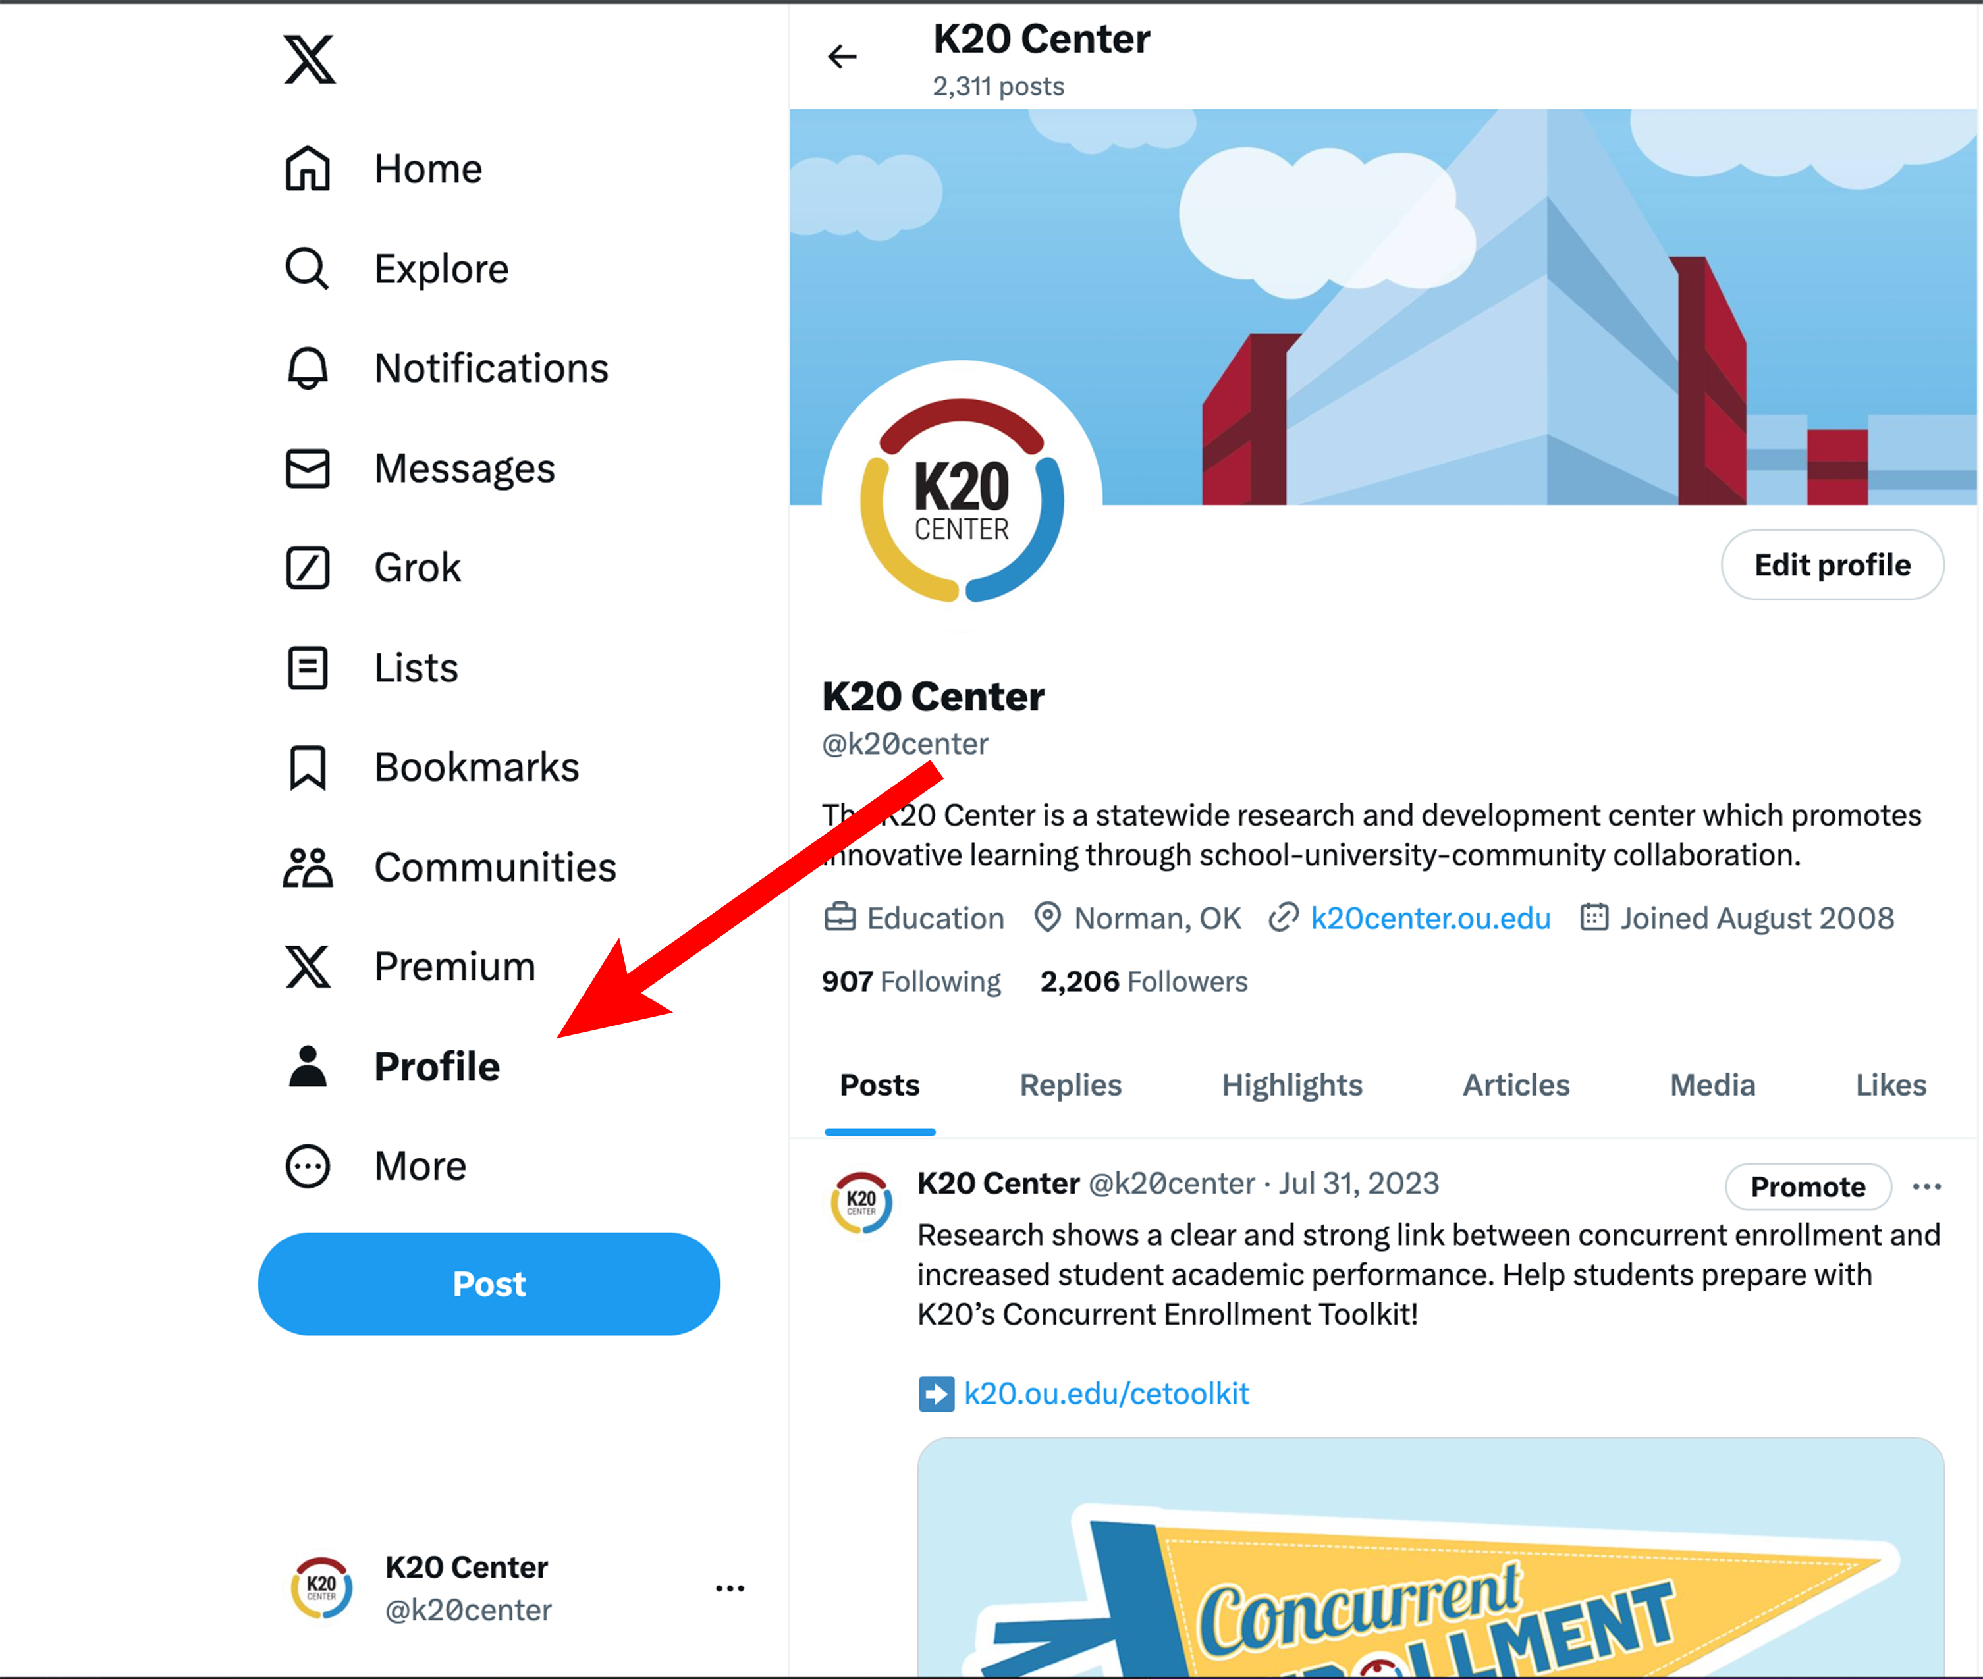
Click on Your Profile
Notes:
Instructor/Facilitator Notes:

Slide 12
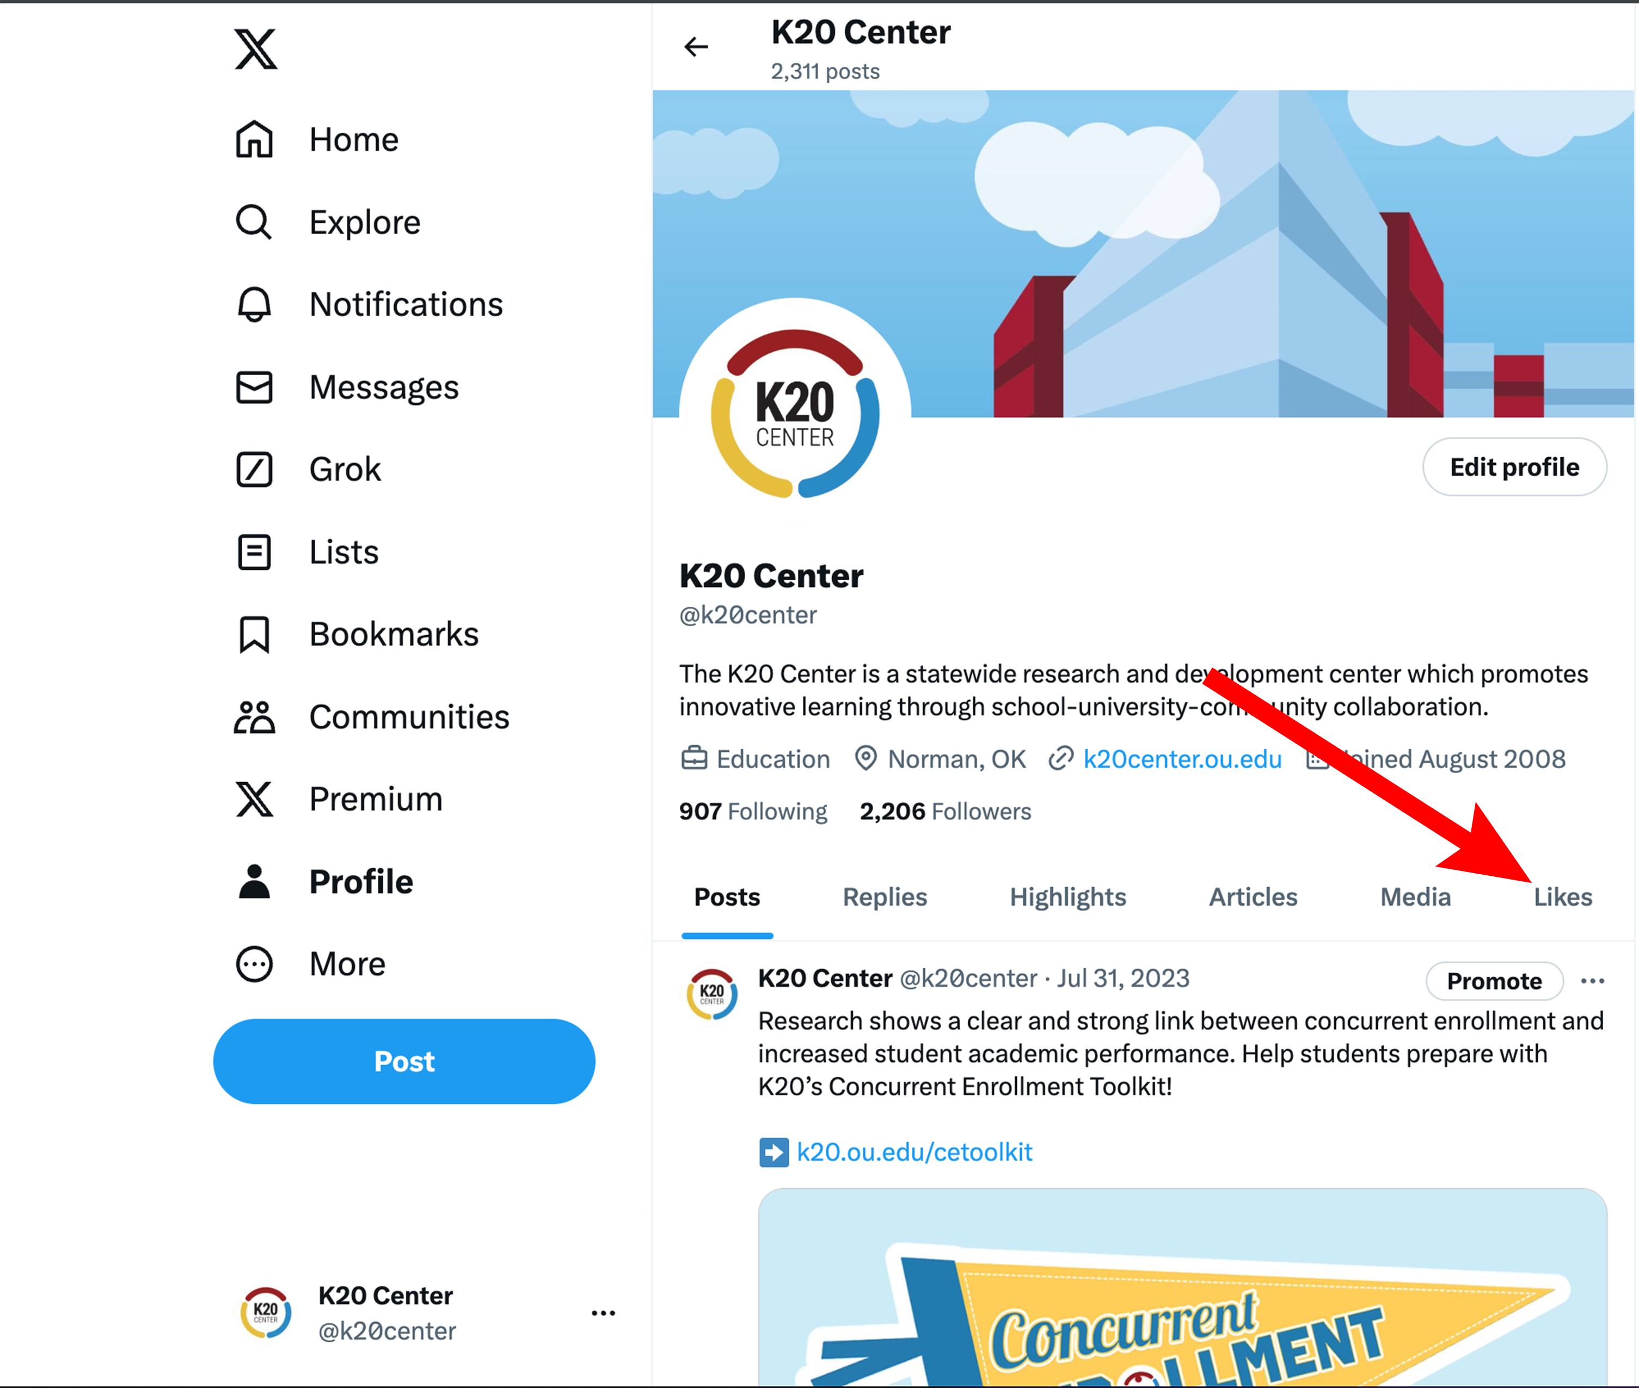
Click on “Likes”
Notes:
Instructor/Facilitator Notes:

Slide 13
Post Away
Share your favorite resource on X using the hashtags:
#HyperDocs
#K20GearUp
Notes:
Instructor/Facilitator Notes:
X (formerly known as Twitter). (n.d.). https://twitter.com/home

Slide 14
Applying HyperDocs to Your Classroom
Identify a standard you want to use in your classroom
Break it into one or two objectives
Highlight any resources or ideas on your note catcher that you would like to use in this project.
Notes:
Instructor/Facilitator Notes:
If your participants need help writing objectives direct them to one of three objective building sites: Iowa State, Arizona State, or UCF.

Slide 15
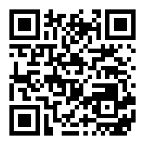
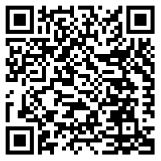
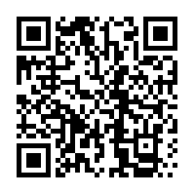
Building Learning Objectives
Arizona State University
Iowa State University
University of Central Florida
Notes:
Instructor/Facilitator Notes:
If your participants need help writing objectives direct them to one of three objective building sites: Iowa State, Arizona State, or UCF.

Slide 16
Build Your Own HyperDoc - BYOH
Title your HyperDoc
Enter your objective(s) in the HyperDoc
Add resources, activities and reflections in your HyperDoc
Share a link to your HyperDoc on Twitter using the hashtags #HyperDoc & #K20GearUp
Notes:
Instructor/Facilitator Notes:

Slide 17
Point of Most Significance
What part of this activity or resource helped you understand HyperDocs?
How will HyperDocs change teaching and learning in your classroom?
Notes:
Instructor/Facilitator Notes:

