Slide 2

Future-Ready Classrooms
The ISTE Standards in Action

Slide 3

Think about this….
What jobs or careers exist today that didn’t exist when you graduated high school?

Slide 4
Jobs That Did Not Exist in 1997
Social Media Manager
App Developer
Data Scientist
Cloud Computing Specialist
Digital Marketing Specialist
Virtual Reality Designer
Blockchain Developer
SM Creator/Influencer
Cyber Security Analyst
Podcast Producer
E-Commerce Manager
AI Ethics Specialist
Drone Operator
Cryptocurrency Trader
Genetic Counselor
Augmented Reality Developer
AI Prompt Engineer

Slide 5
“We are currently preparing students for jobs that don’t yet exist … using technologies that haven’t been invented … in order to solve problems we don’t even know are problems yet.”
–Richard Riley, Former U.S. Secretary of Education

Slide 6
Essential Question
How can I intentionally integrate technology into my instruction in ways that align with the ISTE standards and enhance student learning?

Slide 7
Learning Objectives
  Analyze technology for classroom application.
  Interpret ISTE Student Standards in context.
  Evaluate alignment between instructional technology and standards.
  Develop a classroom technology integration plan.

Slide 8

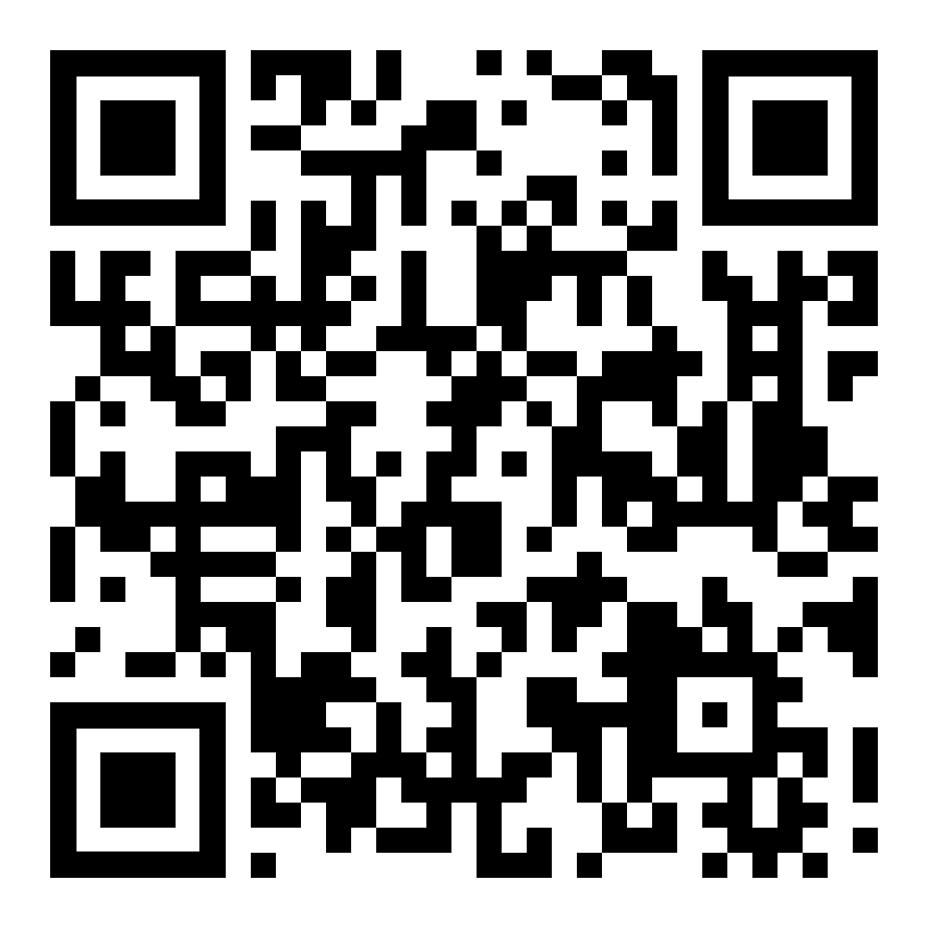
Technology Exploration (Padlet)
Explore educational technology through the lens of future-ready learning.
As you explore, consider:
Opportunities the technology creates;
Skills students may develop;
Career and workforce connections;
Implications for your own practice.
Notes:
Encourage participants to focus less on whether they personally would use the tool and more on what students might gain from the experience.

Slide 9
Small Group Discussion
Share your observations and discuss:
  Which technologies felt most meaningful?
  What patterns did you notice?
  Which future-ready skills appeared most often?
  Which ideas would you carry into your own classroom?

Slide 10
The 4Cs
Communication
Collaboration
Creativity
Critical Thinking

Slide 11






International Society for Technology in Education
Notes:
https://iste.org/

Slide 12
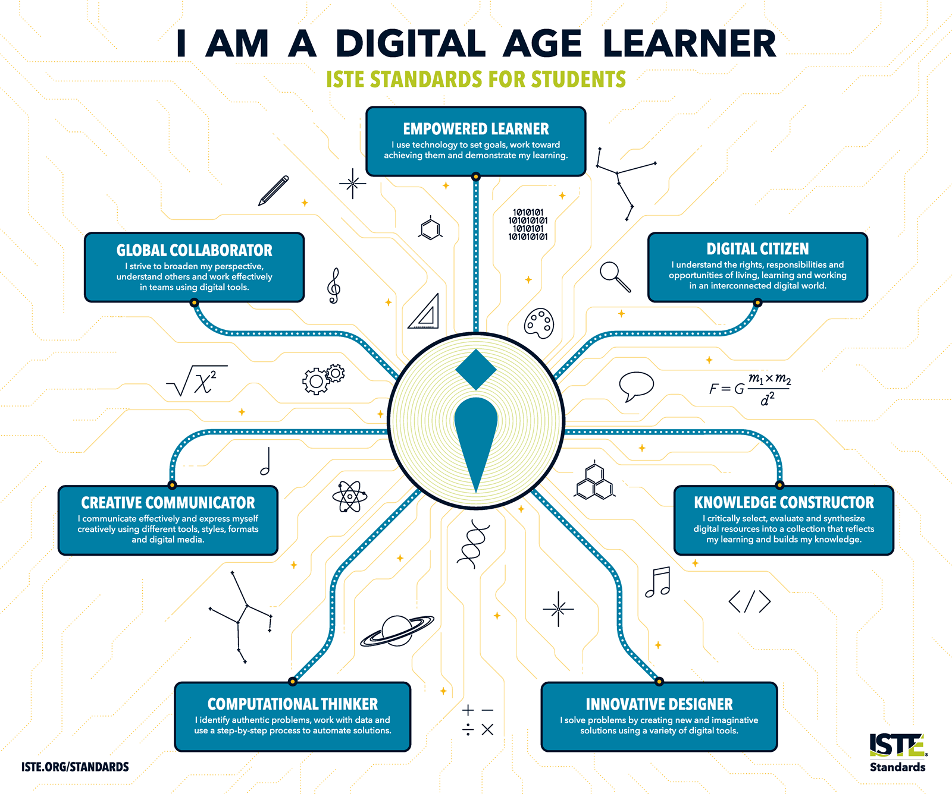
Notes:
ISTE (2016). I am a digital age learner [Poster]. https://iste.org/blog/free-classroom-poster-i-am-a-digital-age-learner
The ISTE Standards describe ways students can use technology to:
Take ownership of learning
Create and communicate ideas
Solve problems
Collaborate with others
Prepare for future opportunities

Slide 13

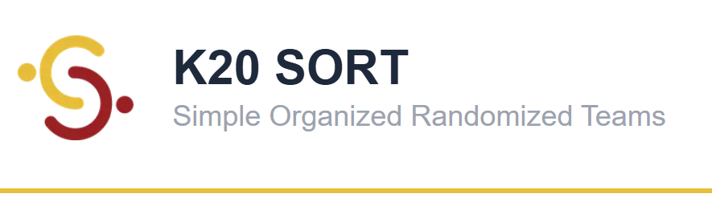

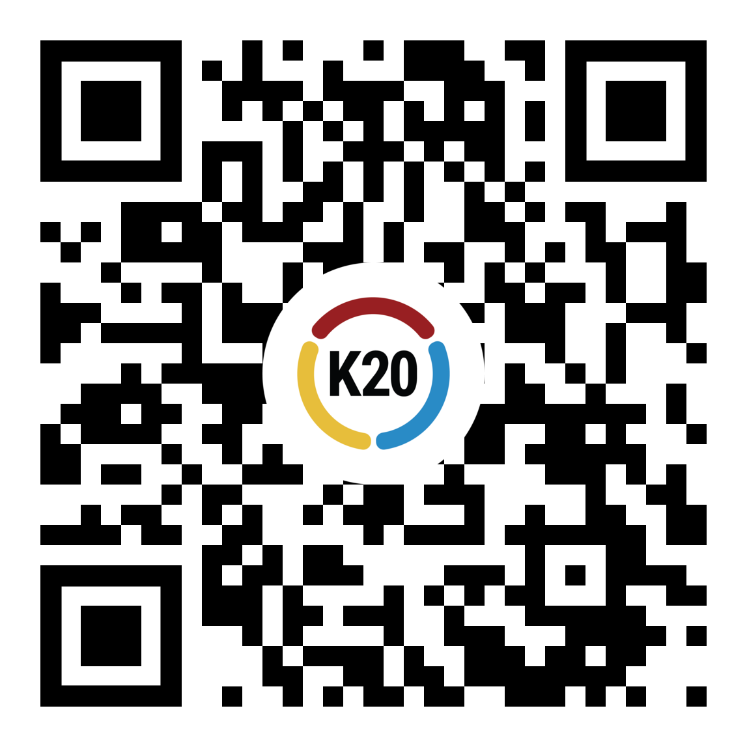
1.1 Empowered Learner
1.2 Digital Citizen
1.3 Knowledge Constructor
1.4 Innovative Designer
1.5 Computational Thinker
1.6 Creative Communicator
1.7 Global Collaborator

Slide 14
Explore the Standards
Let’s dive into the ISTE student standards.
Go to bit.ly/K20ISTE to access and explore the standards for a few minutes.
What does this standard look like in a classroom with students using technology?

Slide 15
What does the standard mean?
How might students demonstrate the standard?
Frayer Model
What connections are there to the 4 C’s?
How does technology support the standard?

Slide 16
It’s Still About Teaching
Communication
Collaboration
Creativity
Critical Thinking
Technology itself
does not transform learning alone.
What does?

Slide 17
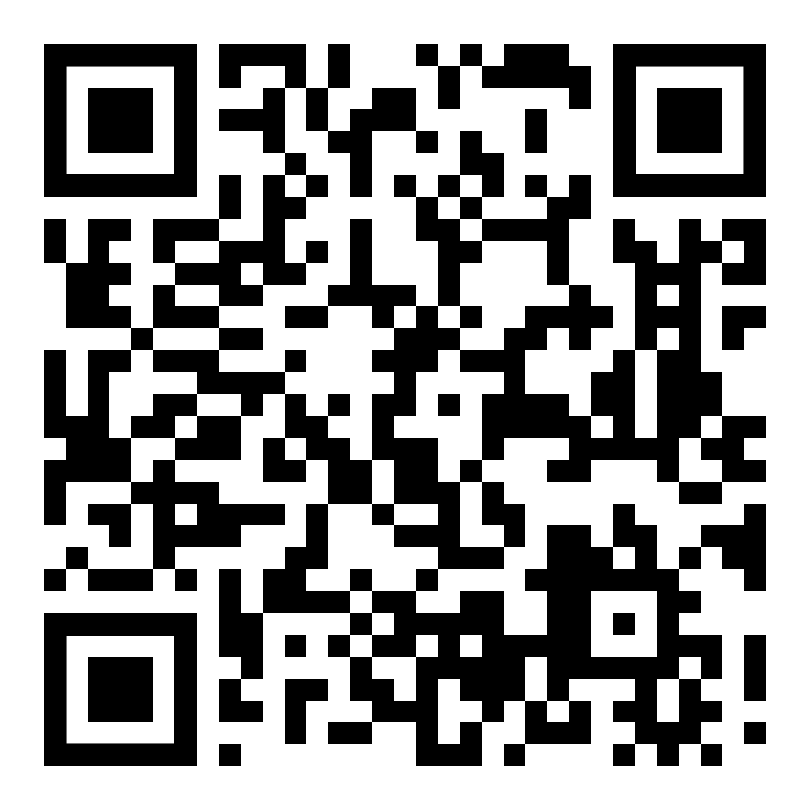
I Notice, I Wonder with Padlet
Post one example from your group’s Frayer Model discussion.
Respond to your standard and include:
A classroom example
A technology connection
One primary 4C

Slide 18

Group Share-Out
Share your thoughts with the whole group
  What patterns do you notice across the standards?
    What do you wonder?
  How do these standards appear in a classroom with students using technology?
  Which standard resonates with your practice?

Slide 19
Technology Integration Planning
Use the graphic organizer to answer the following:
What? | What technology or digital tool did you explore?
So What? | Which ISTE standard or 4C does this tool support? Why is it important for student learning?
Now What? | How might you integrate this tool in your classroom? Using this tool, what might students create, produce, or collaborate on?

Slide 20
Graphic Organizer and Debriefing
Share your responses from the graphic organizer.
What? | What technology or digital tool did you explore?
So What? | Which ISTE standard or 4C does this tool support? Why is it important for student learning?
Now What? | How might you integrate this tool in your classroom? What might students create, produce, or collaborate on using this tool?

Slide 21
Reflect
Remember how we mentioned that there are other ISTE standards? Take a look at Standard 2.2.
ISTE Educator Standard 2.2:
Educators seek opportunities for leadership to support student empowerment and success and to improve teaching and learning.

Slide 22
Reflections
How will you share ISTE standards with your staff?
Talk with your table group and determine how you can share resources and information from this session.
Discuss how you might do a version of this activity with your staff.
How could you use PLC/PD time for teachers to become more familiar with technology and learning resources?

Slide 23
Glow and Grow
Participants discuss one idea from the session they found valuable. (Glow)
Participants discuss one idea they would like to explore further. (Grow)

