Slide 2
Essential Questions
What, Why, and How

Slide 3
What’s the difference?
Card Sort Activity
There are two types of questions in the card sort packet.
Figure out the differences between the two types.
Sort them into two different groups.
Explain what principle guided your choices.
Notes:
Card sort activity:
Participants (groups of 2 or 3) receive card sort cards with different questions.
Have them sort the cards into two different categories based upon the instructions.
Have groups discuss the differences.
Explain the differences between question types to the rest of the group.
Pass out T-Chart to participants.
Source: K20 Center. (n.d.). Card sort. Strategies. https://learn.k20center.ou.edu/strategy/147

Slide 4
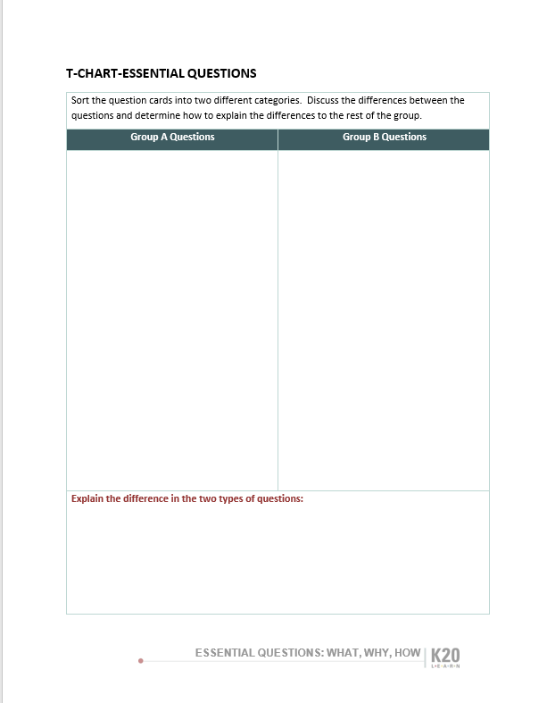
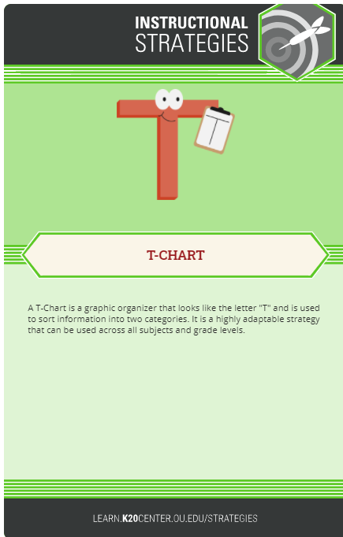
T-Chart
Sort the question cards into two different categories.
Discuss the differences between the questions.
Determine how to explain the differences to the rest of the group.
Notes:
Source: K-20 Center. (n.d.). T-Chart. Strategies. https://learn.k20center.ou.edu/strategy/86

Slide 5
Objectives
Identify the characteristics of Essential Questions.
Recognize the role of Essential Questions in lesson planning.
Develop Essential Questions for a lesson.

Slide 6
Group A Questions | Group B Questions
What do problem solvers do when they get stuck? How do we distinguish truth from perspective? What is justice? What makes something systemic? How do effective writers hook and hold their readers? | Which blood vessels carry blood toward the heart? When is it appropriate to use a comma? What were the key differences between the North and South that led to the Civil War? What is a variable in scientific investigations? Why must the answer be less than zero? When did the main character begin to suspect his friends?
Explain the difference in the two types of questions:

Slide 7
Characteristics of Essential Questions
Thought-provoking
Open-ended
Higher-order
Points toward important, transferable ideas
Big Picture
Raises additional questions; supports inquiry
Requires support and justification; not a single answer.
Recurs over time

Slide 8
Why-Lighting
Highlight the main ideas of your designated section.
Make notes in the margin about why this statement(s) is important.
Summarize what your section is about.
Notes:
K20 Center. (n.d.) Why-Lighting. Strategies. https://learn.k20center.ou.edu/strategy/128

Slide 9
Jigsaw Activity
A: Two Sides of a Coin
B: Three Connotations of Essential Questions
C: Size and Scope Matters
D: Non-Essential Questions
Notes:
K20 Center. (n.d.) Jigsaw. Strategies. https://learn.k20center.ou.edu/strategy/179
McTighe, J., & Wiggins, G. (2013). Essential Questions: Opening Doors to Student Understanding. Alexandria: ASCD.
Digging a little deeper into Essential Questions—Section from Chapter 1 on Essential Questions and Topical Essential Questions, what are nonessential questions, metacognitive questions, etc.
Sections include: Two Sides of the Coin (4-5); Three Connotations of Essential Questions (5-6); Size and Scope Matter (9-10); Non-essential Questions (10-11).

Slide 10
Inverted Pyramid Discussion
Confident Commentary
(Large Group)
Expanding & Sharing
(Small Group)
Brainstorming
(Partners)
Notes:
K20 Center. (n.d.). Inverted pyramid. Strategies. https://learn.k20center.ou.edu/strategy/173
Optional slide depending on group size
Have large group read different sections A, B, C, D from the Essential Questions book.
Sections include: Two Sides of the Coin (4-5); Three Connotations of Essential Questions (5-6) ; Size and Scope Matter (9-10); Non-Essential Questions (10-11)
After reading, they are to find a partner who read the same section. Then they form a group of four of the same section read and expand their understanding. Finally, the large group of all As, Bs, Cs, and Ds, get together and they find a spokesperson to explain their section.

Slide 11
Gist
In 28 words or fewer, answer the questions below:
How do Essential Questions promote higher-order thinking and engagement?
Why are Essential Questions an effective instructional tool?
Notes:
K20 Center. (n.d.). Gist. Strategies. https://learn.k20center.ou.edu/strategy/3289

Slide 12
Let’s Practice
As a group, develop an essential question for a concept in your shared content area.
Refer to your Characteristics of Essential Questions Checklist while you formulate your question.

Slide 13
Gallery Walk
Walk around the room to read each other’s essential questions.
Notes:
K20 Center. (n.d.). Gallery walk / carousel. Strategies. https://learn.k20center.ou.edu/strategy/118

Slide 14
Research Resources
Keely, P. (2008). Science formative assessment: 75 practical strategies for linking assessment, instruction, and learning. Thousand Oaks: Corwin Press.
McTighe, J., & Wiggins, G. (2013). Essential questions: Opening doors to student understanding. Alexandria: ASCD.

