Slide 2
Document-Based Questions for Social Studies

Slide 3
Session Goals
Participants will be able to:
Identify reading and writing strategies that support student acquisition of text-based arguments; and
Create a process for using DBQs in the classroom.

Slide 4
Stoplight Stickies
How comfortable are you using document-based question kits?
Red = uncomfortable (beginner)
Yellow = somewhat comfortable (intermediate)
Green = very comfortable (expert)
Notes:
K20 Center. (n.d.). Stoplight Stickies. Strategies. https://learn.k20center.ou.edu/strategy/92 (ou.edu)

Slide 5
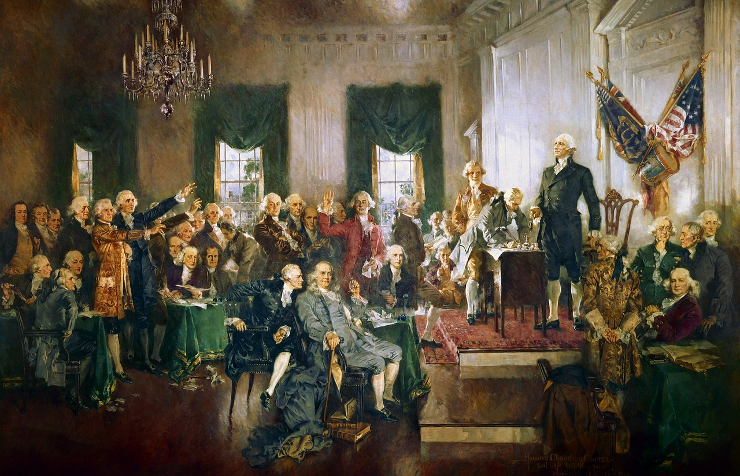
It’s OPTIC-al
O: Observations: What general impressions does the work generate?
P: Parts. What details come to mind about the image?
T: Title. What does the title imply about the image? If there is no title, ask participants to title the work.
I: Interrelationships. How do the individual components work with one another to convey a message?
C: Conclusion. What is the overall message or effect? Include details about time period and importance.
Notes:
Geralt. (n.d.). [Photograph]. Pixabay. https://pixabay.com/illustrations/usa-america-constitution-signing-1779925/
K20 Center. (n.d.). It’s OPTIC-al. Strategies. https://learn.k20center.ou.edu/strategy/99

Slide 6
CUS & Discuss
As you read, use the following symbols:
Circle new words.
Underline details to support the main idea.
Star the main ideas.
Notes:
K20 Center. (n.d.). CUS & Discuss. Strategies. https://learn.k20center.ou.edu/strategy/162

Slide 7
Why-Lighting
As you read:
Highlight the sentences or passages that seem important.
Then, write in the margins why you highlighted those passages.
Notes:
K20 Center. (n.d.). Why-Lighting. Strategies. https://learn.k20center.ou.edu/strategy/128

Slide 8
Claim, Evidence, Reasoning (CER)
Develop a claim about the benefits of using DBQs in the classroom.
Support your claim with evidence and reasoning from the article.
Notes:
K20 Center. (n.d.). Claim, Evidence, Reasoning (CER). Strategies. https://learn.k20center.ou.edu/strategy/156

Slide 9
DBQ Resources
Explore the DBQs available to you using one of these suggested resources or any others you locate:
DBQ Project Online
Library of Congress
Select a DBQ that aligns with your curriculum. A topic that falls into your next quarter would be ideal.

Slide 10
How Am I Feeling? What Am I Thinking?
Draw a vertical line dividing a sticky note in half.
On the left side of the note, write what your feelings are about incorporating DBQ in your classroom.
On the right side of the note, write what you understand about incorporating DBQ in your classroom.
Invite participants to are willing to share out their responses.
Notes:
K20 Center. (n.d.). How Am I Feeling? What Am I Thinking? Strategies. https://learn.k20center.ou.edu/strategy/187

Slide 11
DBQ Action Plan
How can you strategically incorporate document-based questions in your classroom?
How can you incorporate technology in this process?
What are barriers to success in carrying out your plan? How can you address them?

Slide 12
LEARN Strategy Reflection
Stoplight Stickies
It’s OPTIC-al
CUS & Discuss
Why-Lighting
CER
How Am I Feeling? What Am I Thinking?

Slide 13
Thank you!

