Slide 2
Welcome!
On a sticky note, write your content area and the name of one famous celebrity or character that you can impersonate or would like to see impersonated.
We will come by to pick them up.
Notes:
*Play music while participants get settled.
*Get a pulse of which content areas you have in the session.
*Mention the agenda.

Slide 3
IDK Now Means “Increasing Domain Knowledge”
Marzano’s Domain 1: Addressing Content
Notes:
(3 mins) Intro - *who we are and what we do; housekeeping
Explain agenda and Explain the 5E model and that we use this throughout our lessons

Slide 4
Fold the Line
Line up according to your birth date (month and day).
Line up according to your knowledge/comfort level regarding Marzano’s Design Questions 2 and 3 - rate yourself on a scale from 1-5.
DQ2: Helping students INTERACT with new knowledge
DQ3: Helping students PRACTICE and DEEPEN new knowledge
Grouping strategy and quick assessment
Notes:
Engage:
(10 mins) *First try is friendly - line up by birth date (month and day) - but they can’t talk!
*Reminder - Click to move through slide
*Have them sit down with their partners (group of three if odd number) - take papers with them
D2

Slide 5
Session Objectives
Identify effective strategies to use with students when they are interacting with new content knowledge.
Identify how Authenticity aligns with Marzano’s Design Questions 2 and 3.
Notes:
(1 min)
*Connect to fold the line activity - hopefully increase knowledge base about DQ 2 & 3 by showing how authentic strategies can help students develop this new knowledge.

Slide 6
Paired Texts H-Chart
Helps students:
Analyze multiple texts.
Move beyond comparison and contrast to construct their own understanding of the source material.
Notes:
(Explore: 25 mins)
*H-Chart helps students analyze and synthesize multiple sources of info.
*We will work through an example to illustrate.

Slide 7
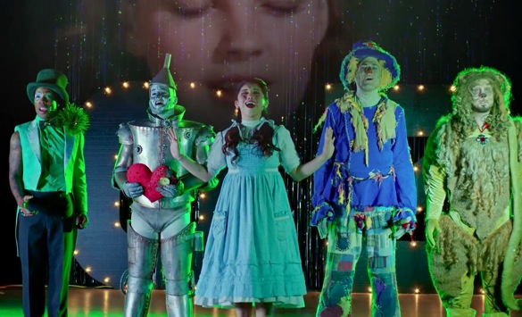
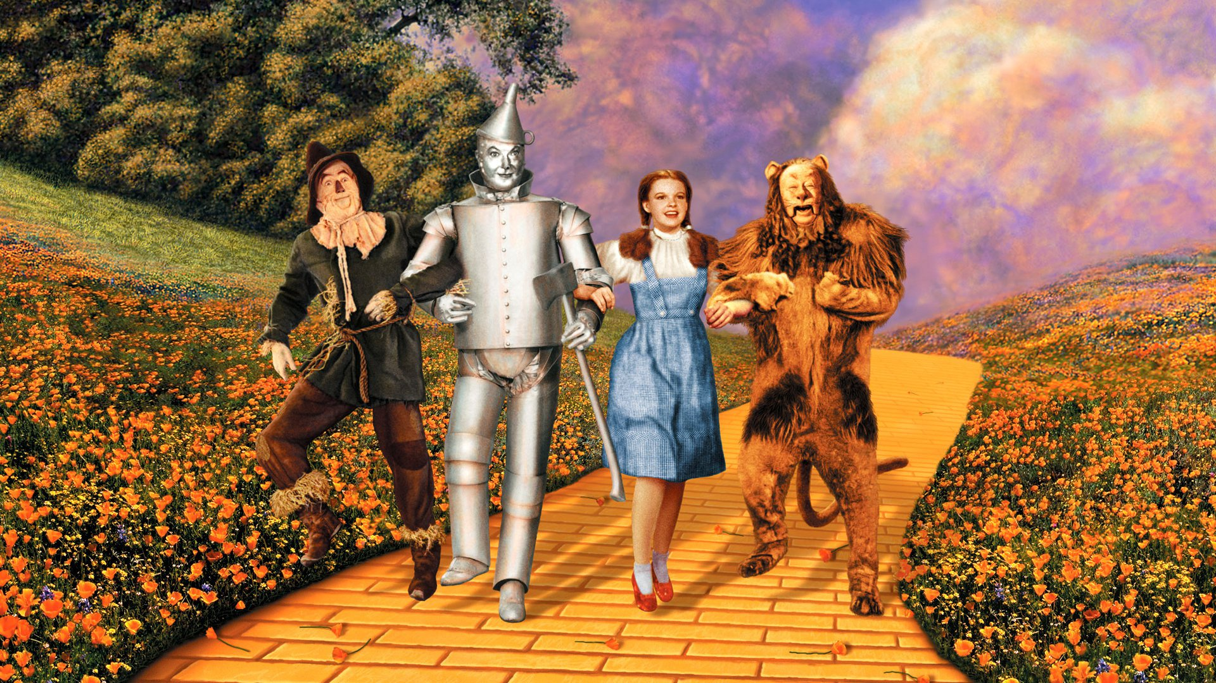
Example H-Chart
Penatonix and Todrick Hall:
Acapella (voices only)
Current performers
21st Century artists who sing some cover songs
The Wizard of Oz
Classic Musical
Dorothy, Lion, Scarecrow, Tin Man, Witch, etc.
1939
Synthesis of the Two Groups
The Wizard of Ahhhs is an updated 21st Century version of the Wizard of Oz with a current blend of songs to tell the same storyline as the original.
https://youtu.be/QkVeKb2igrg
Notes:
(5 min) Example scenario with Penatonix and Todrick Hall vs Wizard of Oz
Go through the specifics of each, and then show video of the Wizard of Ahhhs.
Ask for feedback on what information pairs found to be important.

Slide 8
Paired Texts H-Chart: Authenticity and Design Questions 2 & 3
Authenticity
Identify five words, phrases, or sentences that stand out to you as important or relevant.
Design Questions 2 & 3
Identify five words, phrases, or sentences that stand out to you as important or relevant.
Synthesize both sides into an “elevator speech.”
(a brief 30-second ride)
Notes:
(20 min)This template is on your table. Please fill in the two ”legs” of the chart using the two texts also on your table: the Teaching and Learning Authenticity Rubric and Design Questions 2 & 3. After you have filled in the two ”legs,” create an elevator speech to merge the two frameworks. What do they look like when placed together?

Slide 9
Inverted Pyramid
Helps students:
Group together.
Have analysis discussions that can build their confidence and expand their perspectives.
Identify and eliminate non-essential information.
Notes:
Explain:
(20 mins) (now that you’ve gained that knowledge on Design Question 2 and 3, we will use the Inverted pyramid to help deepen that knowledge we use the Inverted Pyramid strategy.
Explain that this is called this because we’re going down in size.
You do not have a worksheet for this strategy.
*Today we will use this to assist with commentary and analysis, and in our case, a way to combine our partner groups to synthesize our tweets into a collective group perspective on the topic - and help one another eliminate less important info.
Give instructions: You and your partner will join with another group of 2 to share your tweets and recreate a tweet using each other’s thoughts to help refine the main idea. You will continue to combine into groups doing this same elimination process until we are left with 2 large groups.
(Give a time frame for each group based on the class size)
D3
*push how this can be used in the class-You can use this in your classroom as a grouping tool to promote collaboration among students and help them gain a collective perspective on the topic. As you can see, you don’t need a handout for this, but you could definitely use one as you see fit.

Slide 10
Graphic Organizers
Help students:
Visually structure information.
Show the interrelation of different topics.
Summarize or synthesize to create an overview of the information.
Notes:
Extend:
(15 mins)
*You were given graphic organizers on the back of your green agenda
*Group into content areas (I’d like for you to group into your content area-math, ELA, science and SS)
*Complete the graphic organizer for each strategy (now that you’re in your content areas use each other as needed to use a standard from your content area and find a way to use these strategies in a specific way - as though you were creating a lesson plan right now on the spot).
D3
Have each group share out one strategy that they can use and how they will use them
OR*this can be used in your class by allowing students to work independently, using a think-pair-share or placing them directly in a group to help them process the lesson or unit. Could be used as a great study guide as well.

Slide 11
Triangle-Square-Circle
Helps students:
Reflect.
Pick out important pieces of information and question anything they don’t understand completely.
Source: http://www.theteachertoolkit.com/
Notes:
Evaluate:
(10 mins)
*push how this can be used in the class
*Handout is double sided so they can have a blank one to take back to classroom
*Have them reflect on how these strategies helped them better understand Domain questions 2 and 3.
*Show video
*Give any time for questions and then for individual work time
*Have them share out their answers with the group.
D3
Share out and share on the board and direct them back to the resources.
http://www.theteachertoolkit.com/index.php/tool/triangle-square-circle

Slide 12
Resources
K20 Center. (n.d.). Fold the line. Strategies. https://learn.k20center.ou.edu/strategy/d9908066f654727934df7bf4f5079658
K20 Center. (n.d.). Inverted pyramid. Strategies. https://learn.k20center.ou.edu/strategy/d9908066f654727934df7bf4f507a918
K20 Center. (n.d.). Paired texts h-chart. Strategies. https://learn.k20center.ou.edu/strategy/d9908066f654727934df7bf4f5060ba6
The Teacher Toolkit. (n.d.). Triangle-square-circle. Tools. http://www.theteachertoolkit.com/index.php/tool/all-tools

