Slide 1
Transcendent Classrooms:
Increasing Student Achievement With Technology

Slide 2
Tech Bias

Slide 3
Tech Bias
Do you feel frustrated or intimidated when you experience new technologies?
Notes:
Photo from Unsplash

Slide 4
Tech Bias
Do you feel excited or exhilarated when you experience new technologies?
Notes:
Photo from Unsplash

Slide 5
Tech Bias
Do you feel anxiety about adopting new technologies in your classroom?
Notes:
Photo from Unsplash

Slide 6
Tech Bias
Do you feel enthusiastic about adopting new technologies in your classroom?
Notes:
Photo from Unsplash

Slide 7
Tech Bias
Do you feel technology will automatically reduce value in your instruction?
Notes:
Photo from Unsplash

Slide 8
Tech Bias
Do you feel technology will automatically add value to your instruction?
Notes:
Photo from Unsplash

Slide 9
Tech Bias

Slide 10
Magnetic
Statements

Slide 11
Objectives
By the end of this session, participants should be able to do the following:
Identify their own tech biases.
Evaluate the impact of levels of T3 on student achievement by:
Recognizing Ts.
Researching literature on how T3 impacts student achievement.

Slide 12
"Now, more than ever, we need a Moonshot in education: A pedagogical breakthrough so extraordinary that student learning and achievement are exponentially boosted in such a way that assures our students are fully prepared for the VUCA [Volatile, Uncertain, Complex, and Ambiguous] future."
(Magana, 2019)
Notes:
Photo from Unsplash

Slide 13
I Used to Think...
But Now I Know...
Create a T-Chart on a piece of paper or on a Google Doc.
Label the left column “I Think.”
Write your thoughts about technology integration in the left column.

Slide 14
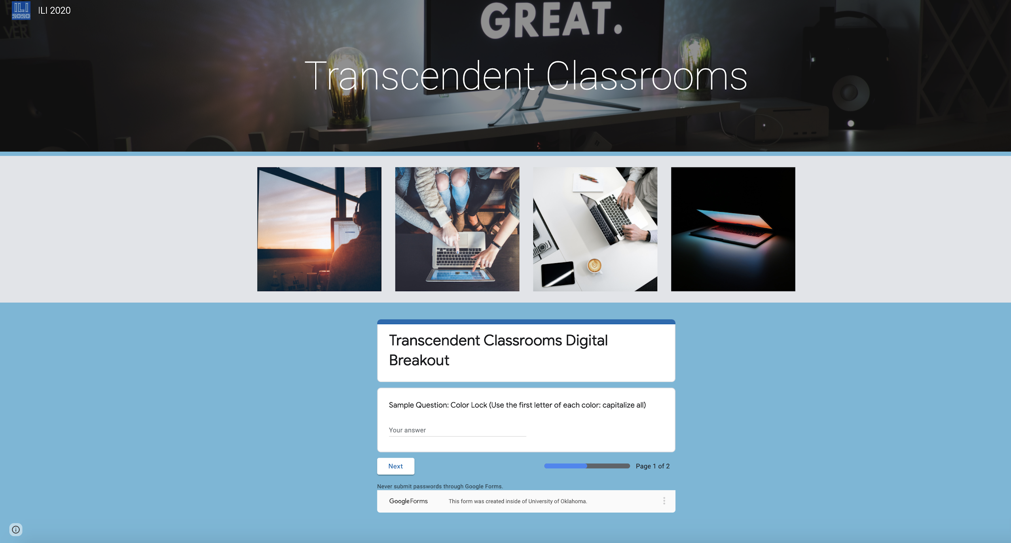
Digital Breakout
https://bit.ly/ILITC2020
)

Slide 15
T3 Digital Breakout: bit.ly/ILITC2020
Notes:
We should use the K20 timer for this

Slide 16
Scenario 1
Mr. H teaches 4th grade and his class is currently learning about decimals through the Millionaire Project. He wants his students to use iPads to research different product prices for the project on decimals.
Notes:
https://unsplash.com/photos/2FPjlAyMQTA

Slide 17
Scenario 2
Mr. H teaches 4th grade and his class is currently learning about decimals through the Millionaire Project. He wants his students to use iPads to research different product prices for the project on decimals.
His students will then create a Google Slides presentation about the Millionaire Project including what they purchased, how much it costs, and an image of each item.
Notes:
https://unsplash.com/photos/2FPjlAyMQTA

Slide 18
Scenario 3
Mr H is having his students discuss things in their world where they see or use decimals. Students then select one area to research more.
Student A mentioned that the city is building new businesses on the corner of her street. She stated she sees decimals when going to Sonic to get a drink. She decides to create a lemonade stand for the construction workers at the end of her street. Her decimal project will be selling lemonade and calculating her daily and weekend totals.

Slide 19
I Used to Think...
But Now I Know...
Grab your T-Chart from earlier in this session.
Label the right column “Now I Know.”
Then, reflect on your learning so far and write down what you have learned in the right column.

Slide 20
Two Stars and a Wish
Reflect on today’s learning.
Open this Form to complete. (PUT LINK HERE)
Notes:
https://forms.gle/MFHjZF8FGbMfbELZ6
email back if less than 25 participants
More than 25 skip google form

