Slide 2
Building School and Classroom Community
Please sit at a table with at least two people you do not know!
Notes:
Make sure to greet participants as they enter - this is a strategy discussed later.

Slide 3
Pick a Pic
Find a picture that makes you smile (on your phone, on the web, a GIF, etc.)
Introduce yourself and share this picture with your group.
How does your picture reflect your identity?
Photo by Viktoria Shalimova via Pexels.
Notes:
Shalimova, V. (2020, March 3). Woman kissing Yorkshire Terrier [Image]. Pexels. https://www.pexels.com/photo/woman-kissing-yorkshire-terrier-3974415/

Slide 4
Community Share via Padlet
Post your picture onto a Padlet board.
For the title—include your name and a brief caption.
After you create a PADLET, place a QR Code here where participants can upload their Pick-a-Pic.
Insert Padlet board link here.
Notes:
Note: A new Padlet and QR code will have to be created for each professional development. When you create a new padlet, choose the Wall design so that participants can easily see others’ photos.

Slide 5
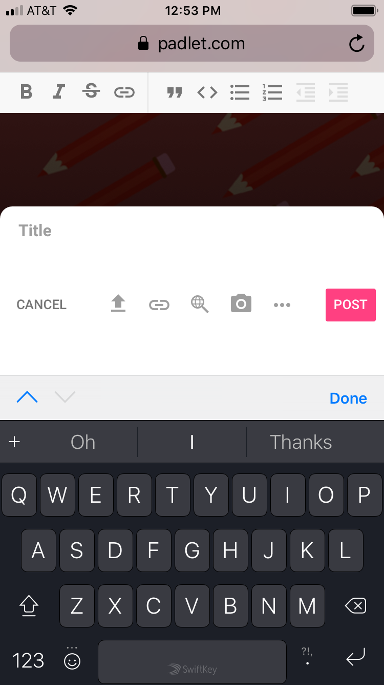
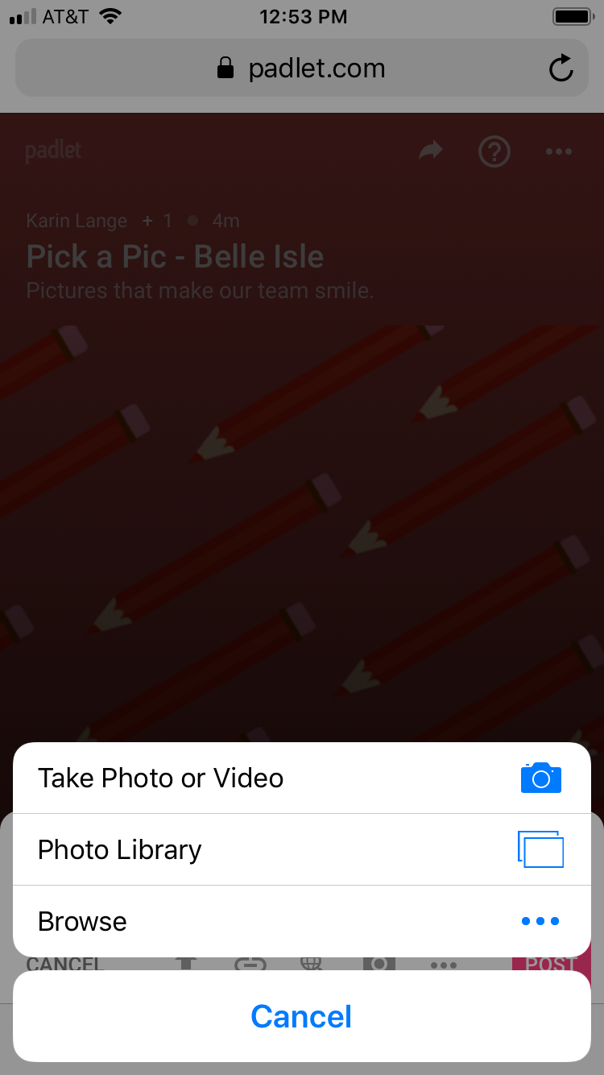
Step 1
Steps 2 & 3
Step 4
Notes:
These images are from an iPhone. Participants with different phones will see a variation of this.
Step 1—Go to the Padlet site with the QR code.
Step 2—Hit the plus sign to upload an image and add a caption.
Step 3—Upload a picture from the Photo library.

Slide 6
Strategy Reflection
Pick a Pic
How did this activity help build community?
How could this activity be adapted for students?
Photo by Viktoria Shalimova via Pexels.
Notes:
Pass out Strategies Reflection handout. Highlight the importance of activities that let students share their identity.
We will continue to explore strategies—what works for you and what you’ve tried—throughout the day.

Slide 7
Strategies Reflection:
Padlet.com
How could Padlet be used in the classroom?
Notes:
Padlet is a great way to share ideas in the classroom.

Slide 8
GEAR UP OKC GOALS:
Goal 1: Increase percent of students who report they are engaged in learning.
Goal 2: Increase GEAR UP OKC students’ academic preparation for PSE upon graduation.
Goal 3: Increase GEAR UP OKC schools’ high school graduation rates and PSE enrollment.
Goal 4: Increase GEAR UP OKC students’ and families of PSE options, preparation, and financing.

Slide 9
In this session, we will…
meet new colleagues while identifying strategies that build community;
envision and define school and class communities; and,
select research-based strategies that develop a sense of community for school and classroom.
Notes:
Emphasize RESEARCH & Sharing expertise in the room.

Slide 10
A sense of “community”includes:
Teacher to Teacher
Teacher to Student
Student to Student
Notes:
Discuss that when we use the word “community,” we are discussing today these relationships.

Slide 11
It’s OPTIC-al
Open one computer at each table.
Label your poster paper vertically in LARGE letters:
Hint: Leave space between each letter to write!
O–P–T–I–C–
Illustration by OpenClipart-Vectors via Pixabay.
Notes:
Distribute chart tablet paper. After groups are finished, have them share out on the chart tablet paper how the photo might represent community.
It’s OPTIC-al = O is Observations, P is participants, T is Theme, I is Identity/Interpersonal Relationships, and C is Caption.
OpenClipart-Vectors. (2017, January 30). Eyes glasses lenses royalty-free vector graphic [Image]. Pixabay. https://pixabay.com/vectors/eyes-glasses-lenses-my-patterns-2022424/.

Slide 12
It’s OPTIC-al
In what ways does this picture reflect a positive school or classroom community?
O - Write down any Observations of community.
P - Who are the Participants in the community?
T - What is the overall Theme of the picture?
I - In what ways do participants demonstrate positive Interpersonal Relationships or Identity?
C - Give the photo a Caption.
OpenClipart-Vectors/27424 Images. (2017, January 30). Eyes. Retrieved from https://pixabay.com/vectors/eyes-glasses-lenses-my-patterns-2022424/.
Notes:
Distribute the attached photos or allow participants to have access to pictures electronically. Have participants divide into groups A, B, or C and view the pictures electronically via BitLy or QR Code.
Once groups are finished, have groups share out on chart tablet how the photo might represent community.

Slide 13
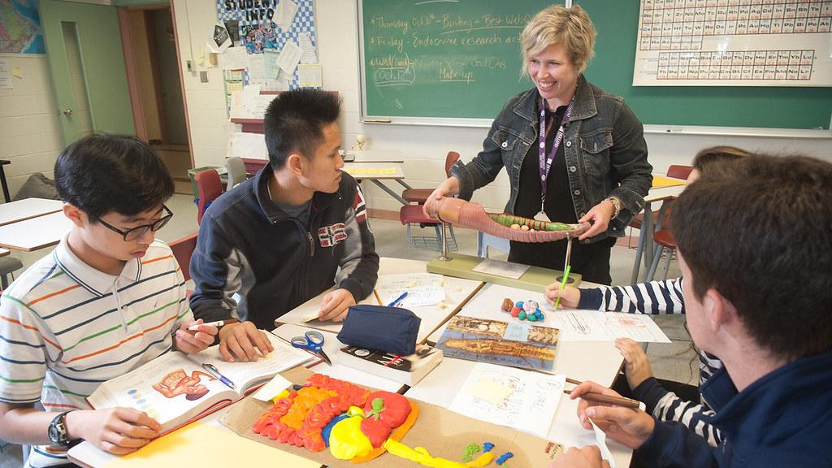
Picture A
Image by Government of Prince Edward Island via Creative Commons.
Notes:
Government of Prince Edward Island. (2016). High school students in various classroom settings [Image]. Creative Commons.
https://search.creativecommons.org/photos/a4254a18-eea3-43b1-b1c7-341caf90da6c

Slide 14
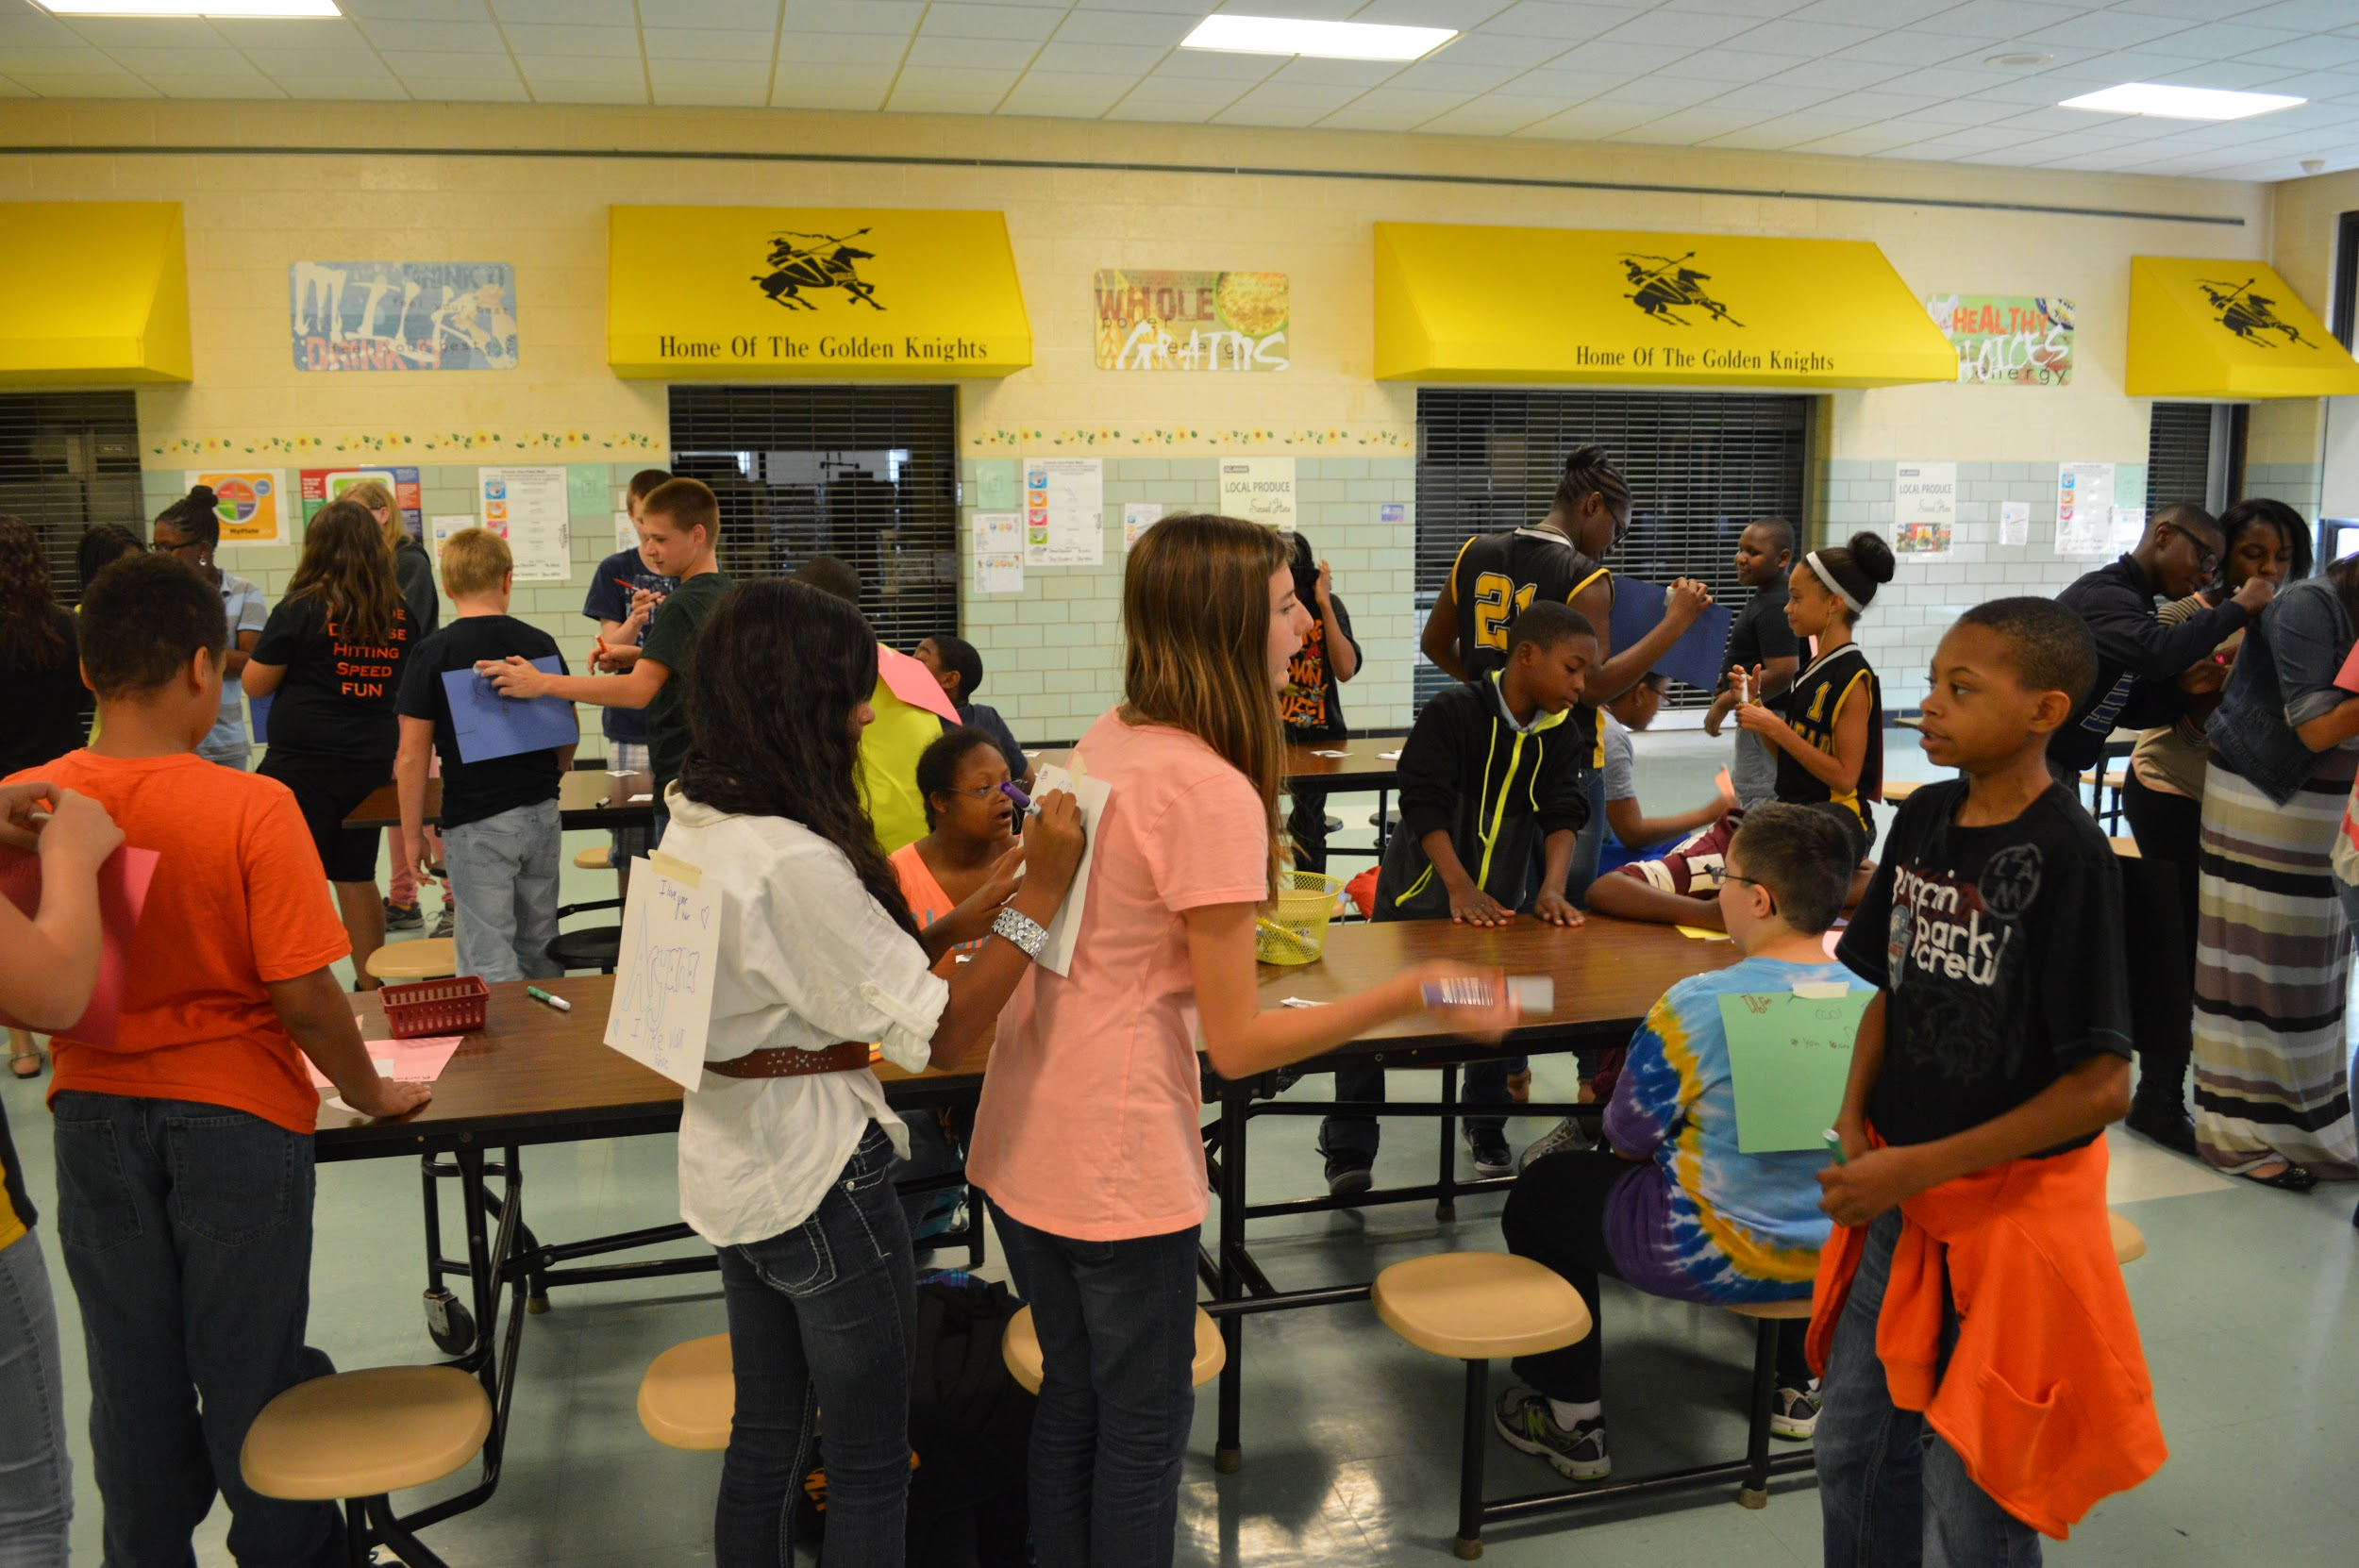
Picture B
Image by Best Buddies Delaware via Flickr.
Notes:
Best Buddies Delaware (2013, October 3). George Read Middle School [Image]. Flickr. https://www.flickr.com/photos/bestbuddiesde/10074314494/in/photostream/.

Slide 15
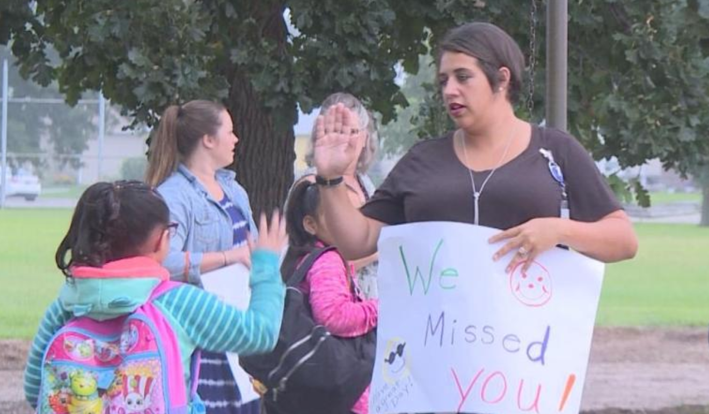
Picture C
Image by Erika Siebring via KNOP-TV.
Notes:
Siebring, E. (2019). Image. Teachers welcome students back to school in North Platte [Image]. KNOP-TV. https://www.knopnews2.com/content/news/Teachers--welcome-students-back-to-school-in-North-Platte-554214081.html

Slide 16
Picture D
Image by Madison Metropolitan School District.
Notes:
Madison Metropolitan School District. (n.d). Schenk teachers share strengths to ensure all students succeed [Image]. Communications & Public Affairs. https://communications.madison.k12.wi.us/schenk-teacher-team

Slide 17
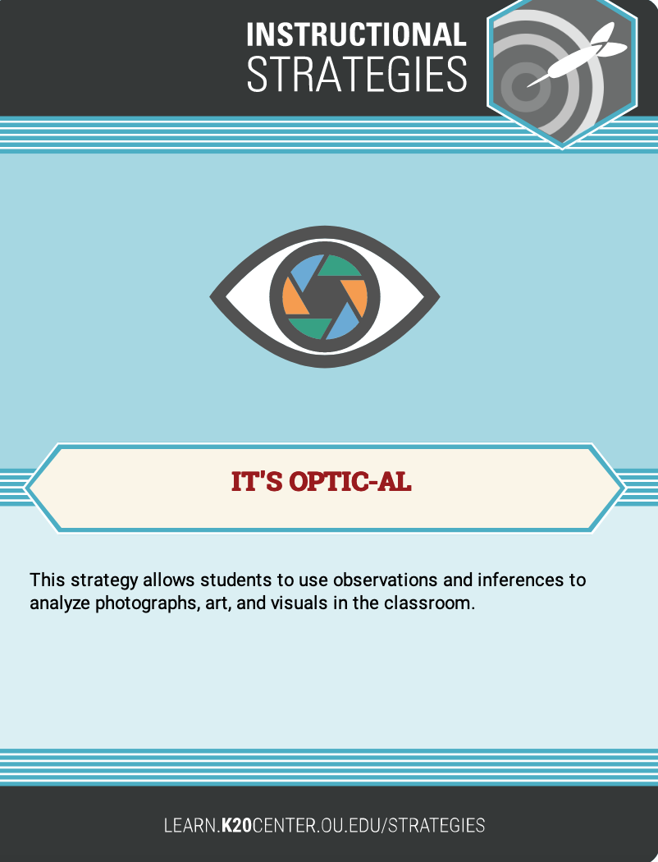
Strategy Reflection:
It’s OPTIC-al
How can this strategy be applied to the classroom?
Could this be used to build community with students?
Notes:
Allow time for discussion of classroom application

Slide 18
Jigsaw: Research Brief
Each group member is to read one of the following sections:
From beginning up to the heading “Elements…”
“Elements of a Positive and Caring Community” up to the heading “The Classroom Reflects…”
“The Classroom Reflects the School Culture” to the end

Slide 19
Categorical Highlighting
As you read your section, highlight…
reasons for building community in one color; and
strategies that build community in another color.

Slide 20
Group Share
Share the HIGHLIGHTS from your section:
What reasons did you identify for building community?
What strategies did you identify for building community?
Notes:
Allow time for discussion and then have groups share out first reasons (round one discussion); and then strategies (round two discussion).

Slide 21
Strategy Reflection:
Jigsaw & Categorical Highlighting
How can Jigsaw and Categorical Highlighting be applied to the classroom?
Notes:
Allow time for discussion.

Slide 22
Break

Slide 23
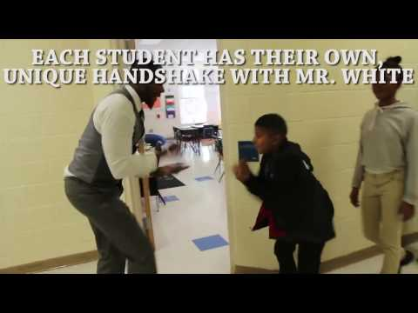
Classroom Variations: Greeting students at the door
Video by USA TODAY via YouTube.
Notes:
USA TODAY. (2017, February 3). This teacher has different handshakes with each student [Video]. YouTube. https://www.youtube.com/watch?v=4JueNr1e0H4

Slide 24
Classroom Variations: Greeting students at the door
Video by Edutopia via YouTube.
Notes:
Edutopia. (2018, February 3). 60-Second Strategy: TUMS at the door [Video]. https://www.youtube.com/watch?time_continue=1&v=956br98qWbE

Slide 25
Strategies Reflection:
Research Brief
Which strategies from the research brief might you use to build community in your classroom?
Greeting students at the door
Student interest surveys
Daily (interpersonal) questions
Knowing students’ names and correct pronunciation
Two-by-ten strategy
Notes:
Refer participants to the Strategies Reflection handout: Allow time for participants to reflect on and discuss these strategies: Jigsaw, Categorical Highlighting, Identifying student interests (research brief), Know students names and pronunciation (research brief) Daily questions (research brief), Two-by-ten (research brief), greeting students at the door (videos)

Slide 26
What is the relationship between school and classroom communities?
Image by Truthseeker08 via Pixabay.
Notes:
Ask participants to share their own experiences when answering this question. If you need to prompt participants further, the research brief also offers some insight to this question.
Truthseeker08. (2016, December). Hands, Team, United [Image]. Pixabay. https://pixabay.com/photos/hand-united-together-people-unity-1917895/.

Slide 27
Looks like, Feels Like, Sounds Like
Reflecting on the reading, today’s discussions, and your own experience, use three sticky notes to describe what you would like your SCHOOL community to look like, feel like, and sound like.
Looks Like
Sounds Like
Feels Like
Image by Alexandra_Koch via Pixabay.
Notes:
Alexandra_Koch. (2019, May). Post It Postit Stickies royalty-free stock illustration [Image]. Pixabay. https://pixabay.com/illustrations/post-it-postit-stickies-note-notes-4166054/.

Slide 28
Group Summary
Create a poster to summarize what your group would like your school community to look like, feel like, and sound like.
Looks Like | Feels Like | Sounds Like

Slide 29
Group Share Out
Select one item from each column that you feel is the most important component of the school community.
You will be asked to share this with the group.

Slide 30
As a School…
What would you like your school community to look like, feel like, and sound like?
Looks Like | Feels Like | Sounds Like

Slide 31
Strategies Reflection:
Looks Like, Feels Like, Sounds Like
Reflect on the strategy used for the poster in this presentation.
How could you use this strategy with your students?
From your experiences, what additional strategies might you use to build community?
Notes:
Refer participants to the Strategies Reflection handout: Looks like, feels like, sounds like. Allow time for participants to discuss as a group some additional strategies they may have used to build community in their classroom. Be sure to have each group share out one additional strategy and explain it.

Slide 32
Select one strategy you will use to build community. Consider the following:
When will you begin?
How often will you repeat or revisit?
What will it look like in your classroom?
What special considerations do you need to plan for?
What additional strategies might you use throughout the school year?
Notes:
Select one strategy to use at the beginning of the school year. Think about when and how this will look in your classroom. Select another strategy that you will use later in the school year.

Slide 33
Every Opportunity
Video by Atlanta Speech School via YouTube.
Notes:
Considering the importance of treating students as individuals—no matter how many students we have.
Atlanta Speech School. (2006, August 18). Every opportunity [Video]. YouTube. https://www.youtube.com/watch?v=VxyxywShewI

Slide 34
Next Steps
Think back to your school’s “Looks Like, Feels Like, Sounds Like” posters.
What are your next steps as a school team to help build community throughout the school year?

Slide 35
Thank You!
We appreciate your participation and invite feedback on our presentation.
Image by Erika Siebring via KNOP-TV.
Notes:
Siebring, E. (2019). Image. Teachers welcome students back to school in North Platte [Image]. KNOP-TV. https://www.knopnews2.com/content/news/Teachers--welcome-students-back-to-school-in-North-Platte-554214081.html

