Slide 2
Authenticity in Math Through LEARN Strategies

Slide 3


Slide 4
What Is Your Dream Scenario?
What is the number one characteristic you want your students to exhibit in your classroom?
What are the attributes of a good mathematician?
In order to be successful in the future, my students need to be able to...

Slide 5
Essential Question
How can LEARN strategies increase student engagement and academic performance in middle school math classes?
Notes:
Add gear up (math)

Slide 6
Objectives
Participants will be able to identify modeled instructional strategies that support authentic instruction and the Oklahoma Academic Standards for Mathematics.
Participants will be able to apply these LEARN strategies and reflect on this experience to determine the relevant components of authenticity.
Participants will create a plan for implementing a LEARN strategy in their classroom.

Slide 7


Slide 8
“How Big Should I Be?”
Proportional Reasoning and Ratios
  6.N.3.3, 6.N.3.4, 7.A.2.3, and review for Pre-Algebra and Algebra 1
Strategies
  Engage: Think-Pair-Share
  Explore: CER

Slide 9
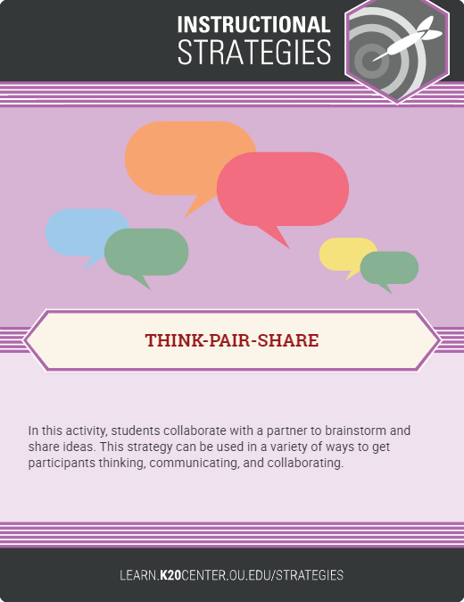
Are You Real?
Fortnite Trailer
(stop the video at 1:20)
Do the characters look real? Why or why not?
Notes:
IGN. (2017, July 8). Fortnite official cinematic trailer. [Video]. YouTube. https://www.youtube.com/watch?v=qpKtzf5fXn4

Slide 10
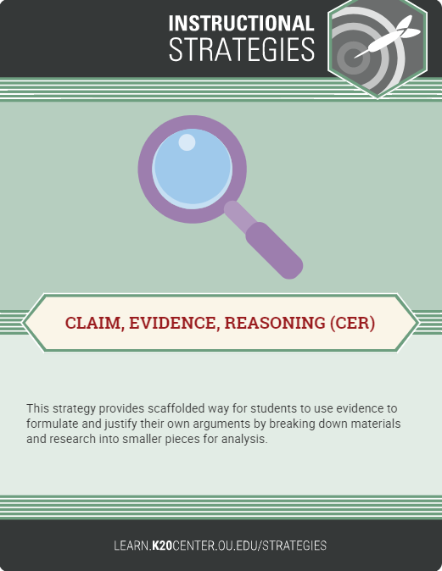
Toys vs. Us Comparison
Take measurements of your toy and your group members according to the table on your handout. Record these measurements.
How can you determine whether your toy is proportional to your group members? Develop a plan. Then, use your plan and your measurements to compare your toy with your group.
Make a claim, backed by evidence, about whether your toy is proportional to your group members.

Slide 11
“Keep on Moving. It’s About the Climb.”
Linear Proportionality and Representation
  7.A.1.1, 7.A.1.2, PA.A.1.1, and review for Algebra 1
Strategies
  Engage: I Notice, I Wonder

Slide 12
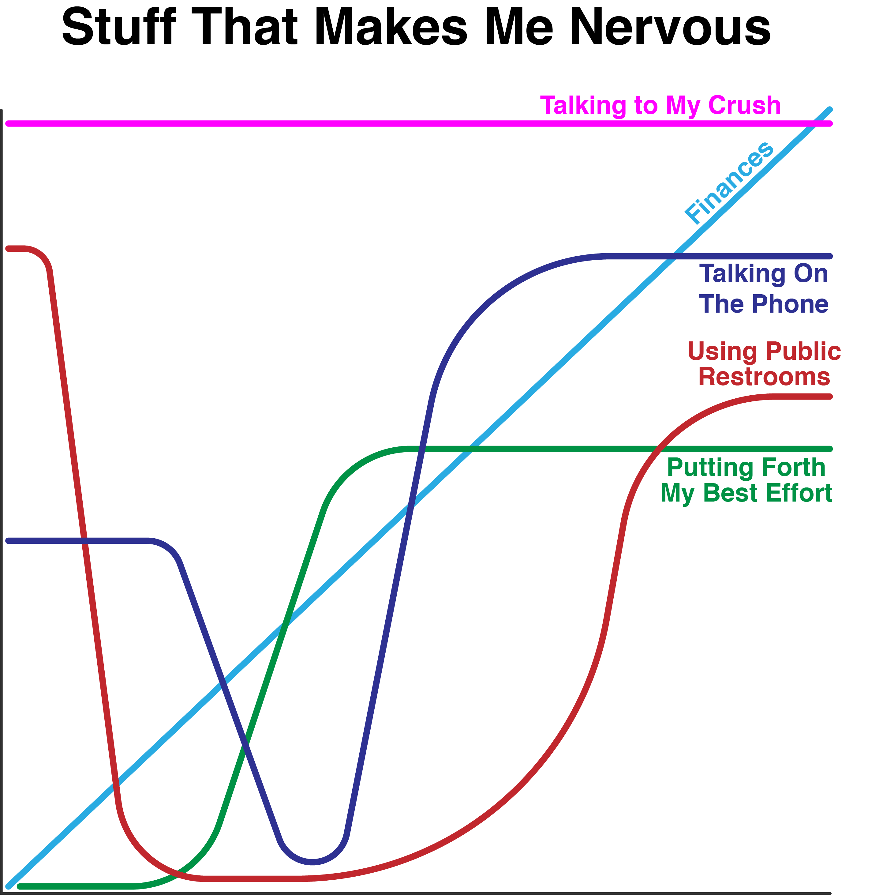
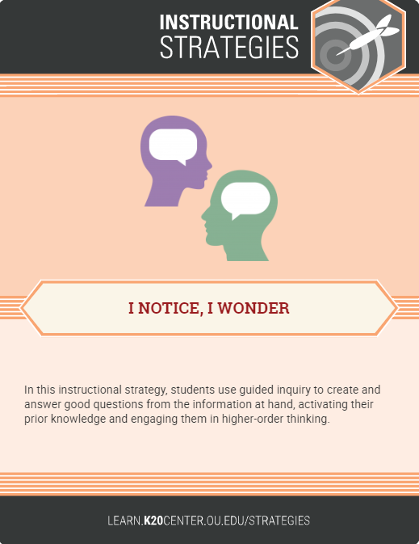
Notes:
https://learn.k20center.ou.edu/lesson/1afb642ae900364707598392a6000c49

Slide 13
“Sharing Is Caring”
Distributive Property
  7.A.4.1, PA.A.3.2, and a review for Algebra 1, Algebra 2, and beyond
Strategies
  Explore: Elbow Partners

Slide 14
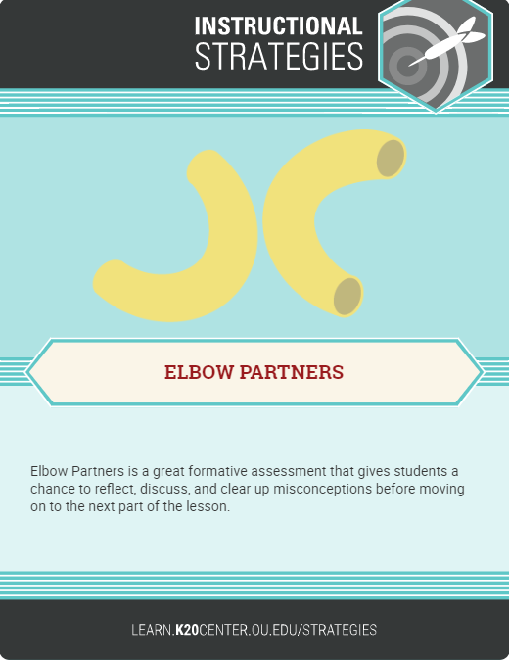
Dice Exploration
Roll one random die. Write the rolled number in the first slot.
Repeat with a second die and the second slot, then with the last die and the third slot.
  One die is a different color. Count the number rolled with this die as a negative number.
Work with your Elbow Partners to solve the problem.

Slide 15
“Going Viral”
Simplifying Expressions and Equations
  7.A.4, PA.A.3, A1.A1.1
Strategies
  Engage: Four Corners
  Explore: Pass the Problem

Slide 16
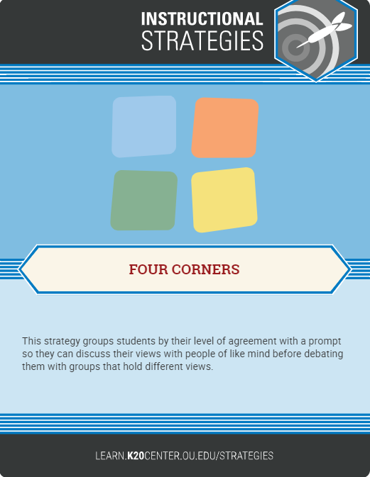
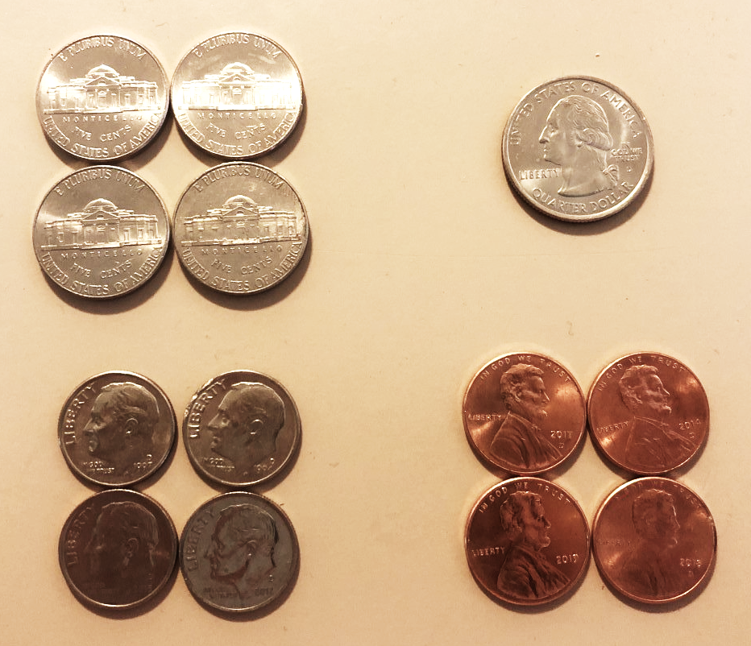
Which One Doesn’t Belong?

Slide 17
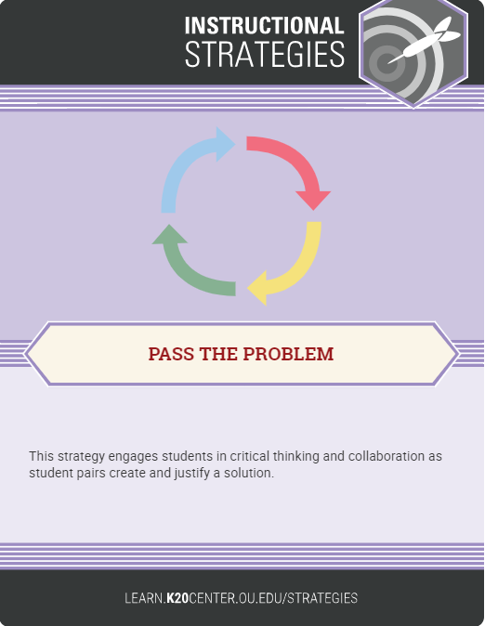
Math Social Media Post
Solve the first line of your viral math post.
  Show all your work so the next group can follow your thinking. When time is up, pass your problem to the next pair in your group.
Solve the second line and pass!
Solve the third line and pass!
Check your original problem—then solve!

Slide 18
“Memes > GIFs” and “Popcorn > Raisinets”
Inequalities
  7.A.3.2, 7.A.3.3, PA.A.4.2, PA.A.4.3, and A1.A.2.1
Strategies
  Engage: Card Sort
  Evaluate: Create Your Problem
  Other: Gallery Walk and Muddiest Point

Slide 19
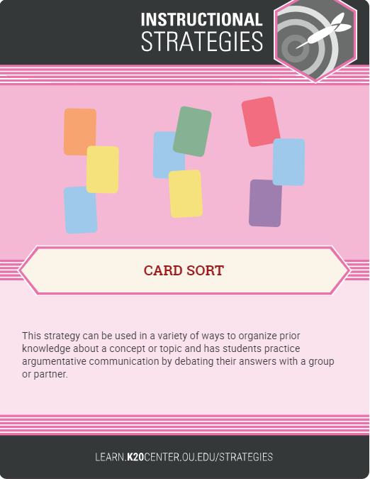
Real-World Scenarios
In pairs, sort the cards to match the scenario to the inequality.
  Discuss why you matched the cards the way you did.

Slide 20
Movie Snacks Are the Best!
Scenario #1:
Your family goes to the movies. The snack bar is all out of large popcorn containers and drink cups. The only size they have left is small. The family has $20 to spend. How many popcorn containers and drinks can they buy if popcorn costs $3 and a drink costs $2? Your family wants no change.

Slide 21
Movie Snacks Are the Best!
Scenario #2:
Your family decides it’s way too hard to figure out how many orders of popcorn and drinks they would need to buy with no change left over. Now, they don’t mind if they get change back. How many different ways can the family buy popcorn and drinks now?

Slide 22
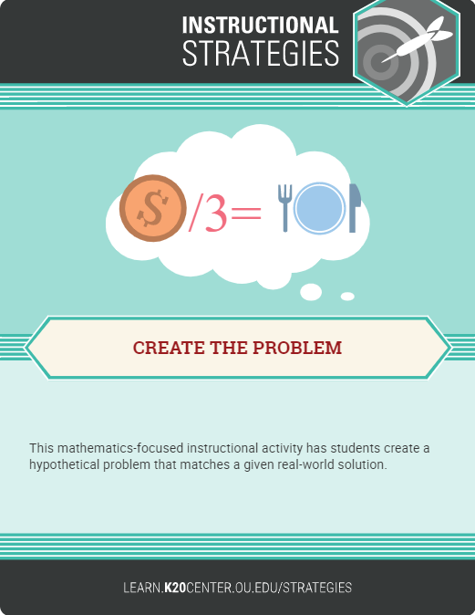
Two-Variable Movie Scenario
It’s your turn to create a two-variable movie scenario for others to solve. Include the following:
  A narrative for your scenario
  Notes on the process required to solve the problem
  Potential errors other students may make along the way

Slide 23
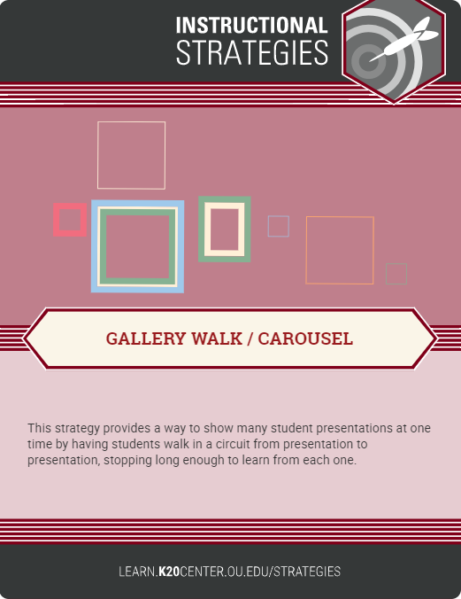
Other Common Strategies

Slide 24
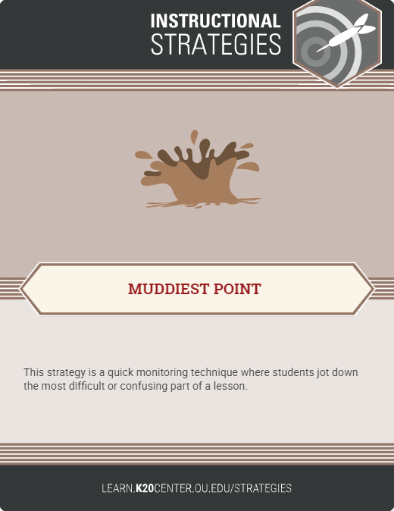
Other Common Strategies

Slide 25


Slide 26
Reflection
Choose a strategy to reflect on.

Slide 27
Reflect on Activity
Student Perspective:
Does this activity allow students to learn math on a higher level?
Does this activity allow students to try things out, build autonomy, and experience cognitive struggle?
Does this activity allow students to participate in a discussion?
Notes:
Choose one activity we just did. Indicate the activity.
Rate from 1 to 5

Slide 28
Reflect on Activity
Teacher Perspective:
What are some barriers that might occur within the strategy?

Slide 29
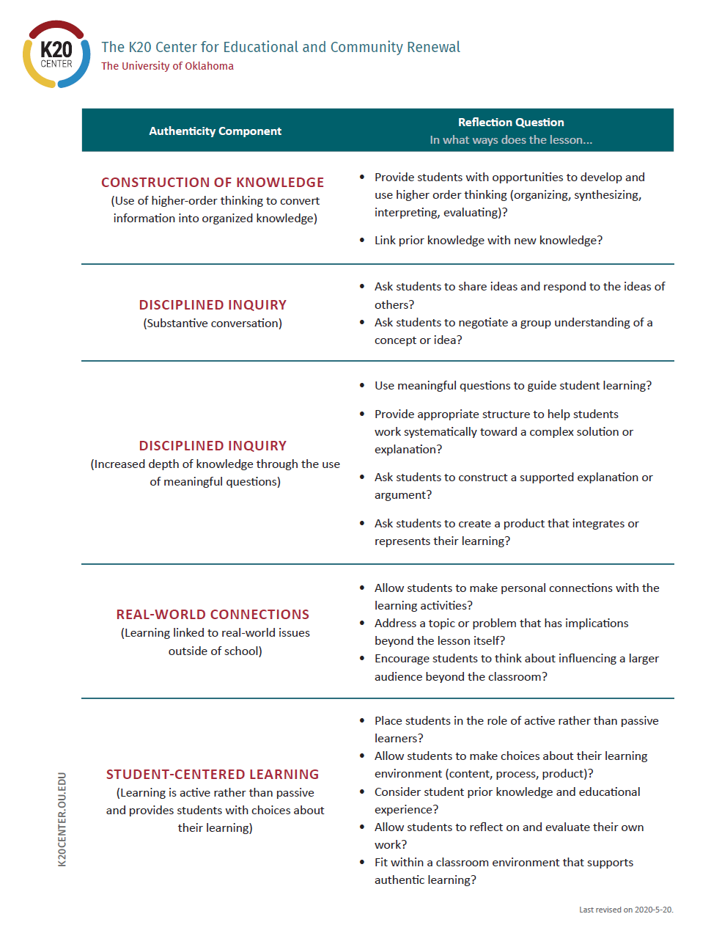
Authentic Lesson Reflection Tool

Slide 30
Authentic Reflection Tool
Use the lesson reflection tool to think about the ways in which this activity lines up with the components of authenticity.
How could this activity be modified to make it even more authentic?
How could this activity have been done with the use of technology?
Notes:
Omit

Slide 31


Slide 32
What is a Student’s Dream Scenario?
In order for my students to have these skills, teaching and learning should look like...

Slide 33
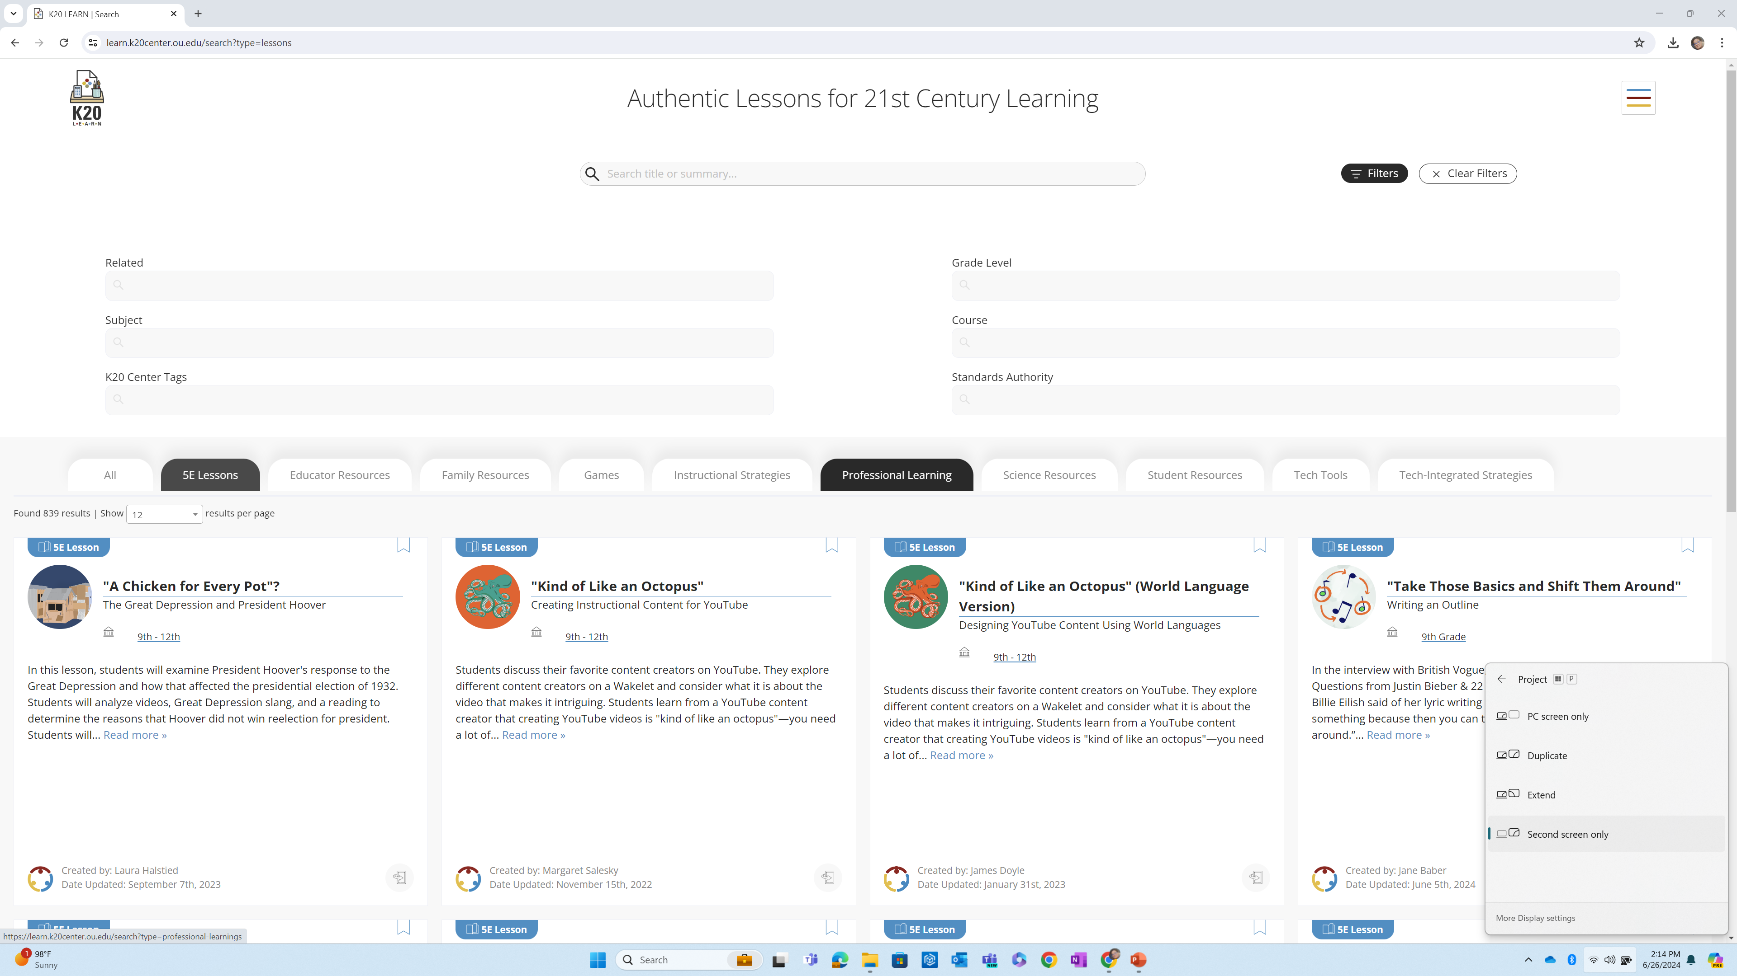
LEARN
https://learn.k20center.ou.edu/

Slide 34
LEARN Strategy Capture
Regroup based on what you teach!
Pull two math attributes (soft skills) from the hat.
Brainstorm some strategies you might use to address these soft skills.
Use the LEARN website to find strategies you can use.
Share example strategies from the poster nearest
to you.
Notes:
Gallery walk
Pick a strategy
Sticky that has a strategy
Star it if you like it

Slide 35


Slide 36
Commit to a Strategy
Which strategy or strategies can you use in your classroom in the next month?
What standards will you use with them?
How will you use each strategy and standard together?

